Slide 1
Conducting the Fluoroscopic Examination
Basic Operational Procedures
Pediatric Fluoroscopy
Mobile Fluoroscopy Equipment

Slide 2
Conducting the Fluoroscopic Exam
Technical factors directly influencing dose rate
  mA
  kVp
  Collimation
  Filtration
  Exposure time
  Target to panel distance

Slide 3
mA
Measure of tube current
Measure of the quantity of x-ray
X-ray output is directly proportional to mA
Number of photons affect dose rate
  An increase in photons equates to an increase in patient dose

Slide 4
kVp
Measure of tube potential
Determines the penetrating ability of x-rays
Refers to the quality of the beam
Maximize differential absorption

Slide 5
Collimation
Most effective method to reduce patient and operator exposure
At 14 inches above table a border must be seen on the monitor (if using manual collimation)

Slide 6
Filtration
A material placed in the useful beam to absorb less penetrating radiation
May not be less than 2.5 mm of aluminum filtration
Inherent 0.5 mm
Added 2.0 mm
2.5 mm total at 80 kVp

Slide 7
Half Value Layer
Material which reduces radiation intensity by 50%
A diagnostic tool
Standard thickness of 3 mm used at normal operating voltages (80 - 120 kVp)

Slide 8
Exposure Time
The X-ray beam “on” time
Reducing beam “on” time decreases patient exposure
Cumulative manual reset time
Predetermined time limit may not exceed 5 minutes
Designed to protect patient

Slide 9
Allowable Exposure Rates
Dose Rate at 80 kVp not to exceed 2.2 R/ mA per min or 5 R total
Exposure rate not greater than 10 R/min with boost
Devices that indicate current must be provided

Slide 10
Allowable Exposure Rates
Monitoring of the exposure (tube current) must take place weekly
Logs MUST be kept
Evaluation of rates by a physicist once each 3 years, or with replacement or modification (w/o AEC)
Cine (& units w/ AEC), once a year and any time modification is done

Slide 11
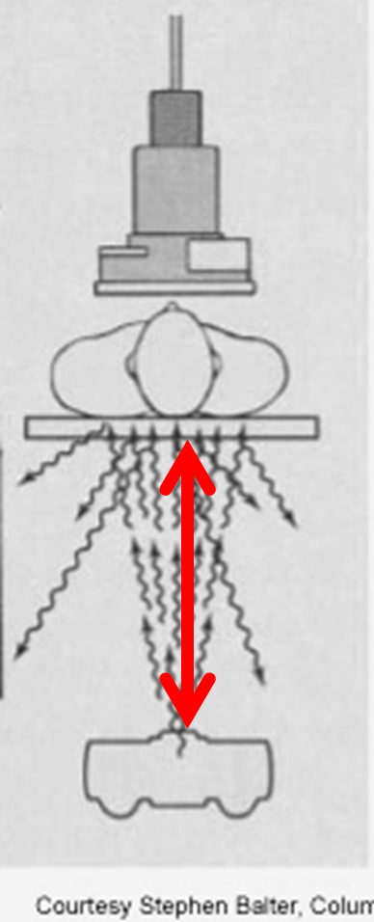
Target to Panel Distance (TPD
AKA source-to-tabletop distance (STTD), source-to-skin distance (SSD)
Patient receives less dose with an increased distance from the x-ray tube
Should be at least 18”, shall be no less than 12”

Slide 12
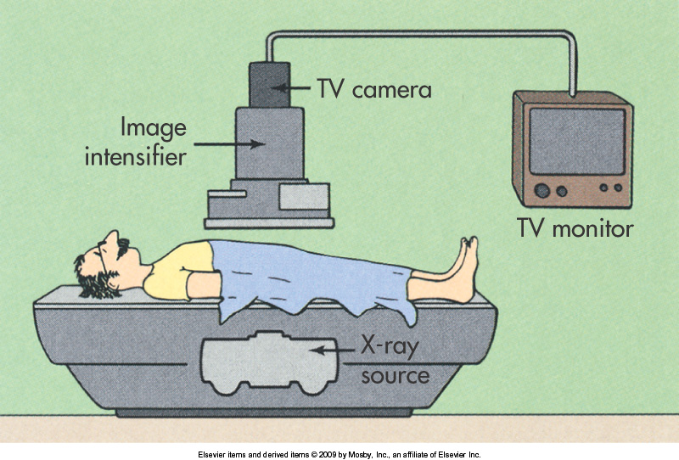
Conducting the Fluoroscopy Exam
Indirectly influenced exposure factors
  Lighting
  Poor image receptor quality
  Low absorption table tops

Slide 13
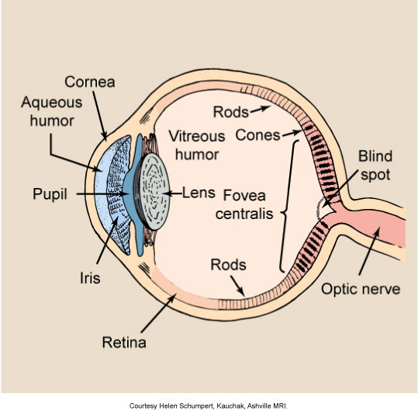
Lighting
Visual acuity: the ability to see fine detail
Rods
  Black and white (Scotopic)
Cones
  Color, daylight (Photopic)
Cones at central retina
Rods at periphery

Slide 14
Lighting
Dim room to enhance visualization of B & W TV images
Normal viewing distance 12-15 inches
Image Integration time of at least 0.2 seconds

Slide 15
Low Absorption Table Tops
May not be more than 1 mm Al/eq at 100kvp
Increased thickness increases patient dose

Slide 16
Image Receptor Quality
Poor conversion due to age (input or output phosphors)
Maladjusted image intensifier
Feedback loop system (ABS circuit adjusting kVp and mA)

Slide 17
Conducting the Exam
Patient and operator shielding are important exposure reducing considerations
  Gonadal shielding (shall be no less than 0.5 mm Pb)
  Bucky slot cover (must be covered with at least 0.25 mm Pb)
  Three-phase or high frequency generators make x-ray generation more efficient

Slide 18
High Voltage Generation
“From the standpoint of patient dose and radiographic quality (when radiographic technique is adjusted to same density and contrast), there is no appreciable improvement with the three-phase generator or high-frequency generator in standard imaging techniques.”

Slide 19
Basic Operational Procedures
Minimization of beam “on” time
Manual reset timer
Maintenance of:
  Low mA
  Optimal kVp
  Collimation
  Proper dose rate
  Minimal magnification
  Limited high-level fluoroscopy (boost)

Slide 20
Basic Operational Procedures
Image recording
  Video tape, photospot / digital photospot recording, conventional spot filming,
QC of image intensifiers
TV camera/monitor
Minimal patient-to-intensifier distance

Slide 21
Basic Operational Procedures
Position to the area of interest prior to fluoroscopy
Reduce patient motion
Provide gonadal shielding
Reduce extraneous room light
Ensure bucky tray is moved from to one end of the table

Slide 22
Pediatric Fluoroscopy
Motion will present the biggest challenge
Personnel need to wear lead gloves and aprons if holding a child
Gonadal shielding of at least 0.5 mm Pb
Clothing and diapers create artifacts
Avoid using ABC or ABS
Use shortest possible patient-to-image distance

Slide 23
Pediatric Fluoroscopy
Collimate to area of interest
May have to manually override automatic collimation
Cine frame rates to a minimum
Grids increase radiation & are not necessary for use with infants
Photospot, spot film cameras, and digital photospot cameras/recording preferable to conventional spot film imaging

Slide 24
Mobile Operation
An audible indicator when radiation is produced
Time accumulator incorporated into the video display
Analog or digital video storage system
“Last frame hold” feature (LIH)
Longest possible “cone” / “spacer” to increase SSD

Slide 25
Mobile Operation
C-arm cover
Properly functioning locks
Equipment in good physical condition
Appropriately cleaned & covered

Slide 26
Mobile Fluoroscopic Equipment
Structural shielding will be the same if used in a fixed space
Minimum 12″ SSD
Image intensification MUST be provided
Shall be impossible to operate if collimating cone or diaphragm is not in place
Maximum permissible dose rate shall not exceed 5 rads/min @ 30 cm (12″)

Slide 27
Mobile Fluoroscopic Equipment
Personnel monitoring REQUIRED for those using mobile equipment
Protective aprons of at least 0.25 mm Pb worn if one is likely to receive 5 mR/hr or more
Use boost position (high level control button) only when necessary
If boost is used, there must be a continuous audible signal

Slide 28
Responsibility & Supervision
California Title 17

Slide 29
Activities & Supervisory Categories
Authorizing Personnel
Documentation of licensure
Monitoring and Maintenance Records
Incident Notification
Continued Education
Safety Provisions

Slide 30
Supervisor Responsibility
Shielding
Equipment registration
Supervision of operators

Slide 31
Authorized Personnel
Only those persons with valid permits or certification
Licentiates of the healing arts, including MD’s, DO’s, DPM’s, and DC’s
Those with Fluoroscopy supervisory permits

Slide 32
Authorized Personnel (cont)
Those with Radiology supervisory permits (general radiology)
Dermatological supervisor and operator permits for low level skin treatment.

Slide 33
Authorized Personnel (cont)
Certified technologist with at least 2 years of formal training
Students in approved programs
Physician assistants with formal training and certification
Limited permit technician with less than 2 years of formal training can not do Fluoroscopy

Slide 34
Scope of Practice
Supervision is limited to scope of practice
Technologists and PAs may only practice under approved supervision
Technologists do not interpret x-rays or imply intent to do so

Slide 35
Display of Documents
Certificates and permits issued by the RHB must be posted in the place of work.
Photocopies will suffice for individuals with multiple employers
Permits must be prominently displayed.
For large groups a list of licensed/certified individuals will suffice with information about the location of the actual documents.

Slide 36
Display of Documents
California regulations RH-2364 “Notification to Employees” must be posted.

Slide 37
Record Keeping
Calibration, test, survey, repair for a period of 3 years
Receipts of transfer and or disposal kept 3 years
Dosimetry reports kept indefinitely

Slide 38
Record Keeping
Dosimetry reports come out monthly or quarterly
  In units of rem or mrem
Badge reporting not to exceed one year
Film processor records logs 1 year

Slide 39
Over-Exposure of Monitoring Badges
An over exposure of a film badge, or dosimeter type device is considered to be presumptive evidence of exposure and not definitive information

Slide 40
Reporting Over Exposures
Immediate notification means by phone
24 hr notification means by phone
30 day notification means in writing
In all cases written follow up occurs in 30 days

Slide 41
Immediate Notification
25 Rem (0.25 Sv) to the total body
75 Rem (0.75 Sv) to the eyes
250 Rem (2.5 Sv ) to the skin

Slide 42
24 Hour Notification
5 Rem (0.05 Sv ) Total body
15 Rem (0.15 Sv) to the eyes
50 Rem (0.5 Sv ) to the skin
Again, to be done by phone

Slide 43
Request For Renewal
Must be filed 30 days prior to expiration
Changes of address must be reported in 30 days

Slide 44
Inspection of Equipment
Machinery not meeting specification shall not be operable
The State (RHB) can inspect without notice at any time

Slide 45
Structural Shielding
Must be in compliance with state specifications
Primary Barrier 1/16 inch lead or equivalent
Secondary Barrier 1/32 inch lead or equivalent
6 feet 8 inches

Slide 46
Health And Safety Code
Un-Lawful operation shall be in violation of HSC Sec (107075)
Failure to operate within codes is a misdemeanor
Regulations fall under state law (California Code of Regulations)

Slide 47
Permit Holders
Be familiar with procedure to be done prior to exposure
Clear Fluoroscopy room of all non-essential personnel prior to exam
Collimate to the area of interest
Eliminate artifacts

Slide 48
Permit Holders (cont)
Patient gonadal shielding is mandatory (unless it interferes with the exam)
Maintain a technique chart which is consistent with the ALARA principle
Observe proper positioning
Take steps to avoid motion

Slide 49
Scope of Supervision
Direct: Under personal supervision.
  The Supervisory personnel works directly with the technologist / PA
Indirect: The supervisory personnel is available for direct supervision

Slide 50
Operator Performance
Perform duties correctly and conscientiously
Wear protective aprons of at least 0.25 mm during fluoroscopy
Avoid holding patients

Slide 51
Technologist Performance
Know appropriate views to take
Use optimal film and processor techniques if using film/screen
If using CR (cassette-based radiography) use the correct algorithm for the body part

Slide 52
Radiation Protection
Protective lead aprons minimum of 0.25 must be worn
Monitoring device at the collar of the apron for Fluoroscopy & at waist for routine radiography
Technologist should remain behind secondary barrier
Maintain at least 6 feet during portable operation.

Slide 53
Radiation Protection
When possible devices such as eye wear, thyroid shielding, gloves, or use mobile shielding
Standard thicknesses of lead aprons eliminate about 96% of exposure from scatter
Monitoring required when one could receive 1/10 of the annual EfD

Slide 54
Continuing Education
No less than 10 CEUs at renewal every 2 years
At least four (4) of the credits address radiation safety for the clinical uses of fluoroscopy
Documentation must be maintained for four (4) years following the date the credits were earned

Slide 55
Continuing Education (cont)
“Approved continuing education credits” means one hour increments of instruction received in subjects related to the application of X-ray to the human body, which have been accepted for purposes of licensing, credentialing, assigning professional status, or certification, by any of the following entities:
• American Registry of Radiologic Technologists (ARRT);
• California Physician Assistant Committee;
• Medical Board of California;
• Osteopathic Medical Board of California;
• California Board of Chiropractic Examiners; or
• Board of Podiatric Medicine.

