Slide 1
Personnel Radiation Protection
Personnel Monitoring
Potentially Pregnant Patients
Occupationally Exposed Women
Bushong, Chapters 35 - 38

Slide 2
Protection
Basis for protection: to PREVENT detrimental stochastic or non-stochastic effects
Stochastic:
  Probability
Non-stochastic (deterministic):
  Severity

Slide 3
Supervisor’s Responsibility
Abide by ALARA
Ensure no individual receives more than 5 rems (50 mSv) in one calendar year

Slide 4
Operator Exposure
Operator exposure is primarily due to scatter radiation from the patient
  To a lesser degree from other scattering media (collimator, tabletop, etc) and leakage
  Exposed only when dead-man switch is activated
  Scatter to operator DIRECTLY proportional to the dose to the patient

Slide 5
Operator Exposure (cont)
Operator should stand as far as practical from radiation sources
Those who remain in the room MUST wear a protective apron of not less than 0.25 mm Pb equivalent
Operator to wear monitoring device outside of the apron at the collar
If so equipped, ensure bucky slot cover and protective curtains are in place

Slide 6
Operator Exposure (cont)
For an under-table fluoroscopy tube, maximum intensities are at angles of 135° and 120° from the primary beam
Minimum intensities are received at scatter angles of 45°, 60°, and 90°, in that order
The operator always stands at right angles to the patient

Slide 7
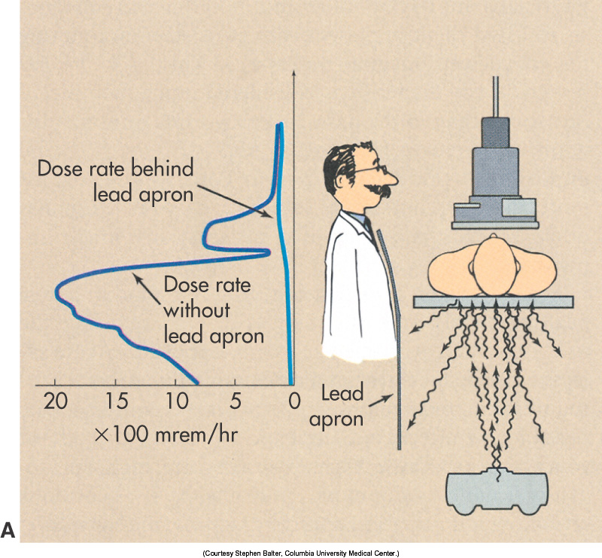

Slide 8
Operator Exposure (cont)
Scatter radiation from a C-arm is highest when the x-ray tube is above the patient
Operator is also exposed to leakage radiation
Operators in interventional labs often have higher exposures because of the lack of a protective curtain and longer beam-on times

Slide 9
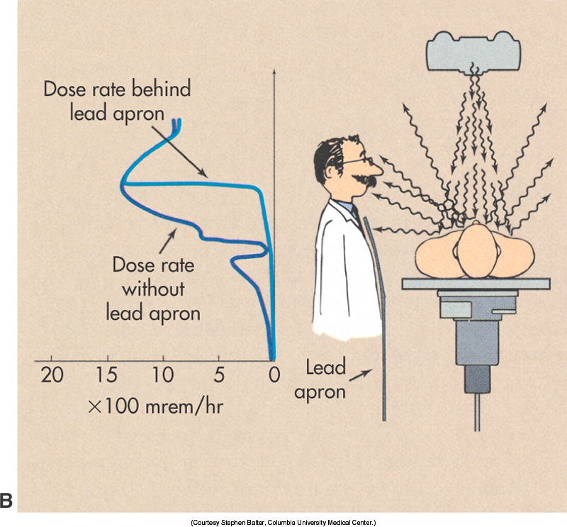

Slide 10
Isoexposure Contours
Shows areas where one would receive the least amount of scatter radiation (if that person must remain in the room)
At 1 foot from the table, the operator could receive 500 mR / hour (5 mGy/hr)
At normal position for the operator, exposure rate is about 300 mR/hr (3 mGy/hr)

Slide 11
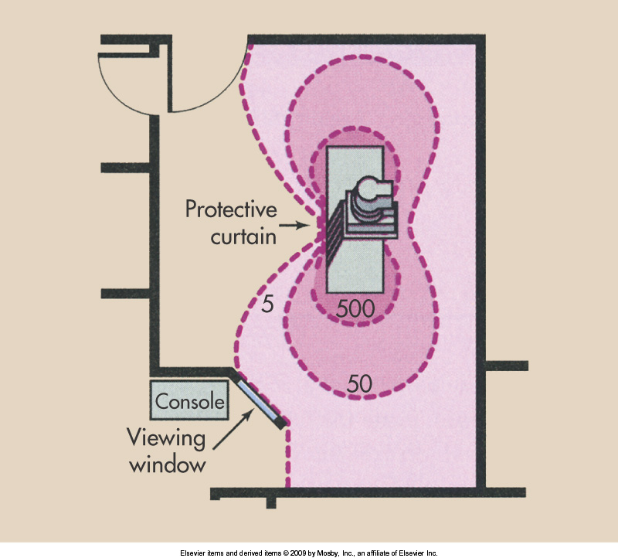

Slide 12
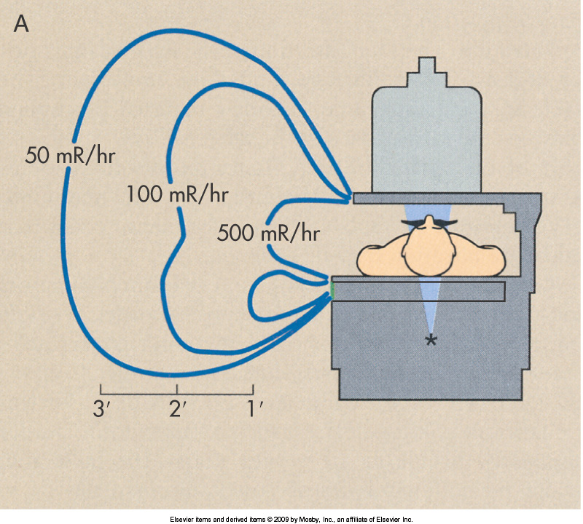

Slide 13
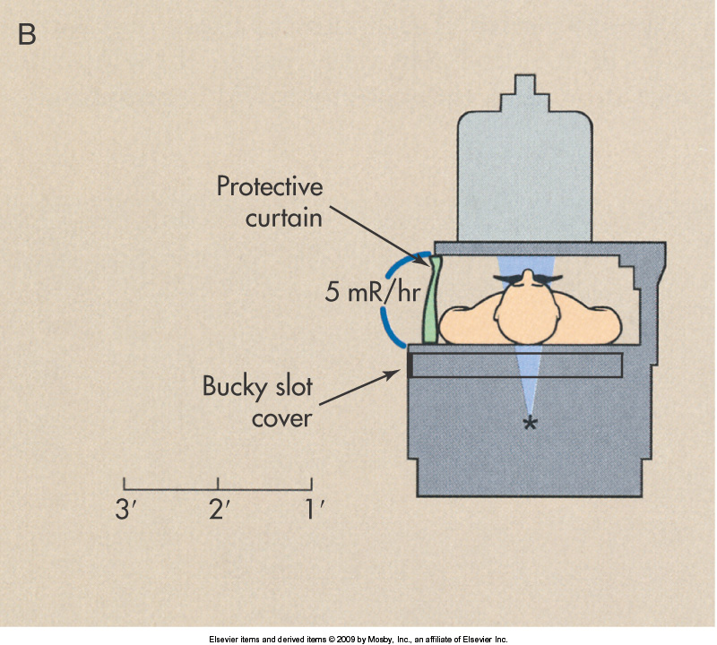

Slide 14
Protective Aprons
Thickness of protective aprons should be 0.5 mm Pb
SHALL be no less than 0.25 mm Pb
Exposure lessened by 97% if using 0.25 mm Pb, 99.7% if using 0.5 mm Pb
Covers about 80% of active bone marrow

Slide 15
Other Protective Devices
Overhanging curtains (ceiling suspended), mobile screens, protective curtains (overlapping protective drapes), protective gloves, leaded glasses
All will be at least 0.25 mm Pb equivalent

Slide 16
Personnel Monitoring Equipment
Personnel monitoring equipment means devices designed to be worn or carried by an individual for the purpose of measuring the dose equivalent received by that individual.
Cardinal Principles of Radiation Protection
  Time, Distance, Shielding

Slide 17
Personnel Monitoring
Records exposure in mrem
Measures exposure over time (quantity)
Provides an indication of the type of incident radiation (quality)
Provides a legally acceptable record of personnel exposure
References whole body exposure

Slide 18
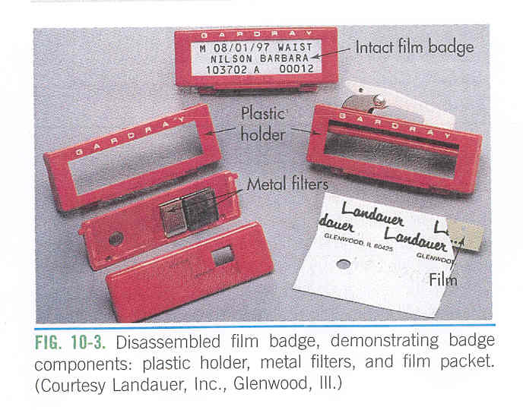
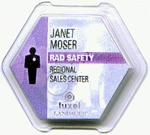
Acceptable Legal Devices
Film Badges
Thermoluminescent dosimeters (TLD)
Optically-stimulated luminescent (OSL)

Slide 19
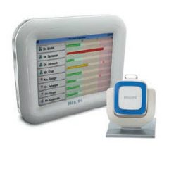
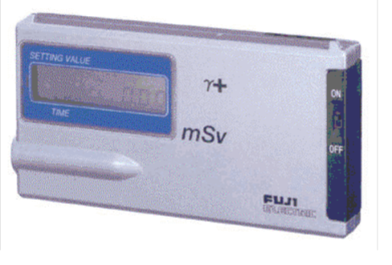
Accessory Devices
Pocket dosimeters
Audible Warning devices
If an accessory device is used, it MUST be used with a legally acceptable device
http://www.healthcare.philips.com/main/products/solutions/doseaware/

Slide 20
Film Badges
Film holder
Copper or Aluminum filters
Packaged film
Exposure sensitivity 10 mR - 700 R
Accuracy ± 25%
True permanent record

Slide 21
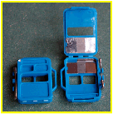
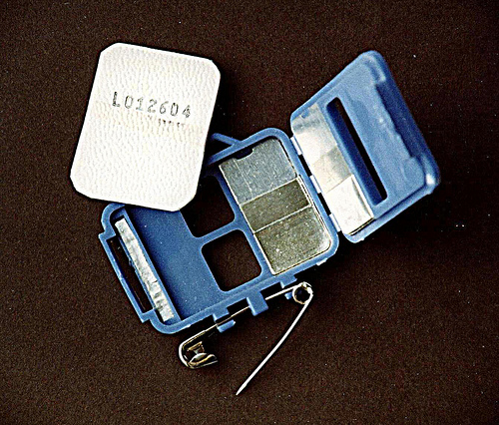
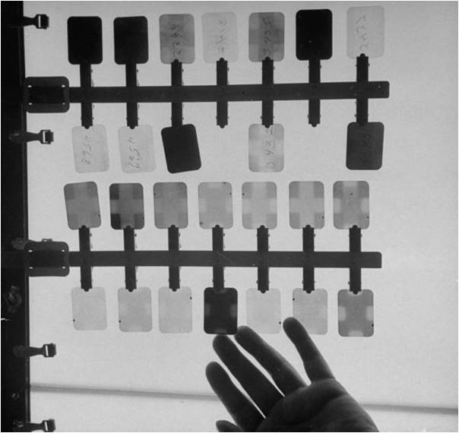

Slide 22
Thermoluminescent dosimeters (TLD)
Lithium fluoride crystals
Heated to release light
Light released is in proportion to dose received
Accuracy of ± 9%
Initial high cost but reusable
No true permanent record
Accuracy as low as 5 mR

Slide 23
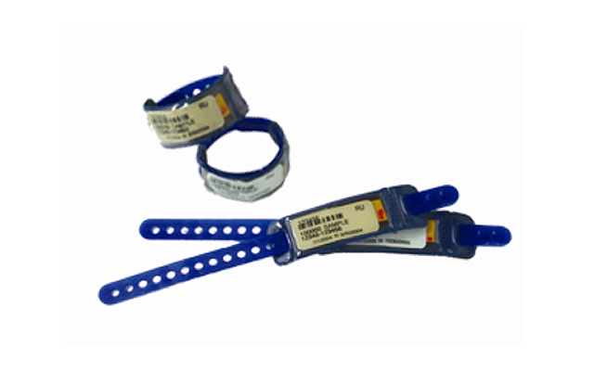
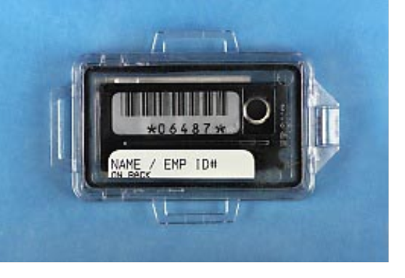
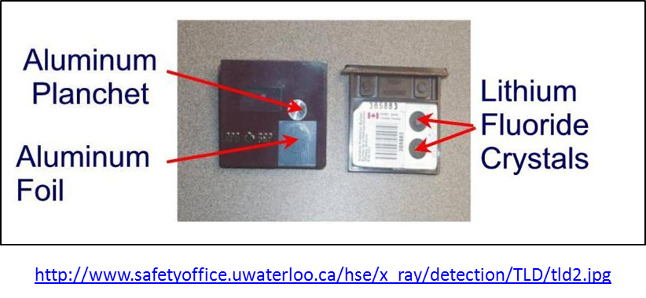

Slide 24
OSL
Filters of copper and tin and an open window
  Demonstrate energy of exposure
  Also demonstrate if exposure occurred while static or in motion
Issued on monthly or quarterly basis
Sensitive to 1 mR
Environmentally stable and durable

Slide 25
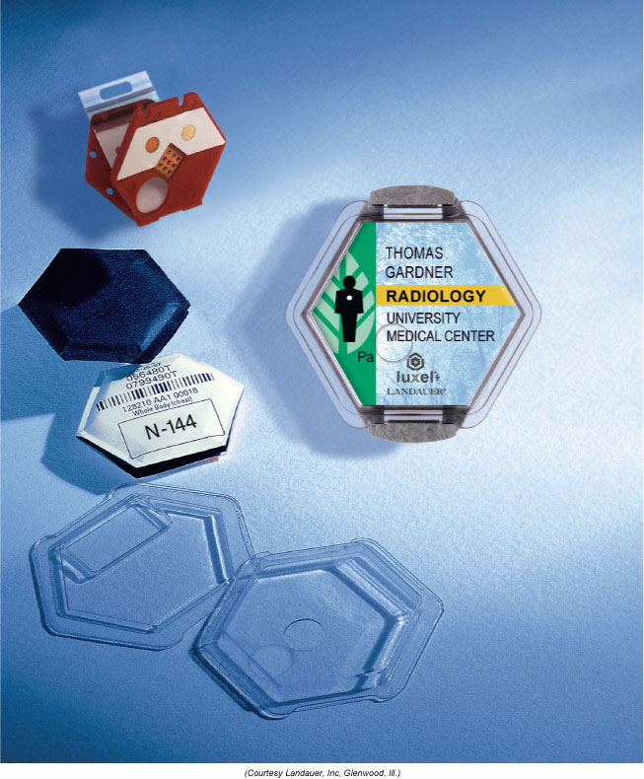
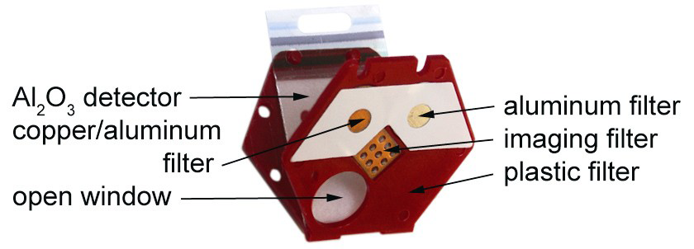
OSL Dosimeter

Slide 26
Badge Location
Waist or chest level without apron
At collar of apron during fluoroscopy
Dual badges may be worn by pregnant occupational workers or those working in interventional areas

Slide 27
Occupational Exposure
Means exposure that a person receives in the process of employment
Does not include, background or dose individuals may receive for medical purposes
Badge is only be worn at the place of employment
Badge reading is presumptive evidence

Slide 28
Whole Body
Head
Trunk including gonads
Arms above the elbows
Legs above the knee
EfD = 5 rem/year (0.05 Sv; 50 mSv)
  100 rem / Sv
Effective Dose (E), (EfD); (DL) Dose Limit
Limits are based on a linear, nonthreshold dose-response relationship

Slide 29
Other EfD (DL)
Lens of the eye 15 rem or 0.15 Sv (150 mSv)
Skin and / or extremities 50 rem or 0.5 Sv (500 mSv)

Slide 30
Non-Occupational Exposure
Non-occupational exposed persons
Usually hospital workers who are not radiology employees but who regularly visit the x-ray rooms
E (or EfD or DL) is 1/10 of that established for the radiation worker

Slide 31
Population Dose Limits
0.1 rem (1 mSv) / year
  100 mrem
0.002 rem or 2 millirems in one hour (2 mrem / hour)
  0.02 mSv

Slide 32
Frequency Reporting
Most badges typically changed out monthly, TLD’s quarterly
State advises monthly changes regardless of the type (no minimum or maximum monitoring time frame)
Up to 1 year to report each monthly or quarterly dose

Slide 33
Practically all overexposure reports to the RHB are a result of poor practice on the part of the X-ray supervisor/operator who conducted the exam

Slide 34
Monitoring Requirements
High Radiation Area = 0.1 rem (1 mSv) in 1 hour at 30 cm from source
Radiation Area = 0.005 rem (0.05 mSv) in 1 hour at 30 cm from source
Persons operating mobile x-ray equipment

Slide 35
Area Definitions
Restricted Area
  A area in which access is limited by the licensee for the purpose of protecting individuals against undue risk from exposure to radiation
Unrestricted Area
  An area to which access is neither limited nor controlled by the licensee.

Slide 36
Area Definitions
Controlled Area
  Barrier should reduce exposure to less than 100 mrem/wk
  Design based on a dose limit of 5000 mrem (5 rem) per year
Uncontrolled Area
  An area which can be occupied by anyone, where the exposure does not exceed 100 mR/yr, or 2 mR/wk
  The barrier to limit exposure to less than 2 mR/hr

Slide 37
Area Definitions
Radiation Area
  A area accessible to individuals, in which they could receive in excess of 0.005 rem (0.05 Sv) in 1 hour at 30 cm from the source
High Radiation Area
  An area accessible to individuals, in which levels could result in an individual receiving a dose equivalent in excess of 0.1 Rem (1 mSv) in 1 hour at 30 cm from the source

Slide 38
Very High Radiation Area
An area accessible to individuals in which radiation levels could be in excess of 500 rads (5 Gy) in 1 hour at 1 meter from the source.

Slide 39
Potentially Pregnant Patients

Slide 40
Women of Childbearing Age
Small potential for adverse biological effects
There is no threshold dose
Effects are directly proportional to absorbed radiation dose (linear, non-threshold)

Slide 41
Recommendation to Women of Childbearing Age
Since there is no absolutely “safe” period for the conduct of diagnostic x-ray examination, should women who have a potential to be pregnant and women having abdominal area x-rays be scheduled according to their menstrual period or postponed to reduce the possibility of exposing an unsuspected embryo/fetus to radiation?

Slide 42
Recommendation to Women of Childbearing Age (cont)
The answer is “no”
Exams falling into this category need not be postponed or selectively scheduled unless it may be related to the patient’s current illness

Slide 43
Occupationally Exposed Women

Slide 44
Occupationally Exposed Women
Must declare in writing conception dates
Dose not to exceed 0.5 rem (5 mSv) for the gestational period
At declaration if the fetal dose is found to be 0.5 rem (5 mSv) (± 0.05 rem or 0.5 mSv), then the dosage remaining for the rest of the pregnancy can not exceed 0.05 rem or 0.5 mSv

Slide 45
Occupationally Exposed Women
Not to exceed 0.05 rem or 50 mrem in any one month.
Risk during 1st Trimester
Due to ALARA, the employer does NOT have to reassign
Delay having children
Take leave of absence if a realistic option

Slide 46
Occupationally Exposed Women
No patient holding
Wrap around apron
Dual monitoring badges
  If a “baby badge” is worn, it is worn at the waist UNDER the apron during portables or fluoroscopy

