Slide 1
Blocks

Slide 2
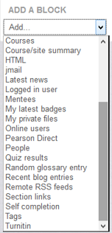
Blocks
Blocks are items which may be added to the left or right of your course. You may want to add a Calendar Block to your course to help your students know when items are due in the course. There is many different Blocks you can choose from.
To add a block you need to Turn edit on. Scroll down to the Add Block section. You can choose from the list of Blocks to assist your class.

