Slide 1
Manage Enrollments

Slide 2
Manual Enrollments
You can manually add students to your course. You can do this by going to the Users option under the course administration.
Select the enrollment method for manual enrollments. You can add students by clicking on the add users option.

Slide 3
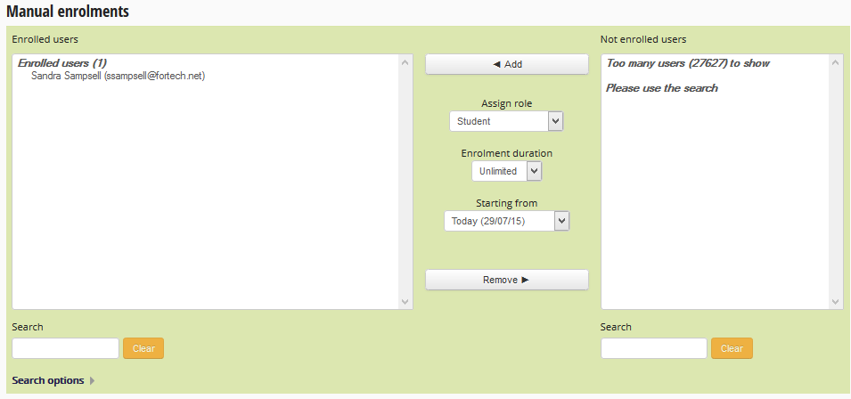
Manual Enrollment
You can enter the students name in the search box. Once you have located the student you can click their name and hit the Add option in the middle of the page. You have now enrolled a student manually.

Slide 4
Self Enrollment
Self enrollment you will need to setup an enrollment key. You can do this by going to the self enrollment option under the enrollment methods in the users section .
You will need to edit your self enrollment by selecting the edit option.

Slide 5
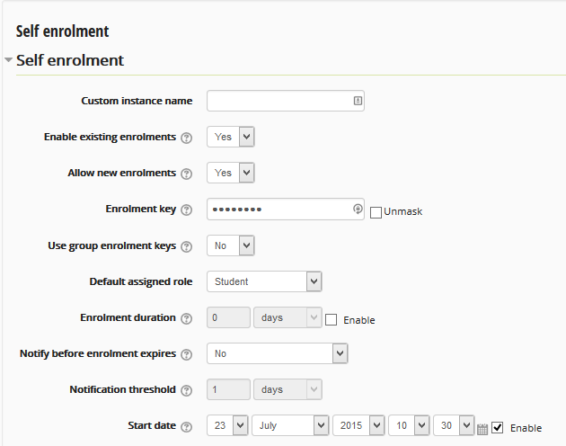
Self Enrollment
You can add an enrollment key to provide to students. This gives them a one time code to enter the course. You may also want to setup an enrollment duration. You can set how many days you want to provide for students to get enrolled. You can also set an enrollment duration by dates.
You can also set a threshold to notify students how long they have to enroll.

