Slide 1
Adding Content

Slide 2
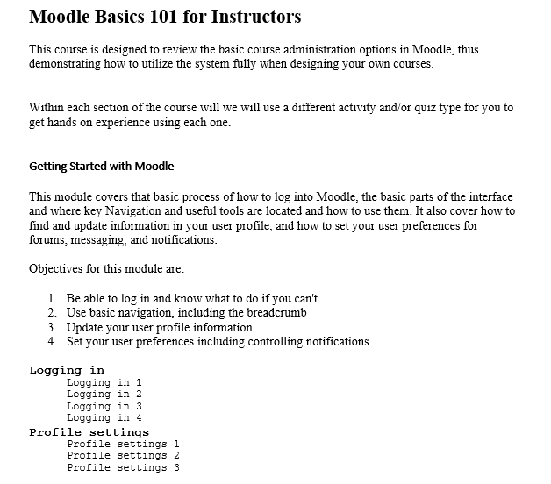
Adding Content
As you know you can add content in many ways. We try to use best practices when adding content. Remember that best practices are always changing.
Before you begin adding content to your course you may want to make an outline of how you want the course to look. Making an outline with topics, subtopics, activities, and resources may assist you in the long run and make setting up your course easier.

Slide 3
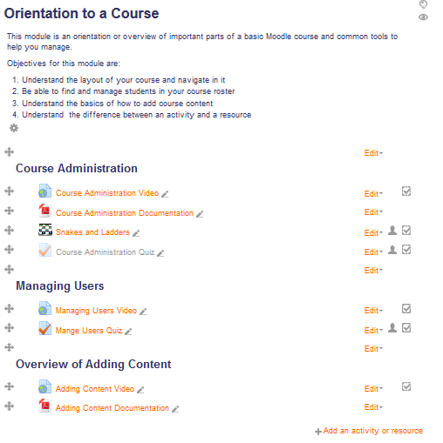
Adding Content
Turn on editing in your course. You will want to start by entering your topic name and descriptions. This gives students an idea of what the topic is about.
You can also setup labels under your topics as subtopics to provide more content.
Remember also to only use 3 font types in your course so that you do not overdo it in the course.
Add your activities and resources under your labels for each subcategory. Don’t worry if there is white space.

