Slide 1
AM Cole MD
SPRING 2017 MULTIMODALITY
Metastatic Amelanotic Melanoma
Primary 01808833

Slide 2
OBJECTIVES
Be able to list at least 4 differential diagnosis of abdominal/pelvic cancer that present with ascites.
Identify the 4 primary causes of ascites and discuss how ascites limits imaging.
Discuss whether peritoneal disease is always metastatic disease.
Determine the most common sites for metastasis of melanoma. (Dr. Kwaiben’s presentation will address this)
Describe the possible presentations of metastatic melanoma
Discuss cancers that are not FDG PET avid. What about in this patient’s case? (To be addressed by Dr. Badiee)
Differentiate the three major types of skin cancer (if time allows). Is one type worse than another?

Slide 3
History
60 YO female
History of metastatic melanoma with carcinomatosis
History of ETOH abuse
Presents to ED diffuse abdominal pain and right shoulder pain
What is your differential diagnosis
  Cholecystitis, hepatitis/cirrhosis, bowel obstruction, portal hypertension, diverticulitis
What types of studies would you be considering?
  Ultrasound, CT, MRI, plain film?

Slide 4
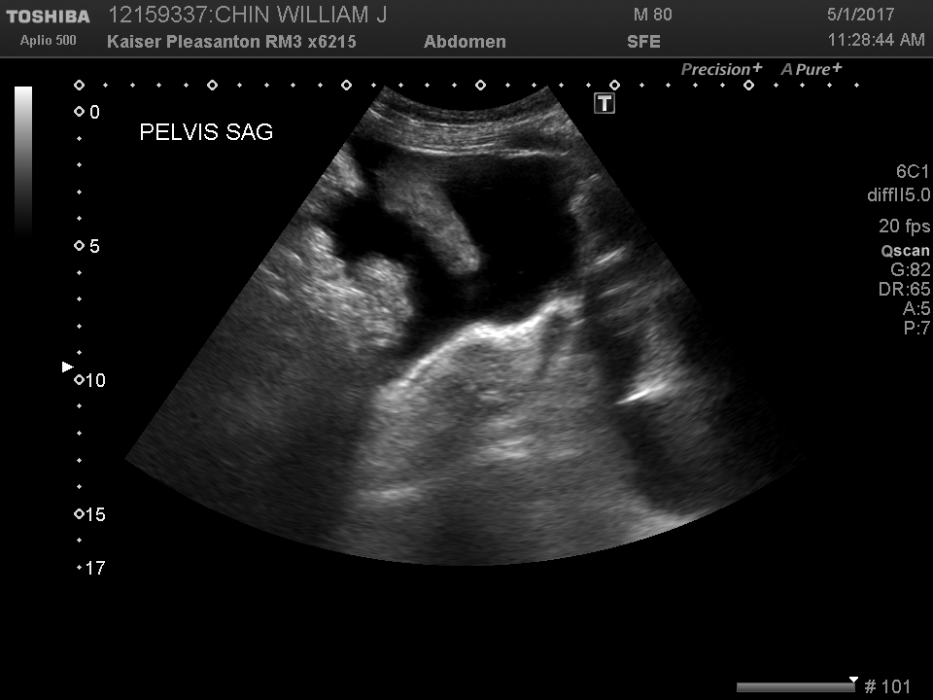
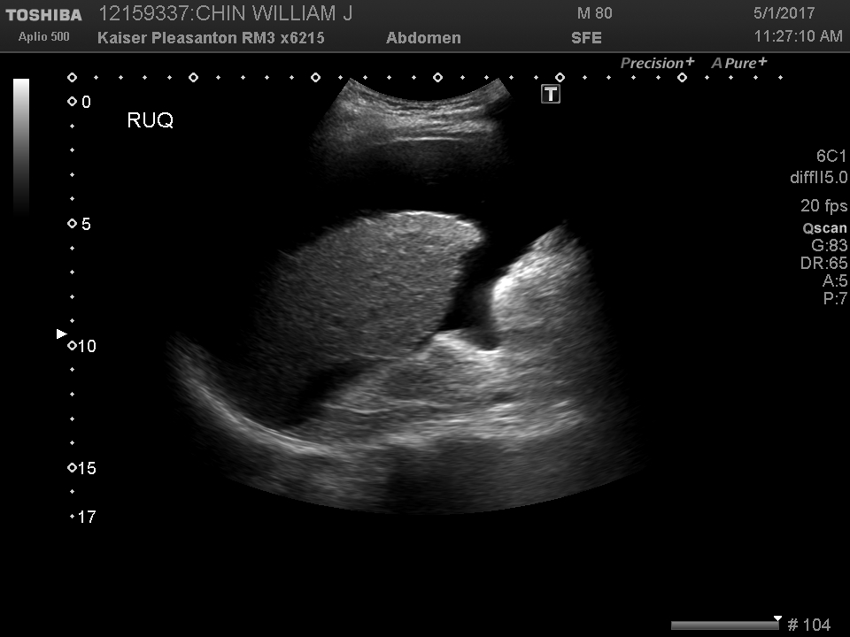
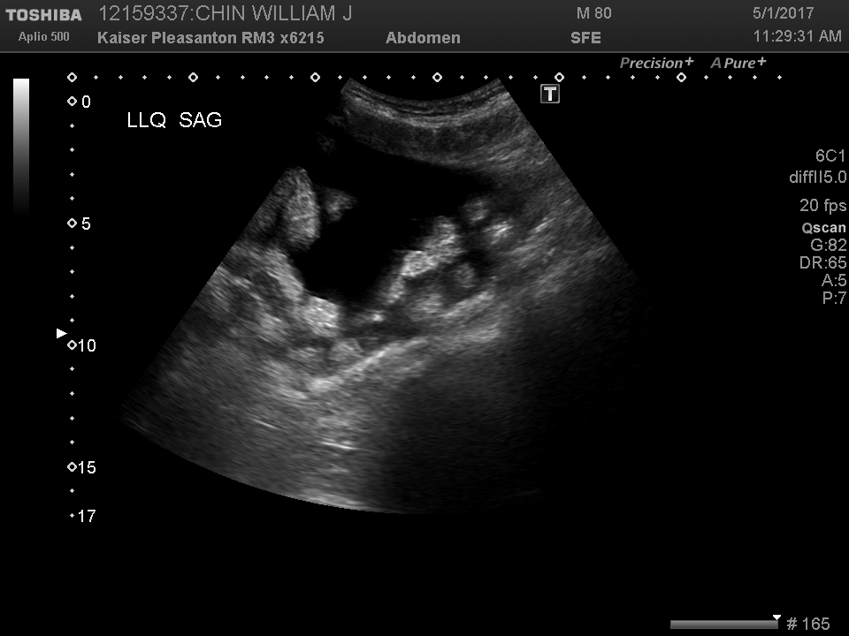
Marked ascites

Slide 5
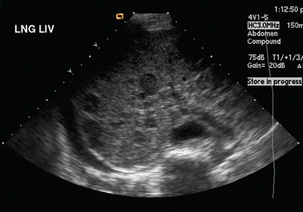
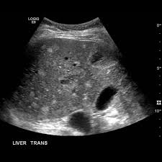
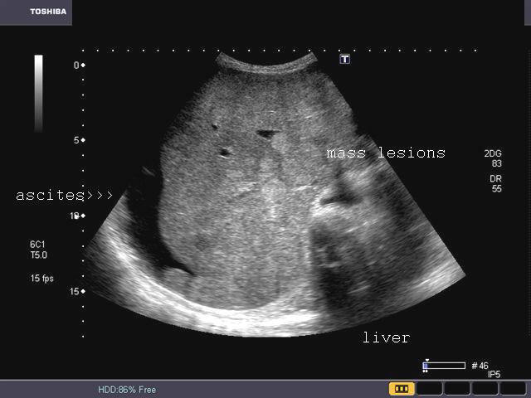

Slide 6
RUQ Ultrasound Exam
What does the ultrasound demonstrate
  Ascites
What is most concerning about ascites with this presentation
  Liver dx, heart failure, tumor
How does ascites complicate cross sectional imaging
  Masks intraperitoneal fat and mesenteric planes (masks the edges of organ/fat interface thereby obscures the contour and contrast of anatomy. Essentially makes everything blend together.
  Obsuration more so with non contrast studies
Should we stop here and proceed to paracentesis? If not, what next?
  More imaging, admit to GI service for treatment of liver disease? Contrast?

Slide 7
What is ascites?
Accumulation of fluid in the peritoneal cavity

Slide 8
Why was the patient having pain and bloating for 3 weeks?
Remember the patient presents with abdominal pain, shoulder pain and bloating.
Presents to her doctor with diffuse abdominal pain and right shoulder pain
History of ETOH abuse
What is your differential diagnosis
  Cholecystitis, hepatitis/cirrhosis, bowel obstruction, portal hypertension, diverticulitis
What types of studies would you be considering?
  Ultrasound, CT, MRI, plain film?
CT abdomen and pelvis with contrast was ordered.

Slide 9
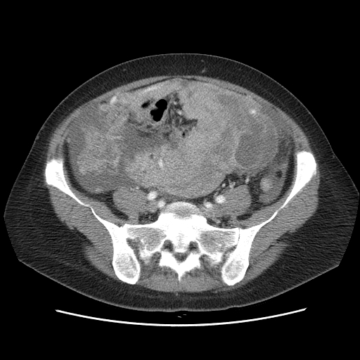
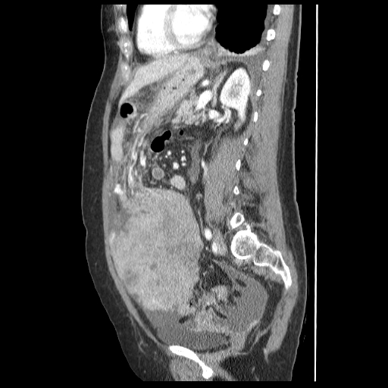

Slide 10
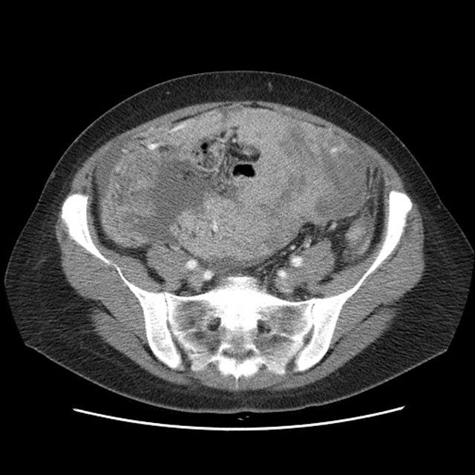
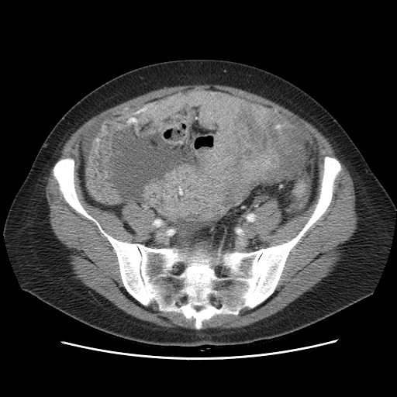

Slide 11
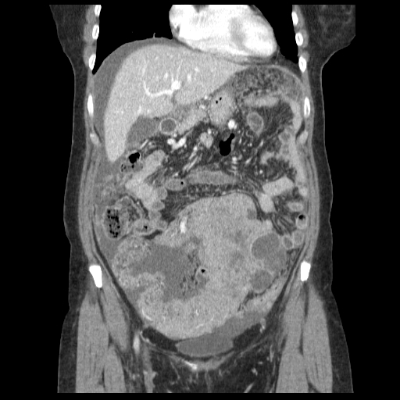

Slide 12
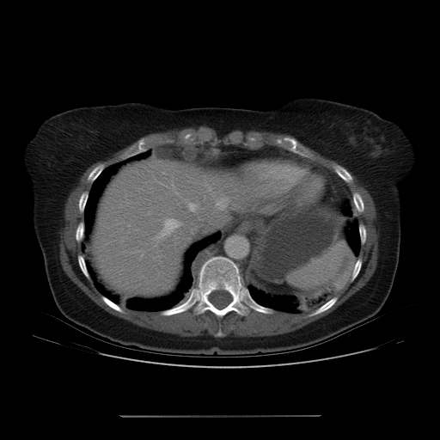
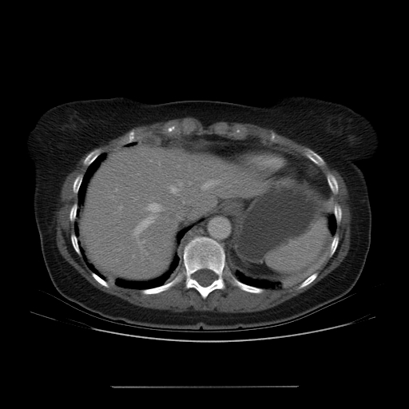

Slide 13
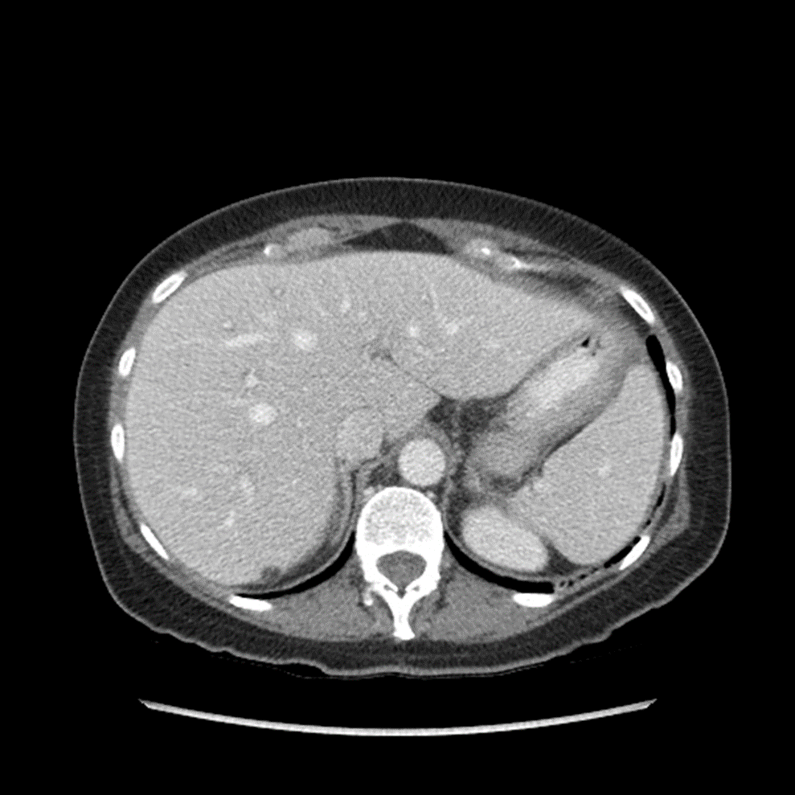
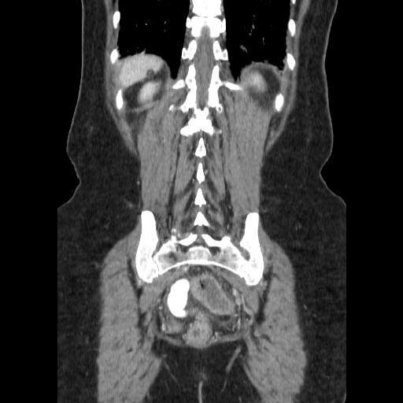

Slide 14
Abdominal CT Exam
Why was the Ultrasound performed before the CT?
  Ultrasound is better to evaluate for cholecystitis (imaging of gallstones and wall thickening)
  Evaluate for liver changes when ETOH history
  Ultrasound is more cost effective and realtime
  Sensitive at detecting low levels of free fluid
What did the CT Exam demonstrate?
  Large mass in the pelvis, marked ascites and peritoneal carcinomatosis.
Could MRI add anything?

Slide 15
Abdominal CT Exam
What is the next study you would order?
  None.
  Surgical excision and tumor burden reduction is next.
  Patient was started on chemotherapy
  Follow up imaging will be performed

Slide 16
Ddx of Abdominal Pelvic mass, peritoneal masses with ascites
Metastatic melanoma
?

Slide 17
Ddx of Abdominal Pelvic mass, peritoneal masses with ascites
Metastatic ovarian cancer
Metastatic colon, stomach, breast and pancreatic ca
Peritoneal lymphomatosis
Tuberculosis
Peritoneal mesothelioma
Diffuse peritoneal leiomyomatosis
Pseudomyxoma peritonei

Slide 18
Follow ups
Frequent in patients with heavy tumor burden and metastatic disease
PET-CT for this patient every 3 and then 6 months to date. Sometimes CT with contrast will also be performed
Significant/high doses of radiation outweigh the benefits of monitoring treatment response.
First PET-CT was done at 3 months to evaluate response and showed only mild supraclavicular node uptake.
Interesting because there were residual abdominal wall implants seen on CT that did were not FDG avid on this or any of the subsequent PET-CT studies.

Slide 19
Continuing History
3 months after initial diagnosis, 11-3-15, a PET-CT was performed to evaluate for response to surgery and chemotherapy given the change in diagnosis thus chemotherapy regime.

Slide 20
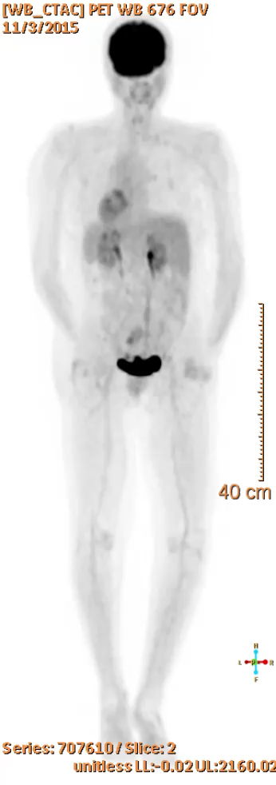
PET-CT 11-3-15

Slide 21
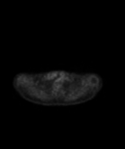
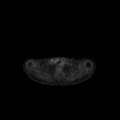
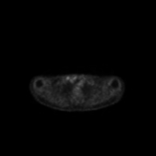
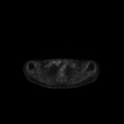
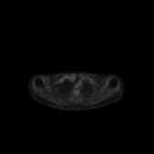
Supraclavicular uptake

Slide 22
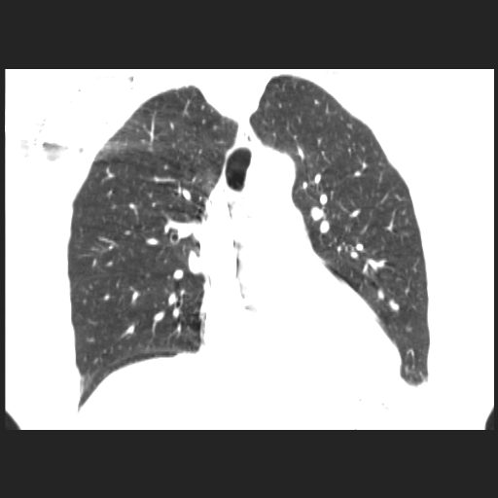
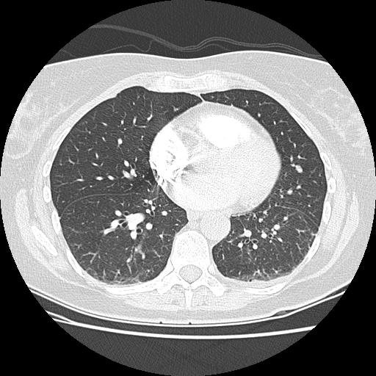
Subsequent PE protocol CT chest was done to exclude PE after surgery on 11-30 showed a pulmonary nodule. Why didn’t we see this on PET-CT from 11-3?

Slide 23
Continuing History
5 month CT abdomen/pelvis 2-13-16 a follow up showed continued shrinking of residual upper abdominal peritoneal implants.
A restaging PET-CT at 8 months shows no disease.
CT Chest to follow up the pulmonary nodule suspected metastatic lesion was performed 7-20-16

Slide 24
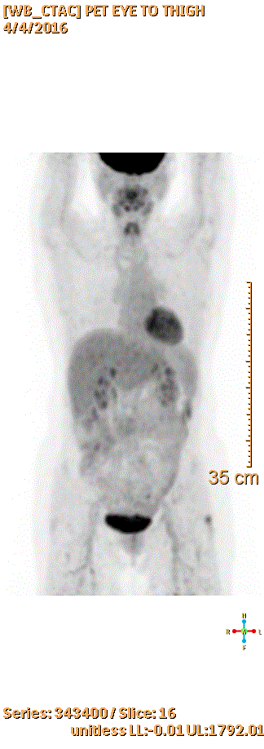
PET-CT 4-4-16 8 months

Slide 25
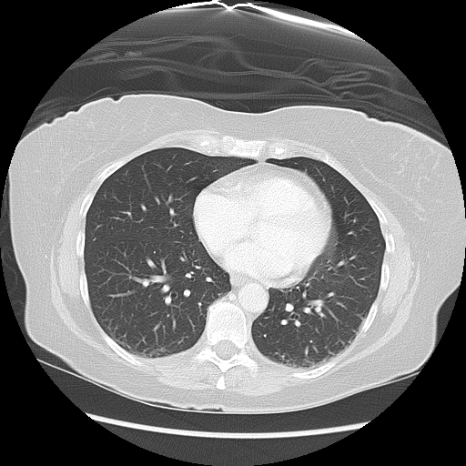
10 months after initial diagnosis
11-30-15 Incidental, r/o PE
7-20-16 Nodule resolved

Slide 26
Continuing History
10 months from the initial diagnosis the patient begins to experience ataxia.
What is ataxia?
What type of imaging is indicated here.
With or without contrast? Why?

Slide 27
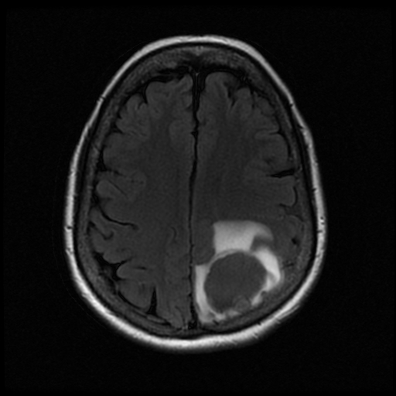
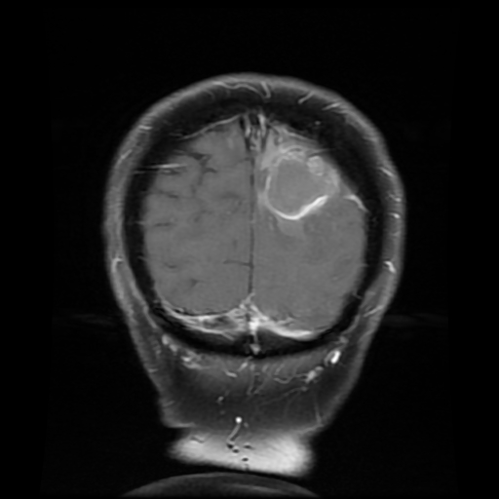
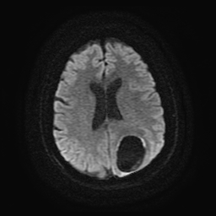
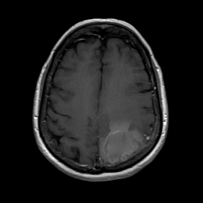
Brain metastasis – MRI brain 7-18-16

Slide 28
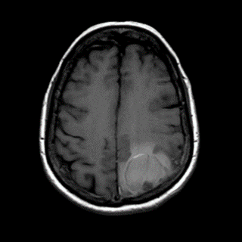
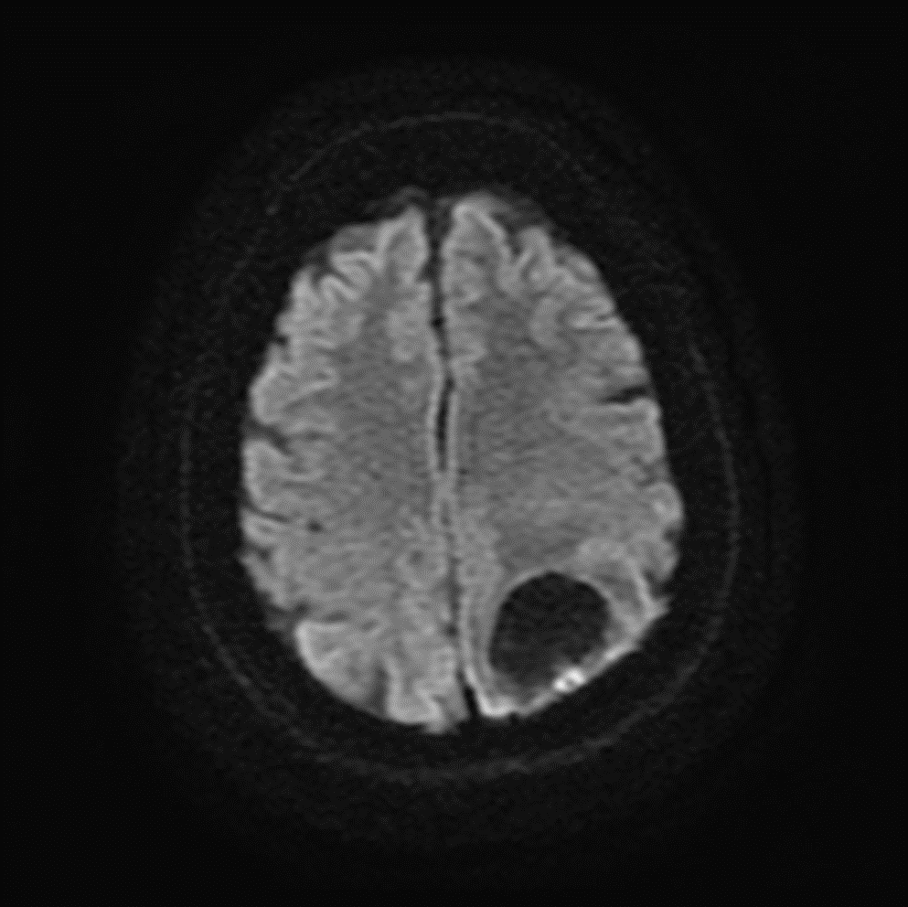

Slide 29
Continuing History
Surgical excision of parietal mass, July 2016 (10 mo following diagnosis)
Post surgical follow up MRI showed post surgical changes and a new left frontal metastatic lesion on August 2016

Slide 30
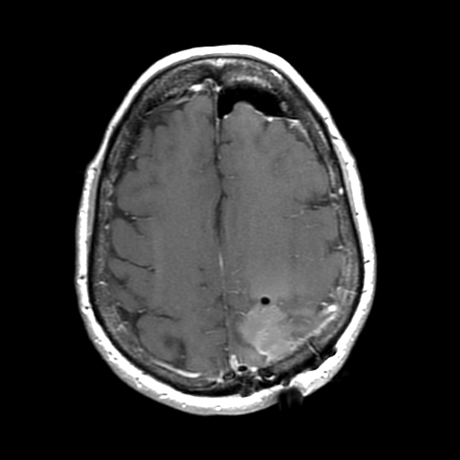
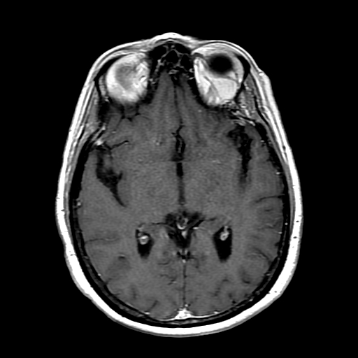
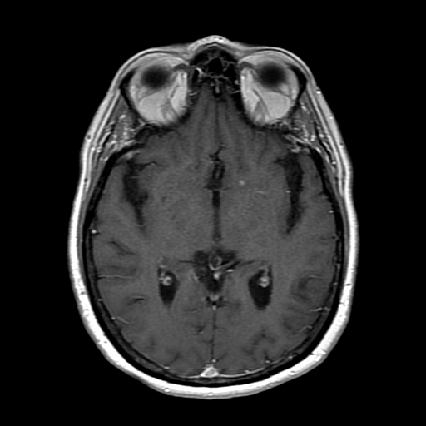
July 2016 Nov 2016 Feb 2017
MRI post surgical and new lesions

Slide 31
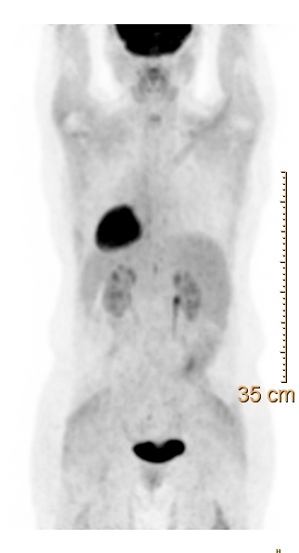
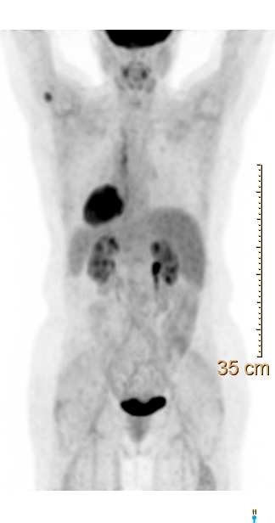
Follow up PET-CT 8-29-16 was negative
PET-CT 12-08-16 was not →

Slide 32
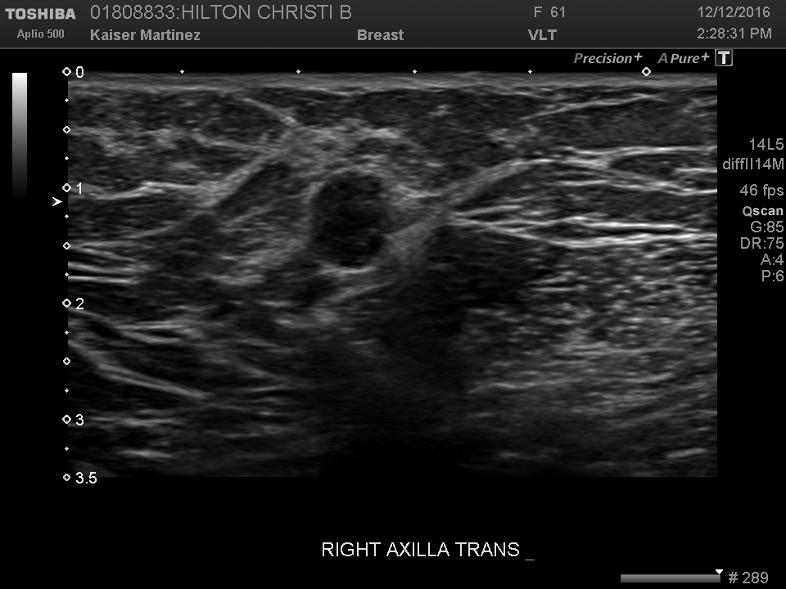
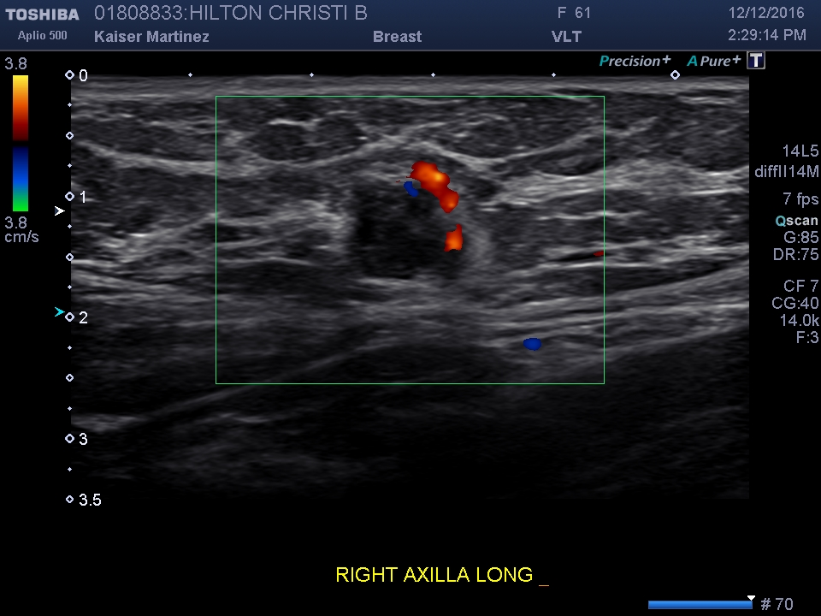
Ultrasound follow up to evaluate right axillary uptake on PET-CT

Slide 33
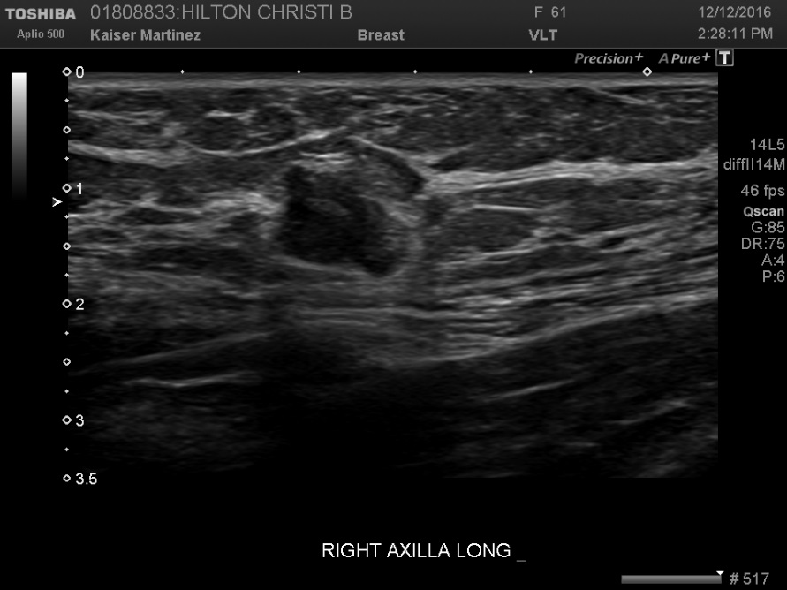
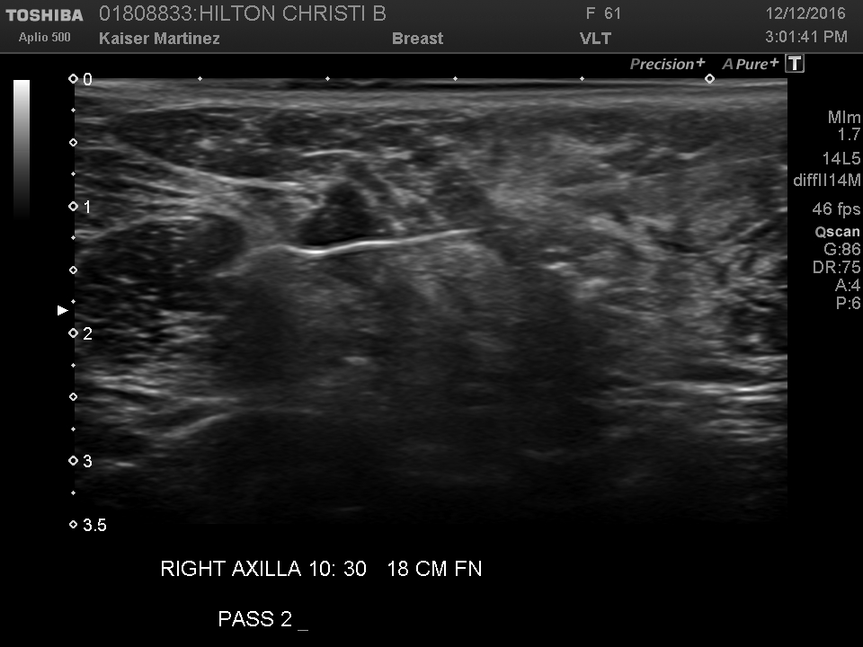
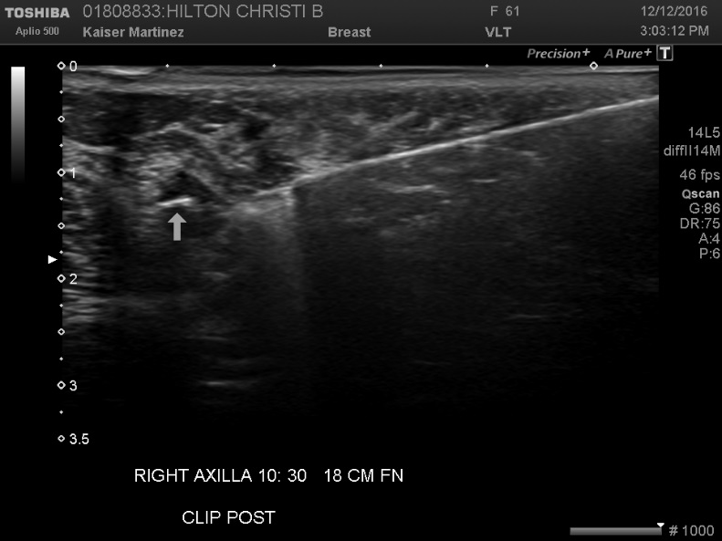

Slide 34
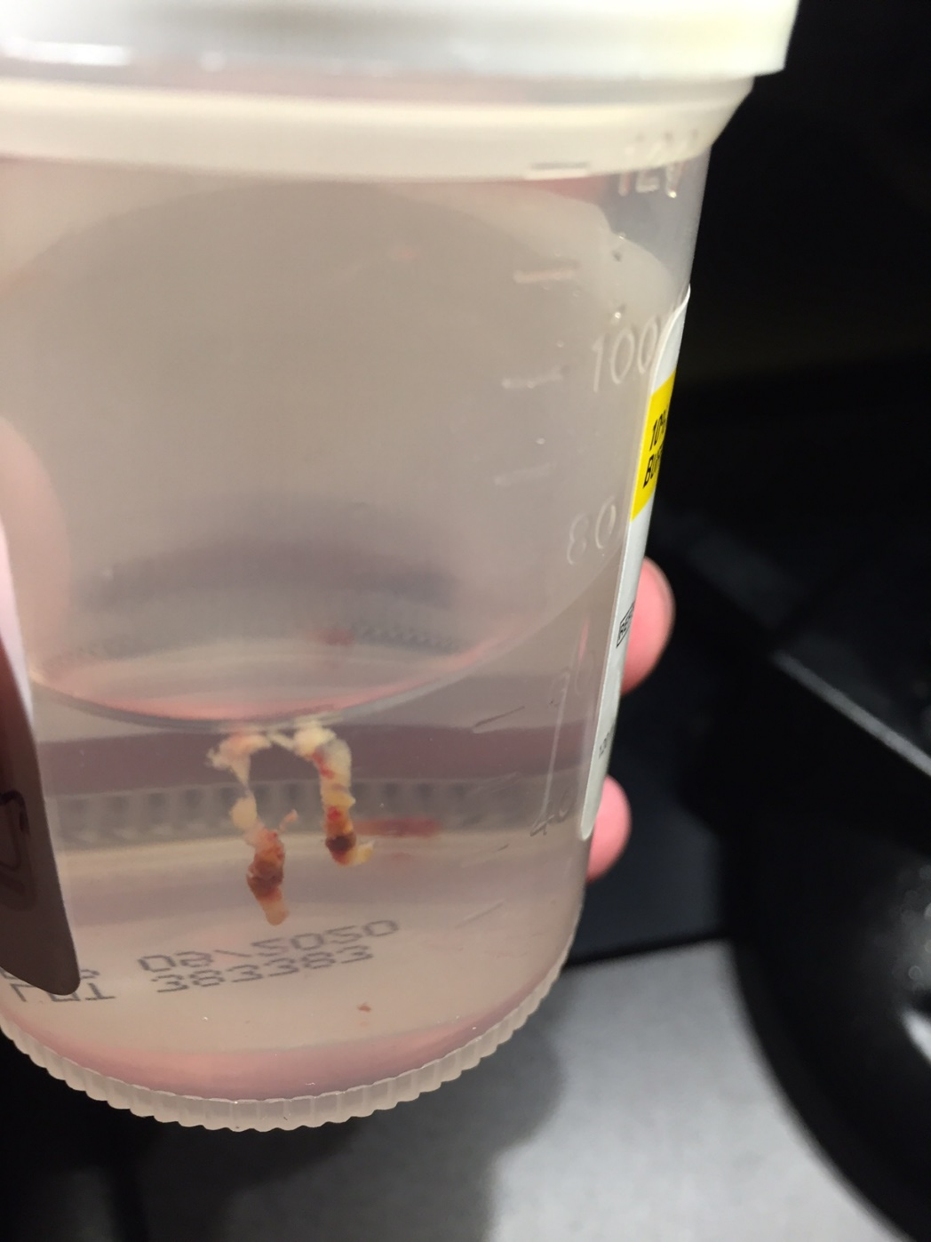
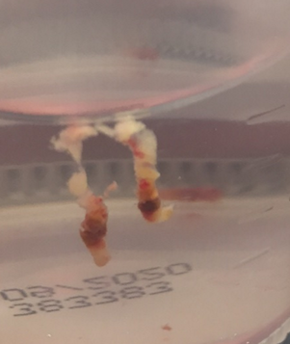
Biopsy cores

Slide 35
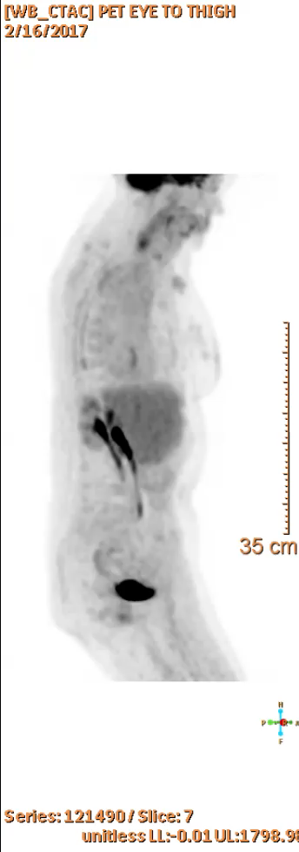
PET-CT 12/16/17-
Post surgical rt axila
New left chest wall
Small left axillary nodes

Slide 36
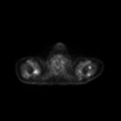
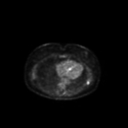
Left axilla and left posterior chest wall

Slide 37
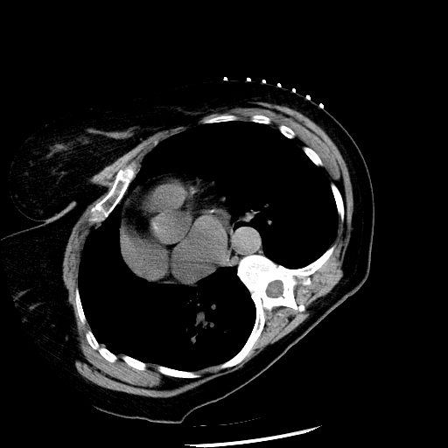
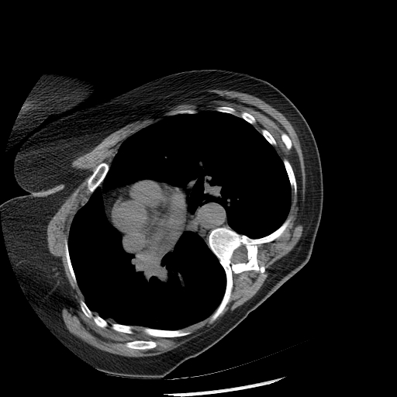
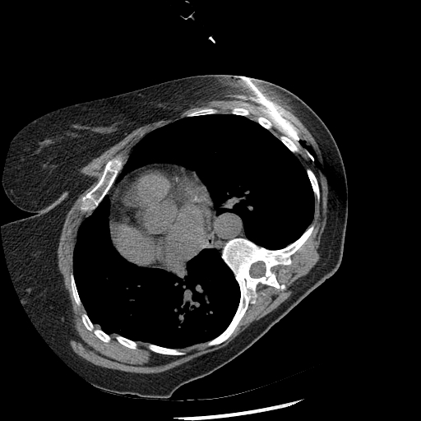
CT wire localization

Slide 38
Continuing History
MRI brain 2/13/17 showed new basal ganglia lesion.
The patient is currently awaiting stereotactic surgical excision of the additional brain mets

