Slide 1
Multimodality Conference
Valerie Kwai Ben, MD
CT with and without contrast, CXR 9/16 , 12/16—Dr Park
PET scan 9/16—Dr Baidee
Upper arm ultrasound 3/17---Dr Cole
MRN: 7067704

Slide 2
Multimodality Conference
Valerie C. Kwai Ben, MD, FACC, FACP, FASE
May 23, 2017

Slide 3
OBJECTIVES
To be able to interpret a routine chest xray and be able to differentiate pulmonary vascular congestion from pneumonia
To be able to understand the indications for a contrast vs noncontrast abdominal CT scan
To be able to interpret a PET scan and the value it lends in the evaluation of cancer
To be able to understand the etiology and management of valvular heart disease
To be able to interpret vascular ultrasounds and differentiate between clinically significant DVTs.

Slide 4
51 year old male presents with cough
HPI: cough for one month associated with shortness of breath laying in bed
PMH: none
Meds: Qvar, Ventolin inhalers, Robitussin AC, Tessalon Perles
ALL: none
SH: Tob none, Etoh none.
Vietnamese, computer worker, married, one daughter aged 16

Slide 5
Exam
BP 130/40 mmHg HR 80 regular, afebrile, 98% saturation
Neck : no JVD
Heart: RRR with displaced PMI laterally, 3/6 diastolic murmur lusb
Lungs: clear
Abd: no hepatosplenomegaly
Extremities: very prominent bounding pulses, no cyanosis, clubbing or edema
Presence of Quincke’s sign (visible pulsations of fingernail bed)

Slide 6
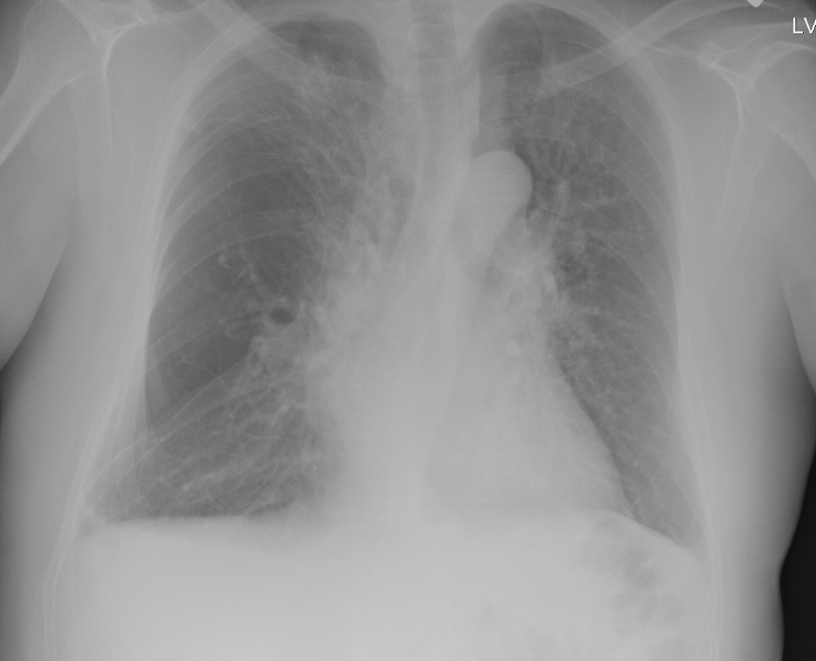
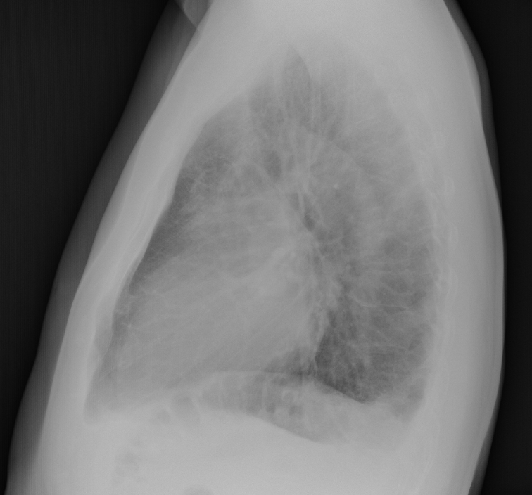
Chest X ray 9/14/16

Slide 7
Chest X Ray 9/14/16
PA AND LATERAL CHEST
** HISTORY **:
Cough
** FINDINGS **:
Ill-defined right apical infiltrate or ill-defined opacity in
right perihilar infiltrate. Possible retrocardiac infiltrate. The
heart is not enlarged. There is no pneumothorax or pleural
effusion. The visualized soft tissues and bony structures are
unremarkable.
** IMPRESSION **:
Bilateral infiltrates versus ill-defined opacity of the right lung
apex. Probable acute pneumonia versus chronic changes but follow up
recommended. This report was marked action required

Slide 8
Chest X Ray Dr Park
Comment on penetration affecting visualization of vasculature
How to differentiate pulmonary vascular congestion vs infiltrate or pneumonia

Slide 9
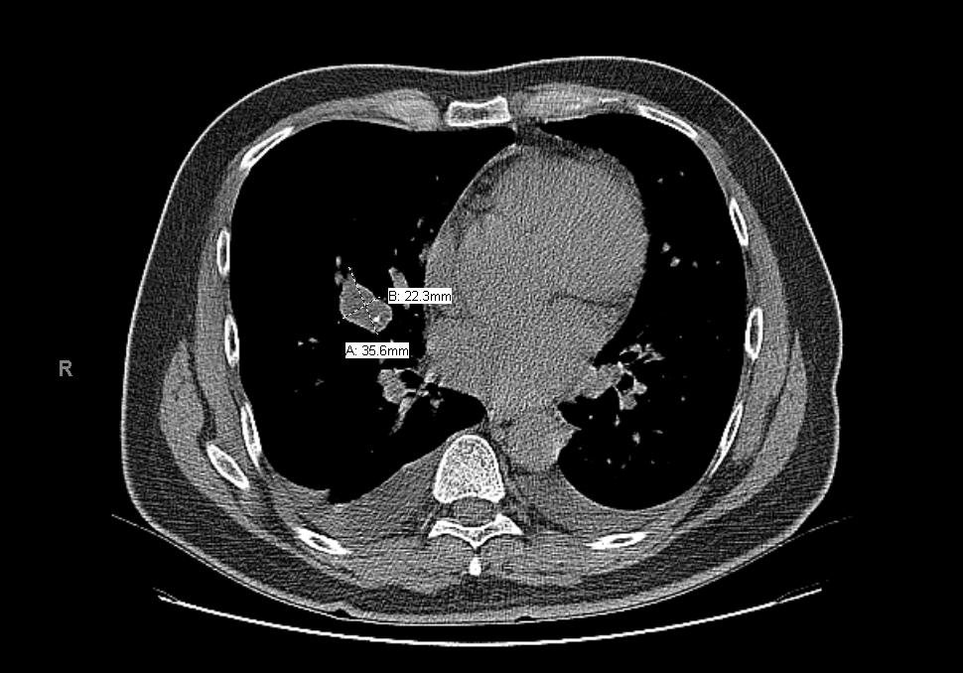
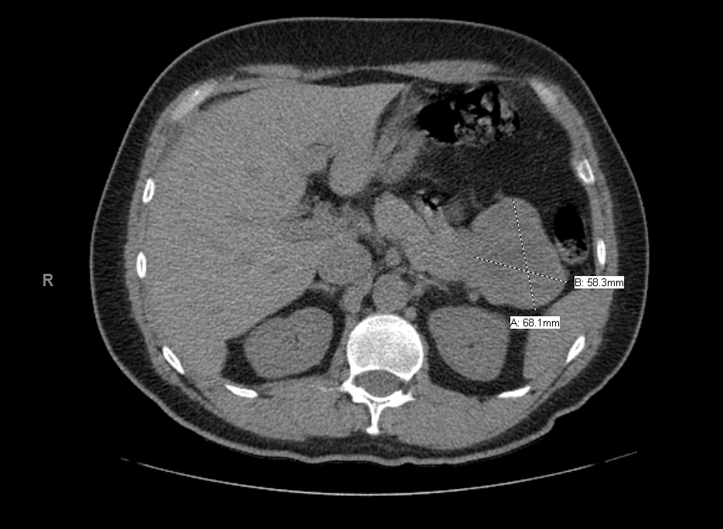
CT Chest (w/o contrast) 9/16/16

Slide 10
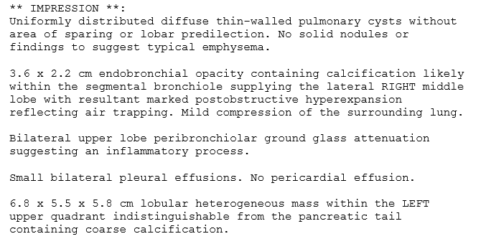
CT Chest (w/o contrast) 9/16/16

Slide 11
Chest CT (without contrast) Dr Park
Differentiate when to order CT with or without contrast
Comment on heart size and bilateral effusions
Comment on pancreatic mass, differential

Slide 12
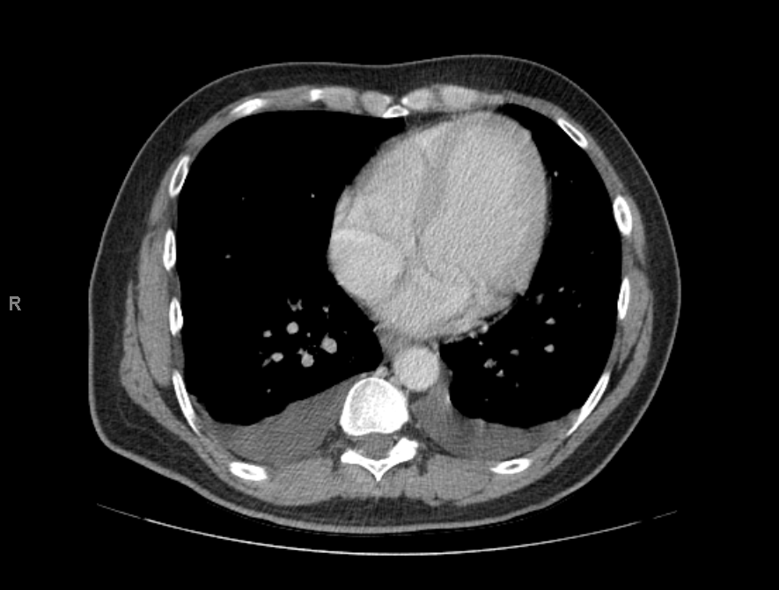
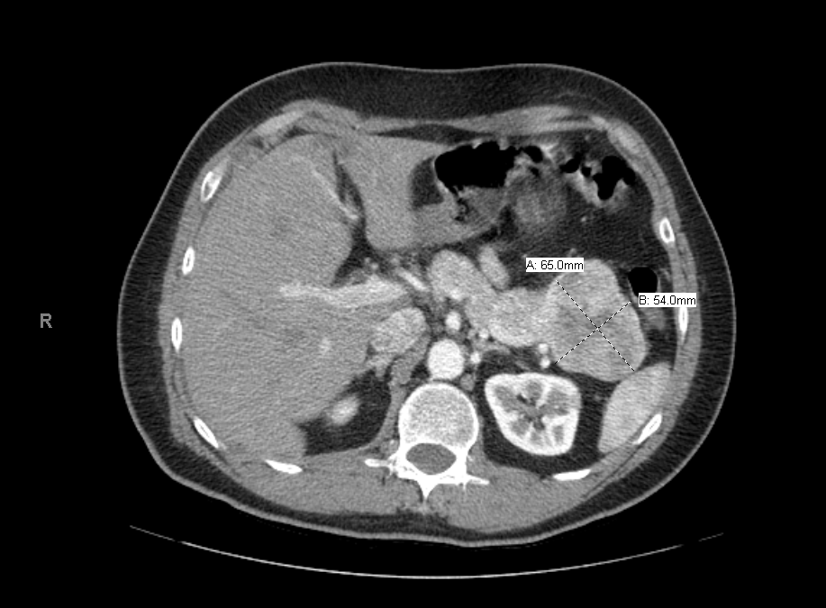
CT Abdomen (with contrast) 9/17/16

Slide 13
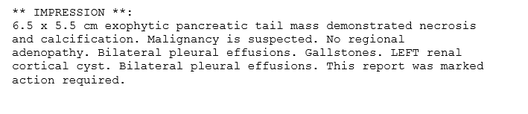
CT Abdomen (with contrast) 9/17/16

Slide 14
CT Abdomen (with contrast) Dr Park
Did the contrast CT add to the information obtained on prior chest CT without contrast?
Does it better differentiate the cardiac findings?

Slide 15
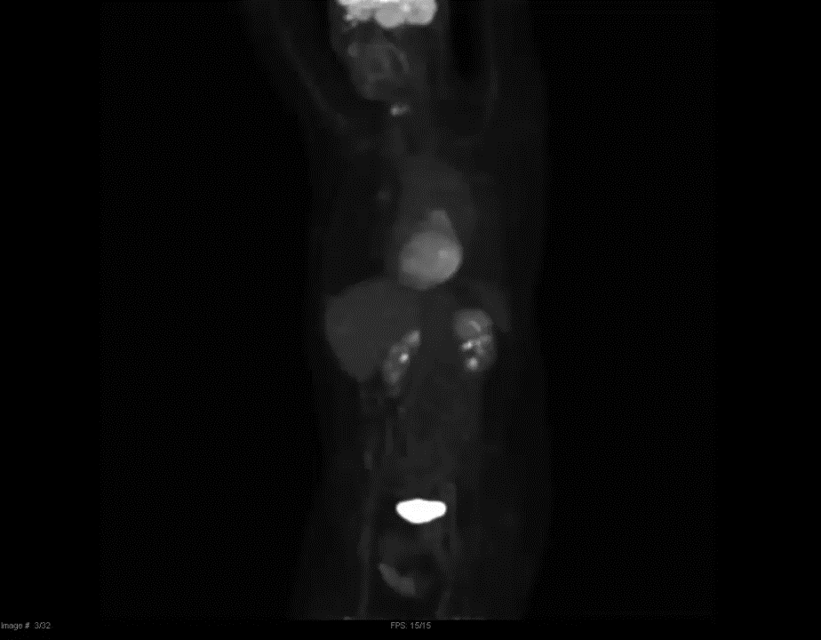

Slide 16
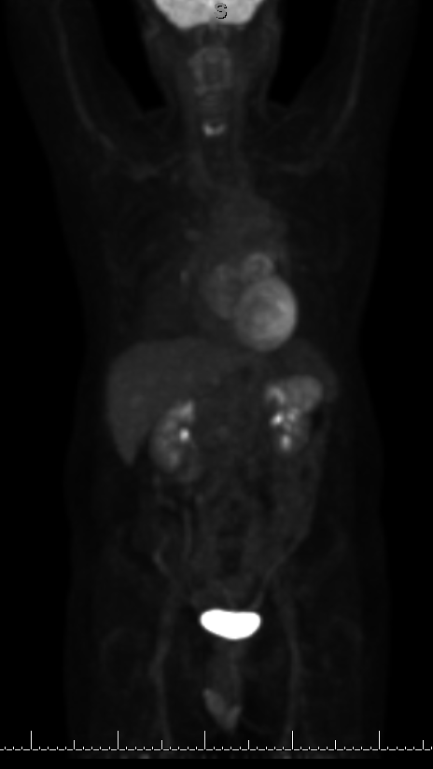
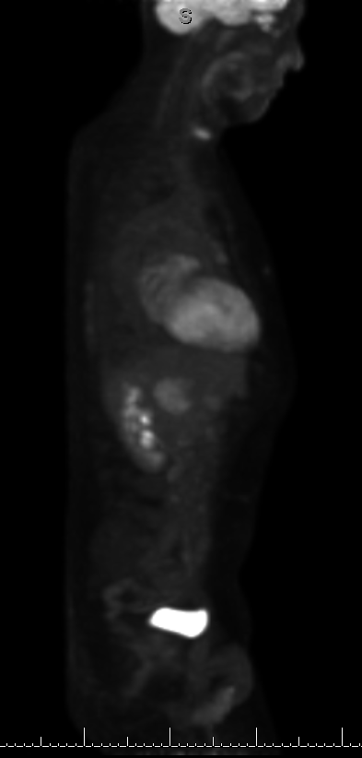
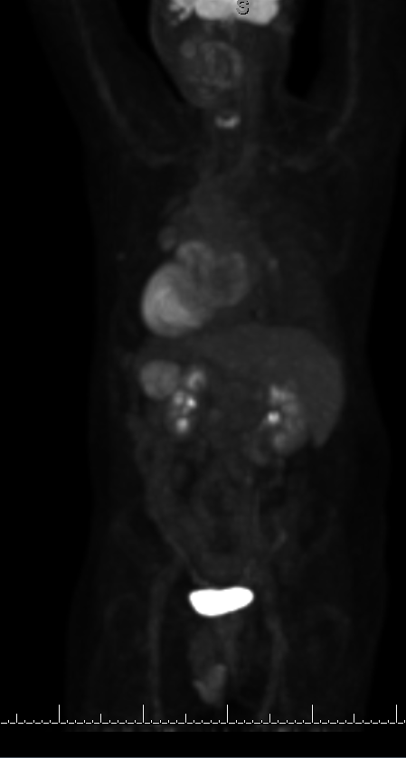
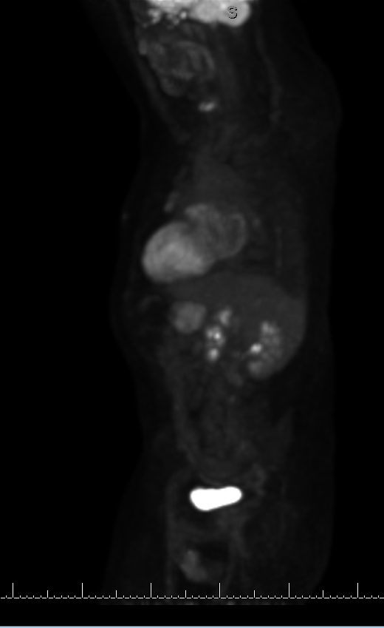
PET Scan 9/22/16

Slide 17
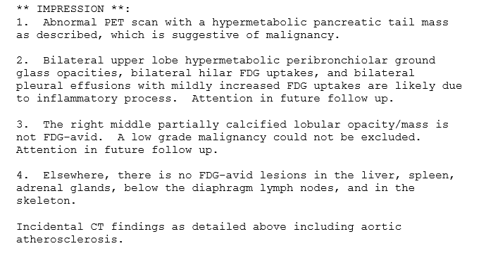
PET Scan 9/22/16

Slide 18
PET Scan 9/22/16 Dr. Baidee
Does the PET scan help with the diagnosis of the pancreatic mass?
Can the PET scan assist with evaluation of cardiac size and function?
Why is there enhancement of the heart and brain?

Slide 19
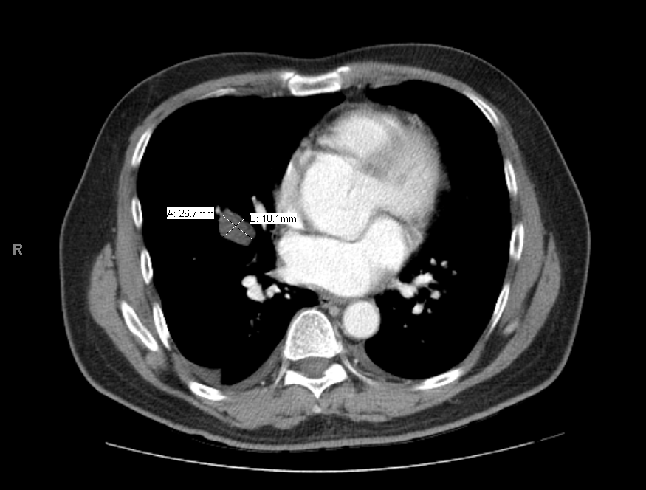
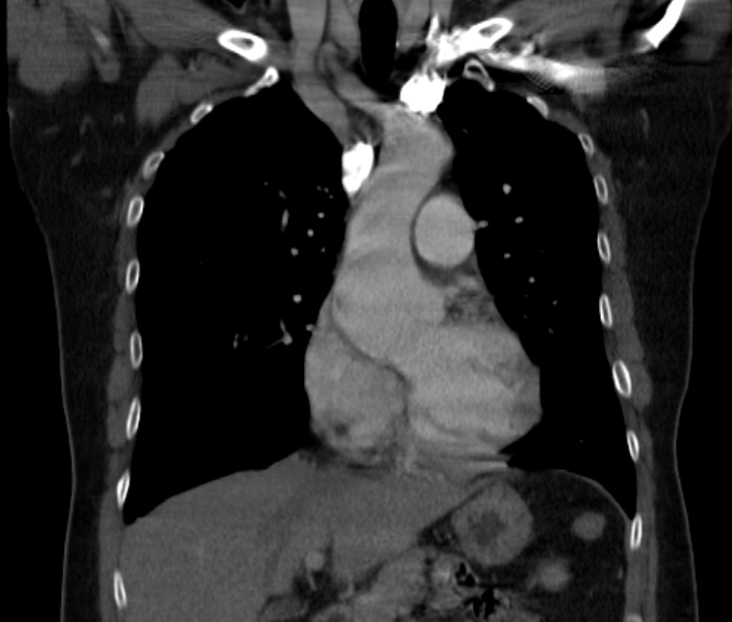
CT Chest (with contrast) 9/27/16

Slide 20
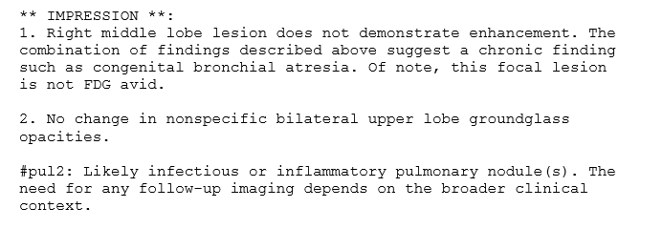
CT Chest (with contrast) 9/27/16

Slide 21
CT Chest (with contrast) 9/27/16 Dr Park
Does this chest CT with contrast add to the information already obtained on prior studies (Chest CT without contrast, abd CT with contrast, PET scan)?
Can you comment on the aorta?

Slide 22
Clinical Course
Patient was seen by General Surgery for pancreatic mass resection
Sent to preoperative medicine clinic for clearance
On behalf of the cardiac murmur, echocardiogram was ordered
Serum tumor markers:
  CA 19-9: <10 (<37)
  Chromogranin A: 21 (<15)
  Pancreatic polypeptide RIA: normal

Slide 23
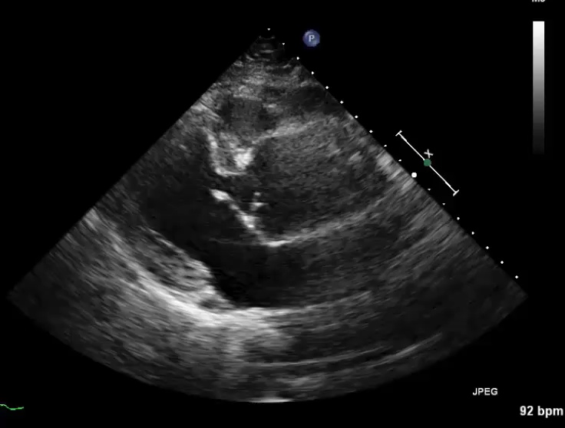
Echocardiogram 9/30/16

Slide 24
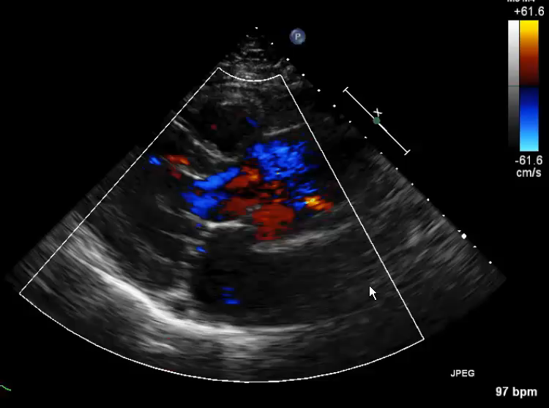

Slide 25
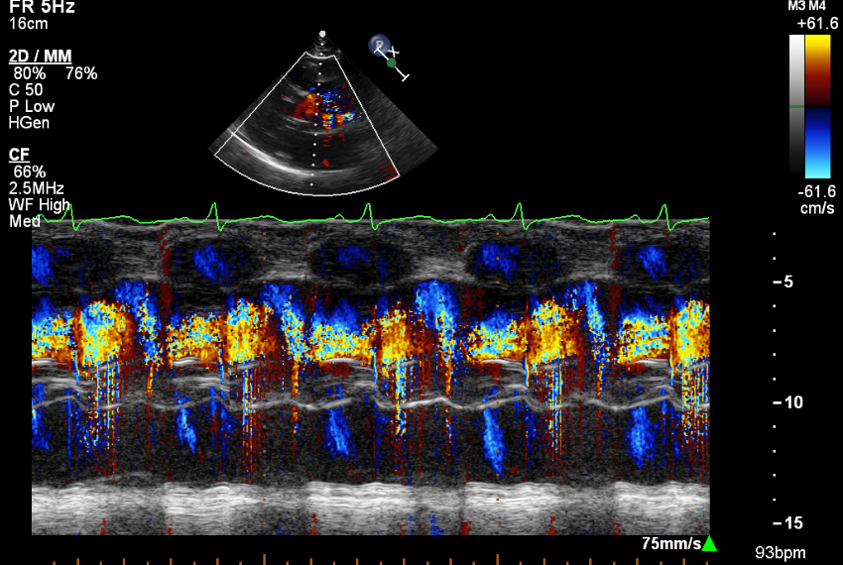

Slide 26
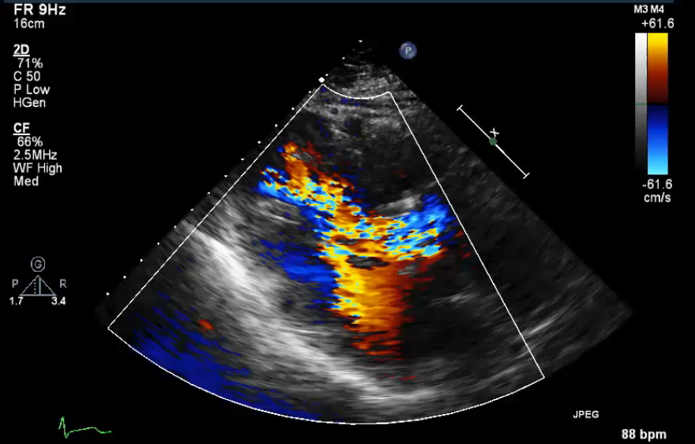

Slide 27
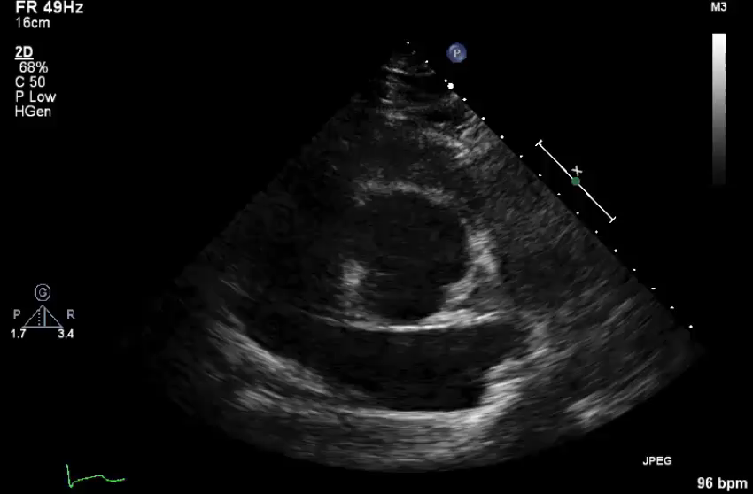
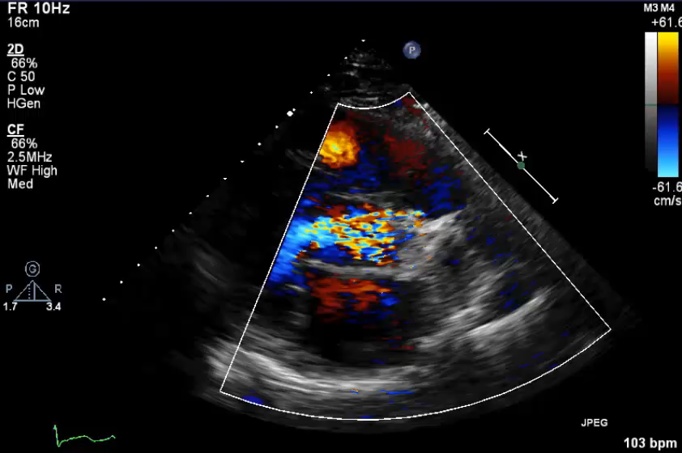

Slide 28
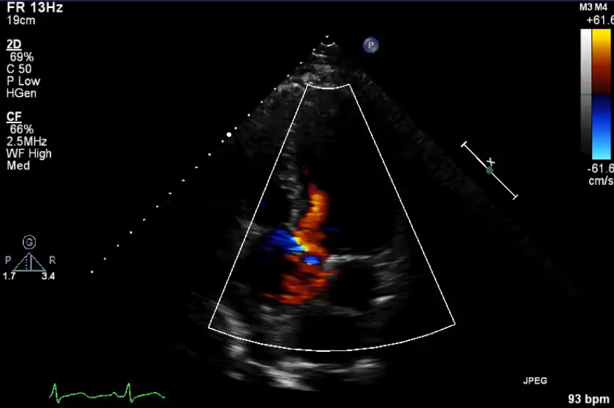
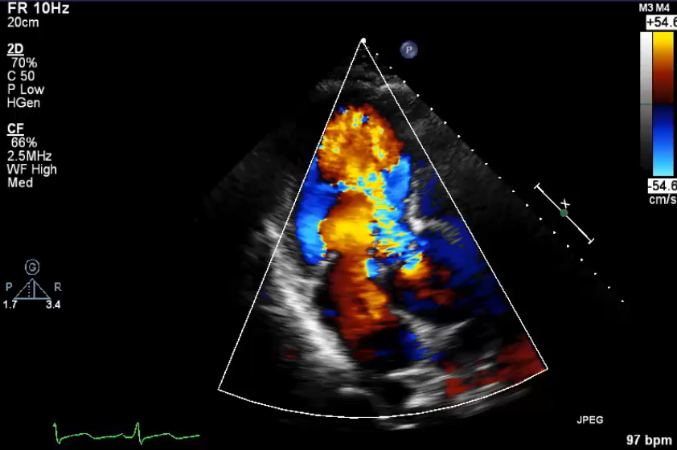

Slide 29
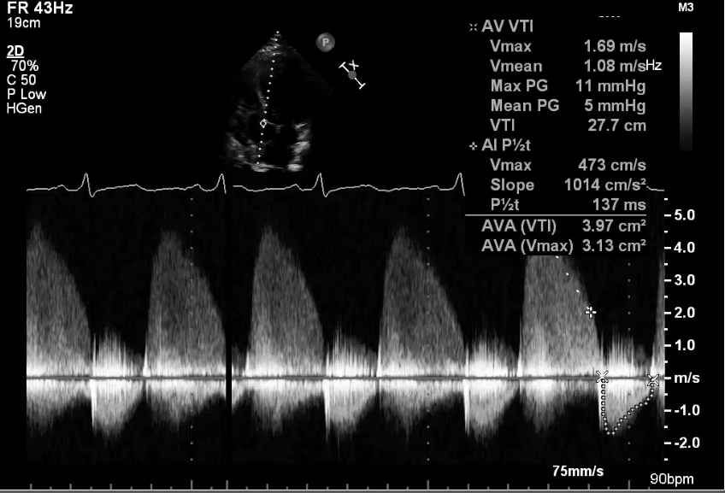
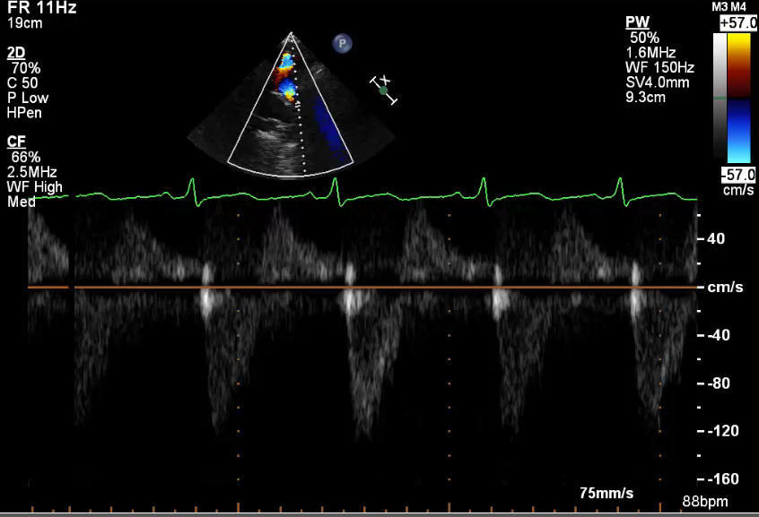

Slide 30
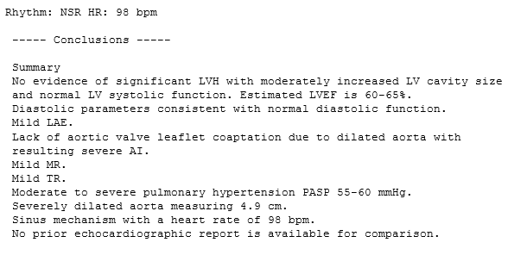
Echocardiogram 9/30/16

Slide 31
Clinical Course
Patient was seen immediately after echo which showed dilated aortic root and severe AI
  BNP 380
Admitted for diuresis and afterload reduction
TEE performed to assess valvular anatomy
Cath performed when medical therapy optimized

Slide 32
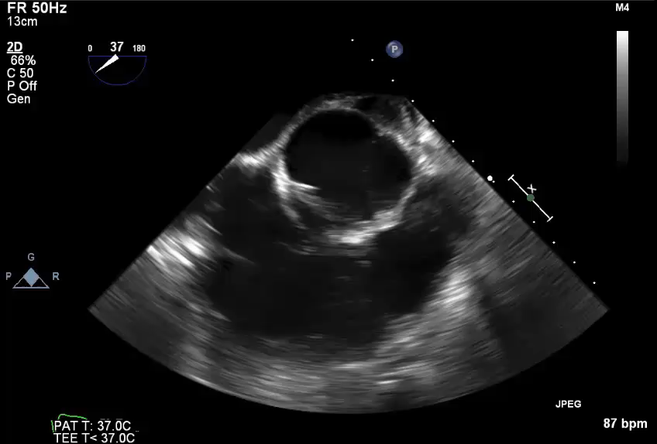
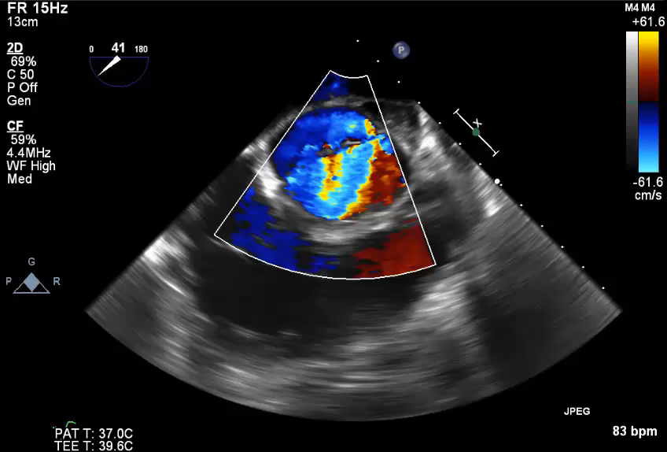
TEE Transesophageal Echo 10/3/16

Slide 33
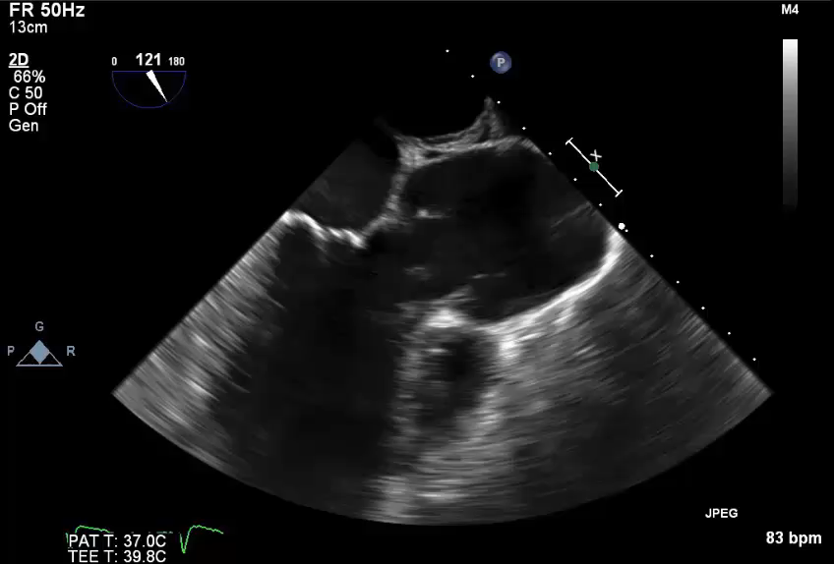
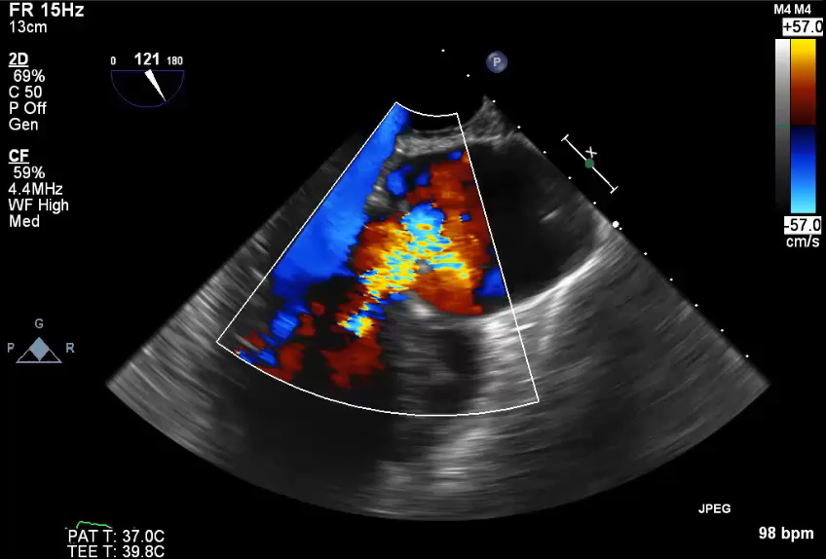
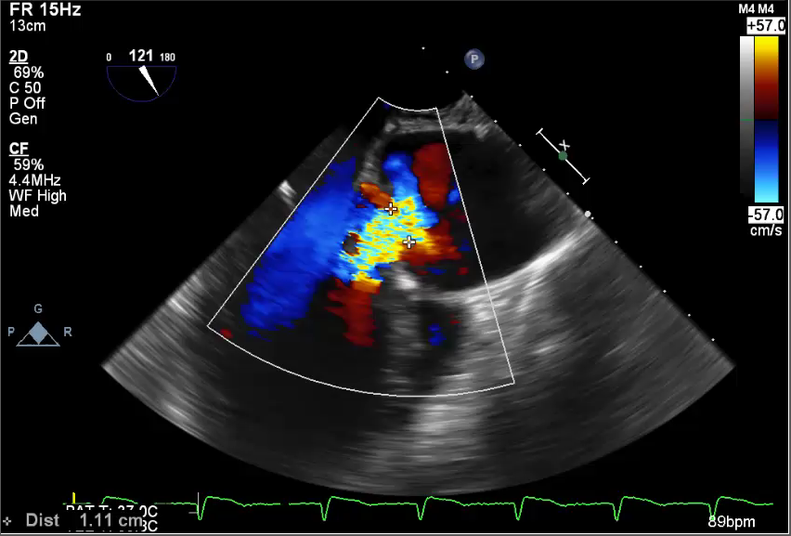
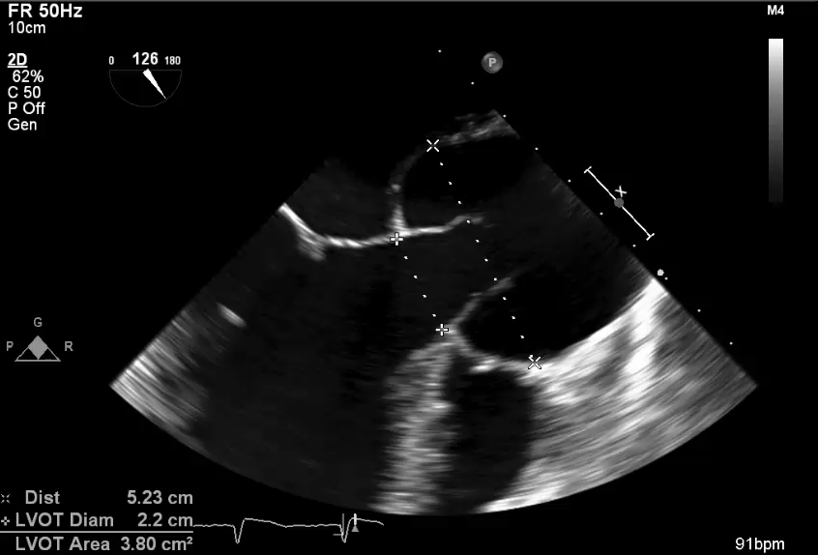

Slide 34
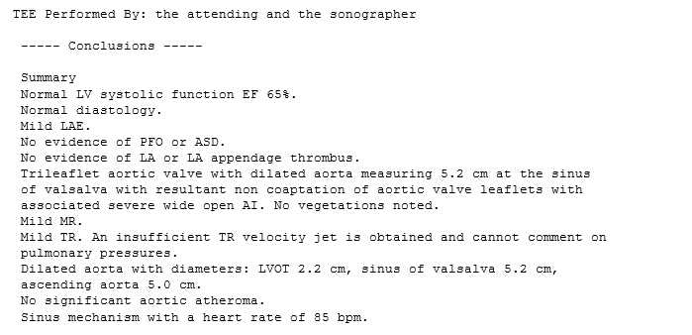
TEE Transesophageal Echocardiogram 10/2/16

Slide 35
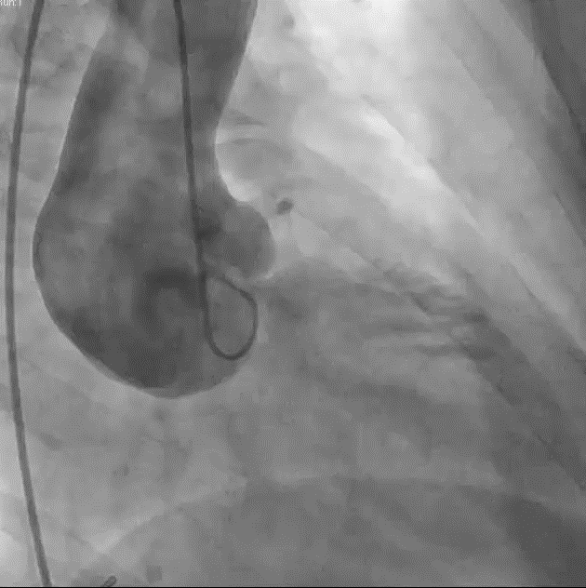
Cardiac Catheterization /Aortogram 10/2/16

Slide 36
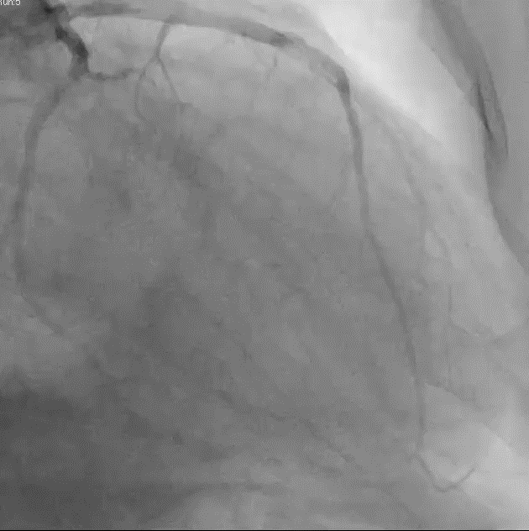
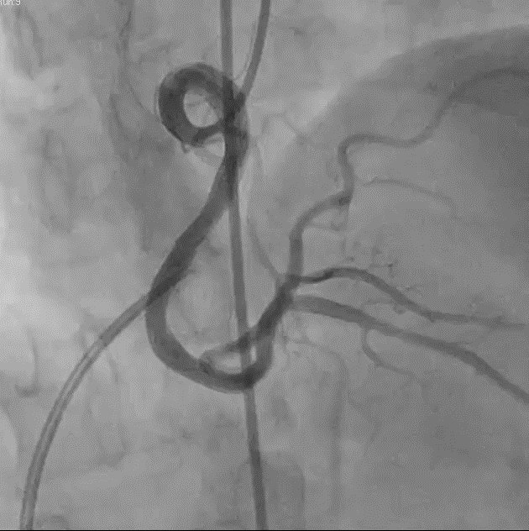
Coronary Angiography

Slide 37
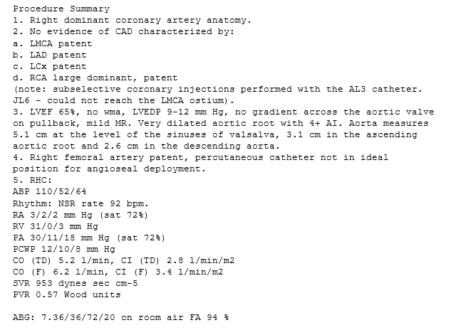
Cardiac Catheterization 10/2/16

Slide 38
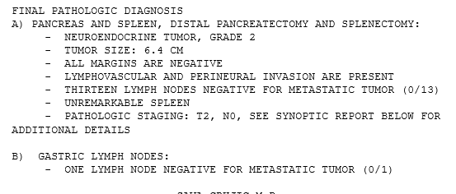
Clinical Course
Cath showed patent coronary arteries and optimized hemodynamics
10/14/16 Patient underwent subtotal distal pancreatectomy and splenectomy
Pathology showed

Slide 39
Clinical Course
Patient allowed to recover from his pancreatectomy for several months
Further managed for CHF from his severe AI

Slide 40
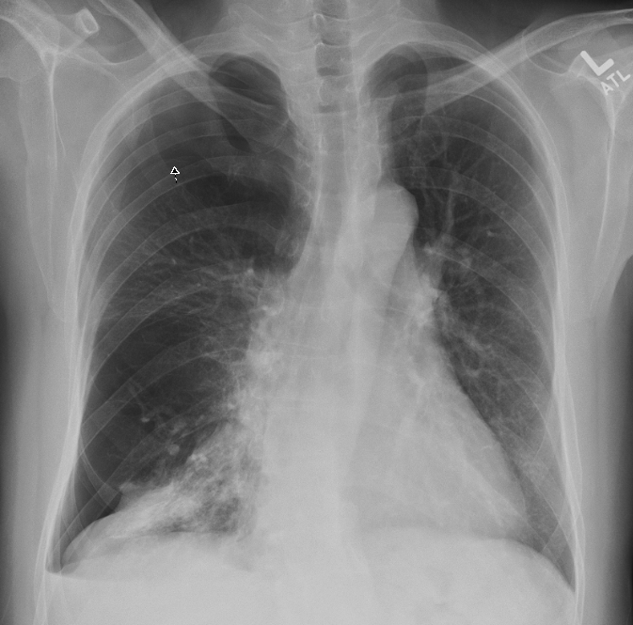
12/13/16 Presents to ER with increase in SOB

Slide 41
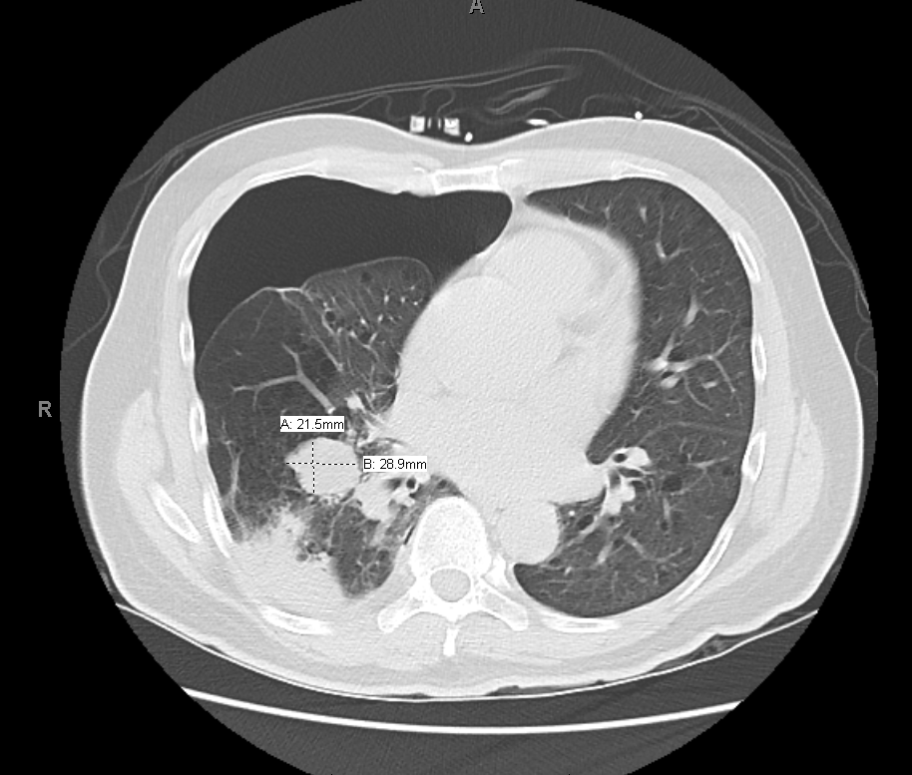
CT Chest (without contrast) 12/13/16

Slide 42
Evaluation of Xray and CT for pneumothorax Dr. Park
How do you evaluate an xray for pneumothorax?
What is a significant pneumothorax?

Slide 43
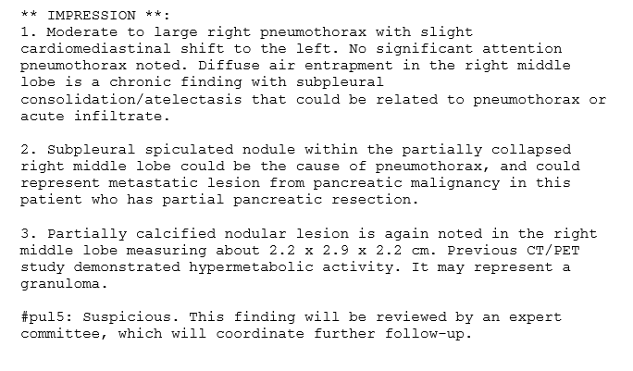
CT Chest (without contrast) 12/13/16

Slide 44
Clinical Course
Patient with pneumothorax was managed with chest tube
Lung lesion felt due to atelectasis or scar and no biopsy was performed
AVR Aortic root surgery was postponed until 2/17

Slide 45
Clinical Course
Patient underwent successful aortic root repair with
  25 mm ST Jude composite valve graft and coronary reimplantation 2/27/17
Right upper extremity swelling noted on POD #5
Right neck ultrasound was ordered

Slide 46
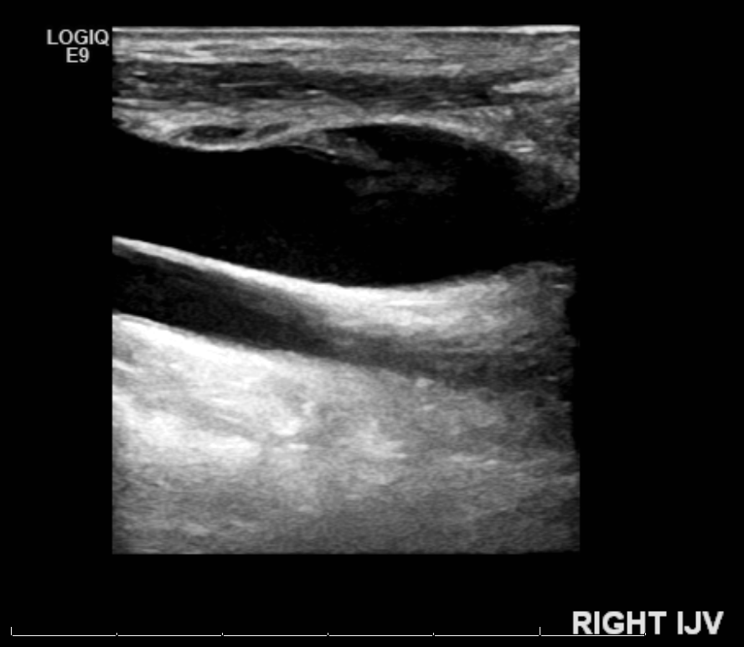
Ultrasound Duplex Scan Upper Extremity 3/5/17

Slide 47
For Dr Cole
What are the features noted on ultrasound for DVT?
Which DVT’s are considered significant to warrant anticoagulation?

Slide 48
Ultrasound Duplex Scan Upper Extremity 3/5/17
RIGHT UPPER EXTREMITY ULTRASOUND
** HISTORY **:
51-year-old man with arm swelling
Technique: Grey-scale, color, and Doppler evaluation of the right upper extremity was performed.
** FINDINGS **:
Right: There is nonocclusive thrombus seen in the right internal jugular vein. Normal compressibility, color flow, and Doppler wave forms of the visualized subclavian, axillary, brachial and basilic/cephalic veins.

Slide 49
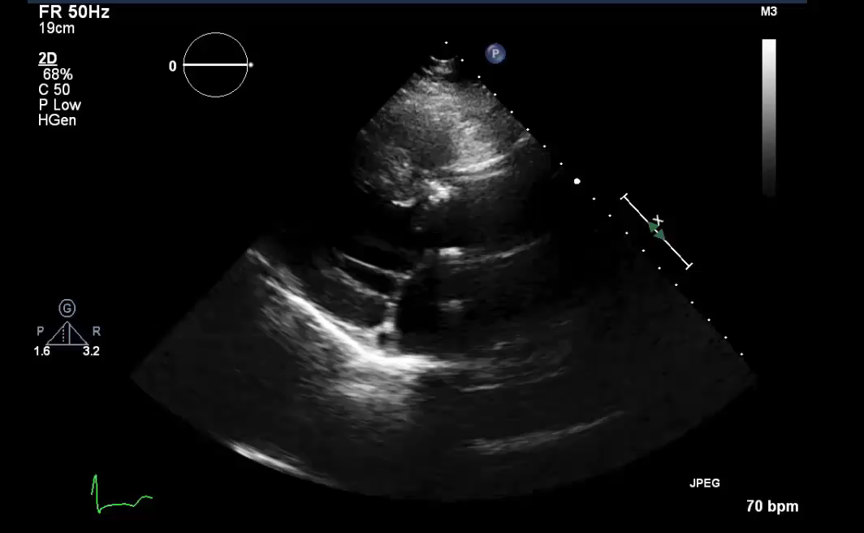
Echocardiogram post Aortic Root and AVR

Slide 50
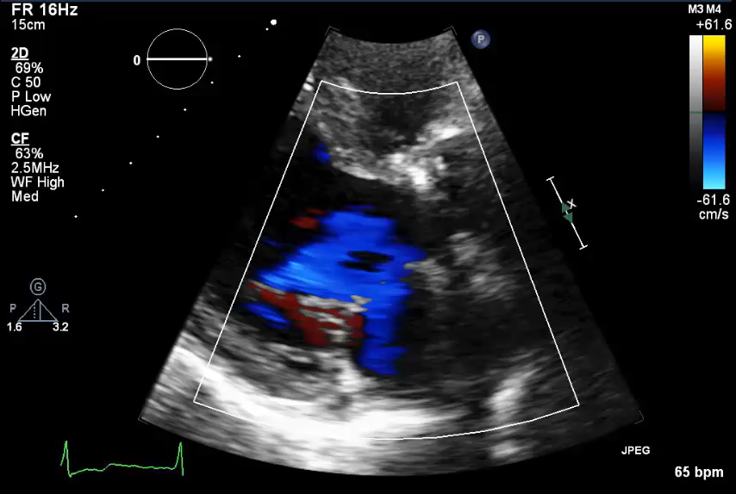
BEFORE SURGERY
AFTER SURGERY

Slide 51
Number of Imaging Studies since first presentation with cough (7 months) 9/16-3/17
Chest Xrays 25
CT scans 10
PET scan 1
Ultrasound, general 1
Echocardiogram TTE 1
Echocardiogram TEE 1
Cardiac Catheterization 1
------------------------------------------------------
Total imaging studies 40

Slide 52
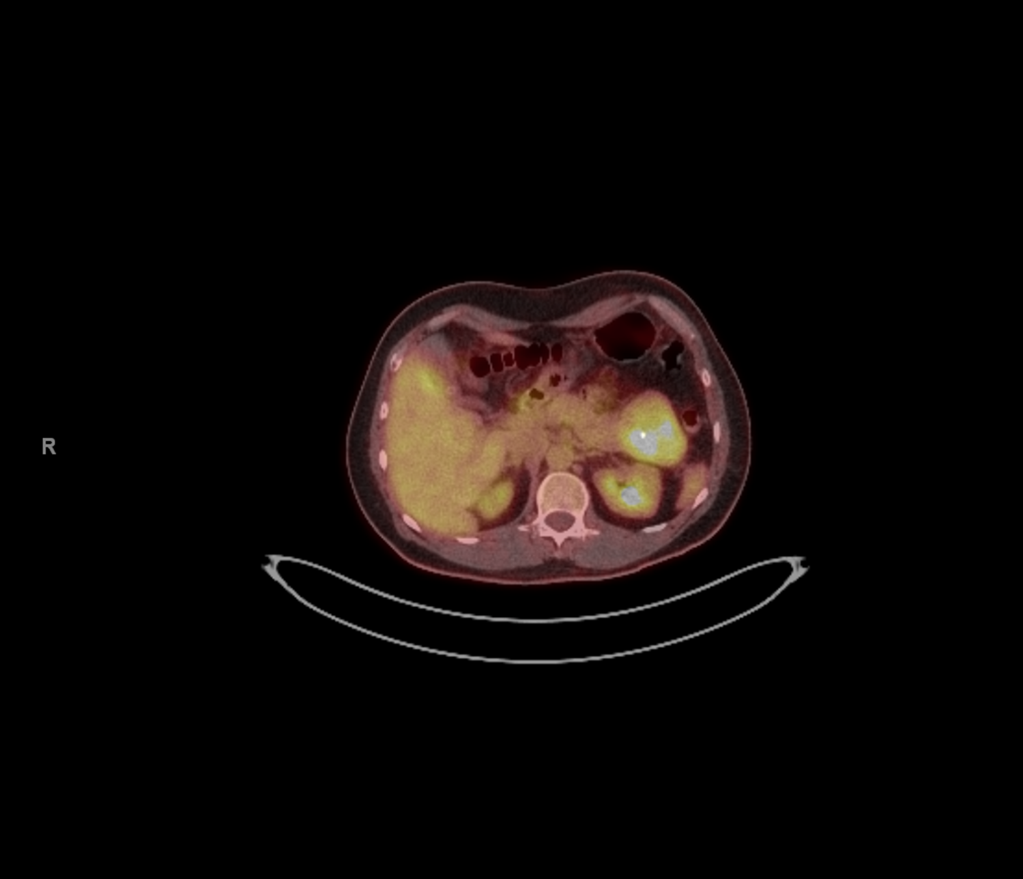
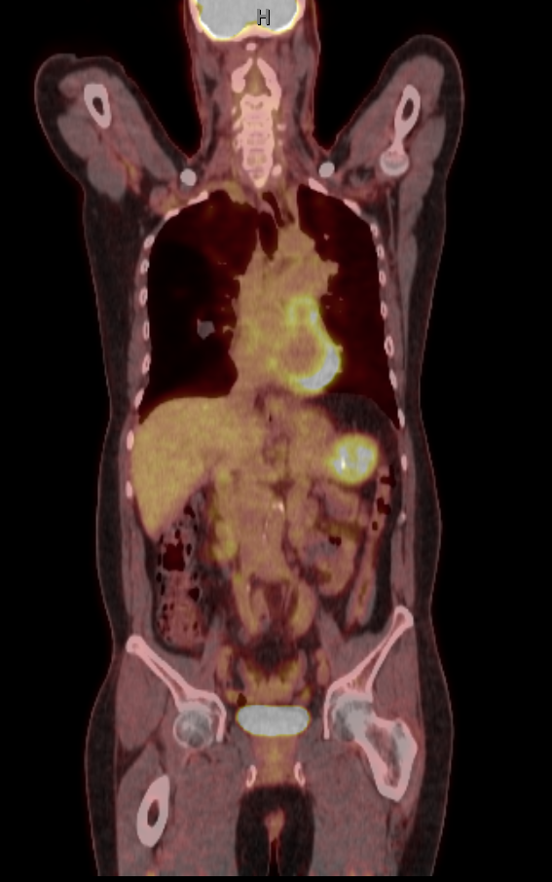
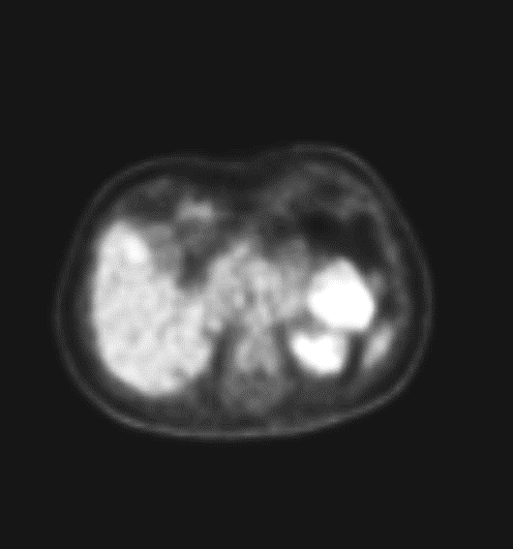
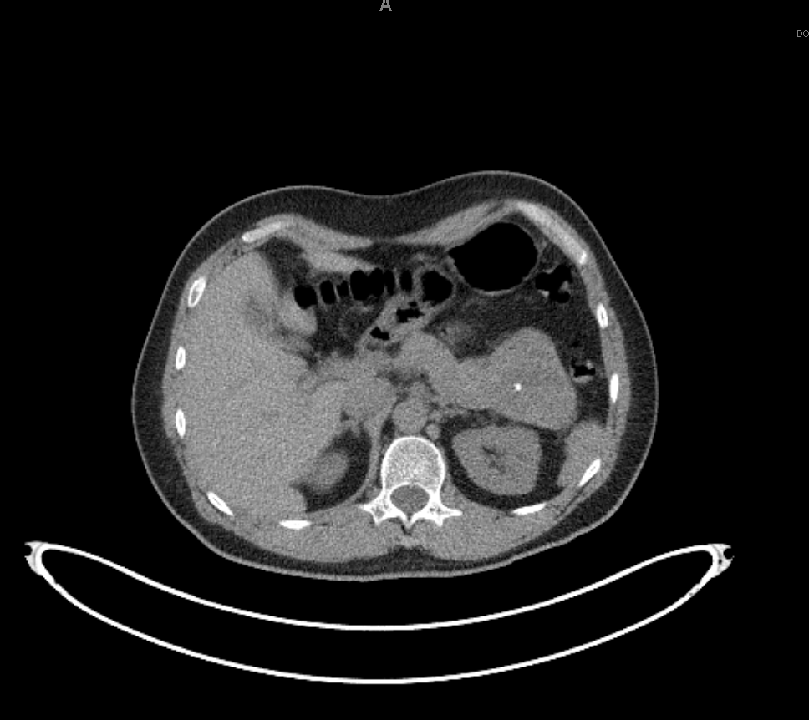

Slide 53
What does the PET/CT exam demonstrate?
Intense increased FDG uptake in the region of the known large pancreatic tail mass consistent with primary malignancy

Slide 54
Why is there enhancement of the heart and brain?
  Physiologic pattern of FDG
    The cortex of the brain- there is generally very intense tracer uptake in the brain because the brains only energy source is glucose. The total uptake in the brain is approximately 6% of the injected dose.
    Myocardium-in the post-prandial state, there is marked cardiac activity. Little myocardial activity is generally noted in the fasting state as the myocardium preferentially utilizes fatty acids for energy generation. However, uptake can be variable as even in the fasting state, glucose can still account for 30-40% of the energy derived from oxidative metabolism..

Slide 55
Indications of PET in cardiac imaging?
PET Evaluation of Coronary Artery Disease:
  PET scans using rubidium-82 (Rb-82) or N-13 ammonia done at rest or with pharmacological stress are considered medically necessary for non-invasive imaging of the perfusion of the heart for the diagnosis and management of members with known or suspected coronary artery disease, provided such scans meet either one of the two following criteria:
Assessment of Myocardial Viability:
  FDG-PET can distinguish between dysfunctional but viable myocardial tissue and scar tissue in order to affect the management decisions in members with ischemic cardiomyopathy and left ventricular dysfunction.

