Slide 1
Badiee MD
SPRING 2017 MULTIMODALITY
METASTATIC BREAST CANCER CASE STUDY
Primary 07182631 (WC)
Echo case TBD to be assigned to VK for LVEF eval prior to chemo
PET CT
MRI
Ultrasound Thyroid

Slide 2
OBJECTIVES
Be able to identify common tumor marker for Breast Cancer
  Carcinoma Antigen 15-3 (CA 15-3), is a tumor marker for many types of cancer, most notably breast cancer
Identify common sites of metastases in breast cancer
  Lymph nodes (axilla), Skin (around the site of primary), Bones, Liver, Lung, brain
Identify the value of PET/CT over other conventional modalities
  Early detection and precise characterization of the extent of recurrent disease are essential for guiding optimal therapy and prognostication. Locoregional recurrence may benefit from curative treatment based on surgery or radiation therapy, whereas distant metastases usually require palliative systemic therapy. Breast cancer recurrence can be suggested by clinical symptoms, radiologic findings, or rising levels of tumor markers (carcinoma antigen 15.3 or carcinoembryonic embryonic antigen). In all of these situations, the accuracy of PET/CT has been shown to be high.
Role of PET/CT in restaging (revaluating) breast cancer
  Identify local recurrence
  Loco-regional nodal metastases
  Distant mets
Role of PET CT to identify areas of recurrent/ metastatic breast cancer
  PET CT allows better discrimination between posttreatment scar or fibrosis and viable tumor tissue
  PET/CT is efficient for detecting loco-regional recurrence, especially in the chest wall, axilla, and extra-axillary lymph nodes basins, with better performance than CT or MRI
  In the specific setting of asymptomatic patients with rising tumor marker levels and negative conventional imaging results, PET/CT has shown strength in detecting recurrence earlier than traditional imaging. In a metaanalysis of 13 studies, the sensitivity, specificity, and accuracy of PET were 87.8%, 69.3%, and 82.8%, respectively.
  PET/CT is also efficient in patients with suspected recurrence but negative tumor marker results.
  Although PET/CT offers the opportunity to provide an overview of disease in a single procedure, its use as a first-line method is not recommended in international guidelines. NCCN guidelines recommend that chest CT, abdominopelvic CT or MRI, and bone scanning be performed first; ¹⁸F-FDG PET/CT is considered optional and “most helpful in situations where standard staging studies are equivocal or suspicious” . The European Society for Medical Oncology recommends that “¹⁸F-FDG PET/CT can be useful for identifying the site of relapse when traditional methods are equivocal or conflicting”.
What other conventional modalities are often performed before PET/CT
  chest CT, abdominopelvic CT, or MRI, and bone scanning
List criterion for brain tumor on MRI
List the criterion for increased thyroid size & ultrasound criteria for thyroid nodules/tumor (b9 and metastatic)/cysts
Role of echocardiogram for evaluation of left ventricular ejection fraction prior and during chemotherapy

Slide 3
History
LL is a 57 year old female with known metastatic breast cancer and rising tumor markers.
What is your differential diagnosis
  Malignancy of primary vs. metastaisis
  Infection (bacterial, viral)
What types of studies would you be considering?
  PET/CT, MRI, Mammo, CT

Slide 4
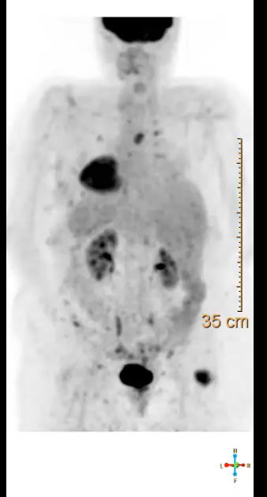

Slide 5
Maximum Intensity Projection (M.I.P.)
What component of the PET/CT is viewed here?
  M.I.P.
  PET CT images are presented and viewed in 3 planes (coronal, transaxial, and sagittal) as well as a 3D maximum intensity projection (M.I.P.), which can be rotated while viewing. The CT, corrected and uncorrected PET scans, as well as the fusion image can be viewed on a single page
Identify the physiological from the pathological uptake
  Physiological pattern of FDG in order of intensity is brain, bladder, renal collecting system, myocardium (variable), liver, spleen, bone marrow, soft tissues.
  Pathological uptake
    Increased accumulation of FDG relative to normal tissue is a useful marker for many cancers
    FDG uptake in tumors is related in a complex manner to the proliferative activity of malignant tissue and to the number of viable tumor cells.
  Brown fat (to be discussed)
Standard Unit Volume (SUV):
  The standardized uptake value (SUV) is commonly used as a relative measure of FDG uptake
  The basic expression for SUV is:
SUV=r(a ′ /w)
  Where r is the radioactivity activity concentration [kBq/ml] measured by the PET scanner within a region of interest (ROI), a′ is the decay-corrected amount of injected radiolabeled FDG [kBq], and w is the weight of the patient [g], which is used a surrogate for a distribution volume of tracer

Slide 6
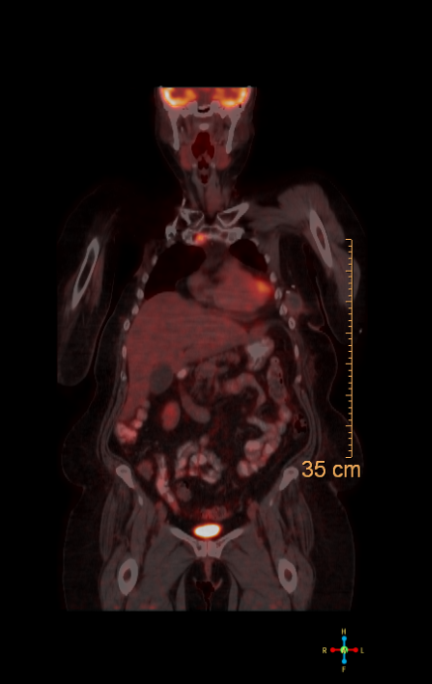
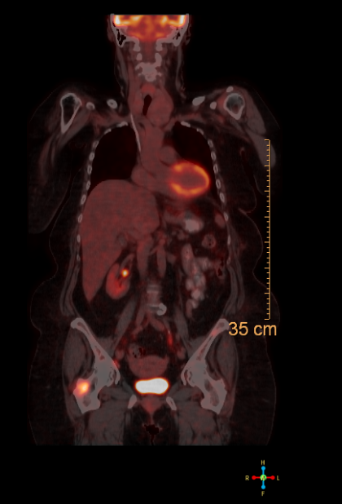

Slide 7
Fused PET CT
What component of the PET/CT is viewed here?
  Coronal Fused PET CT
What Pathologies are visible on this image series?
  Multiple intense skeletal foci
    Sternum
    Right greater trochanter

Slide 8
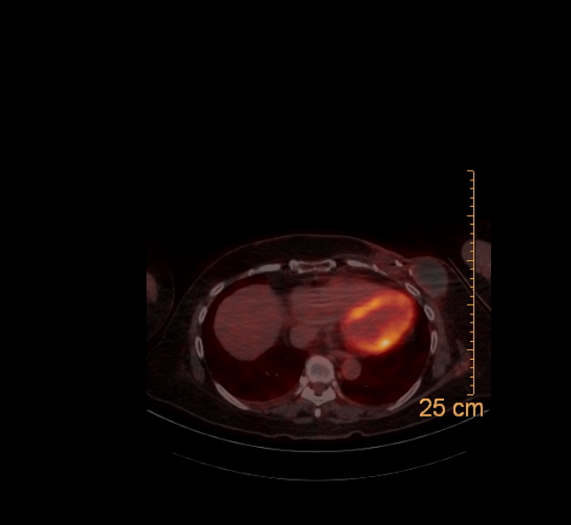
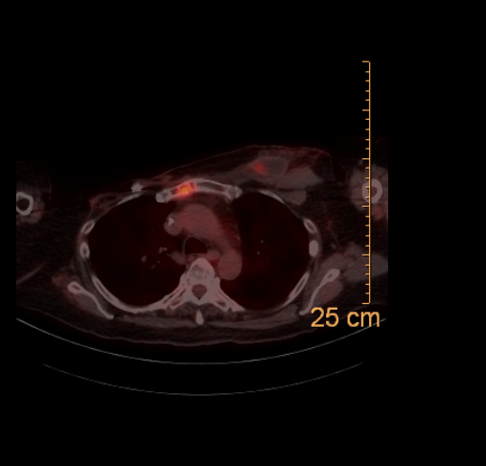
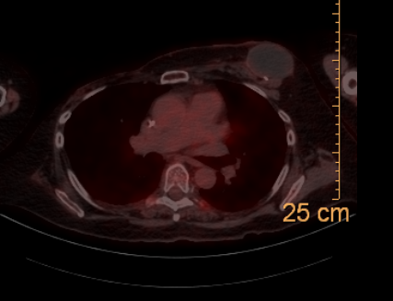
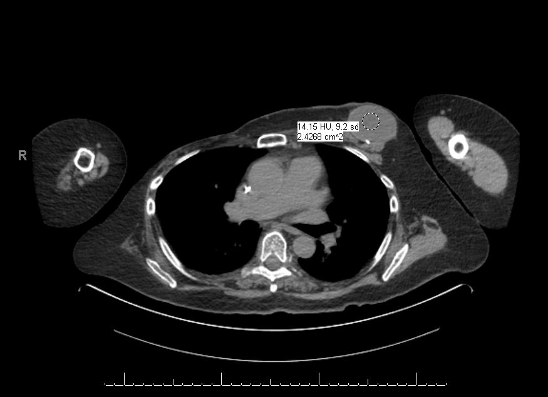

Slide 9
Fused PET CT & CT
What component of the PET/CT is viewed here?
  Axial Fused PET CT and CT
What Pathologies are visible on this image series?
  Intense skeletal focus in manubrium
  Surgical change including bilateral mastectomy
  2 large areas of fluid collections within the left breast surgical bed with patchy areas of peripheral uptake
    FDG is not cancer specific and will accumulate in areas with high levels of metabolism and glycolysis. Therefore increased uptake can be expected in sites of hyperactivity (muscular, nervous); active inflammation (infection.); tissue repair (post surgery), etc.
  Small areas of uptake in paravertebral brown fat
    Brown adipose tissue (BAT) functions as a thermogenic organ by producing heat to maintain body temperature in many mammals, especially in the young. Is richly innervated by sympathetic nervous system
    This tissue has elevated cellular density, rich vascularization, innervations, and multilocular intracellular lipid droplets. BAT overexpress uncoupling protein (UCP1) more than white fat. Fluorodeoxyglucose (FDG) uptake in this hypermetabolic BAT can be confused with nodal uptake, leading to false positive results
    Positron emission tomography/computed tomography (PET/CT) allows to verify BAT uptake (standardized uptake value max = 1.9–20) foci have no corresponding anatomic soft-tissue mass detectable by computed tomography (CT) scanning. Rather, the FDG–avid focus fused to tissues of fat density.
    Several pharmacologic methods have been tried to reduce FDG uptake by hypermetabolic BAT, e.g., use of propranolol, fentanyl, etc. Among the nonpharmacologic approaches use of high-fat, very low-carbohydrate, protein-permitted diet, and warming are the useful approach for significant reduction of the frequency of BAT hypermetabolism

Slide 10
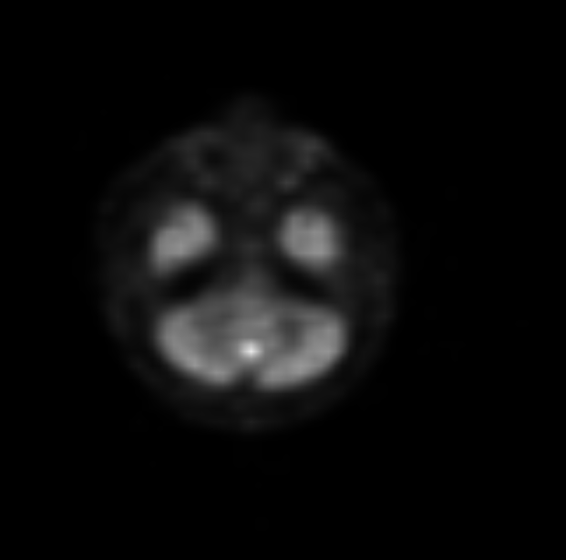
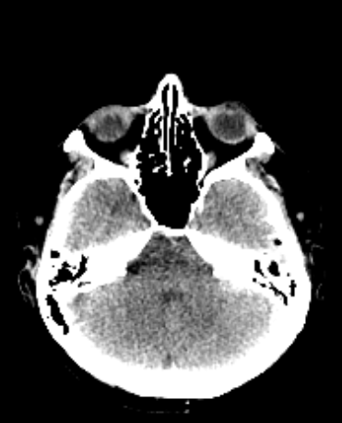
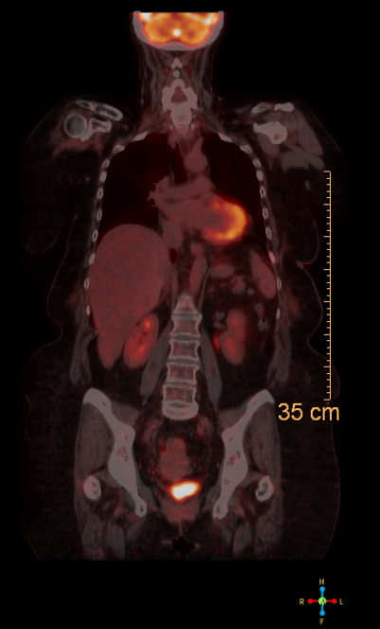
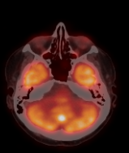

Slide 11
Fused PET CT & CT
What component of the PET/CT is viewed here?
  Axial Fused PET CT and CT / Coronal fused PET CT
What Pathologies are visible on this image series?
  Intense brain lesion
Where is this lesion found
  Midline cerebellum
What is the differential diagnosis?
FDG is not cancer specific and will accumulate in areas with high levels of metabolism and glycolysis
  Brain tumors
    Primary (glioblastoma)
    metastasis
  Active inflammation (infection/ abscess)
  Physiologic
    The high and regionally variable FDG uptake in normal brain (gray matter) often makes the delineation of brain tumors difficult. Therefore, they need to be interpreted in conjunction, ideally by image fusion, with CT or MRI scans
What would the next step in this process?
  MRI for further assessment

Slide 12
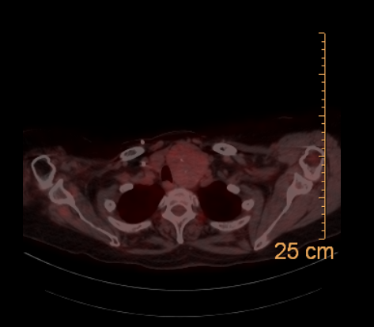
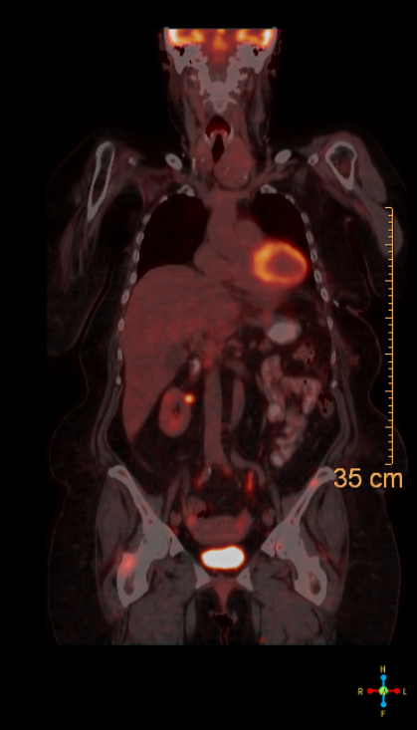
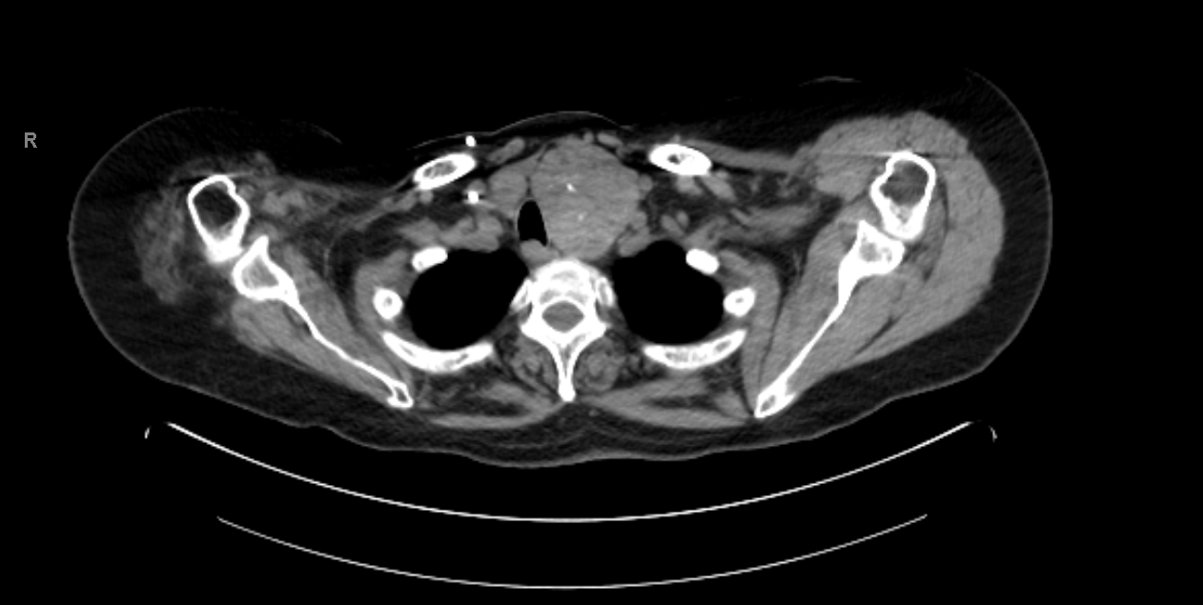

Slide 13
Fused Axial/Coronal PET CT & Axial CT
What component of the PET/CT is viewed here?
  Axial Fused PET CT and CT / Coronal fused PET CT
What new pathologies are now visible on this image series?
  Mild uptake in left neck
Where is this lesion found
  Enlarged left thyroid lobe
What is the differential diagnosis?
  Goiter (benign)
  Graves’ disease (autoimmune disease)
  Thyroiditis (inflammation)
  Thyroid cancer
What would the next step in this process?
  Thyroid US

Slide 14
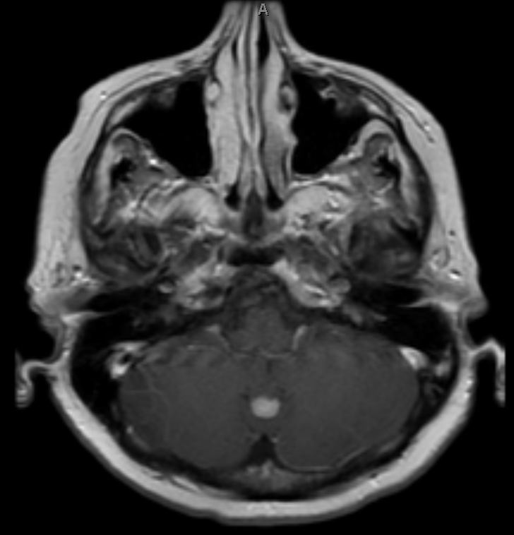
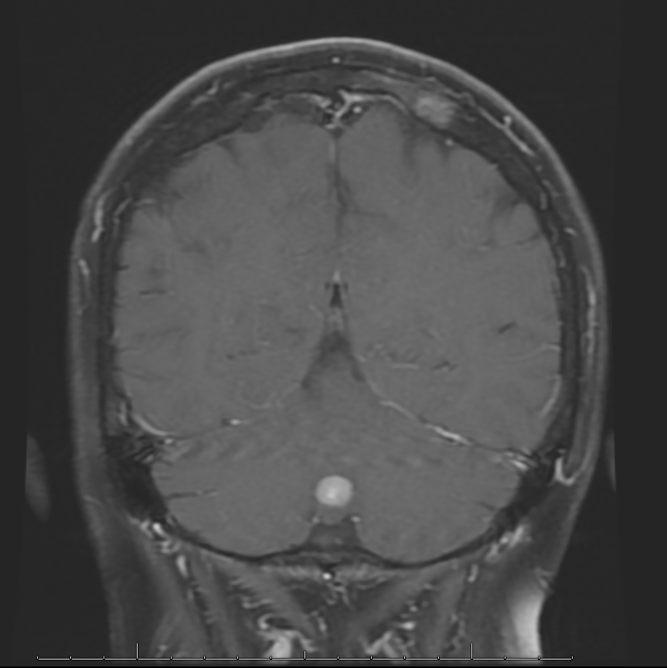

Slide 15
MRI
What modality is viewed here?
What Pathologies are visible on this image series?
  Note the calvarium metastisis (PARK transaxial & sagital)
What contrast media would you expect to be utilized in this image
  Midline cerebellum
What is the differential diagnosis?
  Brain tumors
  Metastasis
What would the next step in this process?
  MRI for further assessment

Slide 16
MRI (PARK IMAGE)

Slide 17
Thyroid US (Cole)

Slide 18
Transthoracic Echocardiogram (Kwai-Ben IMAGE)

Slide 19
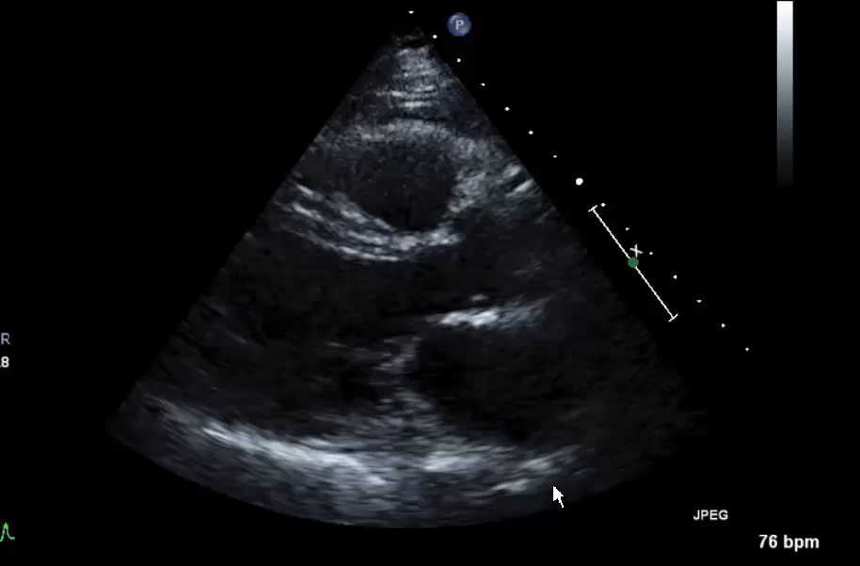

Slide 20
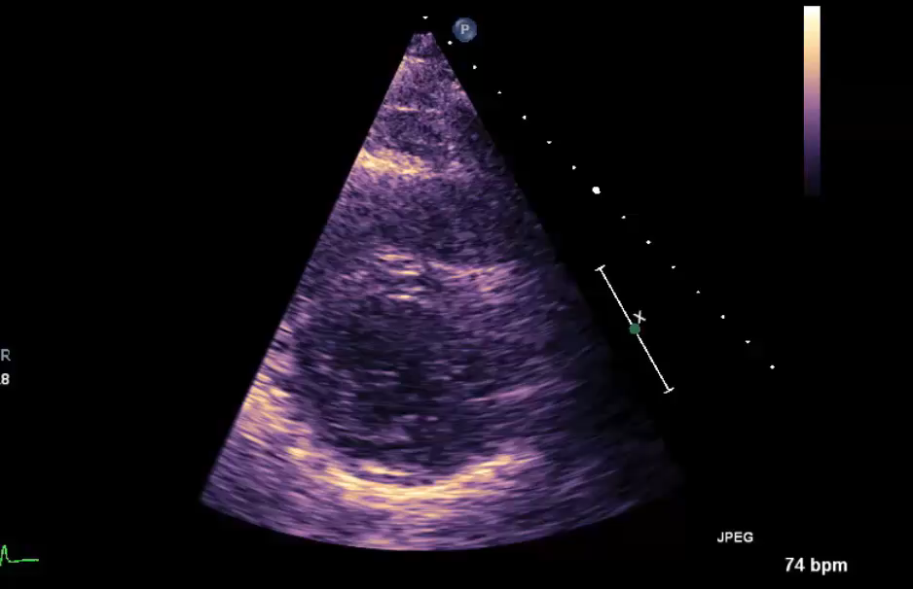

Slide 21
