Slide 1
Conception to Implantation
Presented by Alexis Rojas
Notes:
Day 0 - Day 12 following conception

Slide 2
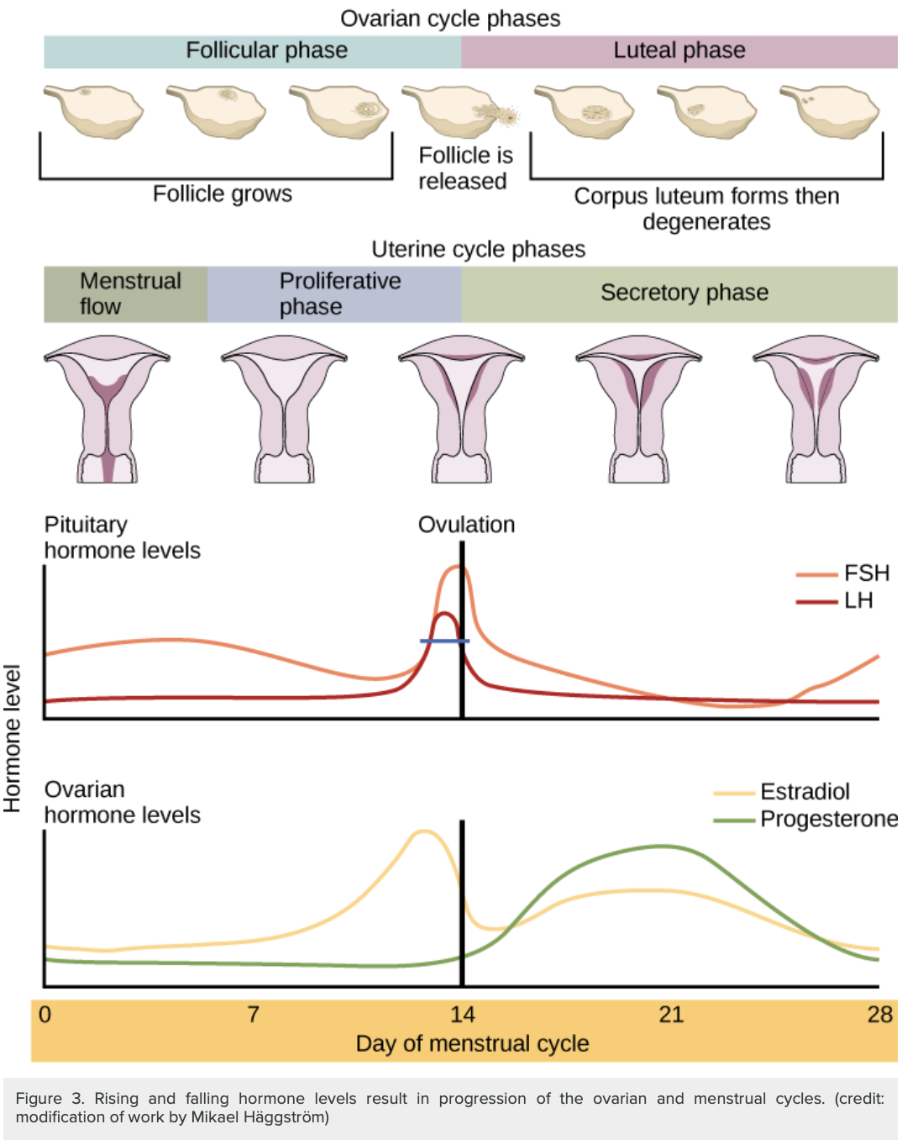
Review of Menstrual Cycle
Physiological cycle to prepare for conception and pregnancy
Ovarian cycle → release ovum for fertilization and influence endometrial lining
Uterine cycle → prepare and support endometrium for embryo development
Notes:
Image credit: https://courses.lumenlearning.com/wm-biology2/chapter/the-ovarian-cycle-the-menstrual-cycle-and-menopause/

Slide 3
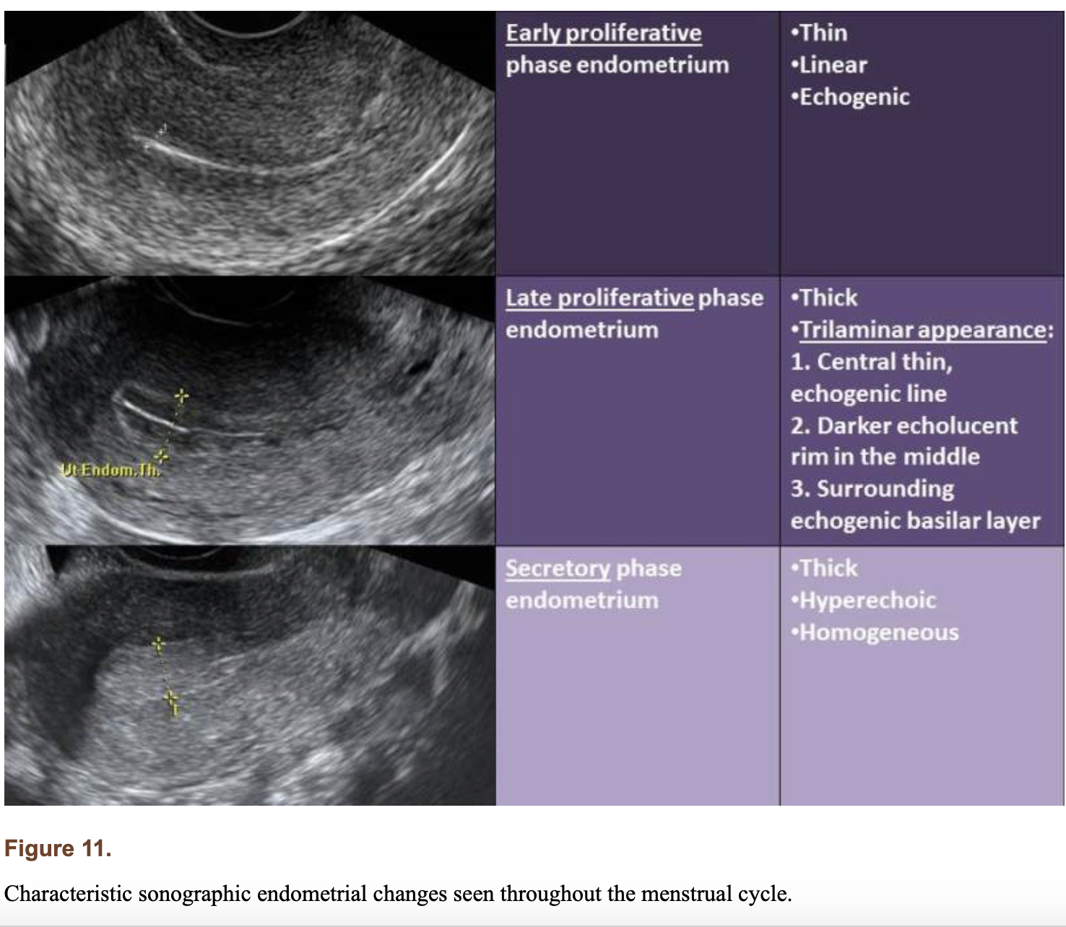
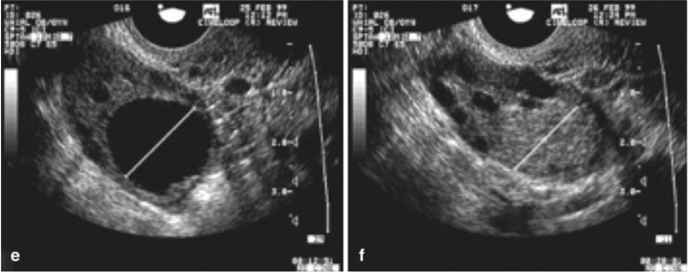
e) Dominant (Graafian) follicular cyst; f) Corpus luteum
Notes:
Endometrial appearance image credit: https://www.ncbi.nlm.nih.gov/books/NBK279054/
Functional ovarian cysts image credit: https://radiologykey.com/ultrasound-in-follicle-monitoring-for-ovulation-inductioniui/

Slide 4
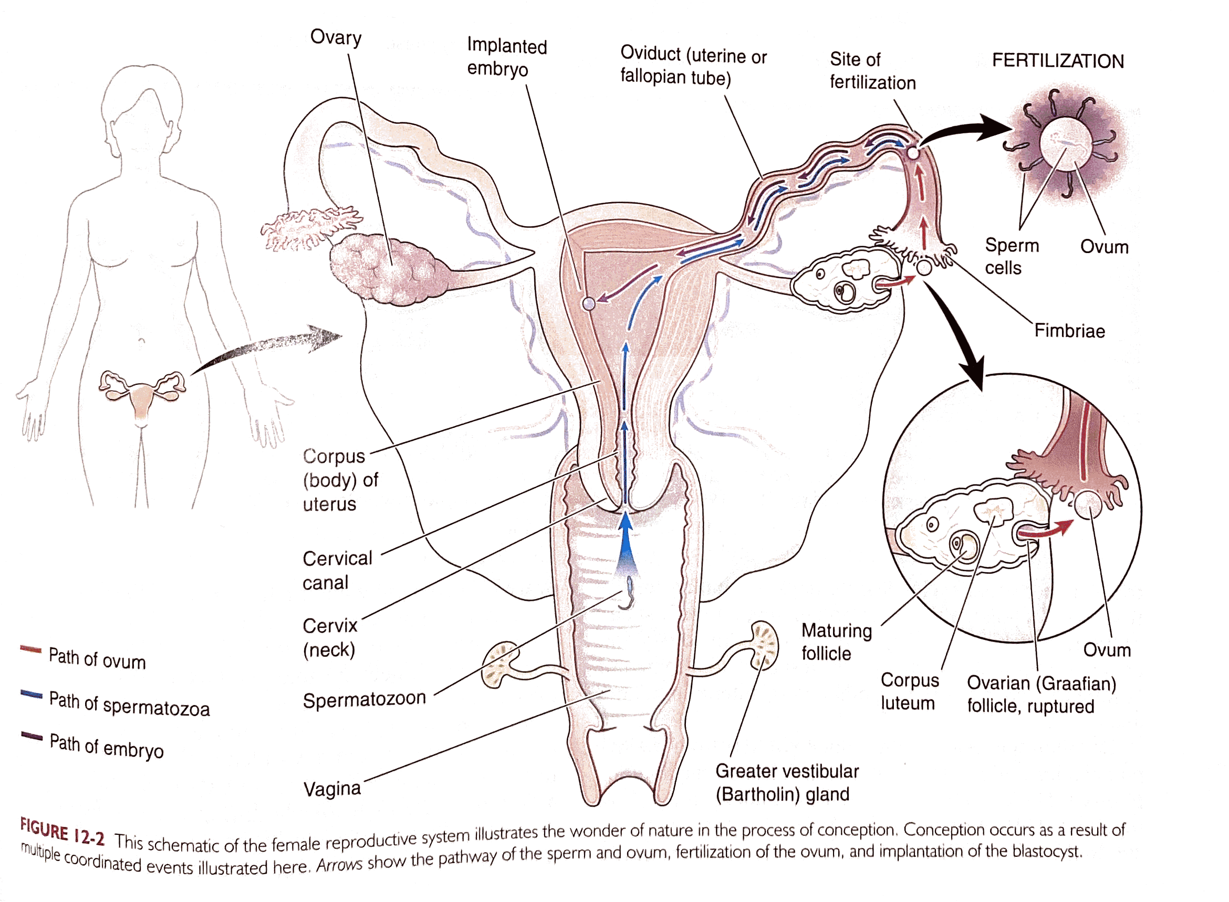
Fertilization
Fertilization in the ampulla
Sperm + Ovum = Zygote
  Sperm and ovum are gametes
    23 chromosomes
  Zygote
    46 chromosomes
  Embryo
    Product of zygote division - 8 weeks
Fertile window
  2-3 days prior to ovulation to 12-24 hours after ovulation.
  Sperm can survive up to 3 days
Notes:
Image credit: page 265 (Stephenson & Dmitrieva, 2018)
References: 1

Slide 5
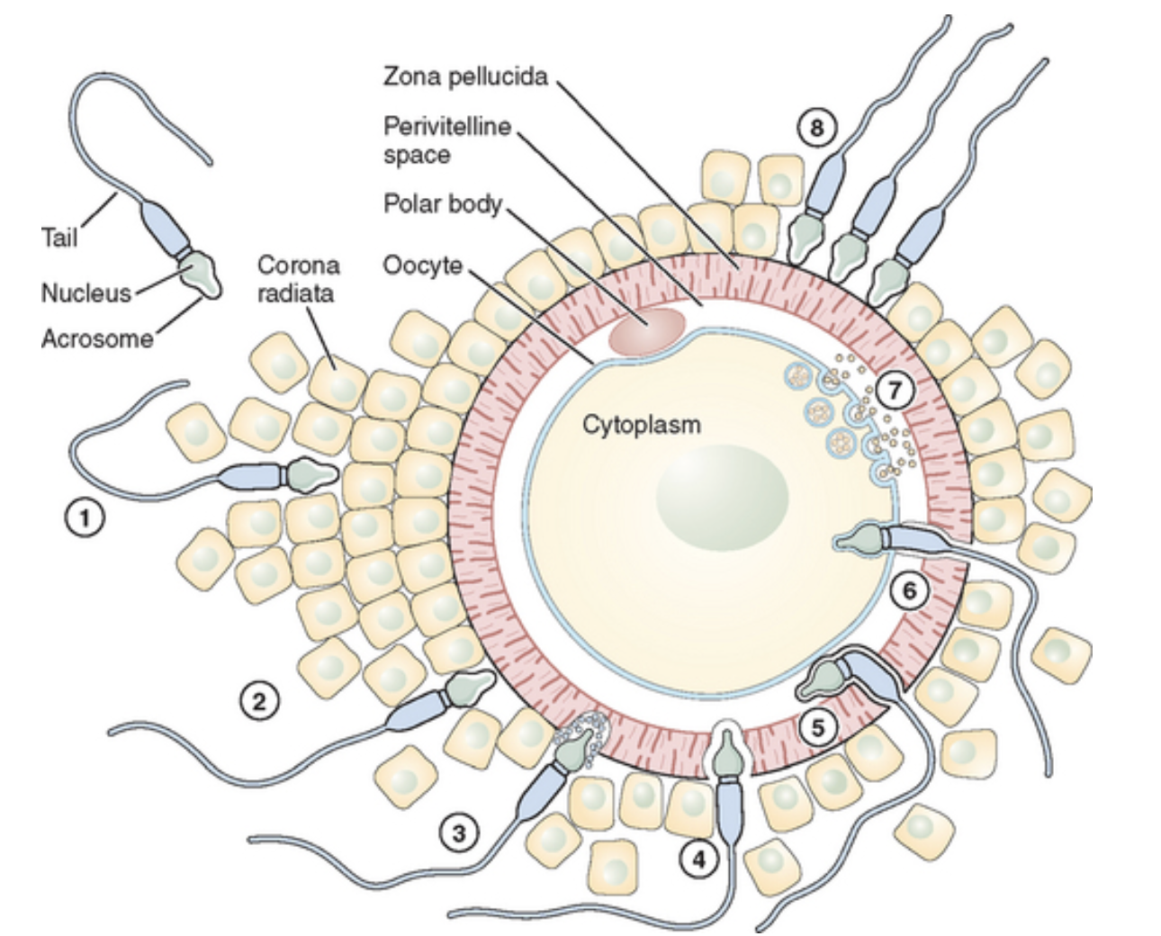
Fertilization
Zona pellucida: thick, protective layer surrounding the ovum
One sperm penetrates the zona pellucida and fuses to the plasma membrane of the ovum
Fertilized egg (aka zygote or conceptus)
Zona pellucida persists and blocks other sperm from reaching the ovum
Notes:
Image credit: https://abdominalkey.com/normal-fertilization-and-implantation/
Reference: 2

Slide 6
Age Considerations
Conceptual age
  Age of pregnancy relative to the time of fertilization
  aka embryonic age or postovulatory age
  Fertile window can be up to 4 days so time of fertilization is difficult to determine
Gestational age
  Age of pregnancy relative to the first day of the LMP
  aka menstrual age
  Beginning of menstruation is easily observable and roughly 2 weeks before fertile window
  Full term pregnancy = LMP + 280 days = 40 weeks
Notes:
Reference: 3. page 333-334 (Stephenson & Dmitrieva, 2018)

Slide 7
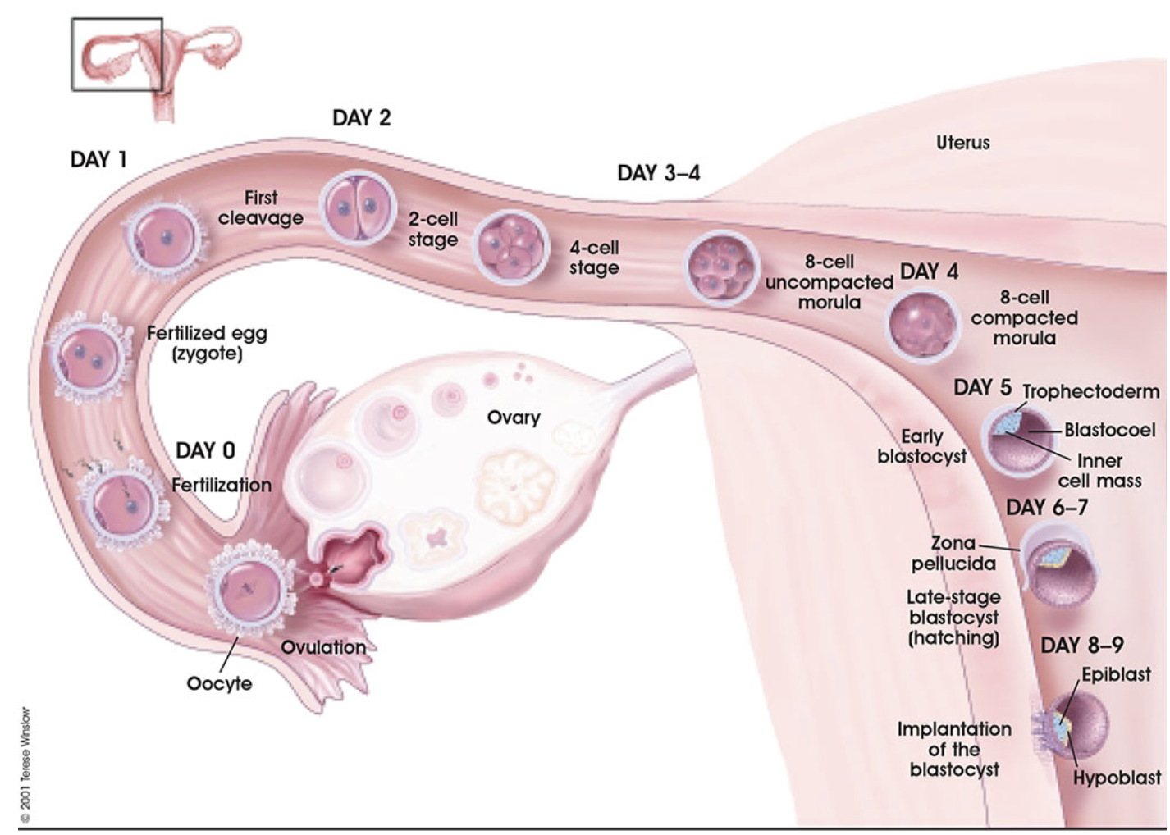
Early Embryonic Development
Zygote undergoes cleavage as it travels from the ampulla to the uterus
  Solid cluster of cells called a morula
Morula size is restricted due to the surrounding zona pellucida
  Compaction of cells → organization of the morula into a blastocyst
Notes:
Image credit: https://embryology.med.unsw.edu.au/embryology/index.php/Implantation
Reference: 4

Slide 8
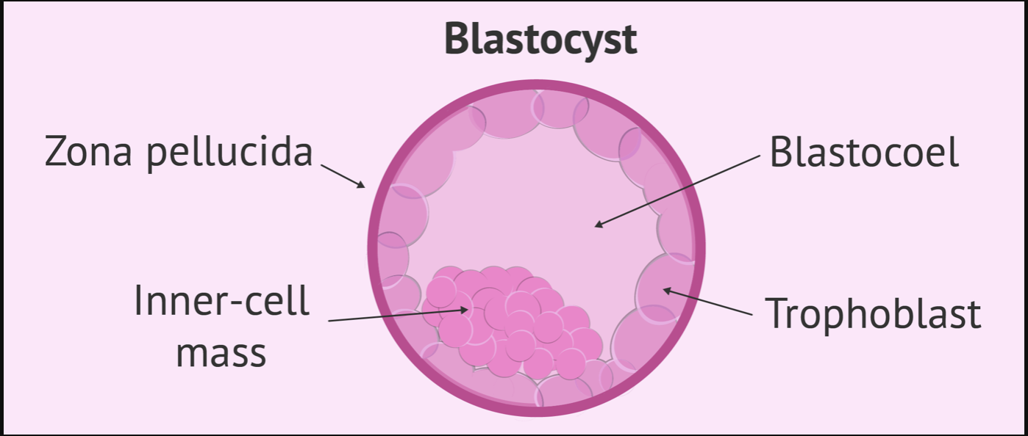
Early Embryonic Development
Blastocyst:
  Trophoblast
    Outer layer of cells
    Becomes part of the placenta
  Blastocele
    Cavity filled with nutritive fluid secretions
  Embryoblast
    Inner cell mass
    Becomes the embryo
      Ectoderm, mesoderm, endoderm
Hatch from zona pellucida → implantation
Notes:
Image credit (embryological development): https://embryology.med.unsw.edu.au/embryology/index.php/Implantation
Image credit (blastocyst): https://babygest.com/en/definition-of-cygote-embryo-and-fetus/blastocyst-development/
Reference: 4
Additional animation: https://embryology.med.unsw.edu.au/embryology/images/a/ae/Human_blastocyst_day_3-6.mp4

Slide 9
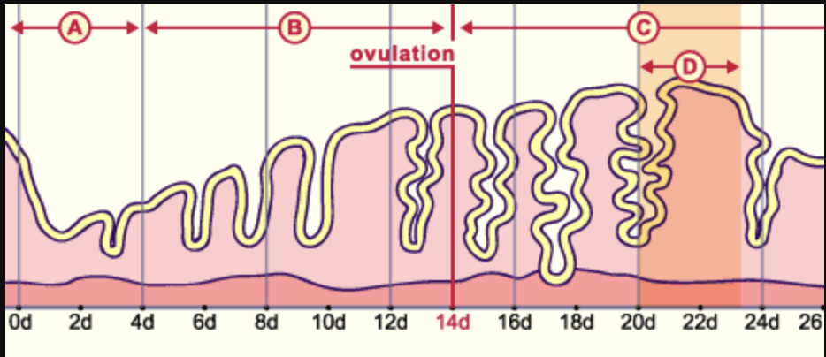
Implantation
Implantation window
  Begins ~ 6 days following fertilization
  Elevated progesterone drives decidualization of endometrial tissue
  Complete by day 11-12 (GA 3w4d)
Notes:
Image credit: http://www.embryology.ch/anglais/gnidation/etape02.html
Reference: 4, 5, 6

Slide 10
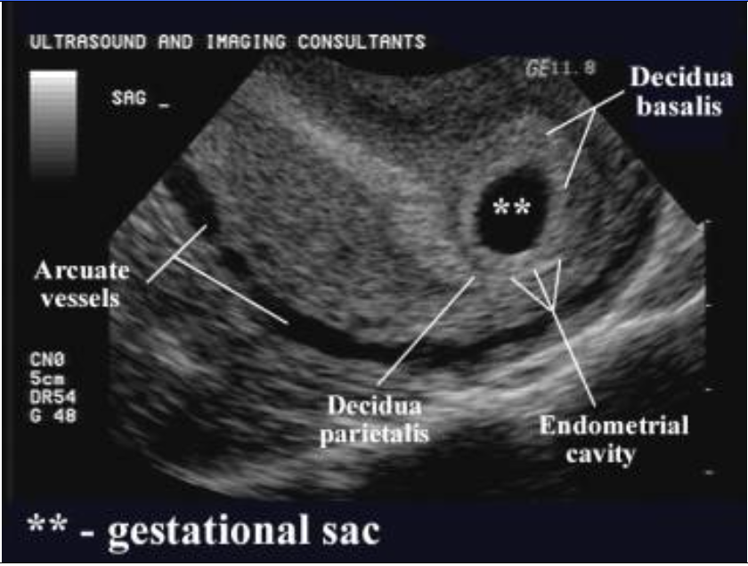
Implantation
Decidualization:
  Morphological changes of the endometrium to support and nourish an embryo
  Secretory phase then accelerated following implantation
  Endometrium differentiates into three layers:
    Decidua basalis → maternal component of placenta
    Decidua capsularis
    Decidua parietalis (vera)
Image: Uterus GA 3w6d
Notes:
Image credit: http://www.fetalultrasound.com/online/text/Anatomy%20-%20First%20Trimester.htm
References: 5, 6

Slide 11
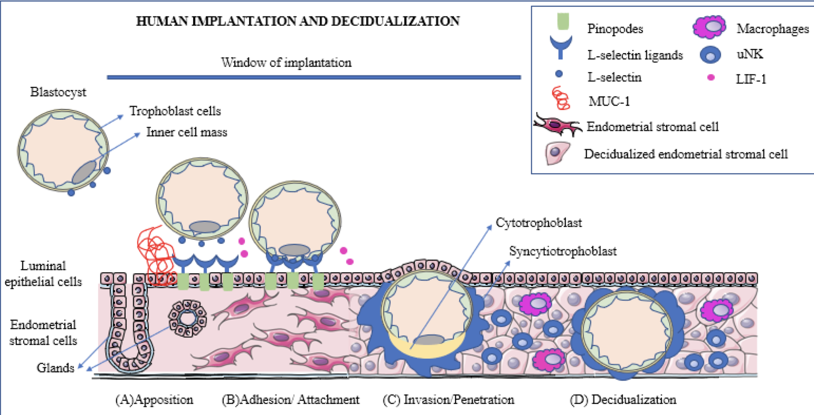
Implantation
Trophoblast cells differentiate
  Syncytiotrophoblast (outer layer)
    Secrete:
      Human chorionic gonadotropin (hCG)
        Maintain corpus luteum and decidualization
      Lytic enzymes
        Facilitate burrowing into the endometrium and access to maternal blood
    Finger-like projections infiltrate the endometrium
  Cytotrophoblast (inner layer)
    Contributes to the chorionic sac (gestational sac)
Notes:
Image source: https://www.mdpi.com/1422-0067/21/6/1973/htm
Reference: 3

Slide 12
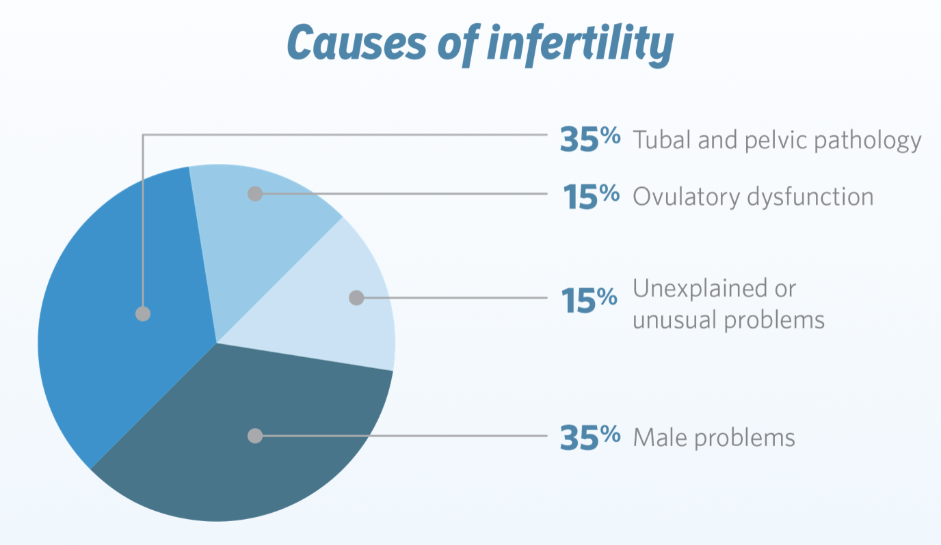
Fertility
Factors affecting conception
  Males and females
  Endocrine dysfunction
    Stress, trauma
    Health issue
  Functional issues
    Obstructive and nonobstructive
  Decreased availability of gametes
Notes:
Image source: https://www.ferringfertility.com/thinking-about-ivf/why-start-now/

Slide 13
References
Trying to conceive. Office on Women's Health. (2018). Retrieved 9 January 2021, from https://www.womenshealth.gov/pregnancy/you-get-pregnant/trying-conceive
Neri, Q. V., Lee, B., Rosenwaks, Z., Machaca, K., & Palermo, G. D. (2014). Understanding fertilization through intracytoplasmic sperm injection (ICSI). Cell calcium, 55(1), 24–37. https://doi.org/10.1016/j.ceca.2013.10.006
Stephenson, S. and Dmitrieva, J., 2018. Diagnostic Medical Sonography: Obstetrics & Gynecology. 4th ed. Philadelphia: Wolters Kluwer, pp.265-339.
Early development. (2021). Retrieved 9 January 2021, from http://www.embryology.ch/anglais/fplacenta/fecond01.html
Reed BG, Carr BR. The Normal Menstrual Cycle and the Control of Ovulation. [Updated 2018 Aug 5]. In: Feingold KR, Anawalt B, Boyce A, et al., editors. Endotext [Internet]. South Dartmouth (MA): MDText.com, Inc.; 2000-. Available from: https://www.ncbi.nlm.nih.gov/books/NBK279054/
Okada, H., Tsuzuki, T., & Murata, H. (2018). Decidualization of the human endometrium. Reproductive medicine and biology, 17(3), 220–227. https://doi.org/10.1002/rmb2.12088

