Slide 1
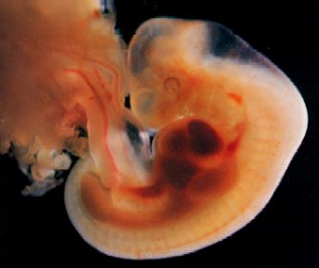
Umbilical cord development
DMS 401: OB Sonography
By: Syeda Shah

Slide 2
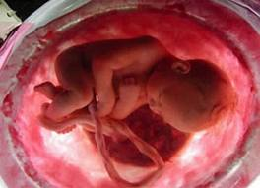
Umbilical Cord
Composed of 2 arteries and one vein coated with “Whartman’s Jelly” that strengthens and protects the cord.
Connects fetus at the umbilical ring to the maternal blood supply through placenta
Carries nutrients and oxygen, takes away the waste through membranous exchange.
http://www.baby2see.com/development/first_trimester.html

Slide 3
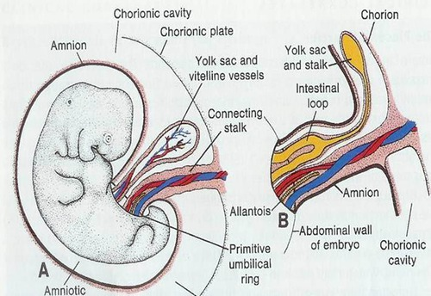
Umbilical Cord Development
Umbilical cord is derived from the Allantois and stalk of the Yolk Sac.
It is covered with single layer of amniotic epithelium.
Average length of the cord is 51.5 cm to 61cm. Mean circumference is ~3.8cm
Does not have any nerves.
http://quizlet.com/24794821/s2-mini3-placental-development-flash-cards/

Slide 4
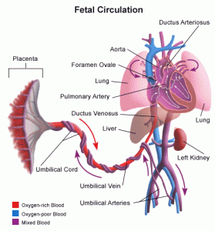
Umbilical Vein Brings Oxygen rich blood to the fetus
Umbilical Arteries carry oxygen poor blood back to the placenta
Three fetal bypasses
1- Foramen Ovale
2- Ductus Arteriosus
3- Ductus Venosus
http://www.stanfordchildrens.org/en/topic/default?id=blood-circulation-in-the-fetus-and-newborn-90-P02362

Slide 5
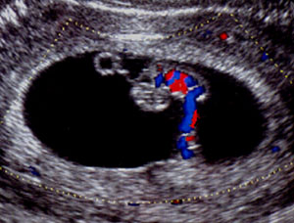
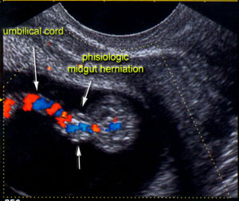
Normal sonographic appearance
Forms around 7th week. Sonographically best visualized late 2nd and early 3rd trimester
8+5 week embryo with umbilical cord
http://sonoworld.com/Client/Fetus/html/11-14week/chapter-04/chapter-04-final.htm

Slide 6
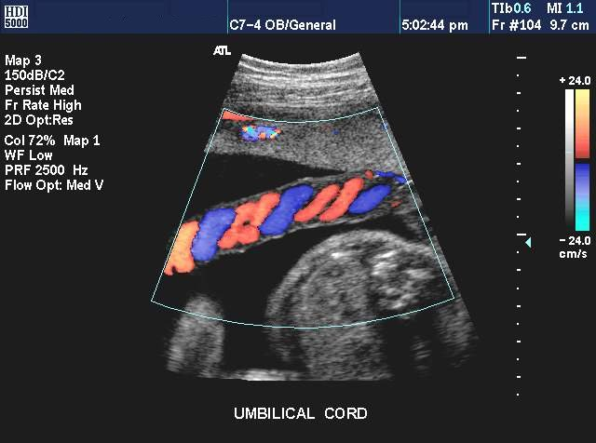
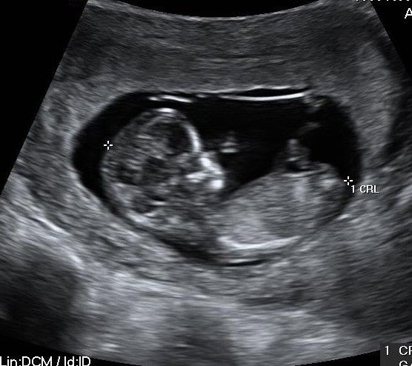
Normal sonographic appearance
http://www.hdi5000ultrasound.com/hdi-5000-specs/
“Stack of Coins Sign”

Slide 7
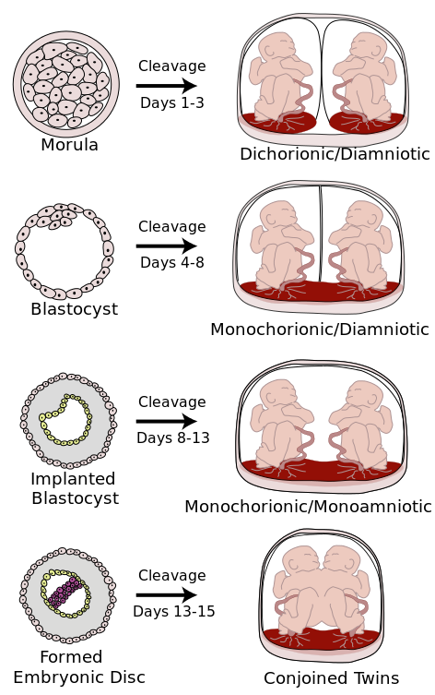
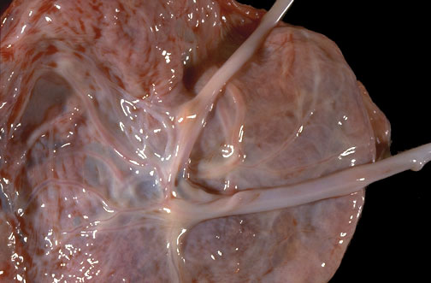
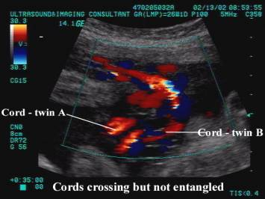
Umbilical Cords in twins
http://library.med.utah.edu/WebPath/PLACHTML/PLAC075.html
http://upload.wikimedia.org/wikipedia/commons/9/93/Placentation.svg

Slide 8
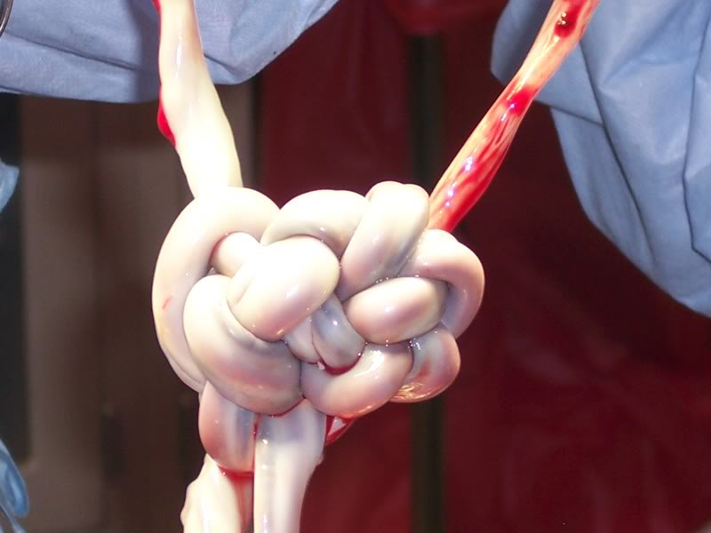
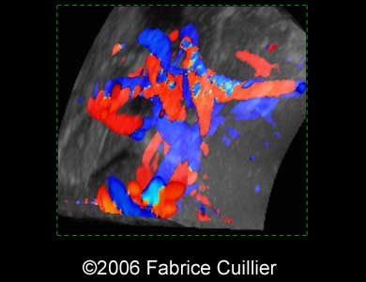
Umbilical Cords in twins
Monoamniotic twins should be evaluated to rule out any entanglement of umbilical cord.
Color and spectral Doppler evaluation of umbilical vein
Narrowing of cord with disappearing outer “Wharton’s jelly” should not be ignored
http://www.babymed.com/monozygotic-monoamniotic-monochorionic-mono-mono-dizygotic-dichorionic-twins http://sonoworld.com/Client/Fetus/page.aspx?id=1979

Slide 9
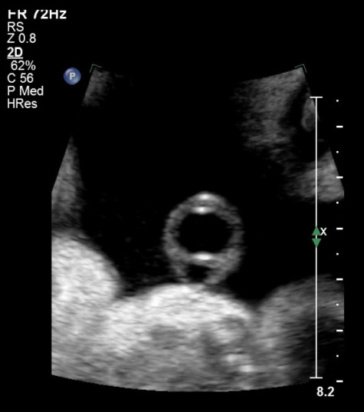
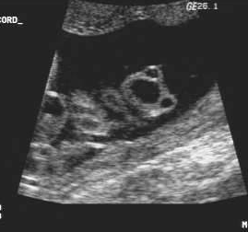
Two vessel umbilical cord
http://www.pregnancy-bliss.co.uk/SUA_and_multiple_soft_markers.html
Single Vessel Umbilical Cord has only one artery and one vein. It has been linked with IUGR (Intra Uterine Growth Restriction). Occurrence has noted to be one in 100 pregnancy. In a controlled group data collection, mortality with single umbilical artery is about 4 times greater.
Normal three vessel cord

Slide 10
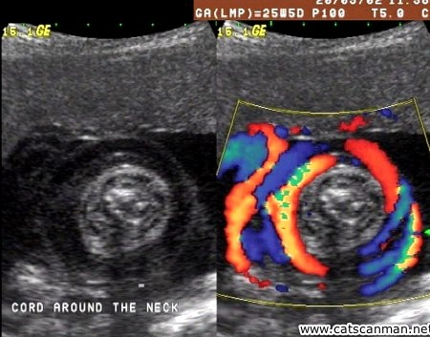
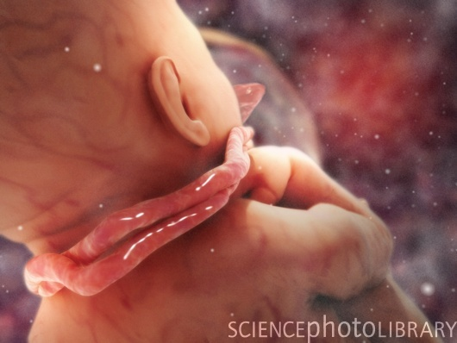
Nuchal Cord
Loosely looped Cord is clinically insignificant but multiple loops and tightly looped cord can present serious issues like decreased fetal breathing, impaired fetal activity, and low birth weight.
http://quizlet.com/28655941/ob-sonography-midterm-flash-cards/
Color Doppler is more sensitive in detecting nuchal cord.
http://st301260.sitekno.com/page/28946/umbilical-cord-complications.html

Slide 11
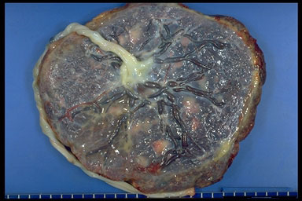
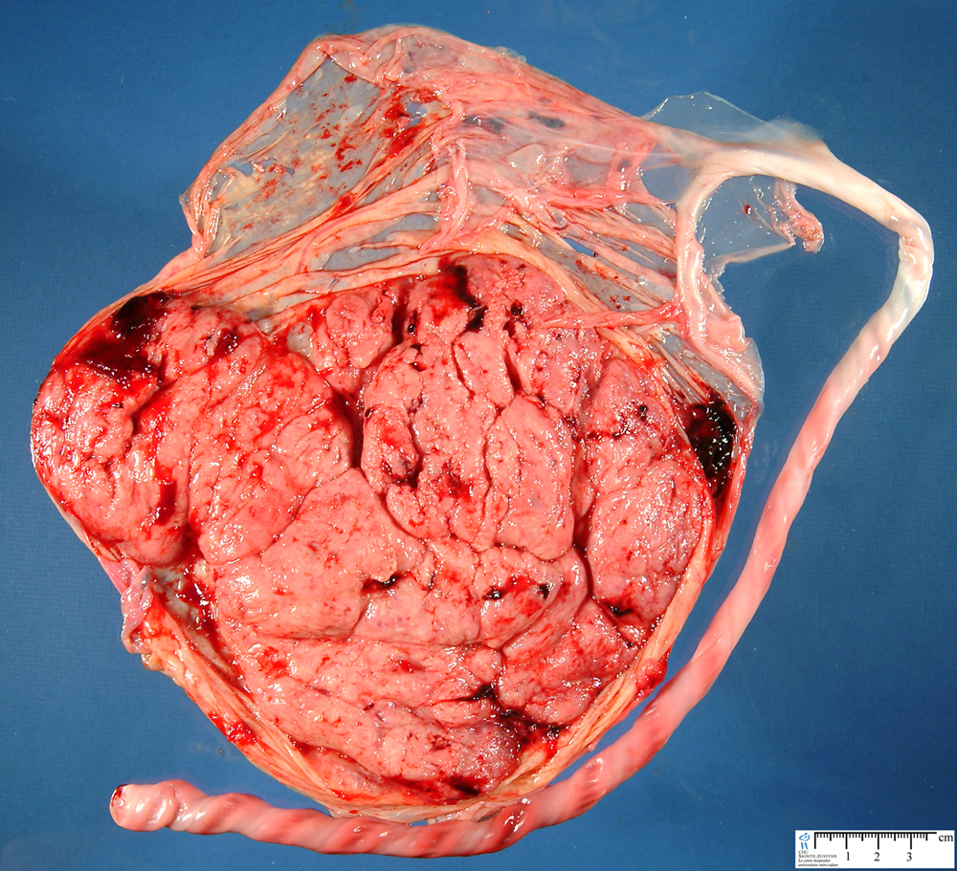
Velamentous insertion
Abnormalities of cord insertion. Insertion site may only be covered by membranes, no Wharton’s Jelly. It makes is more vulnerable to abnormalities.
http://showcase.netins.net/web/placenta/triage.php
http://www.humpath.com/spip.php?article10383

Slide 12
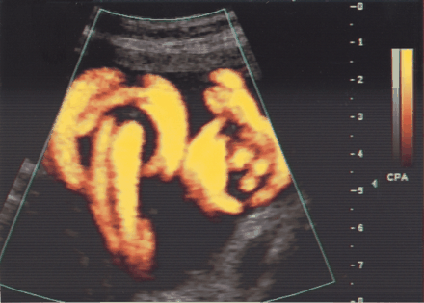
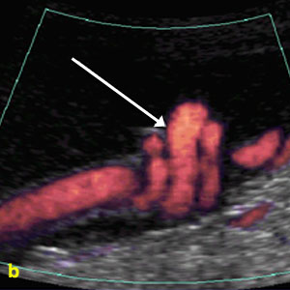
True Knots
A true knot in umbilical cord can be identified as “hanging noose sign”
Spectral Doppler to assess venous and arterial congestion
Decreased fetal activity, abnormal fetal heart rate (FHR)
Smoking or drug use, carrying multiples and polyhydramniose can add likelihood occurrence.
http://www.jultrasoundmed.org/content/24/9/1321/F1.expansion
http://sonoworld.com/Client/Fetus/html/doppler/capitulos-html/chapter_13.htm

Slide 13
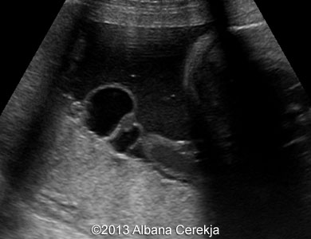
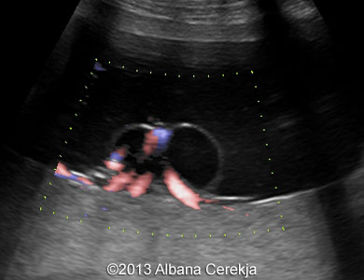
Umbilical cord cyst
Pseudo cysts are avascular umbilical cord cyst, near placental attachment are derived from allantois and omphalomesenteric duct. Single cyst usually has good prognosis.
Multiple cysts, presence of other abnormalities, and persistence during 2nd and 3rd trimester can raise concerns. Linked with karyotypic abnormalities like trisomy 18.
If cysts become larger can compress umbilical arteries and impair growth.
http://sonoworld.com/fetus/page.aspx?id=3392
http://sonoworld.com/fetus/page.aspx?id=3392

Slide 14
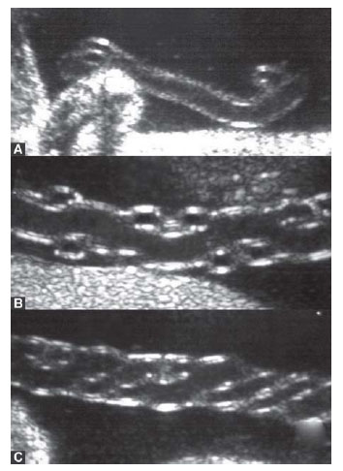
Coiling patterns
A: Hypocoiled B: Normocoiled C: Hypercoiled
Normal coiling pattern is 1 coil up to per 5cm of cord length. Under coiling related to decreased fetal heart rate. Over coiling can result in slowing of blood flow.
Not enough research to establish any known abnormalities but in future studies might look deeper into appropriate coiling pattern and gestational mortality rate.
http://www.jaypeejournals.com/eJournals/ShowText.aspx?ID=257&Type=FREE&TYP=TOP&IN=_eJournals/images/JPLOGO.gif&IID=29&isPDF=NO

Slide 15
Absence of Umbilical Cord
Agenesis of umbilical cord (acordia)
Very short chord
Associated with limb-body wall complex
Linked to Cocaine abuse by mother
Extra embryonic membranous sac

Slide 16
Additional Pathology
Umbilical vein thrombosis: echogenic material within lumen
Umbilical hernia: protrusion of abdominal content into the cord
Omphalocele: protrusion of abdominal structure into the cord
Stricture: localized narrowing of the cord
Hemangioma: solid mass, benign tumor
Hematoma: rare, results from rupture of umbilical vein
Teratoma: rare, germ cell tumor
Text book: page 412

Slide 17
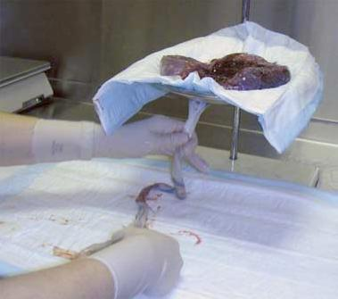
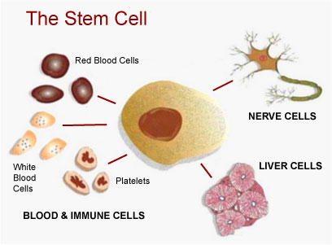
Research: Umbilical Cord Blood
Umbilical Cord blood is rich in valuable stem cells.
High number of hematopoietic progenitors and high proliferative capacity.
Have been effectively used to treat blood related disorders like leukemia and bone marrow disorders.
Positive: Low-cost, low risk of developing graft-vs-host rejection (low aminoreactivity), ethically less controversial
Negative: More research needed, insufficient number of cells, delay in reconstitution, and increased risk of genetic disease.
http://biomed.brown.edu/Courses/BI108/BI108_2007_Groups/group03/sources.html
http://stemcellbank.org.ua/kak-soxranit-pupovinnuyu-krov-vashego-rebenka/?lang=en

Slide 18
Useful resources
http://www.baby2see.com/development/first_trimester.html
https://www.khanacademy.org/science/health-and-medicine/circulatory-system/fetal-circulation/v/umbilical-vessels-and-the-ductus-venosus
http://www.embryology.ch/anglais/fplacenta/cordon01.html

Slide 19
Refrences
Bellotti M. Pennati G. Gasperi C. Battaglia F. Ferrazi E. (September 2000) Role of ductus venosus in distribution of umbilical blood flow in human fetuses during second half of pregnancy. American Journal of Physiology - Heart and Circulatory Physiology Published 1 Vol. 279no. 3,H1256-H1263
http://ajpheart.physiology.org/content/279/3/H1256
Burlacu A. (2012) Umbilical Cord blood: Medical waste or Important Source of Stem Genet Embryol S2:005. doi: 10.4172/2161-0436. S2-005
http://omicsonline.org/umbilical-cord-blood-medical-waste-or-important-source-of-stem-cells-2161-0436.S2-005.pdf
Predanic, M. (April-June 2009) Sonographic Assessment of Umbilical Cord. Jaypee Journals 3(2):48-57
http://www.jaypeejournals.com/eJournals/ShowText.aspx?ID=257&Type=FREE&TYP=TOP&IN=_eJournals/images/JPLOGO.gif&IID=29&isPDF=NO
Sonographic Assessment of Umbilical Cord. 2014. Retrieved October 10, 2014.
https://iame.com/online/umbilical/content.php
Stephenson, S. Diagnostic Medical Sonography. Obstetrics and Gynecology. China: Walter Kluwer Health Lippincott Williams and Wilkins, 2012. Print.

