Slide 1

Fetal Thorax

Slide 2
Before You Begin!
Remember to check:
  Cardiac activity
  Amniotic fluid levels
  Cervix
  Fetal situs
    Use fetal lie to determine situs
    Heart and stomach should be left sided

Slide 3
What Will I Look For?
Symmetry
Bony Parts
  Ribs, spine, etc.
Esophagus
Trachea
Diaphragm
Lungs
Heart

Slide 4
Symmetry of the Thoracic Cavity
Does the chest look relatively symmetrical?
Are the ribs even all the way around?
Are the lungs relatively even?
If not, this indicates an issue.

Slide 5
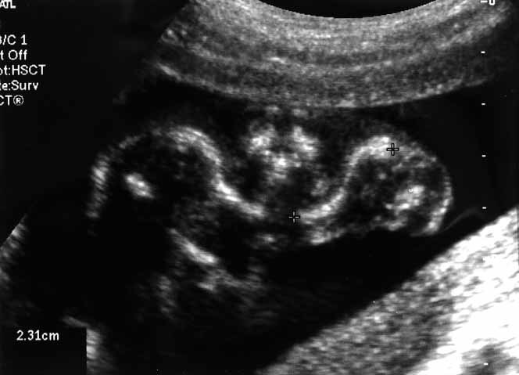
Fetal Boney Bits!
Thoracic Bony Parts:
  Ribs, clavicles, scapulae, spine, sternum
Visualized as hyperechoic structures after ossification
Ossification occurs at:
Clavicles (S Shapes in image) | 8 Weeks
Scapulae | 10 Weeks
Sternum | 21-27 Weeks

Slide 6
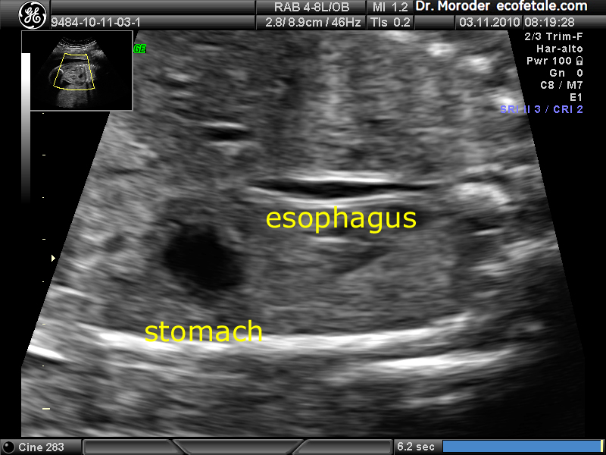
Fetal Esophagus
  Anechoic tube that disappears/collapses when the fetus swallows amniotic fluid
    Swallowing provides clues to a fetus’ mental capabilities.
    Absence of swallowing indicates an issue and can explain polyhydramnios.

Slide 7
Fetal Trachea
To view the fetal trachea in transverse:
  First, find the 4 chamber heart view => Then sweep superior
      Structures visualized:
      Thymus can be seen!
        Absence or hypoplastic thymus indicates an issue
      Pulmonary Artery and AO make a “V”
      Superior Vena Cava
      Trachea
        Identifying trachea can rule out tracheal agenesis
        This view can help rule out some heart anomalies

Slide 8
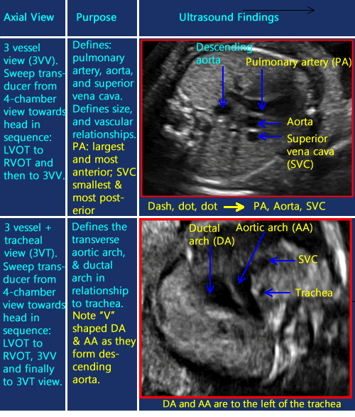
Fetal Trachea

Slide 9
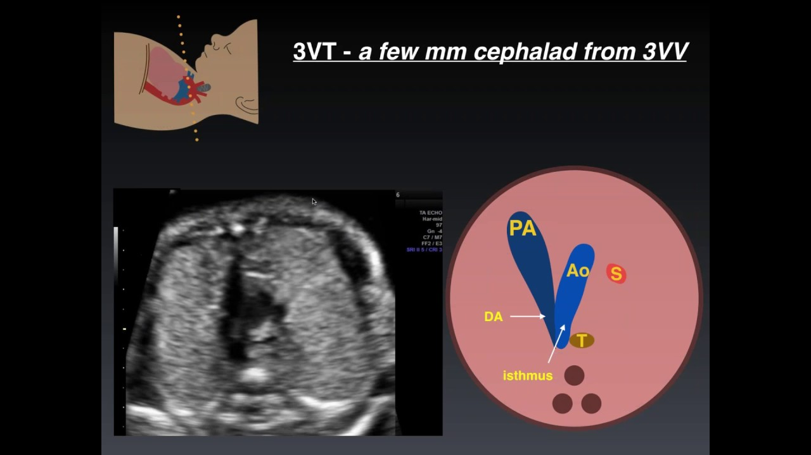
Fetal Trachea

Slide 10
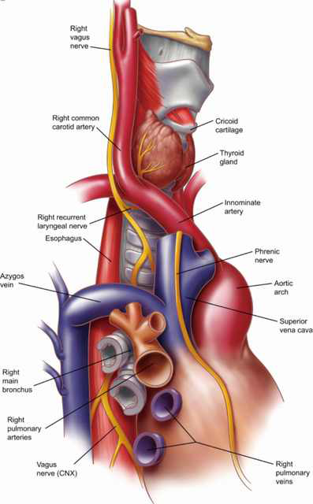
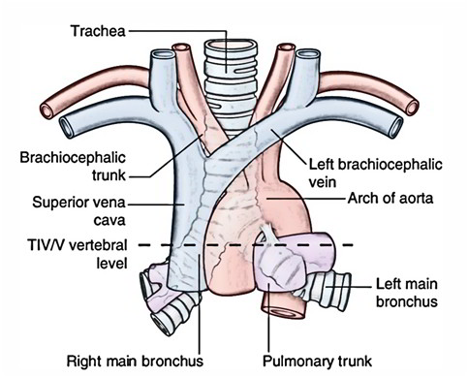
Trachea Gross Anatomy

Slide 11
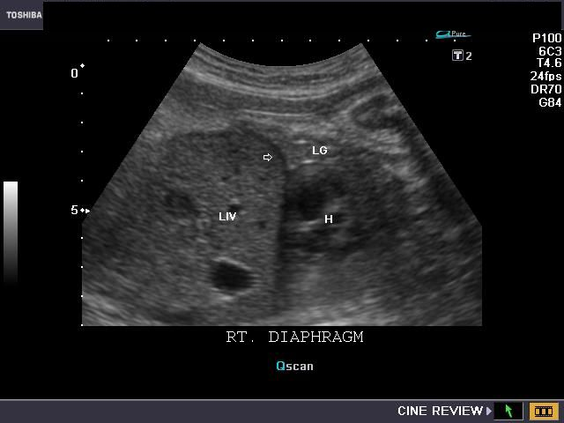
Fetal Diaphragm
  Sonographic Appearance:
Dome shaped and smooth
  Nothing unexpected should be traveling though
  Look for herniation
Hypoechoic (the opposite of adults)
Inferior to heart/lungs and superior to stomach/liver

Slide 12
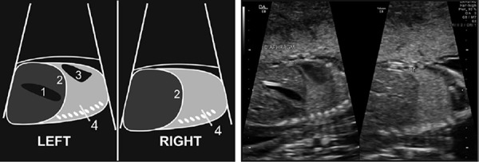
Fetal Diaphragm

Slide 13
Fetal Lungs
Sonographic Appearance
    They take up 2/3 of the thoracic cavity
    Moderate echogenicity that changes with age
  Breathing should be seen in the 2nd and 3rd trimesters
  Every ~20 minutes we should see a “seesaw” motion that increases in frequency with age. This is the beginning of lung coordination.

Slide 14
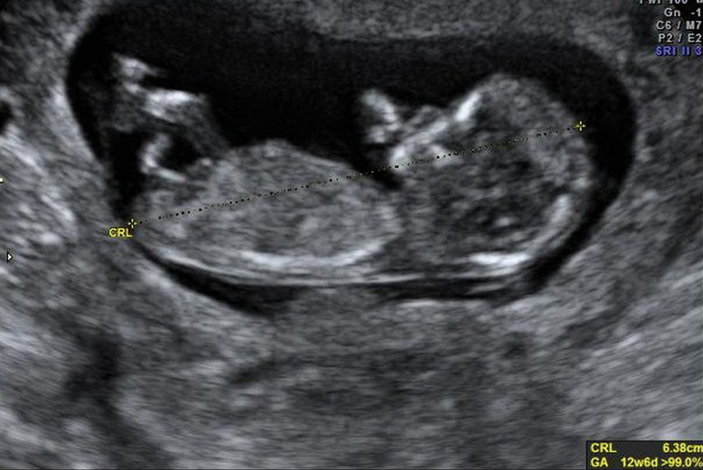
Lungs 1st Trimester

Slide 15
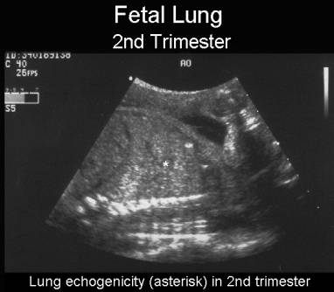
Lungs 2nd Trimester

Slide 16
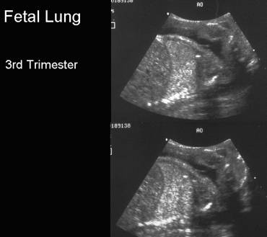
Lungs 3rd Trimester

Slide 17
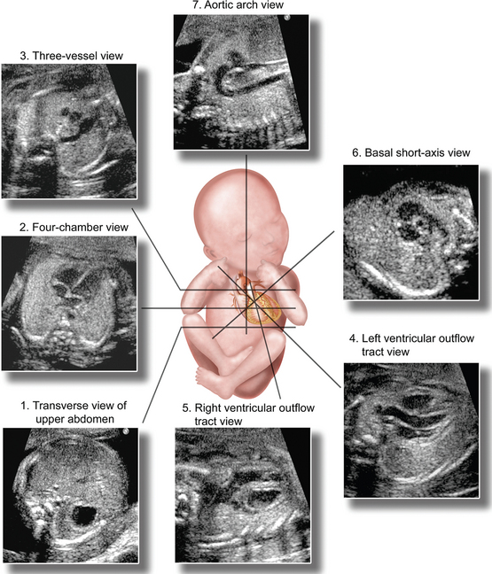
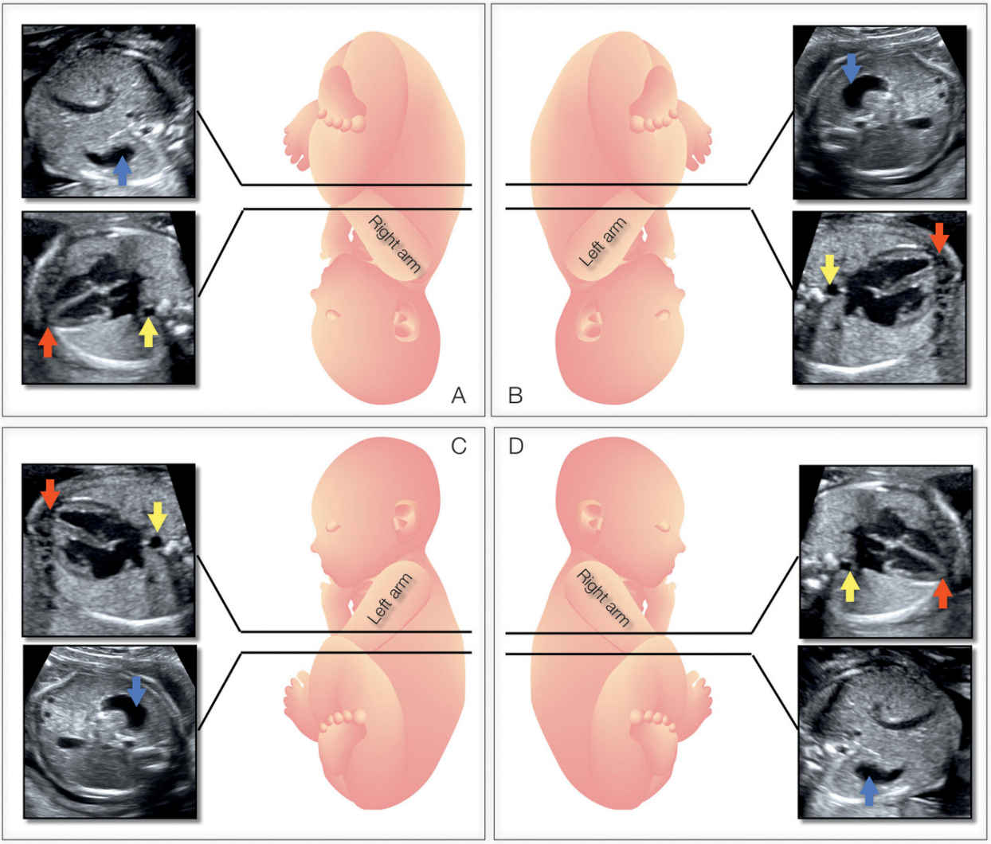
Fetal Heart
Sonographic Appearance
  Occupies1/3 of the thoracic cavity
  Rotated 45° left from midline

Slide 18
Cardiac:Lung Ratio
Lungs take up 2/3 of the thoracic cavity (~66%)
Heart takes up 1/3 of the thoracic cavity (~33%)
To obtain Cardiac:Lung Ratio:
  Measure the circumference of the heart where there is a 4 chamber view, at least 1 complete rib, and ossification centers of the spine
  Measure the circumference of the chest at this same level
    A normal ratio is 1:3
    This helps rule out a plethora of issues.

Slide 19
Summary
We looked at:
Symmetry
Bony Parts
  Ribs, spine, etc.
Esophagus
Trachea
Diaphragm
Lungs
Heart

Slide 20
References
Dr. Wilson, Cardiac Position [Audio blog post].
Dr. Wilson, Fetal Thorax [Audio blog post].
Stephenson, S. R., & Dmitrieva, J. (n.d.). Obstetrics and Gynecology Fourth Edition (4th ed.).
Journal: https://obgyn.onlinelibrary.wiley.com/doi/full/10.1002/uog.2670
Journal: https://www.ncbi.nlm.nih.gov/pmc/articles/PMC1590163/
https://fetus.ucsf.edu/cdh
https://onlinelibrary.wiley.com/doi/full/10.7863/ultra.34.5.853
https://radiologykey.com/ultrasound-evaluation-of-the-fetal-thorax/

