Slide 1
Fetal Cranium Conceptualized
By Raman Singh ♥️

Slide 2
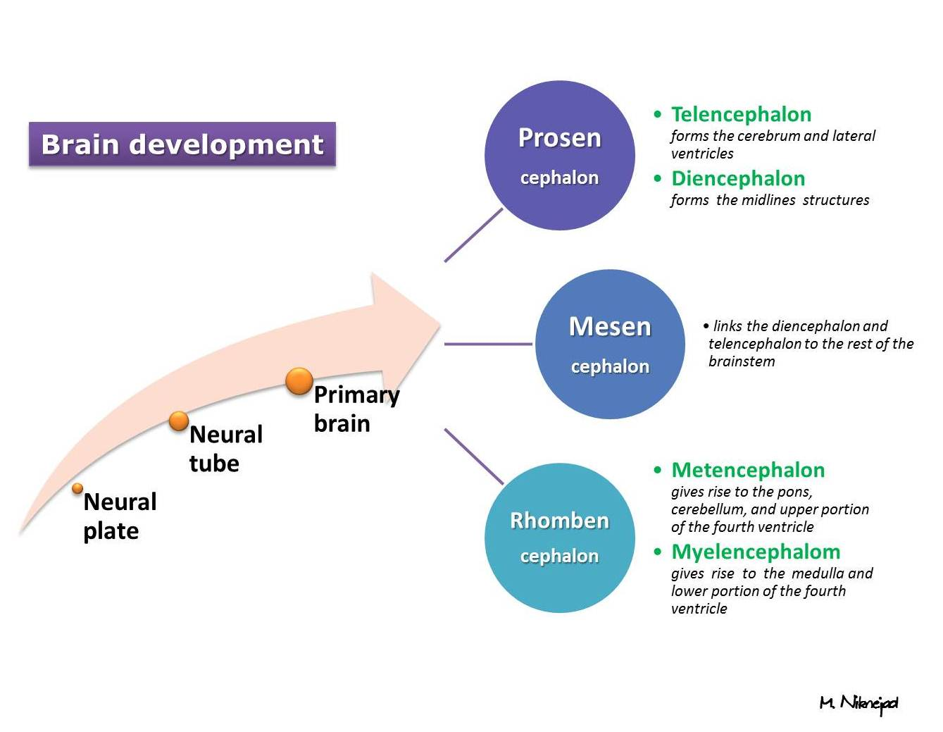
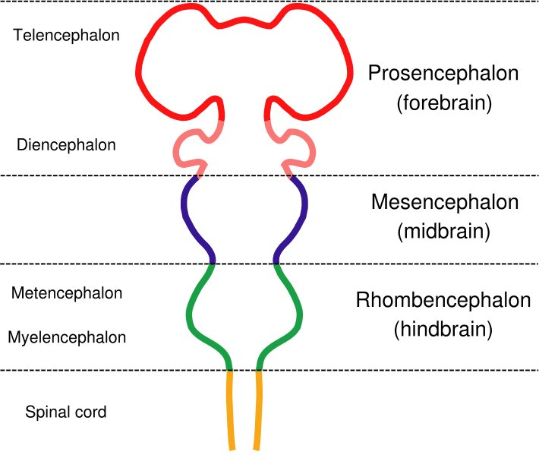
Embryology

Slide 3
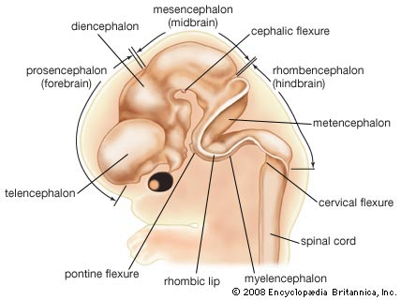

Slide 4
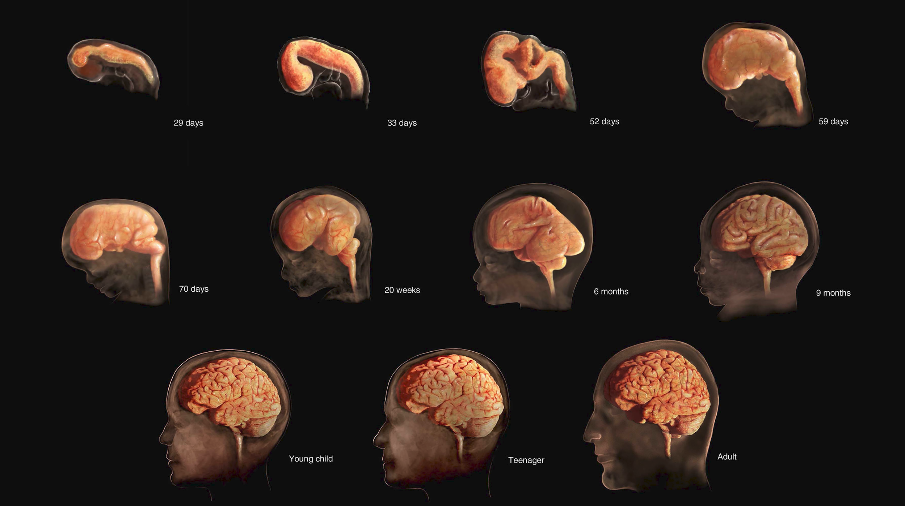

Slide 5
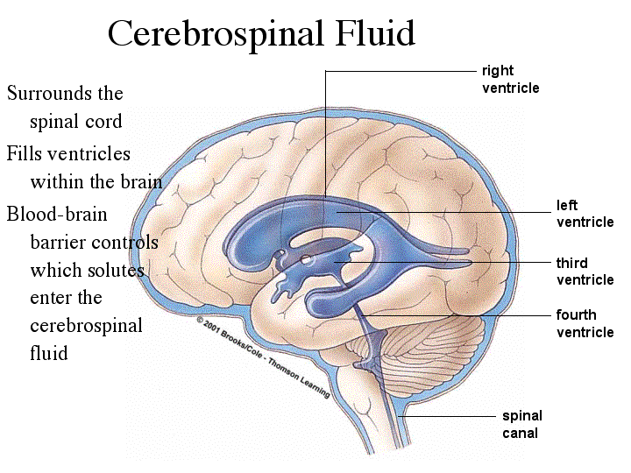
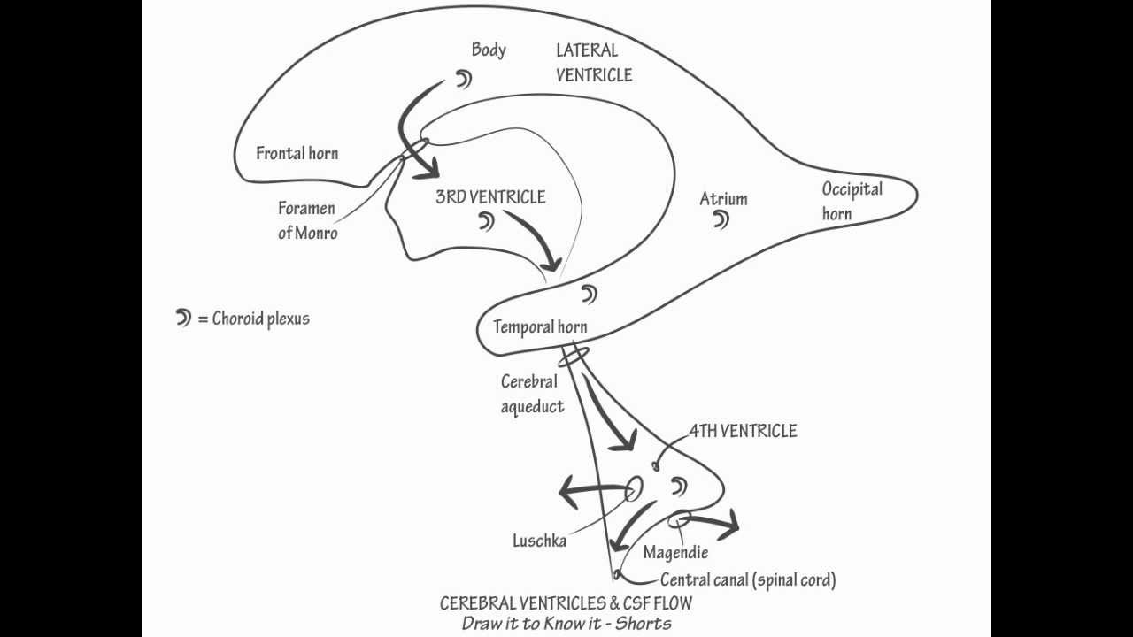
Ventricular System
Set of cavities responsible for the production, transport and removal of cerebrospinal fluid

Slide 6
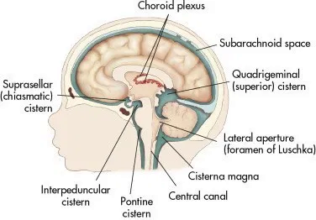
Choroid Plexus & Cisterna Magna
Choroid plexus= secretory tissue that produces cerebrospinal fluid
Cisterna Magna= contains cerebrospinal fluid and is located behind the cerebellum; communicates with the fourth ventricle via the foramina of Magendie and Luschka

Slide 7
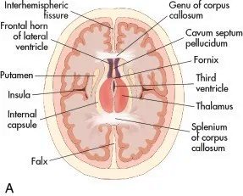
Thalami & Cavum Septum Pellucidum
Thalamus= forms upper and lateral walls of 3rd ventricle; acts as a relay station, filtering info b/w brain and body; regulation of consciousness, motor signals, etc.
Cavum Septum Pellucidum= potential cavity b/w septum pellucidum
Midline Falx= separates the two cerebral hemispheres

Slide 8
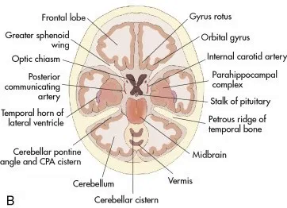
Cerebellum & Vermis
Cerebellum= coordination of voluntary movements, such as posture, balance, and speech
Vermis= separates cerebellum into two separate cerebellar hemispheres

Slide 9
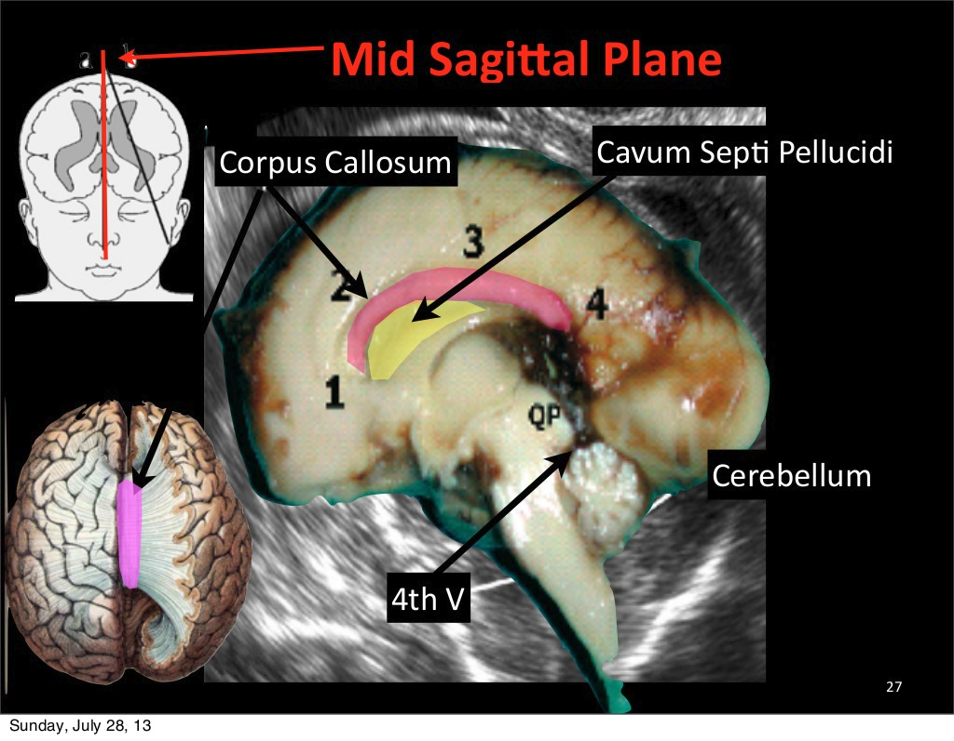

Slide 10
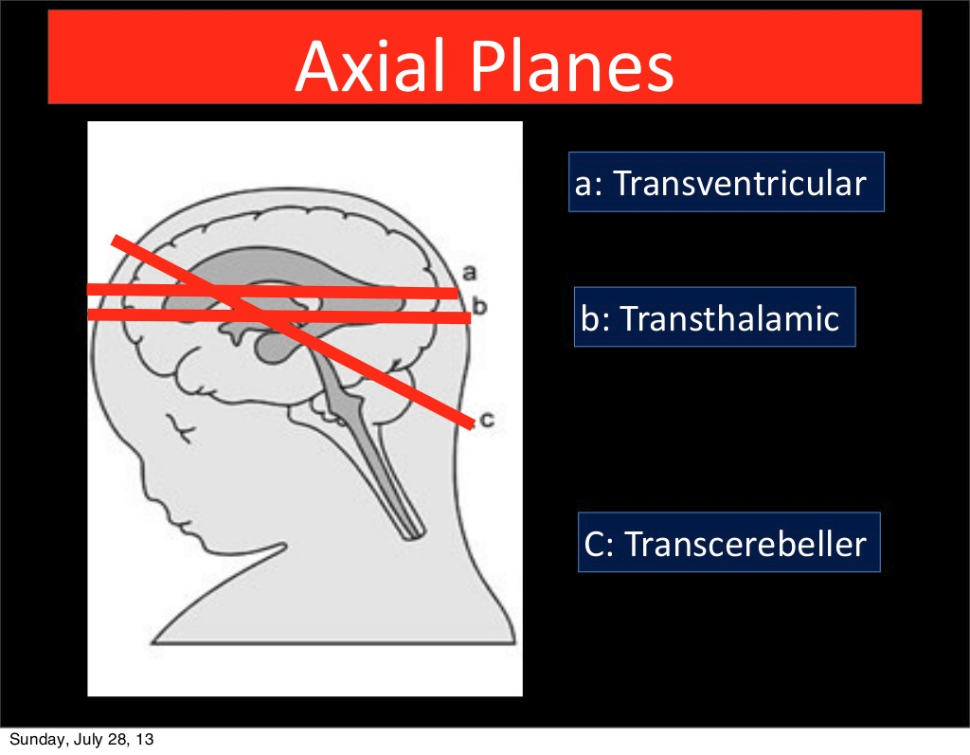

Slide 11
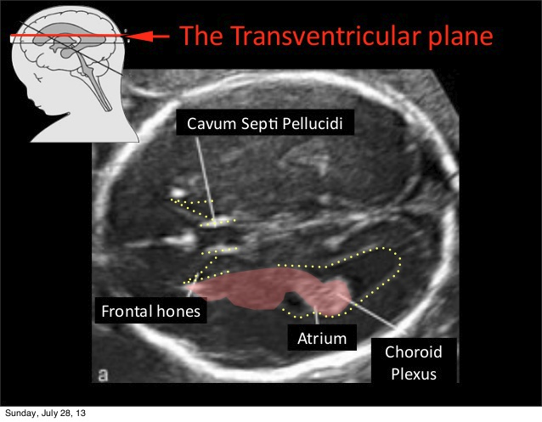

Slide 12
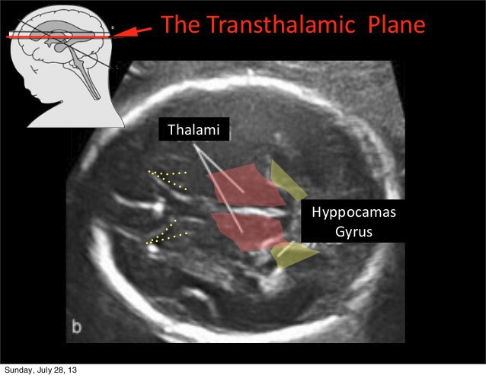

Slide 13
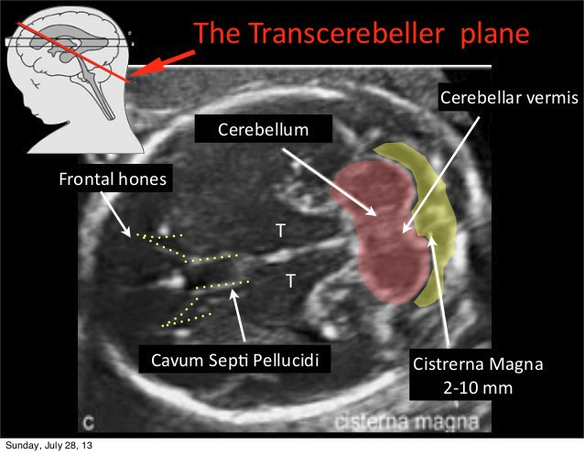

Slide 14
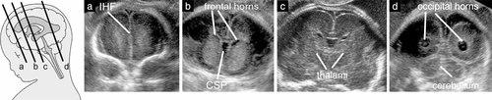
Coronal Views
From anterior to posterior: corpus callosum, ventricular system & interhemispheric relations
At anterior horns you can see interhemispheric fissure, corpus callosum, CSP, & third ventricle
Subarachnoid space is hypoechoic area between skull & cerebral cortex
Posteriorly, you see occipital horns
Last view is inferior to fourth ventricle & superior to cisterna magna

Slide 15
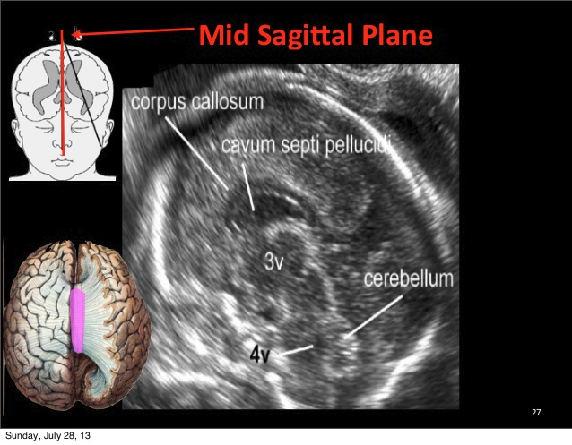
Sagittal Views
Semilunar structure
3 parts: Genu, body & splenium
Around corpus callosum are cingulate gyrus & CSP
Posterior fossa has cerebellum, fourth ventricle, & cisterna magna
Surface should be smooth in 2nd trimester & may be more echodense in 3rd trimester

Slide 16
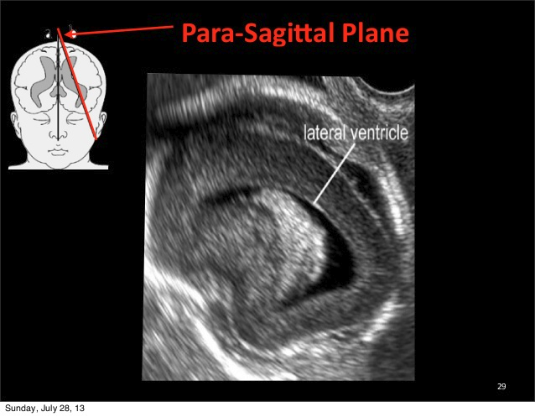
Parasagittal Views
Views from left or right of midline sagittal section
Used to evaluate anterior horns & bodies of the lateral ventricles
Caudothalamic Groove= bright echogenic arc separates caudate nucleus from thalamus
You may see germinal matrix, which is an abnormal finding
All parts of the lateral ventricles (body, anterior, posterior & temporal horns) are usually not seen; if they ARE seen there may be ventricular dilation

Slide 17
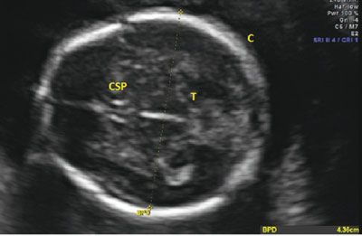
Biparietal Diameter
Measured at level of thalami & cavum septi pellucidum
Must be perpendicular to central axis of the head
We should NOT see cerebelleum
Position the cursors on the outer edge of proximal skull to the inner edge of distal skull

Slide 18
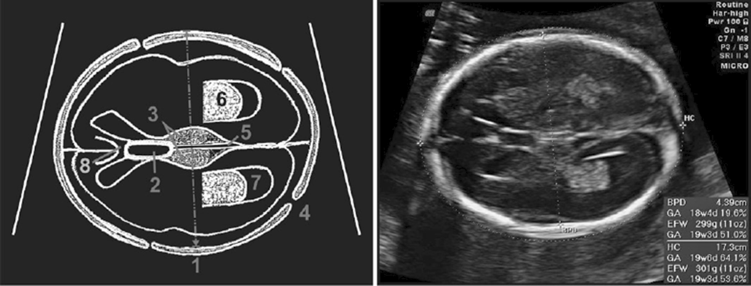
Axial Plane- BPD Level
Biparietal diameter (BPD)
Cavum Septum Pellucidum (CSP)
Thalami
Hypoechoic skull sutures
Third ventricle
Choroid
Post. lat. ventricles
Corpus callosum

Slide 19
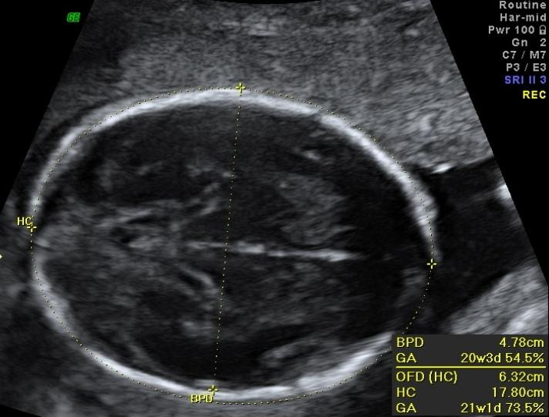
Head Circumference
Measured in same plane as the BPD
NO cerebellum
Use the ellipse tool
Macocephaly- large head; 2 to 3 standard deviations above
Microcephaly- small head; 2 to 3 standard deviations above

Slide 20
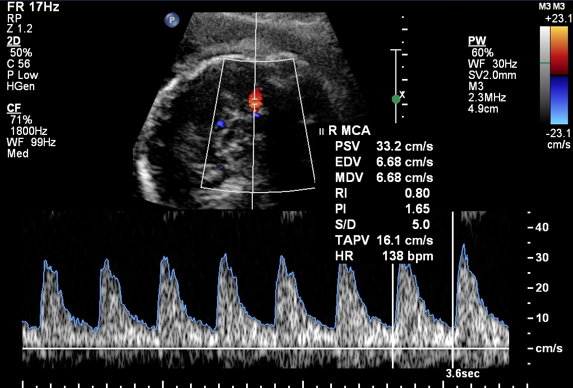
Middle Cerebral Artery
From BPD, move transducer towards base of skull until you see cerebral penducles
Doppler the MCA, which is found near base of skull
Measure closest to internal carotid artery & closest to uterine wall
Try to get <15 degrees angle of insonation & 2mm gate
High resistance flow

Slide 21
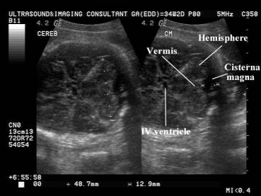
Cerebellar Level
Image cerebellum inferior to BPD
Echogenic vermis
2 nonechogenic hemispheres resembling a peanut
Measure the cisterna magna in AP, between the vermis and inner occipital bone
Measurement should NOT be less than 10mm

Slide 22
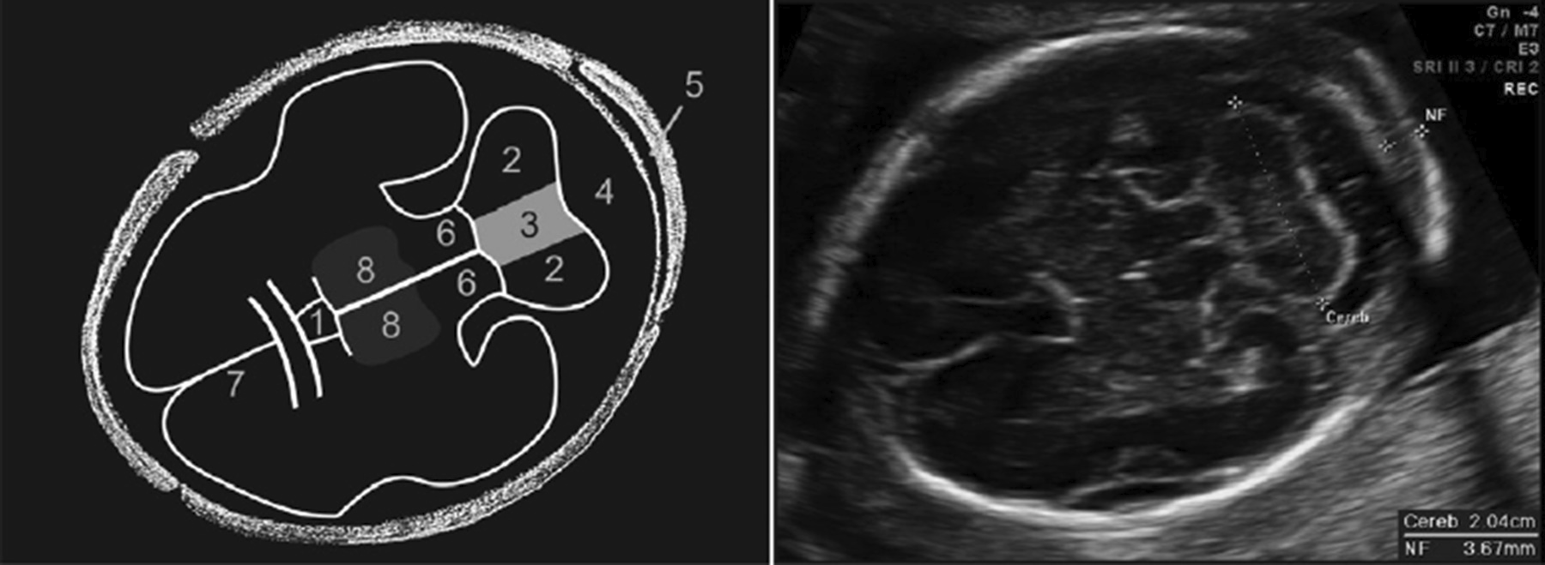
Axial Plane- Cerebellum Level
Cavum septum pellucidum (CSP)
Cerebellar lobes
Cerebellar vermis
Cisterna magna
Nuchal fold
Cerebellar peduncles
Falx
Thalami

Slide 23
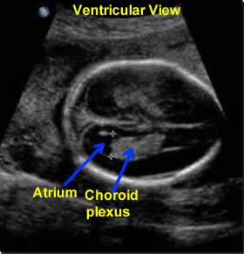
Lateral Ventricle Level
Lateral ventricles should be seen by 16 weeks
Choroid plexus will be echogenic
Show continuity of the atrium of lateral ventricle with occipital horn
Measure the widest diameter of atrium through the choroid plexus
Should NOT be more than 10mm

Slide 24
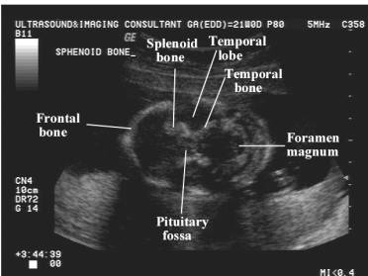
Base of the Skull
Echogenic “X” formed by lesser wings of sphenoid bone and petrous pyramid
Bony ridges mark anterior, middle & posterior fossa

Slide 25
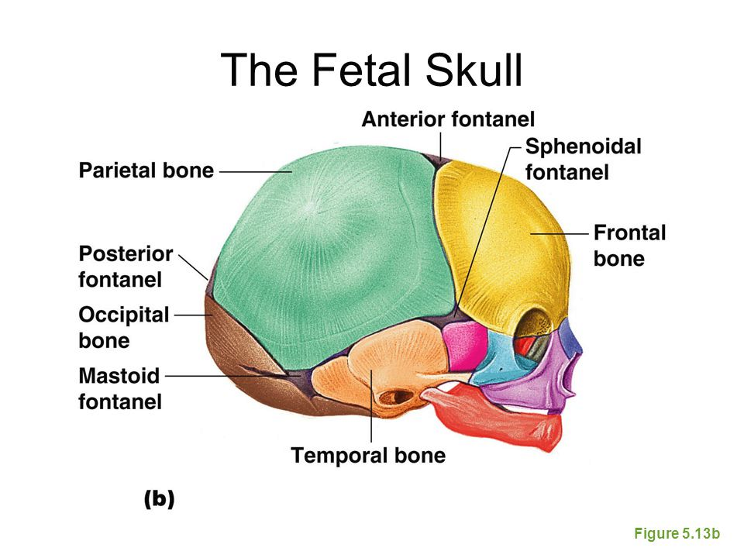

Slide 26
Helpful Videos
https://www.youtube.com/watch?v=tZglB1A32-4
https://www.youtube.com/watch?v=Tp25wrm-AoA
https://www.youtube.com/watch?v=tQuTLtEj_7g
https://www.youtube.com/watch?v=C2tfRWxcwP0
https://www.youtube.com/watch?v=fhDcHr1MVLU

Slide 27
References
https://radiologykey.com/sonography-of-the-second-and-third-trimesters/
https://www.ncbi.nlm.nih.gov/pmc/articles/PMC3991457/
https://www.gehealthcare.com/article/artificial-intelligence-helps-doctors-with-critical-measurement-during-pregnancy#:~:text=Automating%20the%20process%20of%20measuring,health%20of%20the%20growing%20fetus
https://www.ultrasound-images.com/fetal-brain/
https://www.youtube.com/watch?v=tZglB1A32-4
https://radiopaedia.org/articles/ventricular-system?lang=us
https://www.obgproject.com/2018/10/05/fetal-head-part-1/
http://www.fetalultrasound.com/online/text/Anatomy%20-%20Second%20Trimester.htm
https://sonoworld.com/client/fetus/html/chapter-02/chapter-02/cns/cnsfmf.html
https://www.slideshare.net/nasrat1949/fetal-neurosonogram
https://www.obimages.net/free-chapter-normal-cns-ultrasound-brain-anatomy/
https://obgyn.onlinelibrary.wiley.com/doi/full/10.1002/uog.3909
https://www.ncbi.nlm.nih.gov/books/NBK542184/
https://www.ncbi.nlm.nih.gov/books/NBK537048/

