Slide 1
Maternal/Fetal measurements and sonographic assessment for fetal growth
Candee Lam

Slide 2
What you should have a better understanding of at the end of the lecture..
3rd trimester scans
  Why third trimester scans are important
  Maternal measurements
  Fetal measurements
  General sonographic assessment
  In comparison to 20 week scans

Slide 3
Second and third trimester ultrasounds are performed for..
detection of fetal abnormalities
fetal cardiac screening
assessment of fetal growth
amniotic fluid (AFI) evaluation
placental position and evaluation for previa
fetal gender determination
twin evaluation
evaluation of pregnancy complications including bleeding, pelvic pain, and preterm labor
fetal position
Biophysical Profile and fetal Doppler

Slide 4
Fetal measurements : BPD
Used around the 12th week
Measured at the CSP and thalamus
OUTER to INNER
Less effective after the 33rd menstrual week
Head shape can vary

Slide 6
Candee, why do we care about these measurements in 3rd trimester?
Progressive diseases
  Hydrocephalus
  Maternal diabetes
  Ventriculomegaly
    Associated w/ compression of the choroid plexus

Slide 7
Fetal measurements : HC
Should be measured in the same image of BPD
Include CSP and midline falx
Useful for asymmetric IUGR
Compare to AC

Slide 8
Fetal measurements:
OFD and CI
Occipitofrontal diameter (OFD)
OUTER to OUTER of the middle of the front of the occipital bones
Cephalic index (CI)
CI = BPD/FOD x100

Slide 9
Fetal measurements : cerebellum
TRV cerebellum measurement = gestational age
Independent from fetal growth disturbances
Q: WHAT SEPARATES THE CEREBELLUM
A: ………vermis

Slide 10
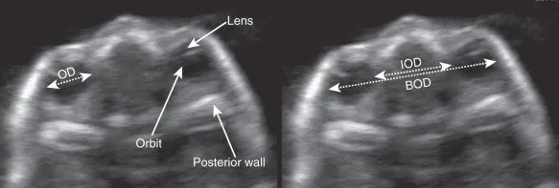
Fetal measurements : binocular measurements
BOD : Distance from outer edge of L and R fetal eyes
OD : Outer orbit to outer orbit
IOD : Globes of the eyes

Slide 11
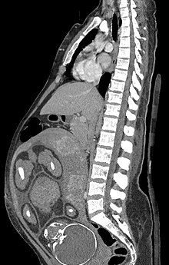
Fetal body measurement : AC
Abdominal circumference is good indicator of fetal weight
Not good for determining gestational age
BPD TO AC ratio
  13-33 head =abd
  Over 33 head < abd

Slide 12
Abdomen measurements errors
Can’t see skin edge
Too big
  Oblique plane
  Fetus is prone
    Landmarks are obscured
Too small
  Ribs mistaken for skin
  Fat on dependent side
Round image is best
Abdomen is compressed
  Do not push too hard

Slide 13
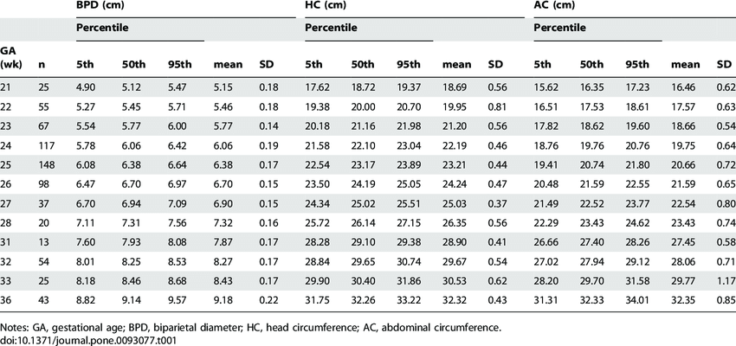

Slide 14
Intra-uterine Growth Retardation (IUGR)
Macrosomia
Large for Gestational age : weight (> 4000 grams)
>90th percentile
Associated with diabetic mothers, maternal obesity, diabetes, maternal weight gain, pregnancy >40 weeks, advanced maternal age and multiparity.

Slide 15
IUGR (Intrauterine Growth Restriction)
Small for Gestational Age weight
<10th percentile
2 Types
Symmetrical- these babies are in proportion but reduced in size
Asymmetrical-these babies have a smaller abdomen compared to limbs and head.

Slide 16
GREAT VIDEO TO WATCH!!
https://www.youtube.com/watch?v=9TRI7SHyuOw

Slide 17
Peace out third quarter

Slide 18
References
Stephenson, Susan R. “Chapter 29” Diagnostic Medical Sonography: Obstetrics and Gynecology, by Amber Matuzak, 4th ed., Wolters Kluwer Health, 2018, pp. 391-419
Fong, Katherine. https://pubs.rsna.org/doi/full/10.1148/rg.241035027 2004, Jan 1
https://www.ncbi.nlm.nih.gov/pmc/articles/PMC7137302/
https://www.ajronline.org/doi/pdf/10.2214/ajr.164.3.7863900
https://www.ncbi.nlm.nih.gov/pmc/articles/PMC6278043/
https://www.ultrasoundpaedia.com/normal-3rdtrimester/
https://www.youtube.com/watch?v=9TRI7SHyuOw

