Slide 1









Let’s Talk About Twinning
By Nailah Hollman
Notes:
Multiple gestations have increased over the past decade accounting for 3% of all births.
Twins are mostly commonly the result of assisted reproductive technologies, an increase in FSH concentration as women age, and heritage
African Americans have the highest rate of multiple gestations with a rate of 1/72 and Asians have the lowest, with a rate of 1/92.

Slide 2


Objectives
Types of twinning and their sonographic appearance.
How do 1st trimester, 2nd trimester, and 3rd trimester’s scanning differ for twins.
How to perform a 20-week anatomy scan on a twin pregnancy.

Slide 3
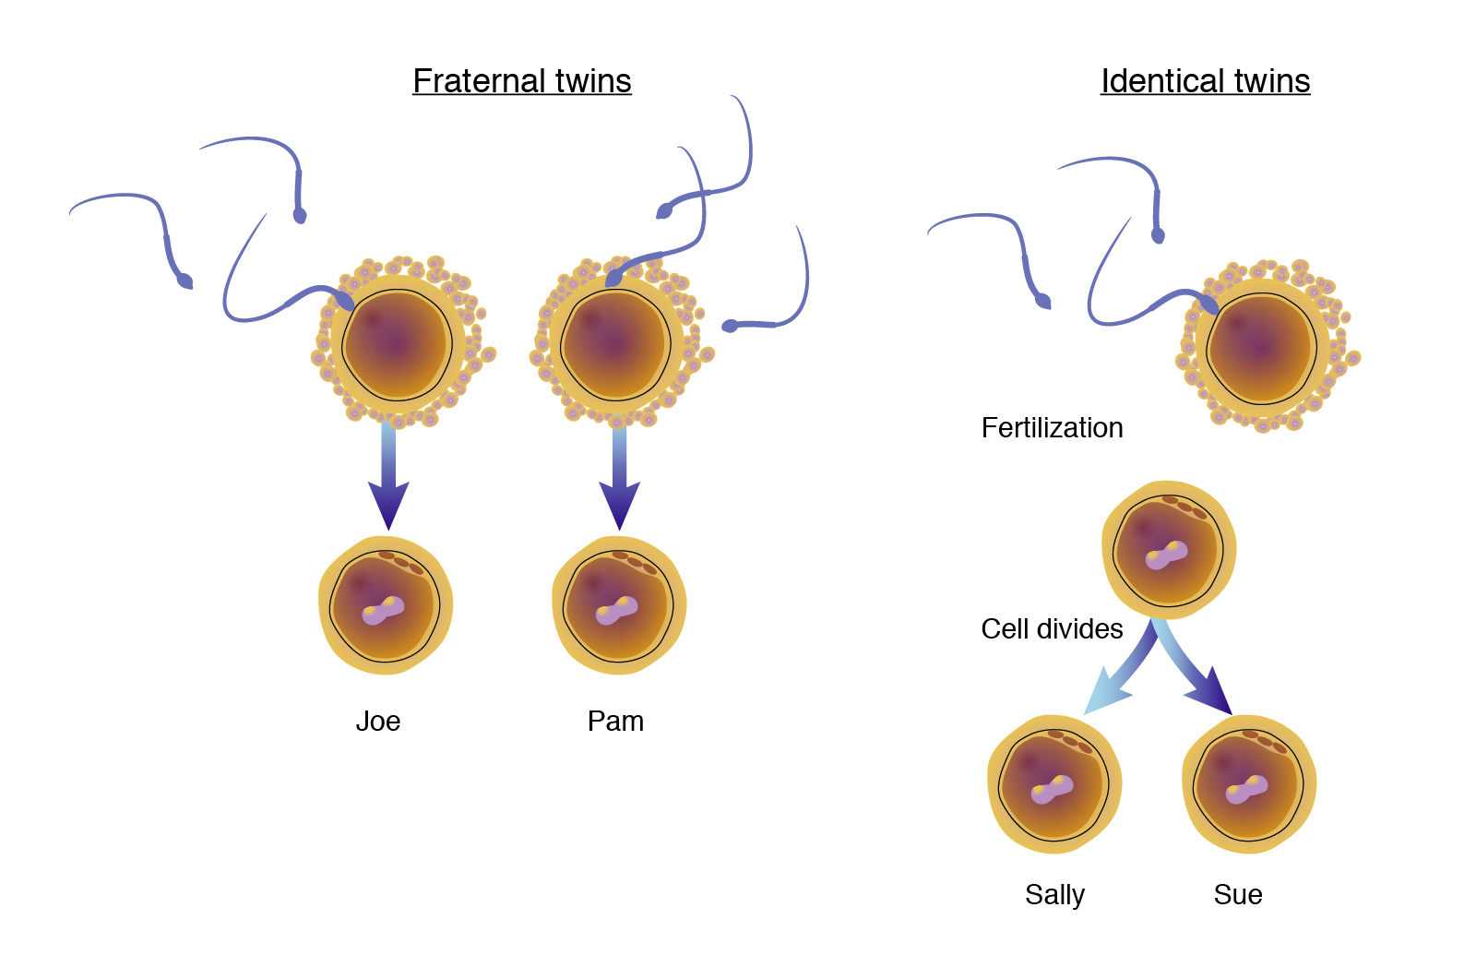
Types of Twinning
Dizygotic
Monozygotic
Notes:
Dizygotic: two ova are fertilized. In this case the twins share 50% of their genotype with variable phenotypic makeup.
Monozygotic: one ovum is fertilized and splits in two. In this case the twins share 100% of their genotype and display the same phenotypic characteristics.

Slide 4
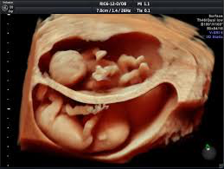
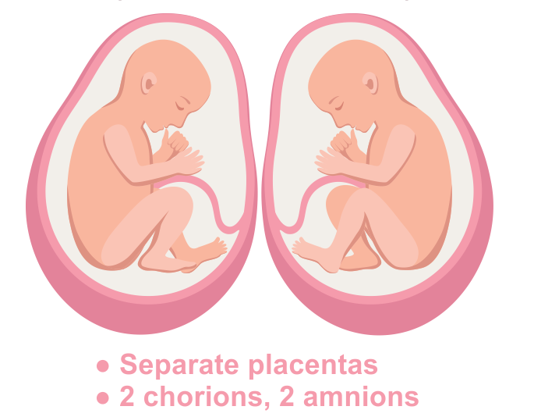
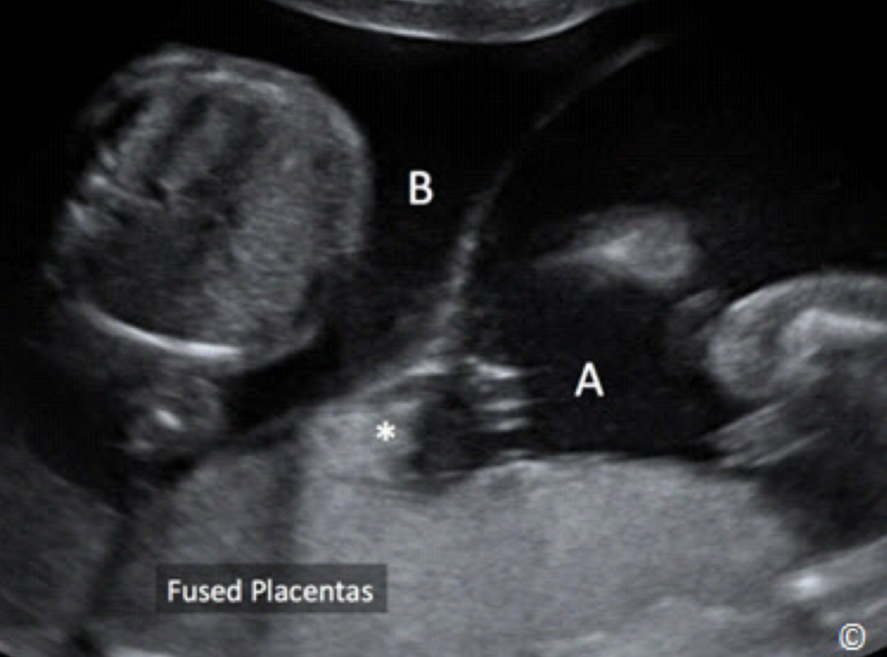
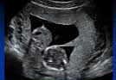
Dizygotic
Two placentas
Dichorionic
Diamniotic
Share half of their genes
Accounts for 70% percent of all twin gestations
Notes:
Twins can be same or opposite sex.
You can dichorionic and diamniotic with a fused placenta. This just means that the zygotes implanted really close to one another but they still their own chorions so they are not at risk for vascular anastomosis

Slide 5
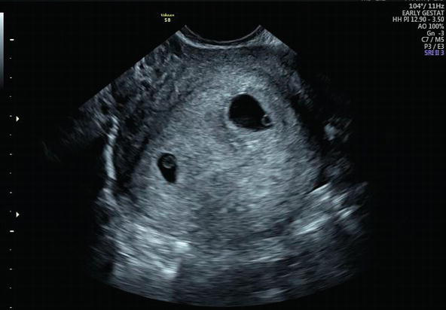
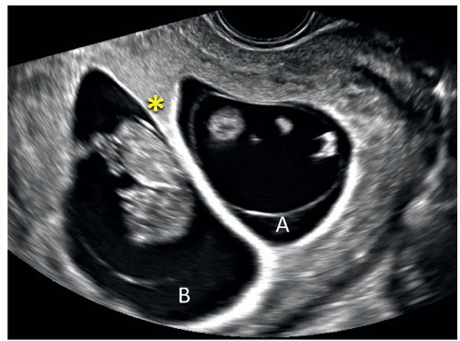
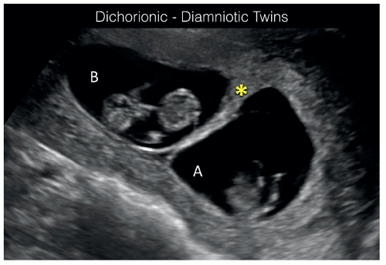
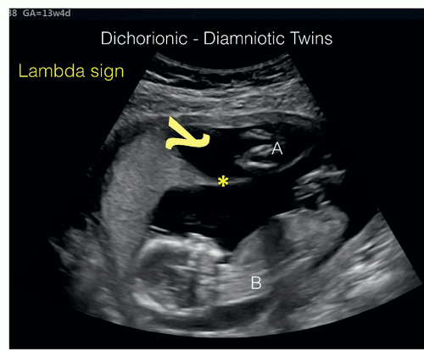
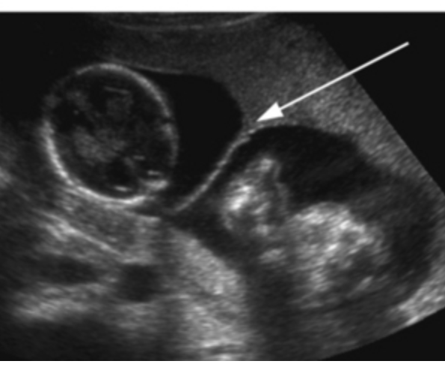
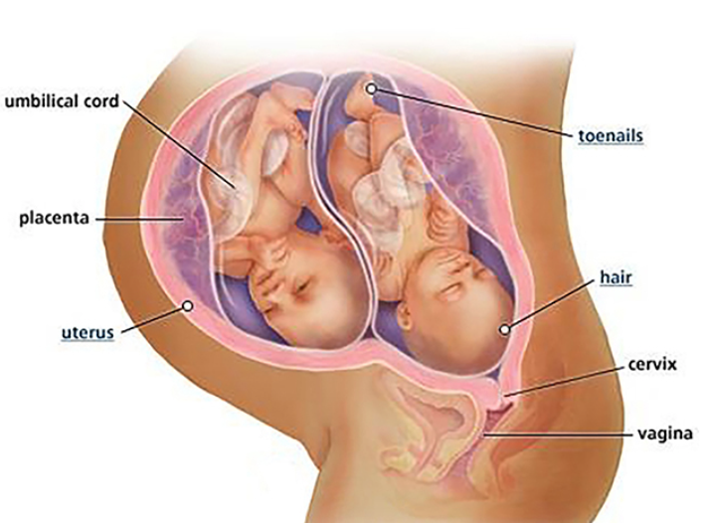
Dizygotic
5 weeks
9 weeks
11 weeks
13 weeks
20 weeks (approx.)
32 weeks
Notes:
As pregnancy progresses determining chorionicity and amnionicity becomes more difficult.

Slide 6
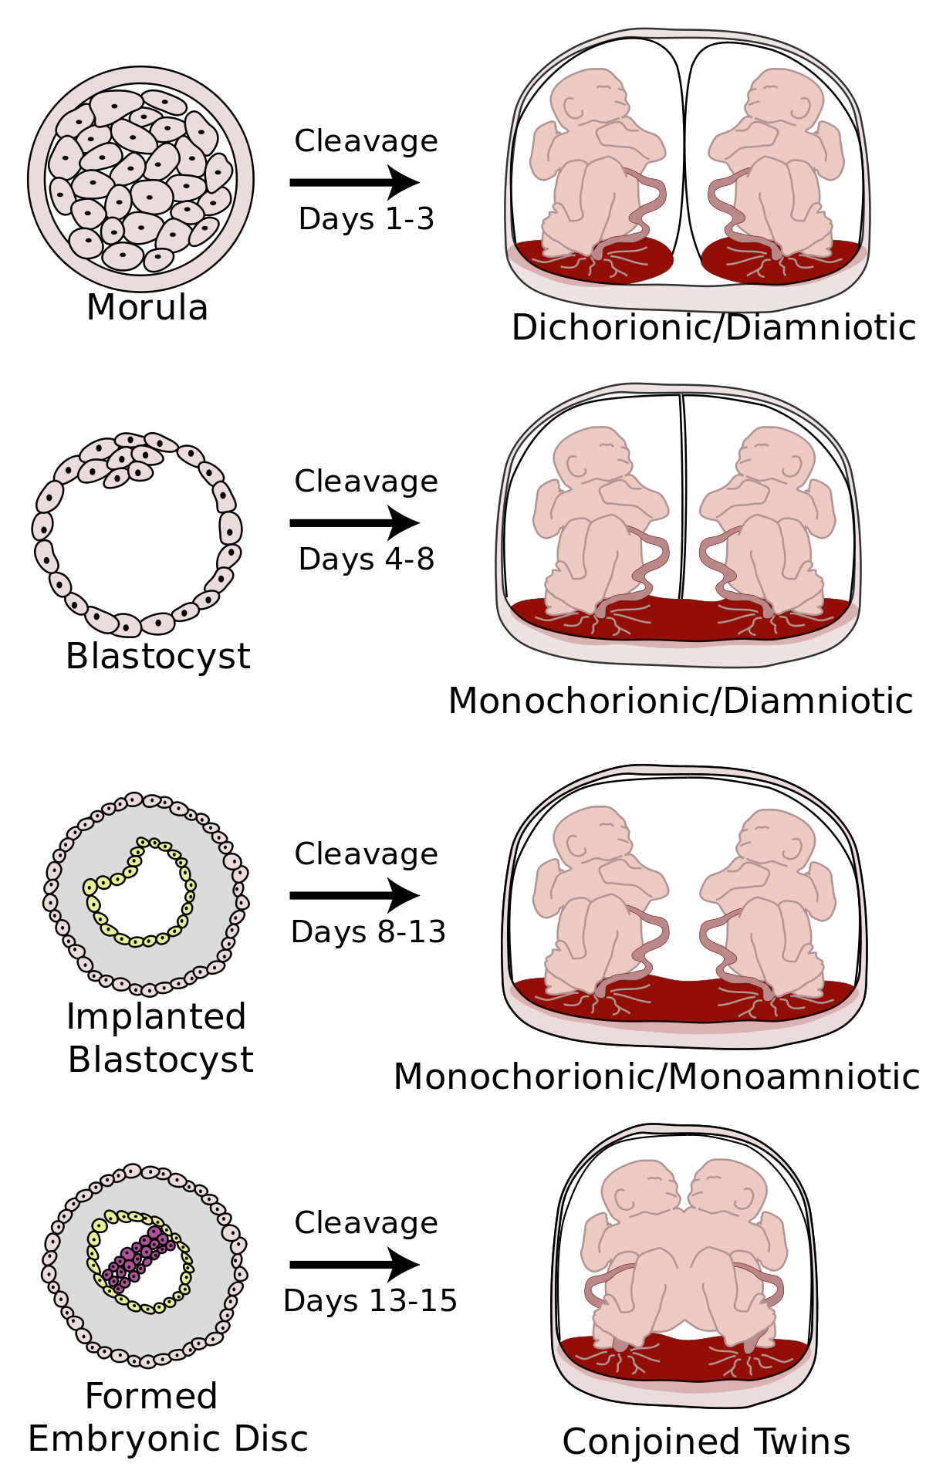
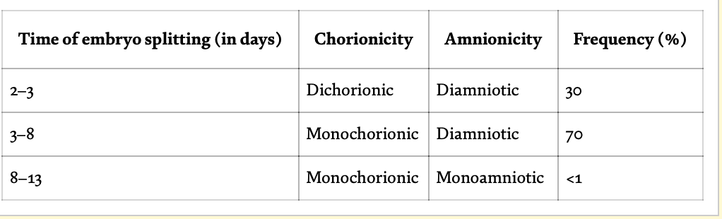
Monozygotic
1-3
Monochorionic
Share 100% of genes
Always same sex
3-8
8-13
13-15
Notes:
Share one chorion so they have a higher risk for vascular anastomosis.
Monochorionic Diamniotic is the most common type.
Pg. 675 in the book says 25% and 75%.

Slide 7
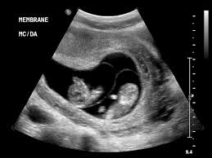
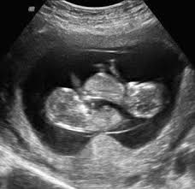
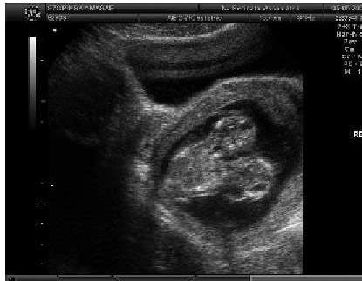
Monozygotic
monochorionic diamniotic
monochorionic monoamniotic
conjoined
Notes:
There is monozygotic twinning with dichorionic diamniotic. In this case the twins would be identical (share all of their genes) oppose to fraternal (share half of their genes).

Slide 8
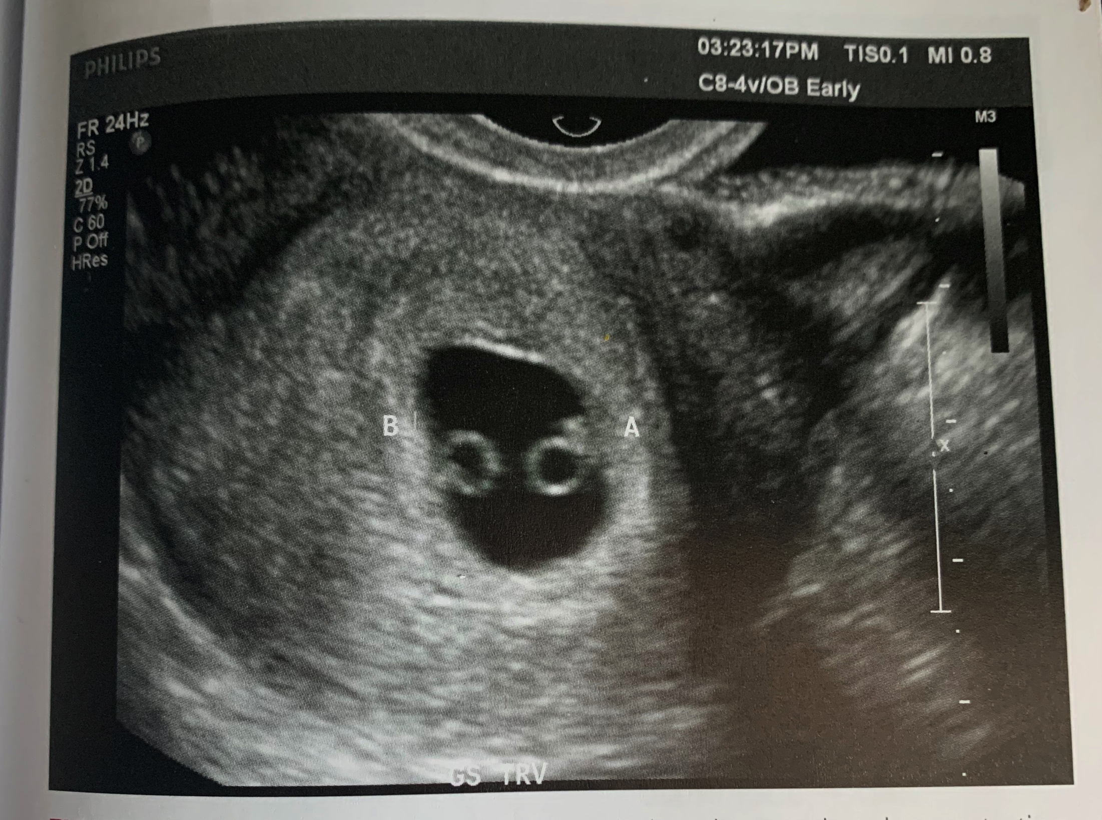
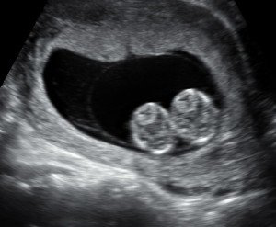
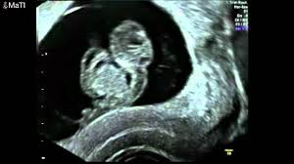
First Trimester
Most accurate determination of chorionicity and amnionicity
Between 5-9 weeks:
  The number of gestational sacs can determine chorionicity.
  The number of yolk sacs can determine amnionicity.
Between 10-14 weeks:
  The number of placental sites and the appearance of the intertwin membrane can determine chorionicity and amnionicity using the “Twin Peak/ Lambda sign” and the “T-sign”
Notes:
Prior to 7 weeks, using the number of gestational sacs to determine chorionicity can be difficult. A report found that between 5-5.9 weeks 11% of dichorionic gestations and 86% monochorionic were missed diagnosed as singletons (pg. 676).

Slide 9
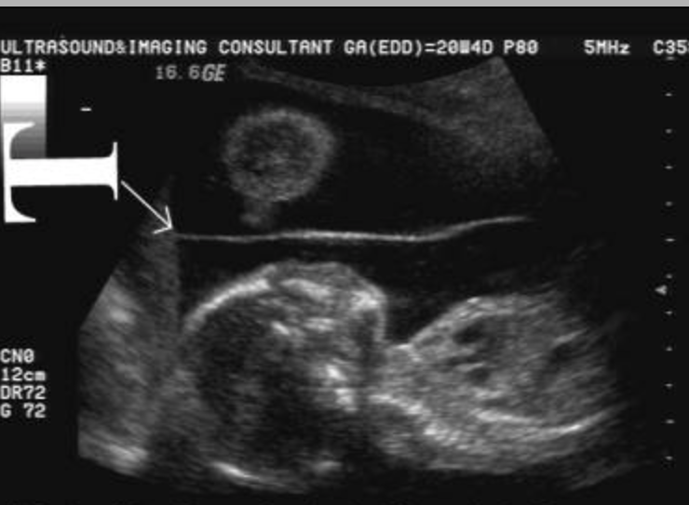
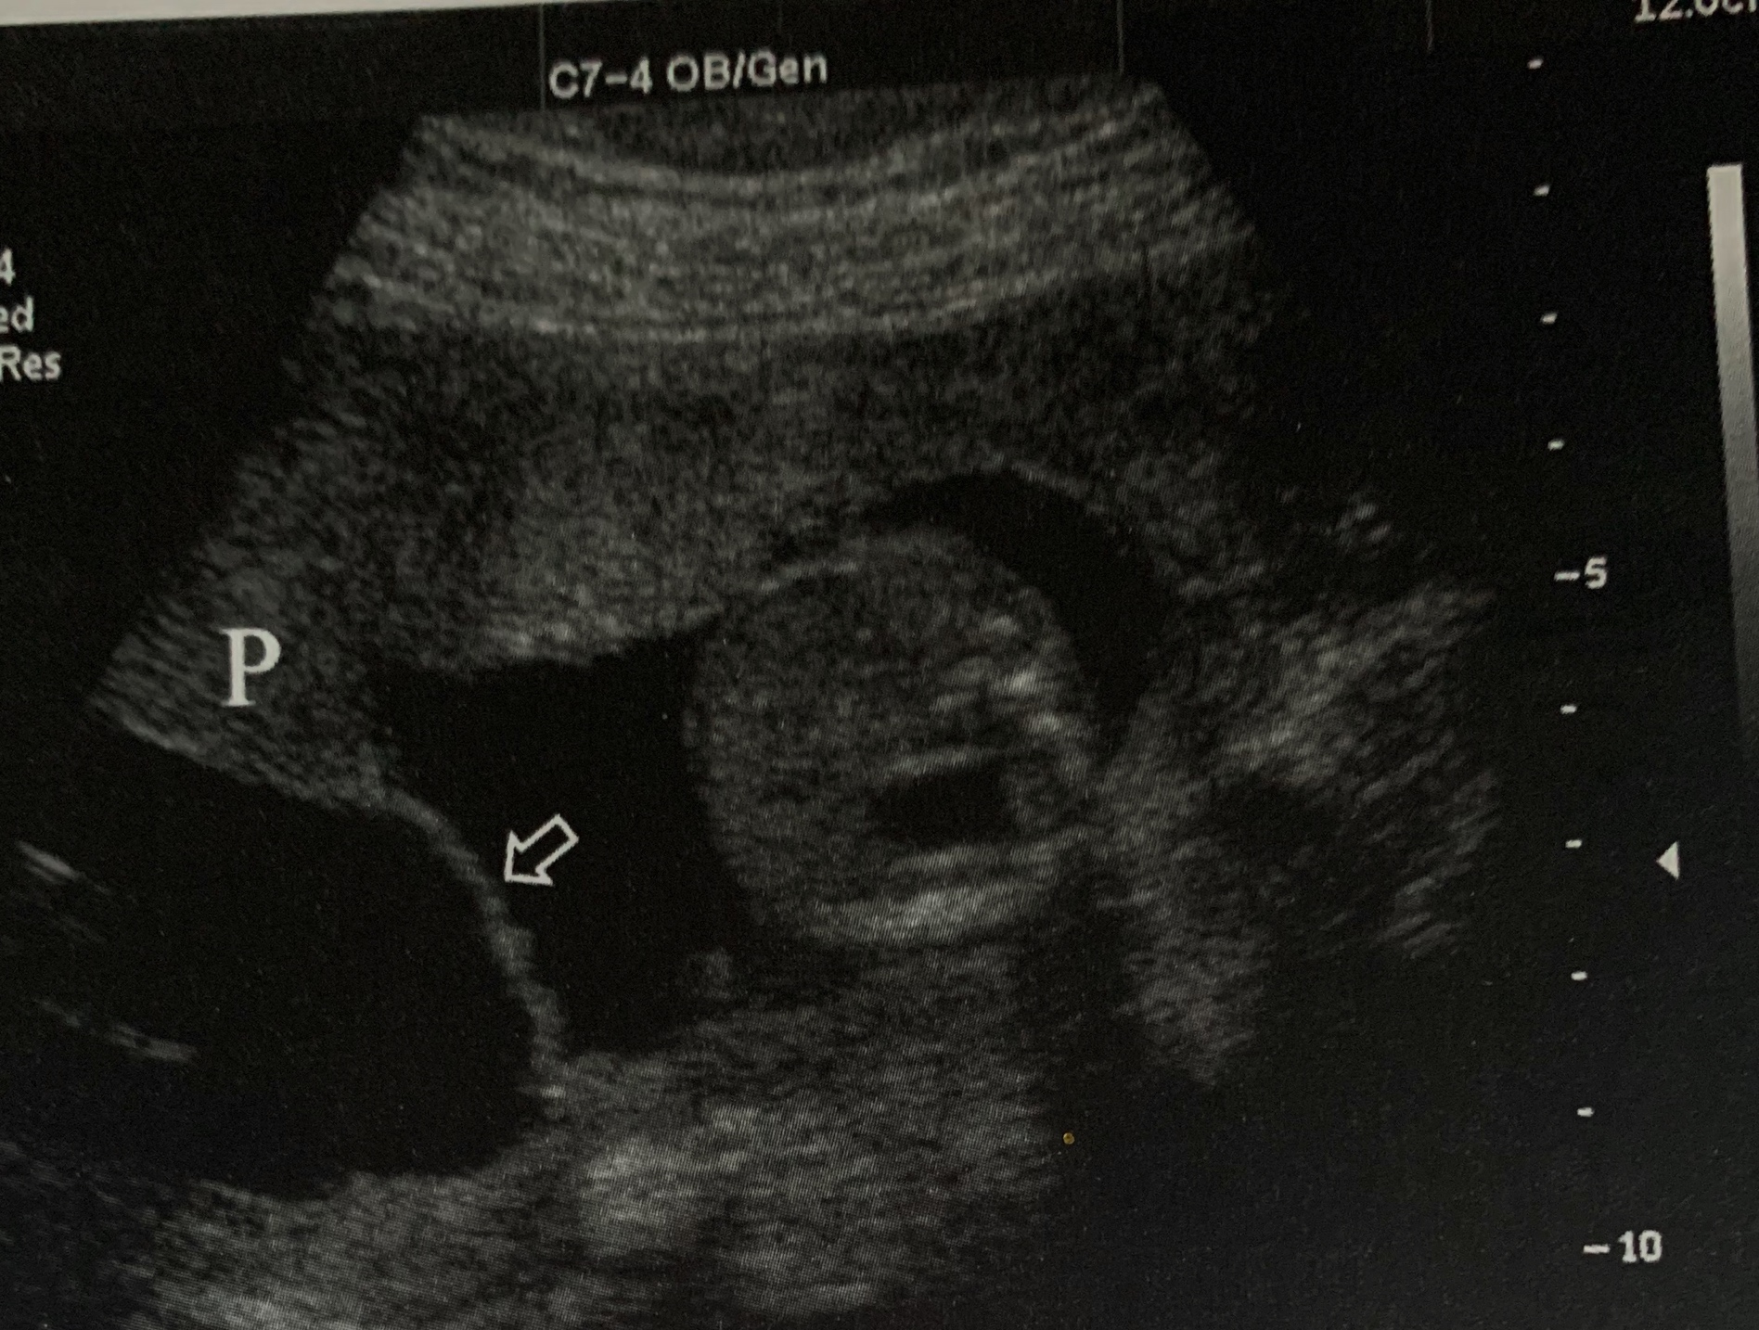
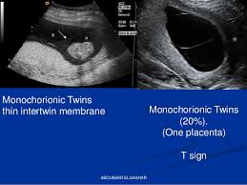
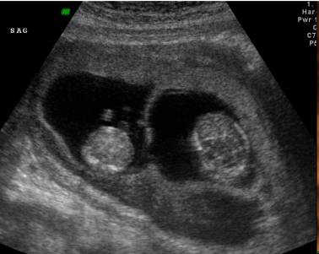
Twin Peak Vs. T-sign
T-sign
Thinner because membrane only contains two layers of amnion.
< 1mm
Twin Peak
Thicker because membrane contains two layers of chorion and two layers of amnion.
> 1.5 mm

Slide 10
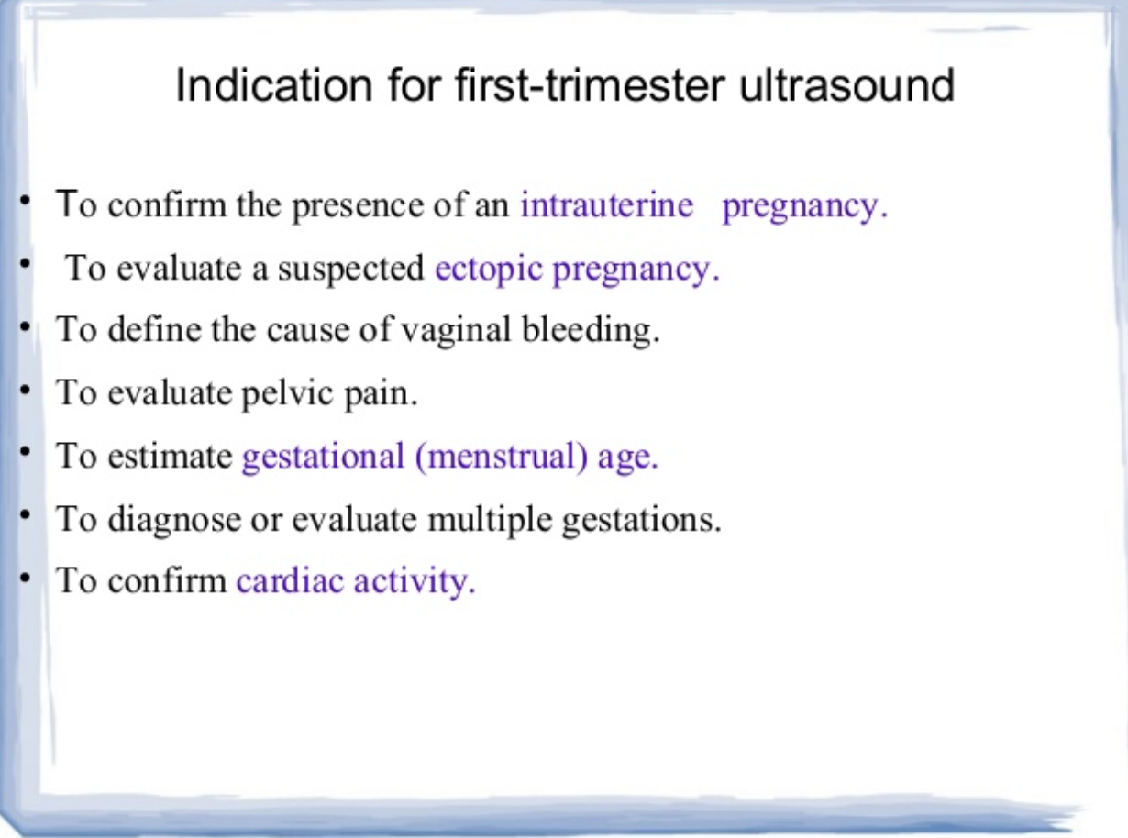
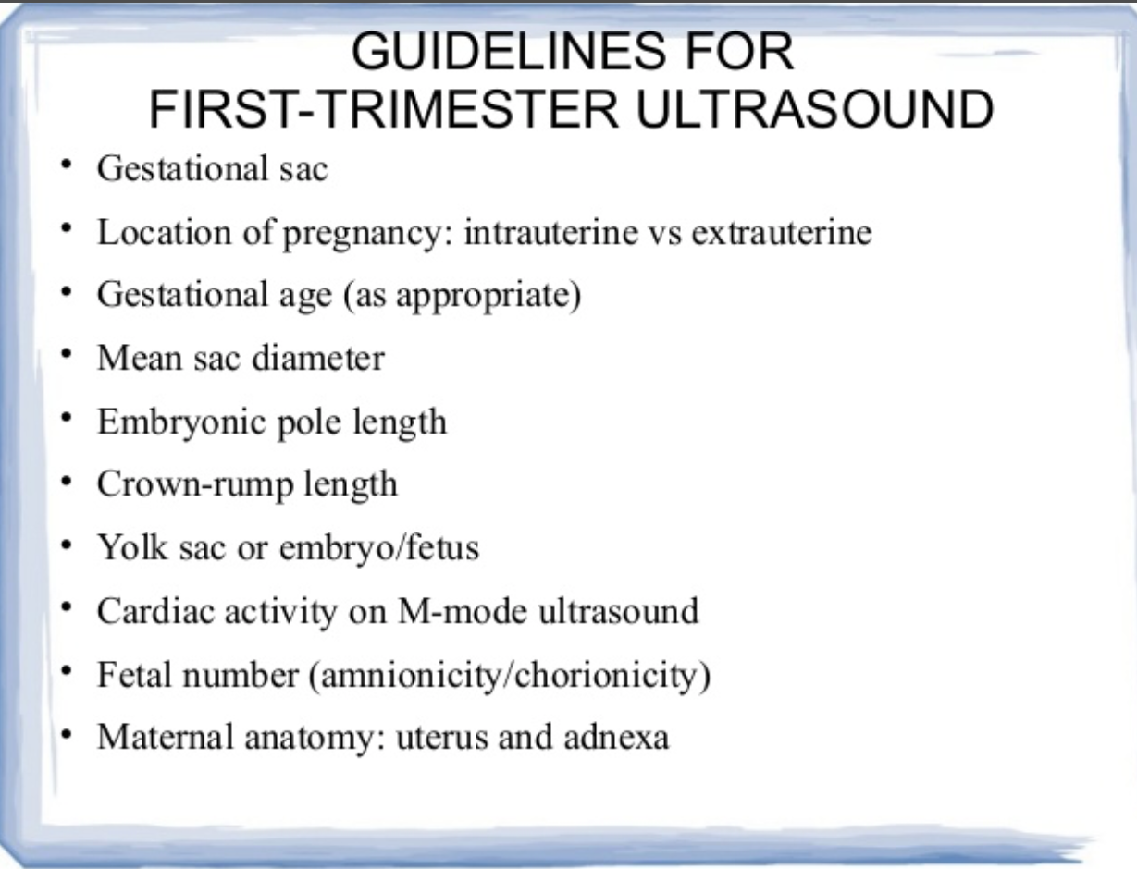
First Trimester Sonographic Assessment
Labeling twins
Multiple gestations are considered high risk, therefore they are scanned more frequently
Fetal genitalia can help determine twin type
Monozygotic twins are at higher risk of abnormality than dizygotic
Notes:
Label twins to keep track of each individual’s twin growth
Fetal genitalia can determine twin type be opposite sex twin always mean dizygotic twins.
Great discrepancy between CRL of twins suggests possibility of single fetal loss.
Uncomplicated dichorionic twins should have a first trimester scan, detailed second trimester scan, and scans every 4 weeks after that
Uncomplicated monochorionic twins should have a first trimester scan, and be scanned every two weeks after 16 weeks to monitor for twin-to-twin transfusion syndrome (TTTS) and twin anemia polycythemia sequence (TAPS).
Routine 20 week anatomy scans are still performed
TTTS
https://www.hopkinsmedicine.org/health/conditions-and-diseases/twintotwin-transfusion-syndrome-ttts
TAPS
https://www.hopkinsmedicine.org/health/conditions-and-diseases/twin-anemia-polycythemia-sequence-taps

Slide 11
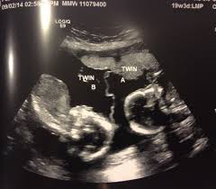
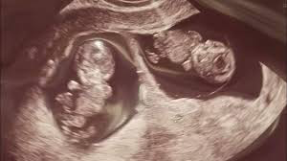
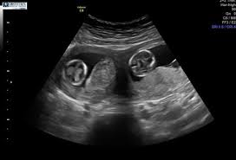
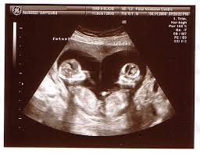
Second Trimester 20-Week Anatomy Scan
Document chorionicity and amnionicity
Use descriptive identifiers to label twins
Take note of size discrepancy between twins
Notes:
The same as a singleton scan, with each fetus getting their own anatomy scan.
Still want to determine chorionicity and amnionicity
Membrane thickness is not as reliable after 26 weeks because the membrane thins as pregnancy progresses
Should use descriptive identifiers for labeling twins to avoid mixing up the fetuses and to be able to properly track their growth. The presenting twin should be twin A.
Take note of size discrepancy between twins

Slide 12
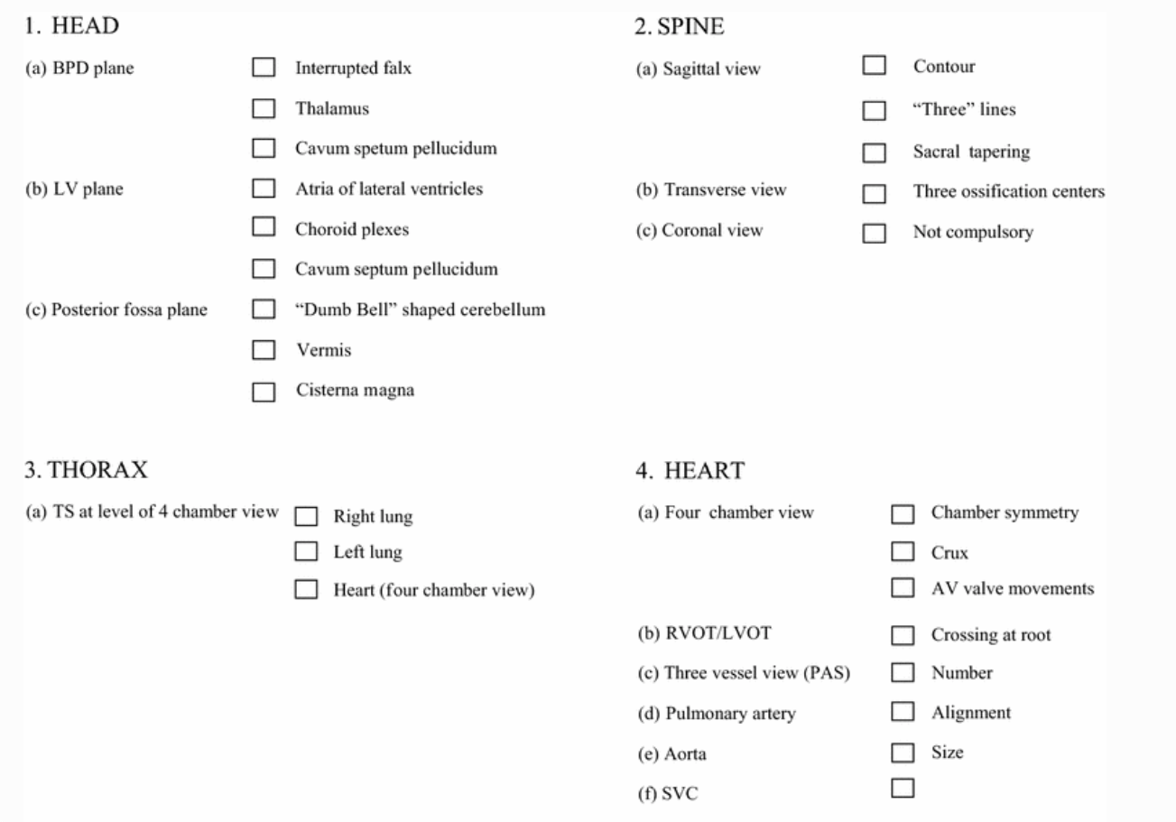
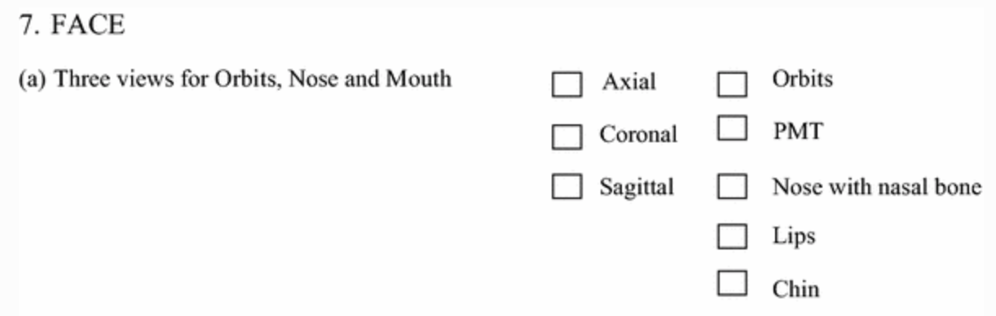
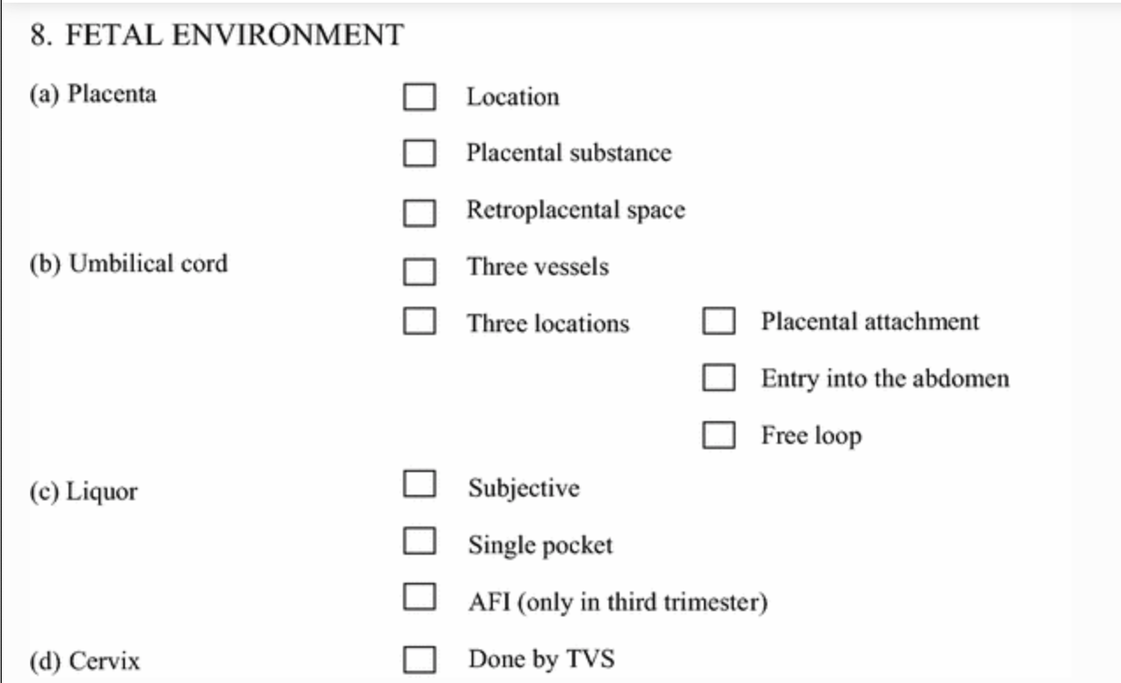
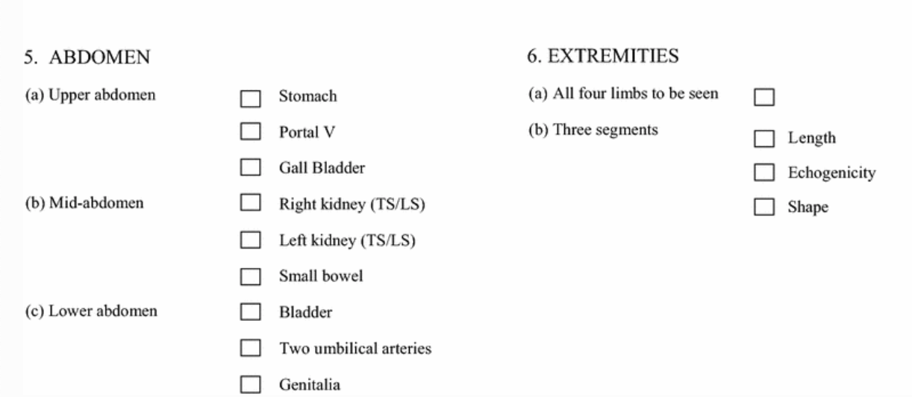
Second Trimester 20-Week Anatomy Scan

Slide 13
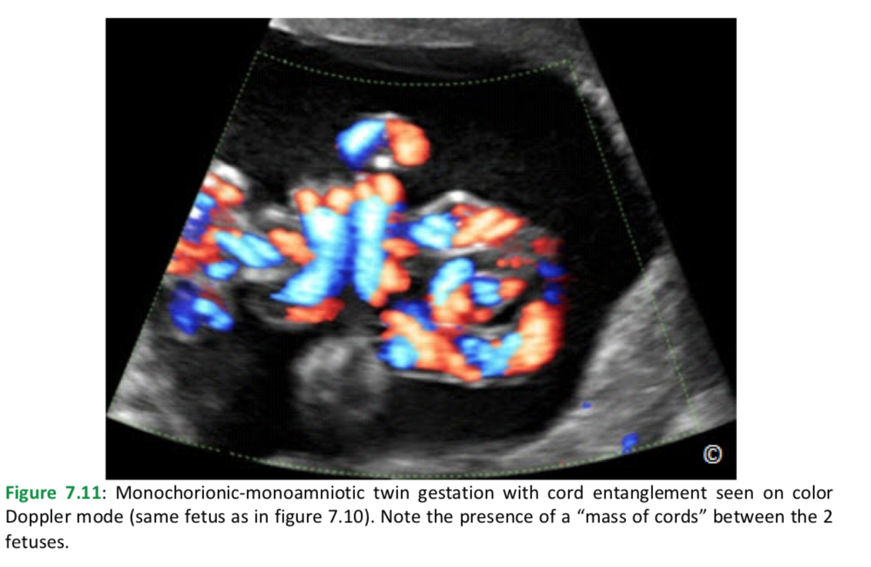
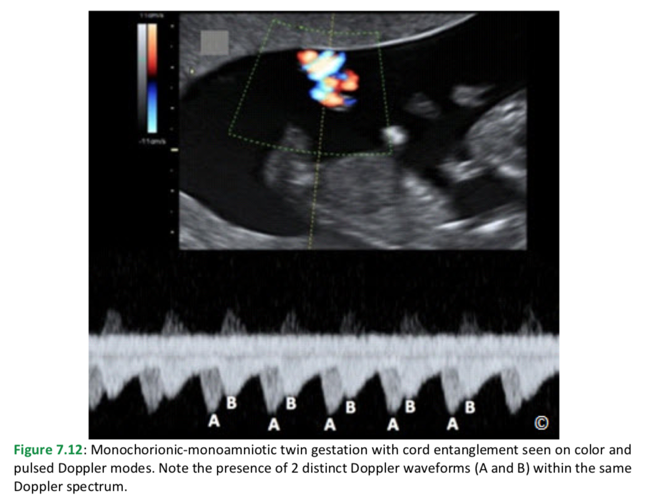
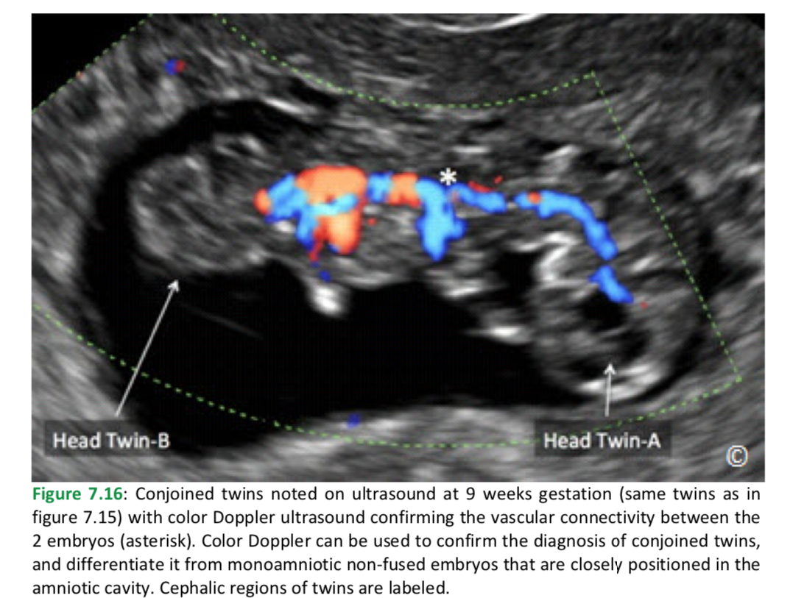
Vascular Anastomoses
Notes:
Really evaluate the umbilical cord.
Look for cord insertion sites
Check for knots

Slide 14
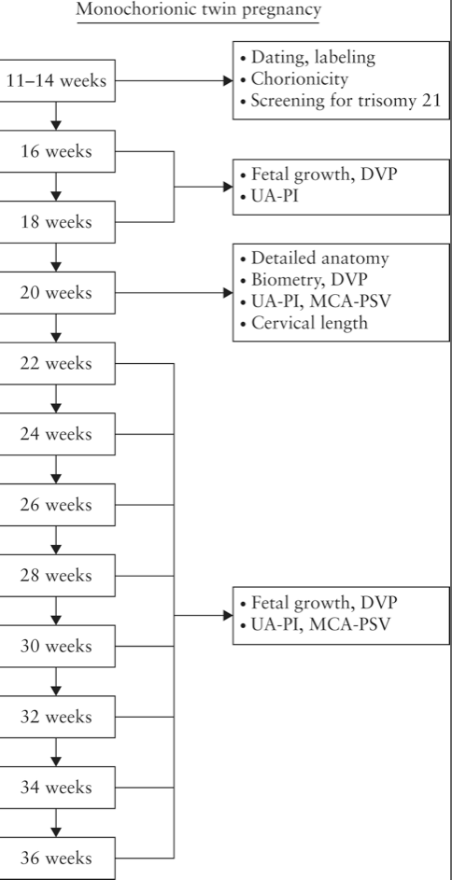
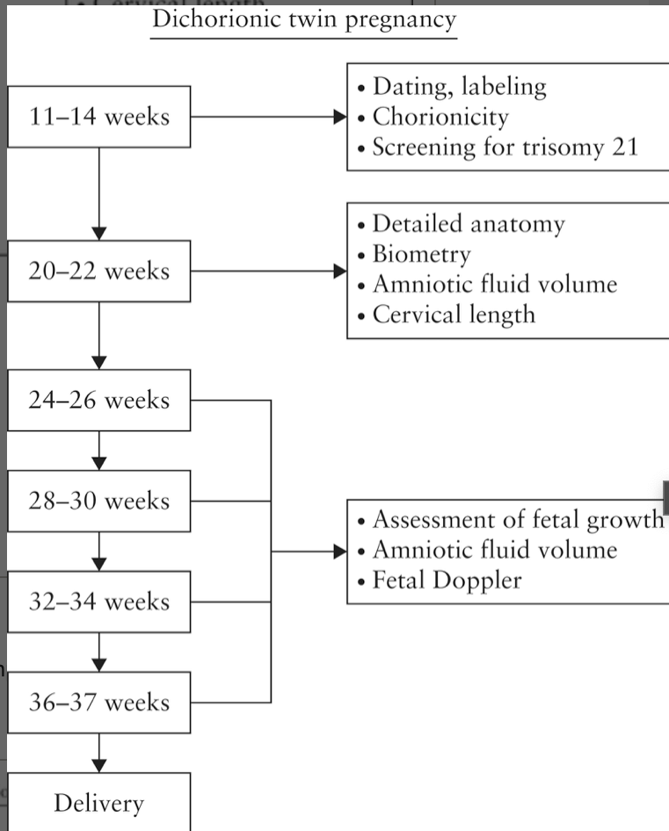
Third Trimester Sonographic Assessment
Twins grow at the rate of singletons until around 30 weeks
Notes:
In the third trimester you essentially asses fetal growth.
https://obgyn.onlinelibrary.wiley.com/doi/10.1002/uog.15821

Slide 15
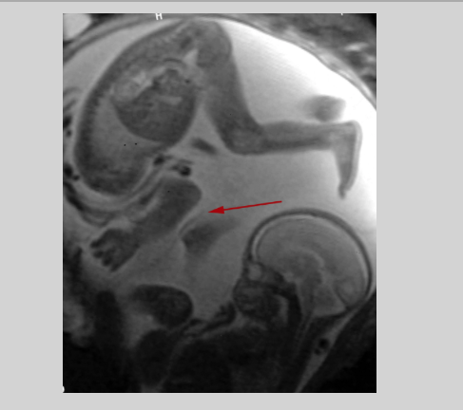
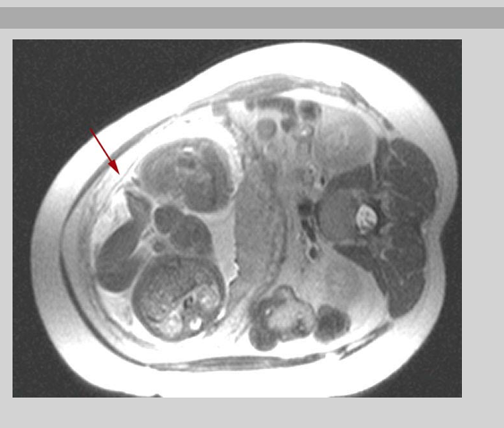
Intertwin Membrane
27 weeks
26 weeks
28 weeks
Notes:
MRI images of dichorionic diamnitoic gestation.

Slide 16
References:
https://radiologykey.com/multiple-pregnancies-in-the-first-trimester/
https://www.intechopen.com/books/multiple-pregnancy-new-challenges/early-pregnancy-ultrasound-assessment-of-multiple-pregnancy
https://www.genome.gov/genetics-glossary/identical-twins
https://obgyn.onlinelibrary.wiley.com/doi/10.1002/uog.15821
https://www.hopkinsmedicine.org/health/conditions-and-diseases/twin-anemia-polycythemia-sequence-taps
https://www.hopkinsmedicine.org/health/conditions-and-diseases/twintotwin-transfusion-syndrome-ttts
https://link.springer.com/article/10.1007/s40556-014-0019-6
https://www.glowm.com/pdf/Ultrasound_in_obstetrics_and_gynecology-chapter7.pdf
http://radnet.bidmc.harvard.edu/fetalatlas/gestations/didi/didi.html

Slide 17


