Slide 1
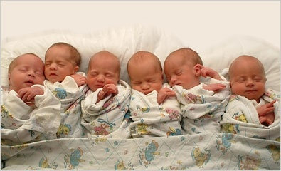
TWIN DEVELOPMENT
Jasmin Gabriel

Slide 2
Normally…
1
zygote
1
egg
1
sperm
+
=

Slide 3
but sometimes…
Something awesomely
unique happens!

Slide 4

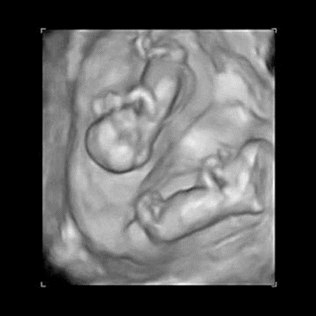

Slide 5
2
dizygotic
monozygotic
types
Around 90% of all multiples are made up of twins; the remaining 10% is with triplets, quadruplets and very occasionally quintuplets and more.
Around one in every three sets of twins born is identical, and the remaining 2/3 is of the non-identical variety.
In recent years there has been a big increase in the numbers of twins being born. This is due to advancing maternal age, assisted reproduction technology, as well as the use of fertility drugs.
Importantly, better neonatal care has meant that premature twins have a better chance of survival than ever before.

Slide 6
Identical twins do not run in families and can happen for any couple with any pregnancy.
Non-identical twins are influenced by genetics; women whose mothers or grandmothers had non-identical twins do have more chance of having non-identical twins themselves.
But identical twins are just random.

Slide 7
dizygotic
2
zygotes
2
eggs
2
sperms
+
=

Slide 8



dizygotic
Fraternal
2 placentas : 2 chorions : 2 amniotic sacs
Genetically different
or
or

Slide 9
monozygotic
2
embryos
1zygote
=
______________________
2

Slide 10

monozygotic
Identical
# of placentas : chorions : amniotic sacs varies
Genetically identical
x
or
never

Slide 11
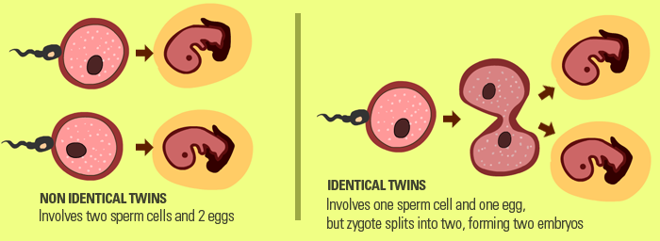
Dizygotic | Monozygotic

Slide 12


Dizygotic
Monozygotic

Slide 13
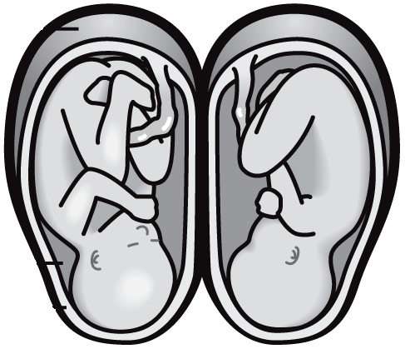
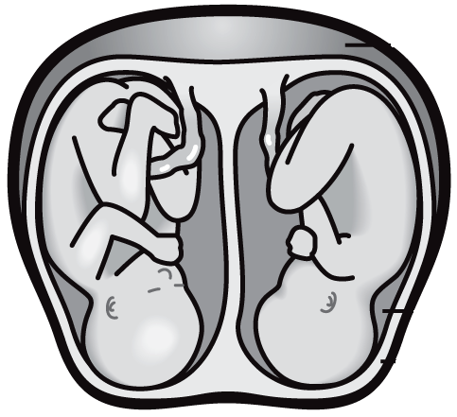
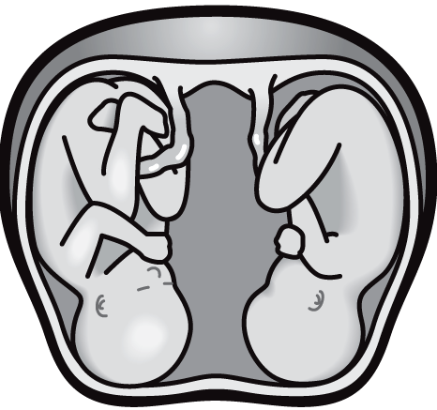
CHORIONICITY
Dichorionic (DC)
Monochorionic (MC)
AMNIONICITY
Diamniotic (DA)
Monoamniotic (MA)

Slide 14
The degree of separation of the twins in utero depends on if and when they split into two zygotes
Dizygotic twins were always two zygotes.
Dichorionic twins either never divided (i.e.: were dizygotic) or they divided within the first 4 days.
Monoamnionic twins divide after the first week.
Monozygotic twins split into two zygotes at some time very early in the pregnancy.
The timing of this separation determines the:
  Chorionicity (the number of placenta) and
  Amniocity (the number of sacs) of the pregnancy.

Slide 15
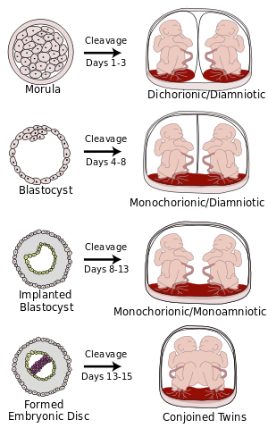
monozygotic placentation

Slide 16
twins
Most common
Dizygotic 70%
Monozygotic 30%

Slide 17
Statistics:
Normally, twins have two separate chorions and amniotic sacs termed Dichorionic-Diamniotic or "DiDi". It occurs in 18–36% (or around 25%) of monozygotic twins.
Monochorionic twins generally have two amniotic sacs (called Monochorionic-Diamniotic "MoDi"), which occurs in 60–70% of the pregnancies with monozygotic twins
Monochorionic twins share the same amnion in 1–2% of monozygotic twin pregnancies.^{[40]}Monoamniotic twins are always monozygotic.The survival rate for monoamniotic twins is somewhere between 50% to 60%.
When the division of the developing zygote into 2 embryos occurs, 99% of the time it is within 8 days of fertilization.
Mortality is highest for conjoined twins due to the many complications resulting from shared organs.

Slide 18
higher
order
multiples

Slide 19
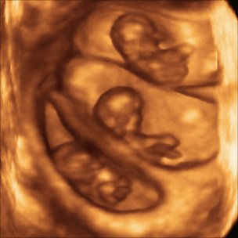
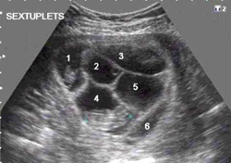
triplets
higher order
multiples
sextuplets

Slide 20
RISK FACTORS
ASSISTED REPRODUCTIVE TECHNOLOGIES
MATERNAL AGE/DELAYED CHILDBEARING
Maternal age/Pregnancy history
Race
Heredity
Nutrition/Maternal height & weight

Slide 21
Twins are suspected if…
Enlarged uterus
Multiple fetal heart tones
↑ Maternal serum alpha-fetoprotein

Slide 22
ALL multiple gestation
pregnancies are HIGH RISK!
Many anomalies can occur
Perinatal morbidity & mortality are increased

Slide 23
Therefore…
It is of utmost importance that these
pregnancies are monitored closely
& regularly throughout gestation.
ULTRASOUND is the BEST
modality for the task!

Slide 24
1ST TRIMESTER ASSESSMENT
1
Chorionicity
& Amnionicity
# of gestational sacs
# of amniotic sacs
# of yolk sacs
Twin Peak/Lambda Sign
T-Sign
2
Gestational
Age
3
Cervical
Length &
Competence

Slide 25
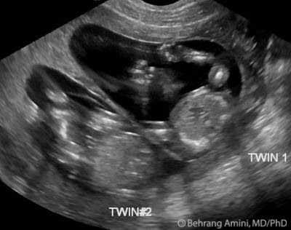
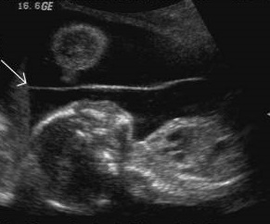
2ND & 3RD TRIMESTER ASSESSMENT
1
Chorionicity & Amnionicity
Sex of Fetuses
# of Placentas
Intertwin Membrane Thickness
Twin Peak/Lambda Sign
T-Sign

Slide 26
2ND & 3RD TRIMESTER ASSESSMENT
continued…
# of Fetuses
Cervical Length & Competence
Fetal Lie
Biometry & Anatomy
Amniotic Fluid Volume
Pulsed and/or Color Doppler

Slide 27
Complications
maternal
vanishing
twin
fetal
vasa previa
conjoined
TRAP
selective
reduction
fetus in fetu
monoamniotic
TTTS

Slide 28
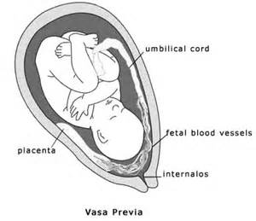

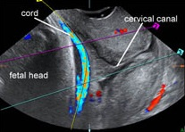
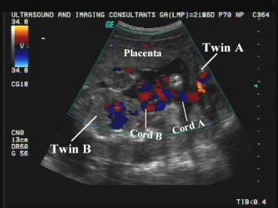
VASA PREVIA
MONOAMNIOTIC

Slide 29
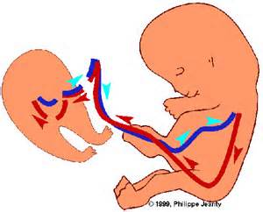
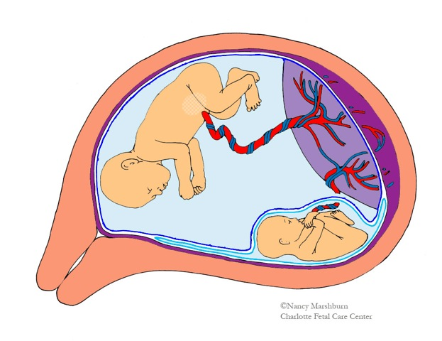
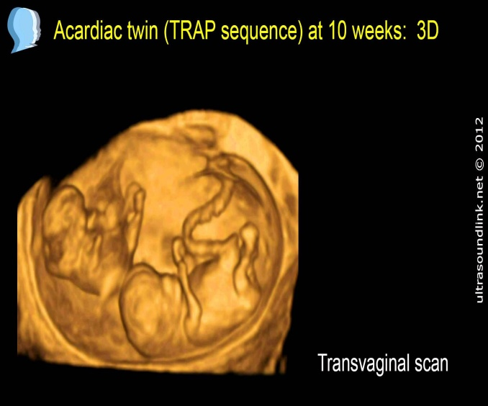
TRAP
TTTS

Slide 30
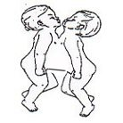
CONJOINED
Most Common
Thoraco-omphalopagus
Thoracopagus – thorax
Omphalopagus – abdomen
Craniopagus – head
Pygopagus – buttocks
Ischiopagus – ischia
Cephalothoracopagus – head & thorax
Fetus in fetu

Slide 31
Twins 35 weeks
Triplets 32 weeks
Quadruplets 30 weeks
duration

Slide 32
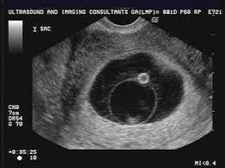
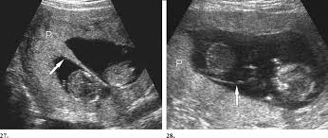
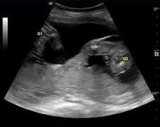
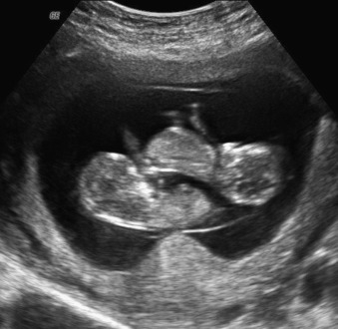
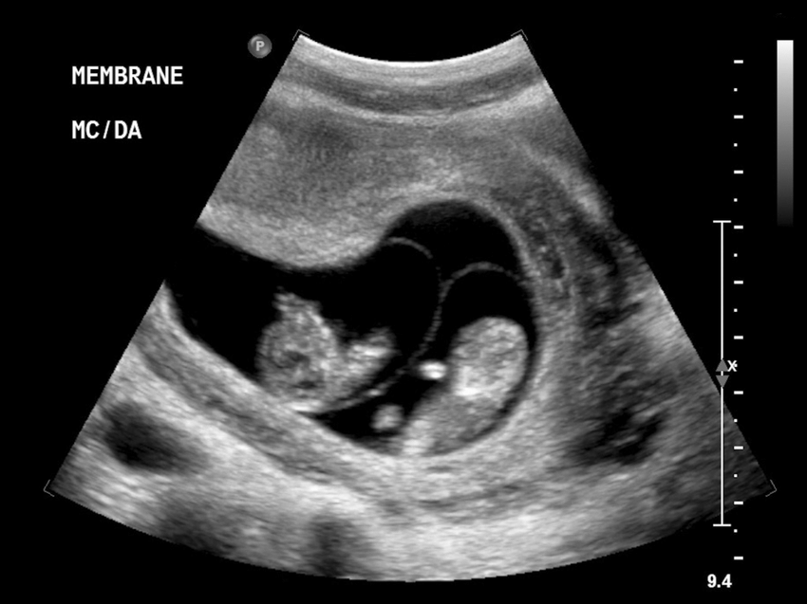
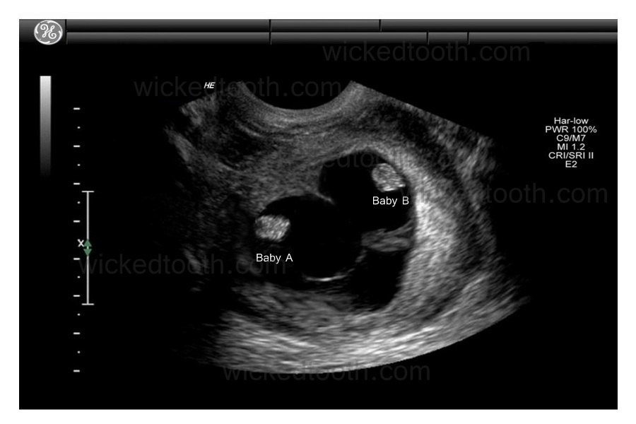

Slide 33
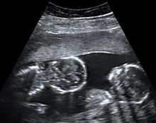
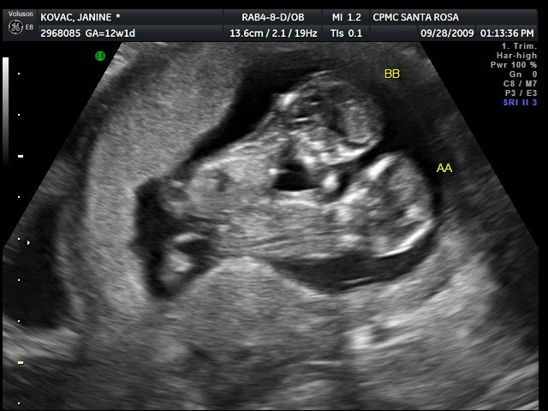
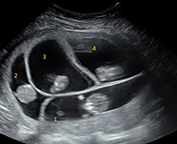

Slide 34
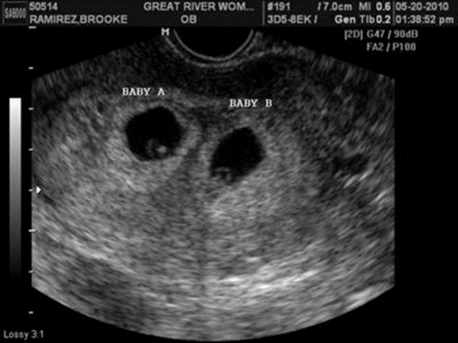
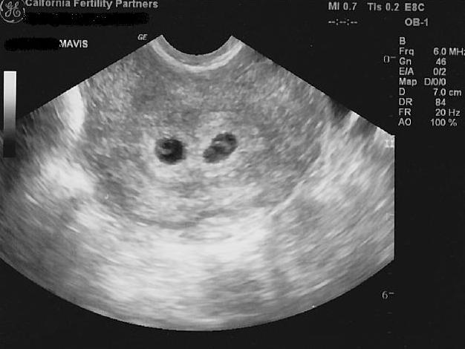
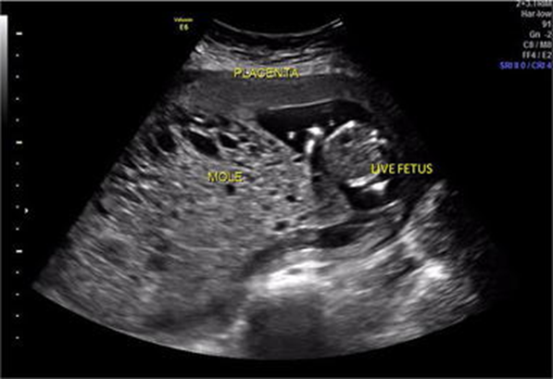

Slide 35
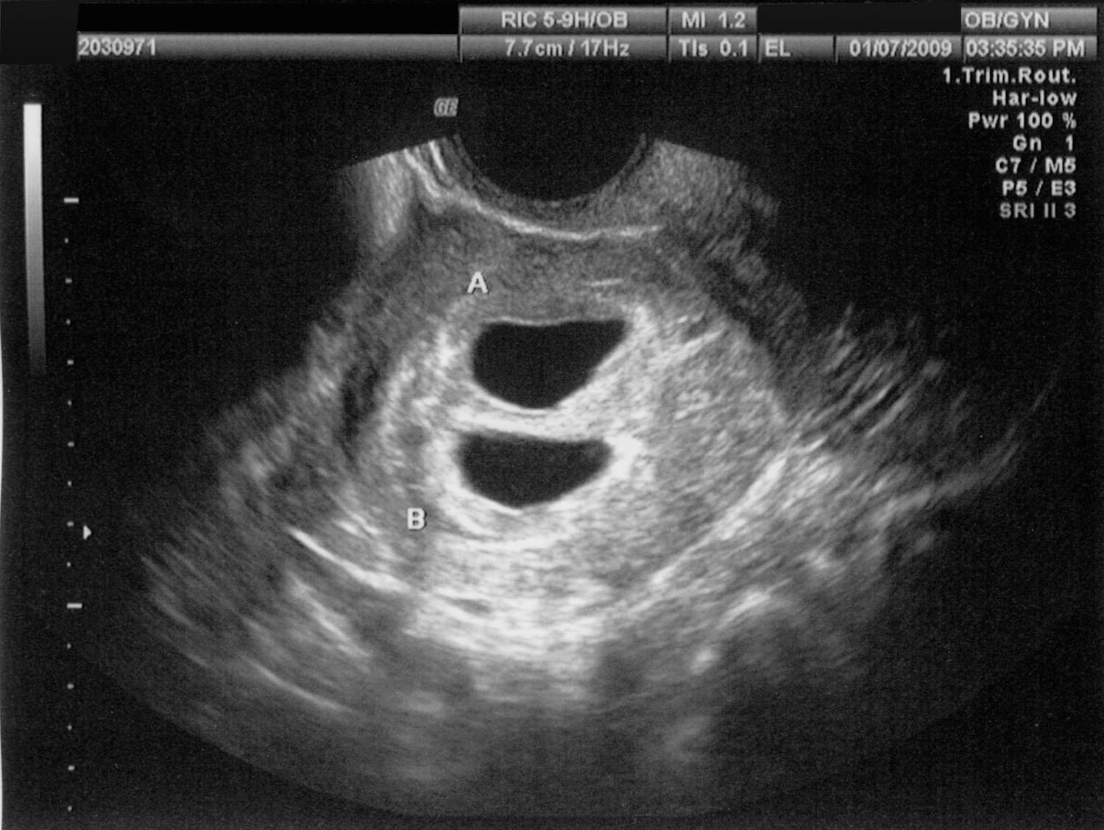
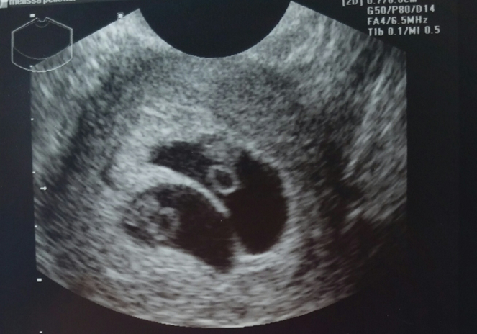
Which Type?

Slide 36
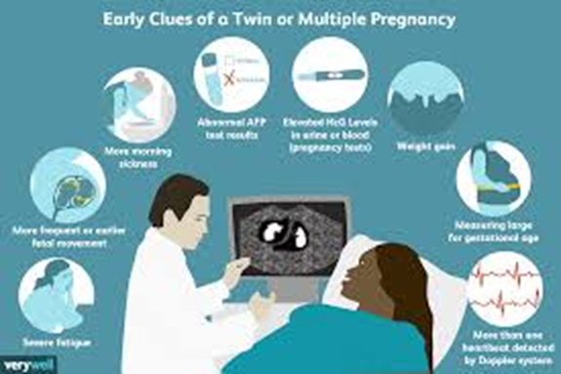

Slide 37
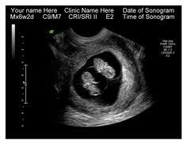
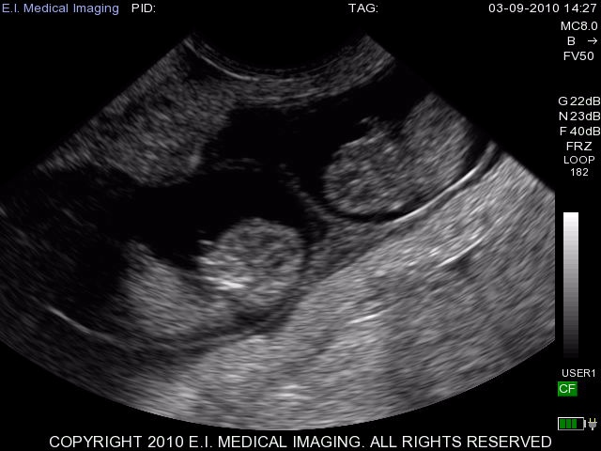

Slide 38

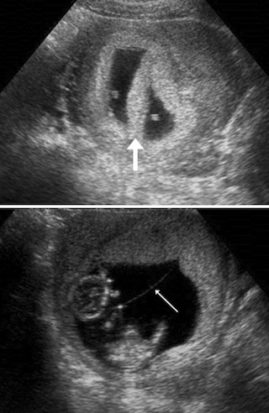

Slide 39
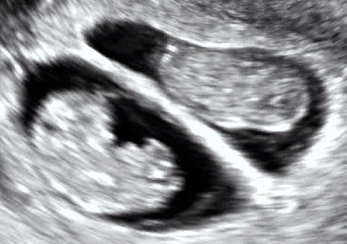
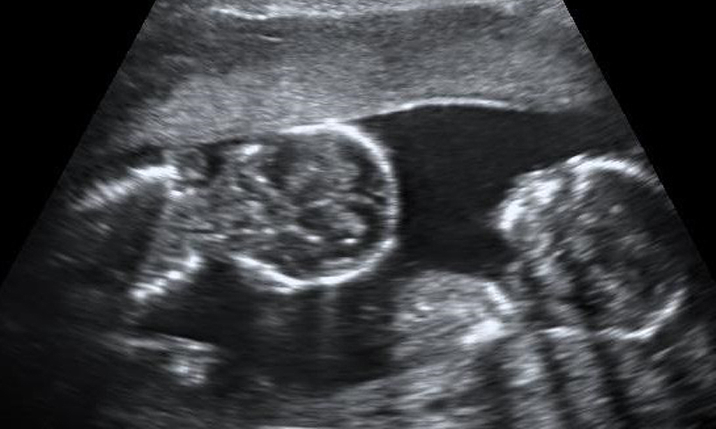

Slide 40
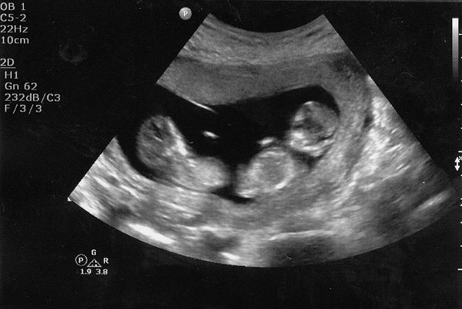
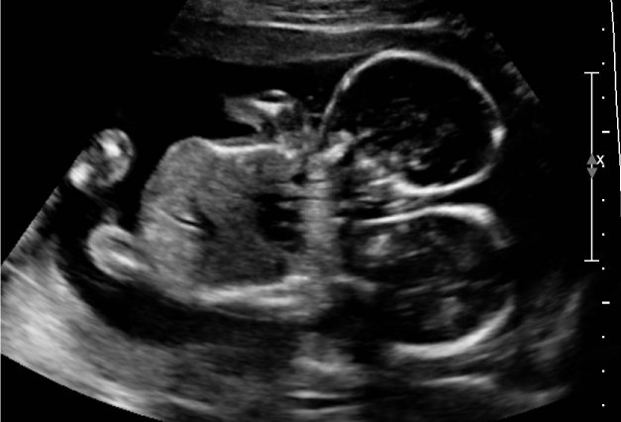

Slide 41
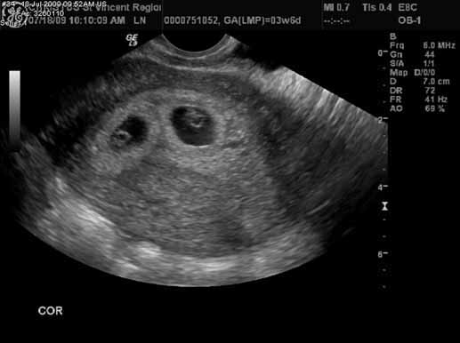
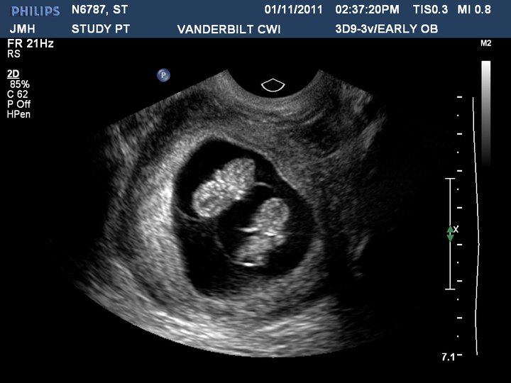
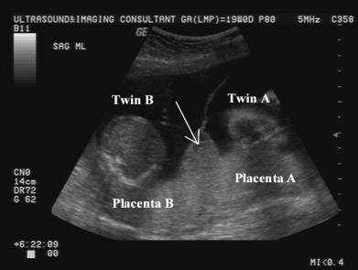

Slide 42
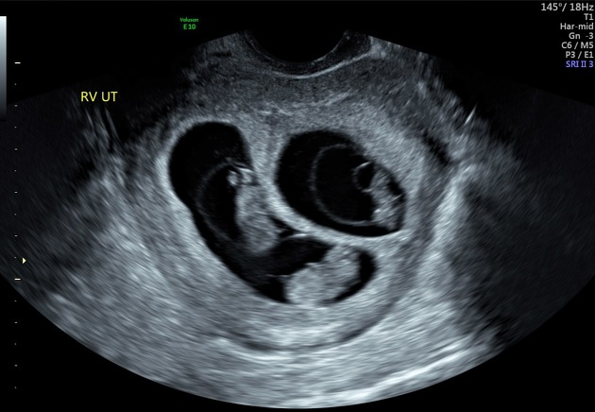
Extra- Credit 2pts…..Who can name this type of multiple gestation?
Dichorionic Tri-Amniotic

Slide 43
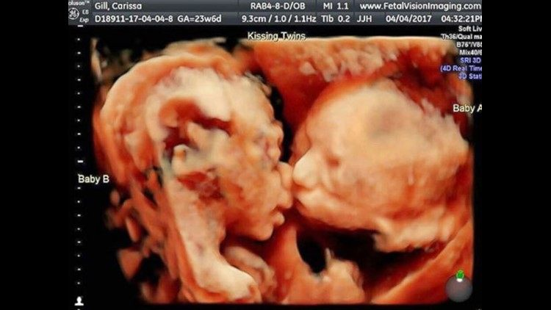

Slide 44
Photos
(in order of appearance)
Ovarian Hyperstimulation Syndrome from http://ivf.co.il
11 Month Old Twins Dancing To Daddy’s Guitar from http://youtube.com
Twins Poster from http://whatculture.com
How Twins Are Formed from www.eschooltoday.com
Twin Typing In Utero by Pamela Fierro from www.netplaces.com
Scarlett Johansson & Her Twin Brother Hunter Walk The Red Carpet Together from www.justjared.com
Barberronde from www.profootballtalk.nbcsports.com
Various Types Of Chorionicity And Amnionicity from www.en.wikipedia.org
Triplets 3D Ultrasound from www.bbc.co.uk
Sextuplets from www.ivfconnections.com
Twin Peak Sign Ultrasound by Roentgen Ray Reader from roentgenrayreader.blogspot.com
T-Sign In Monochorionic Diamniotic Pregnancy from www.fetalultrasound.com
Definition Of Vasa Previa from www.drugline.org
Ultrasound Images Of Vasa Previa from http://www.glowm.com
The Real Dangers Of Monochorionic Monoamniotic Twin Pregnancy from http://3.bp.blogspot.com
Entangled Umbilical Cords In Monochorionic Monamniotic Twins from www.fetalultrasound.com
Acardiac Monster by Phillippe Jeanty from www.sonoworld.com
Acardiac Twin (TRAP) Sequence At 10 Weeks: 3D from www.ultrasoundlink.net
TTTS by Nancy Marshburn from www.carolinashealthcare.org
Thoraco-omphalopagus from taogeytwins.blogspot.com
Twins Still Dancing Two Years Later from http://youtube.com

