Slide 1
Anatomical Survey Standards
Presented by Chrishawna Porter

Slide 2
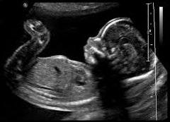
What is the Anatomical Survey?
We have a lot to cover, let’s get started!
An anatomical scan is a second trimester ultrasound typically performed around 20 weeks gestation!
What are we assessing during the exam?
Site of placental implantation
Fetal biometry
Fetal Anomalies
Fetal Growth/Well-being
Assessment of Fluids

Slide 3
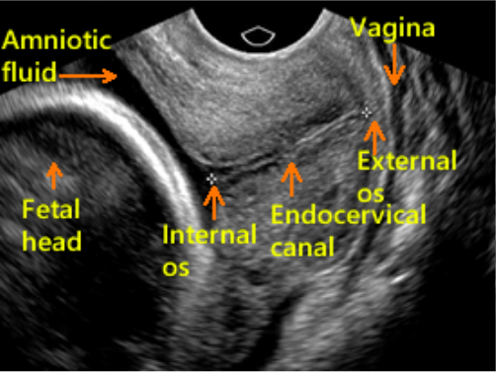
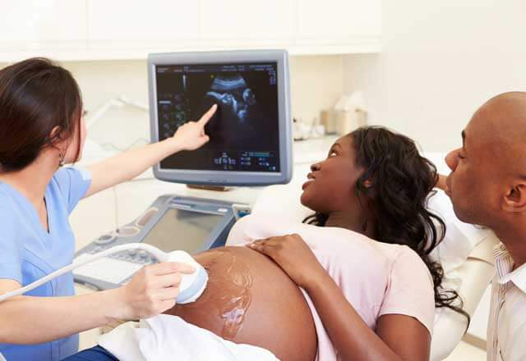
Maternal Assessment
It’s important to remember when performing any obstetrics exam that we are always dealing with at least two patients, mama and baby!
Always evaluate:
Cervix for competency
Length of Cervix
Placenta location in relation to cervix
Mothers ovaries & Adnexa
Uterine Anomalies
Baby’s body position (Vertex, Transverse or Breech)
Cervix should measure between 3-4cm!

Slide 4
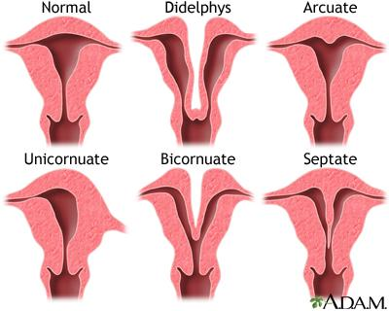
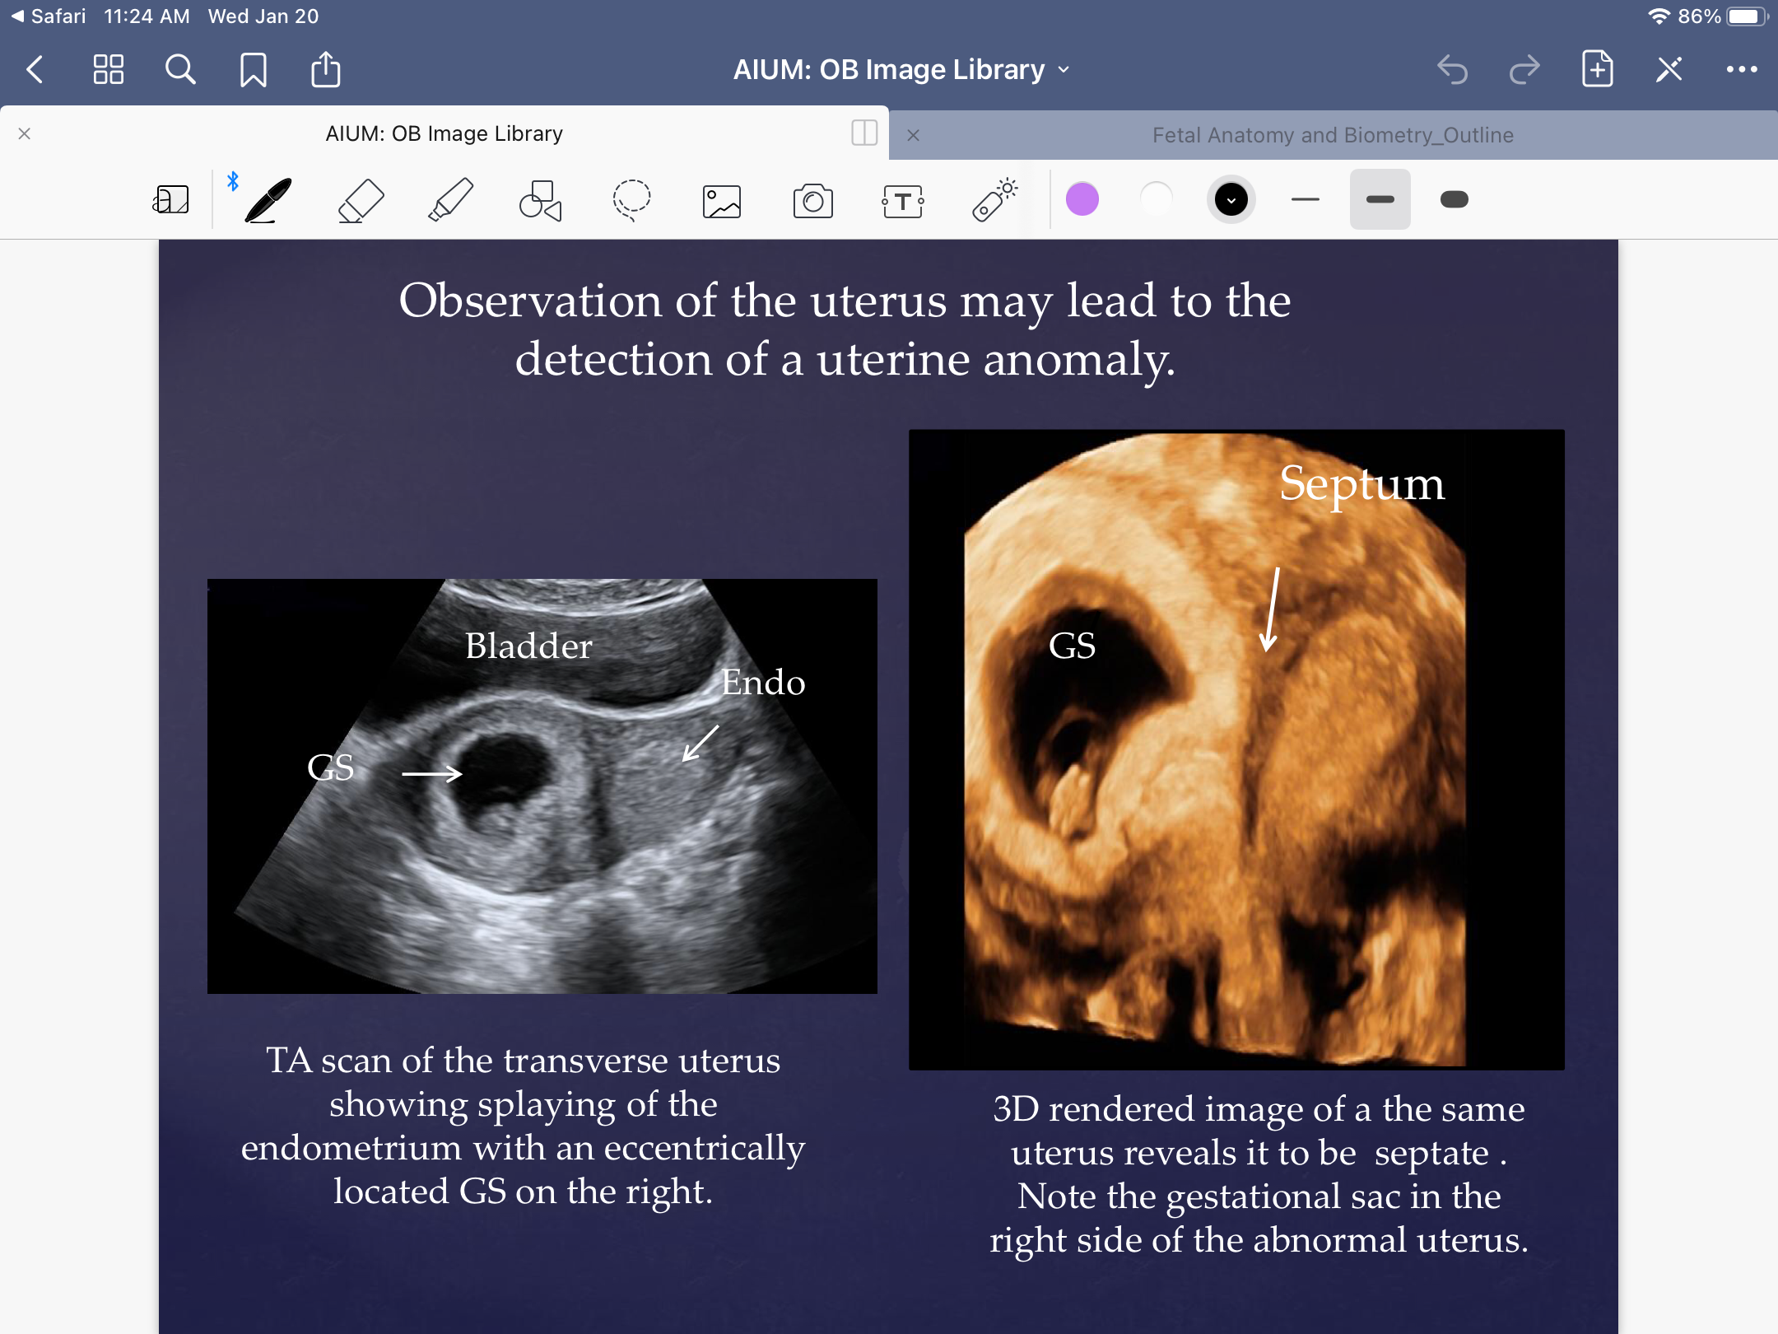
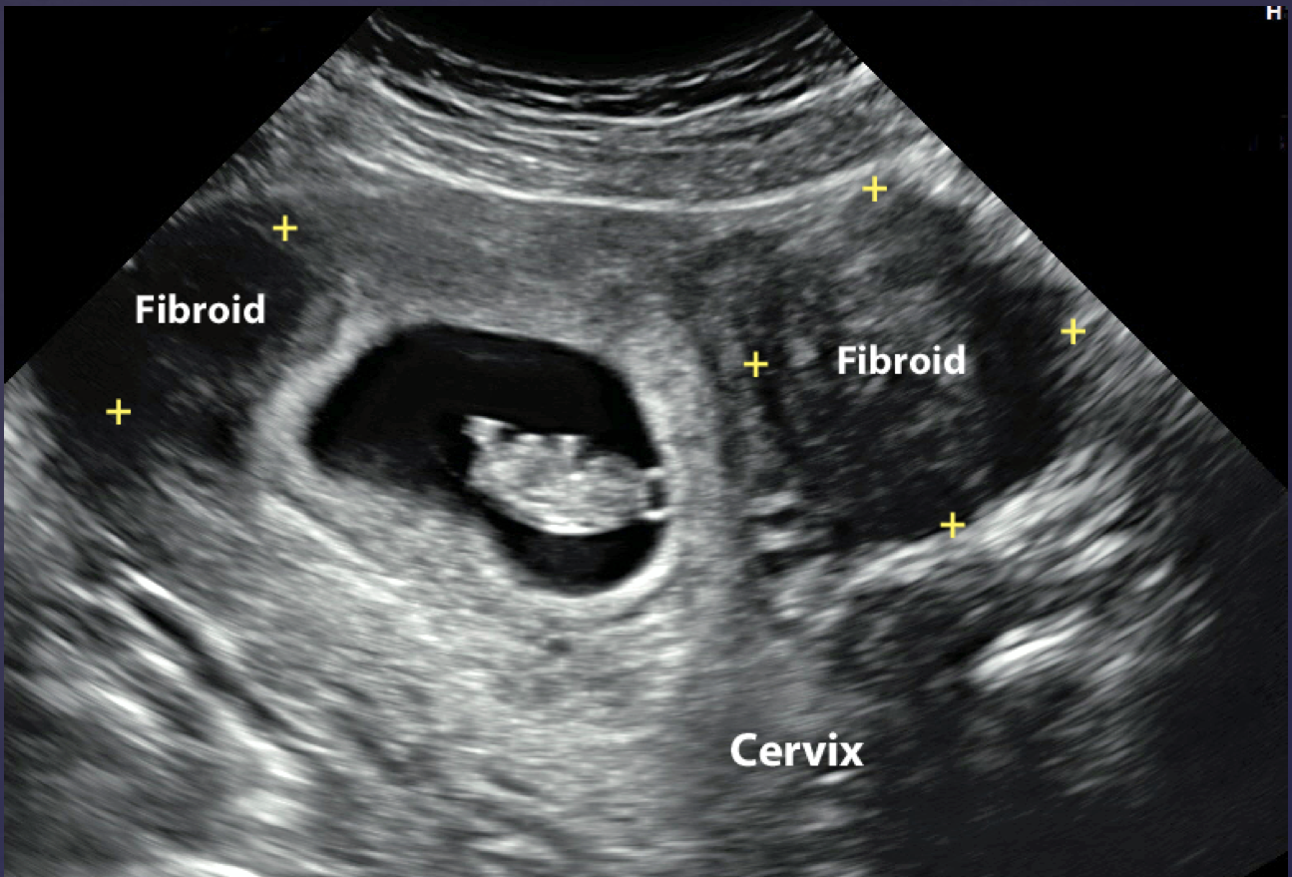
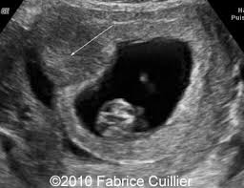
Endometrial Polyp

Slide 5
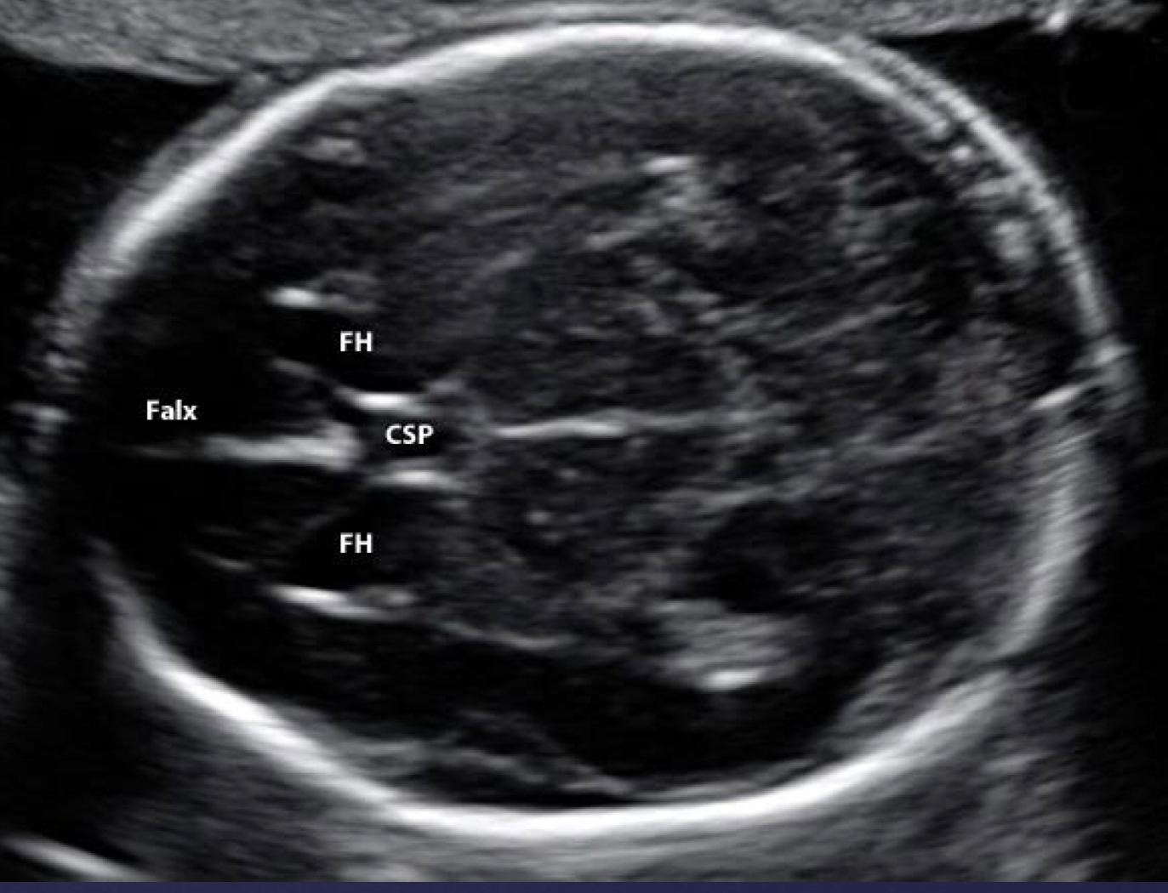
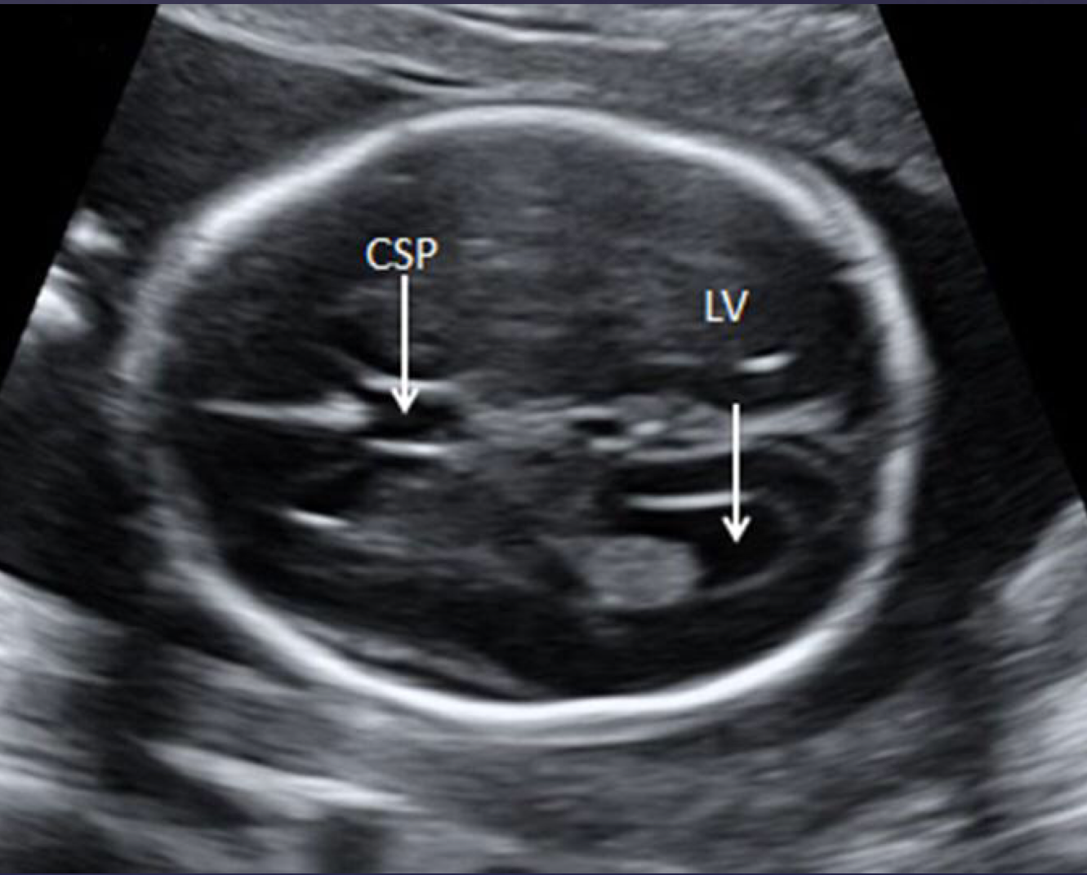
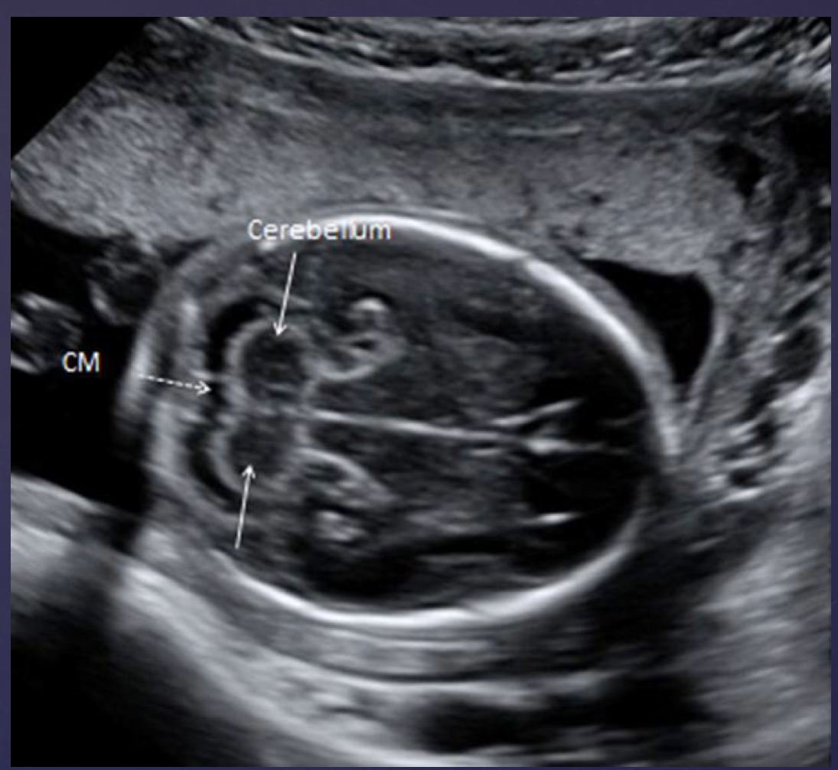
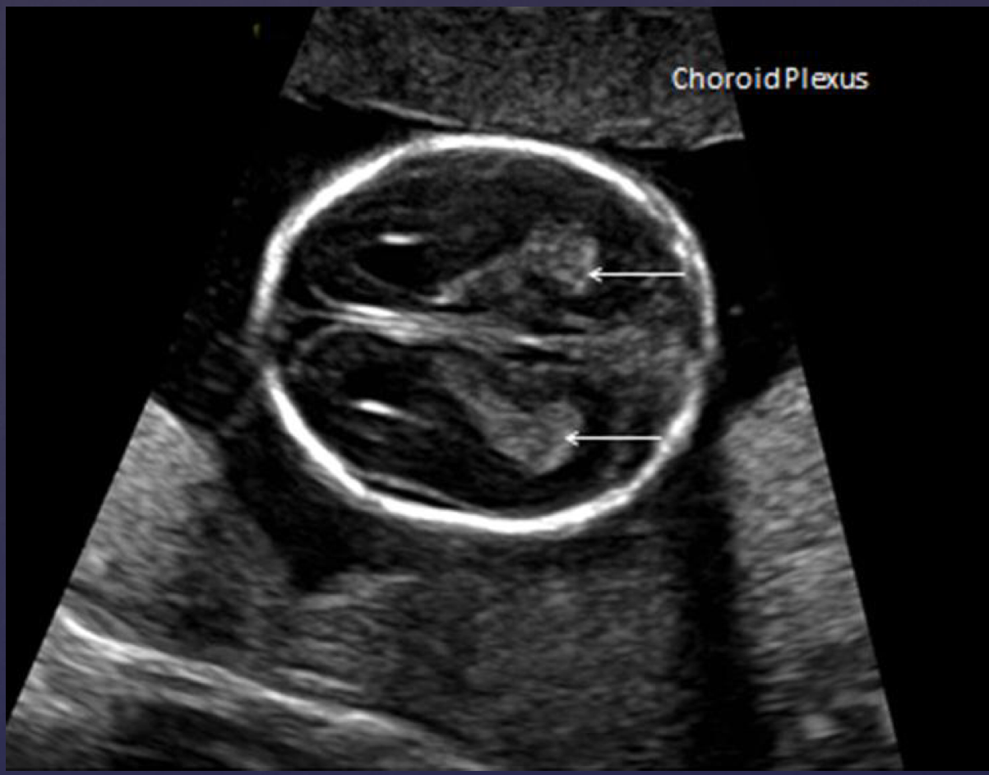
Fetal Head
In addition to several measurements we will take throughout our 2nd trimester scan here are a few cranial areas we will assess for anomalies:
Cerebellum
Choroid Plexus
Cisterna Magna
Lateral Ventricles
Midline Falx
Cavum Septum Pellucidum
FH is for Frontal Horns!

Slide 6
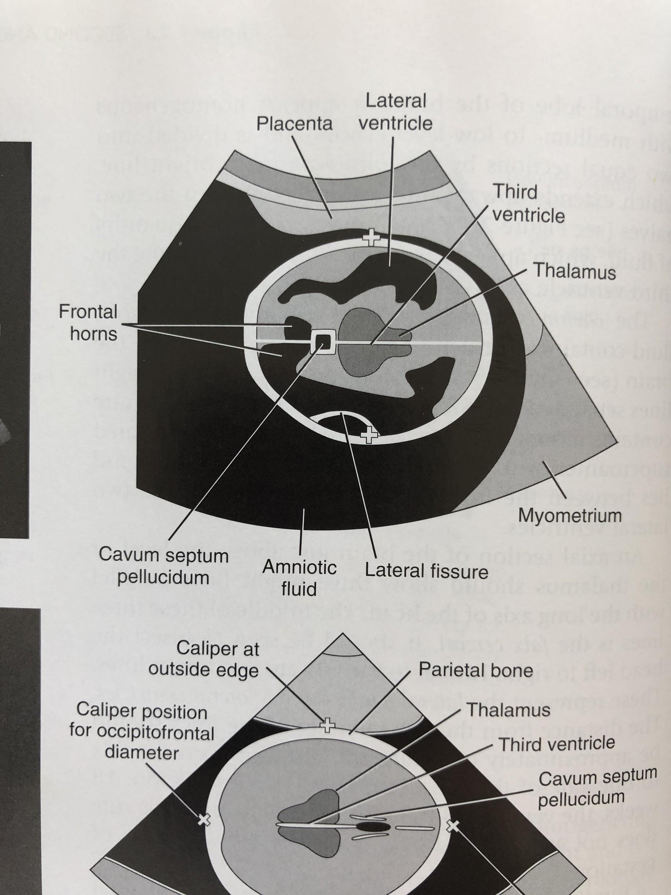
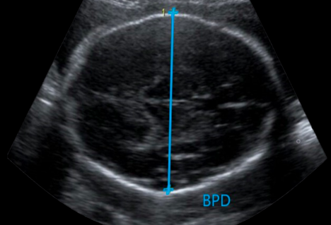
Biparietal Diameter (BPD)
Starting from the fetal head and working our way caudally we will begin with our first measurement, the BPD.
Typically used from 12 weeks throughout the rest of the pregnancy
Captured with probe in the Transverse scanning plane
Measurement taken at the level of the Thalamus and Cavum Septum Pellucidum
Too low if cerebellum is visualized.*
Always taken Outer to Inner!
Notes:
At this point we are no longer using CRL to measure fetal age. It will be replaced by 4 measurements: BPD, HC, AC, and FL.

Slide 7
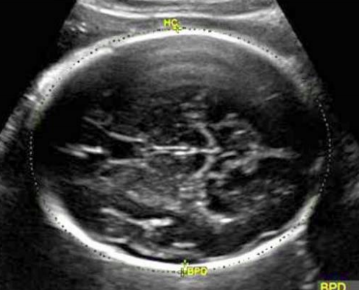
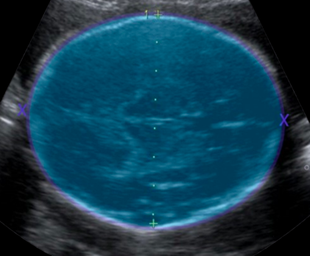
Head Circumference (HC)
Fun Fact: Calvarium is the “Roof of the Skull”!
Remaining at the same level and scanning plane we captured our BPD measurement we will now measure the entire cranial circumference!
Using the ellipse tool measure the outer echogenic edge of the fetal calvarium.
For the most accurate values ensure the calvarium is both symmetrical and smooth!

Slide 8
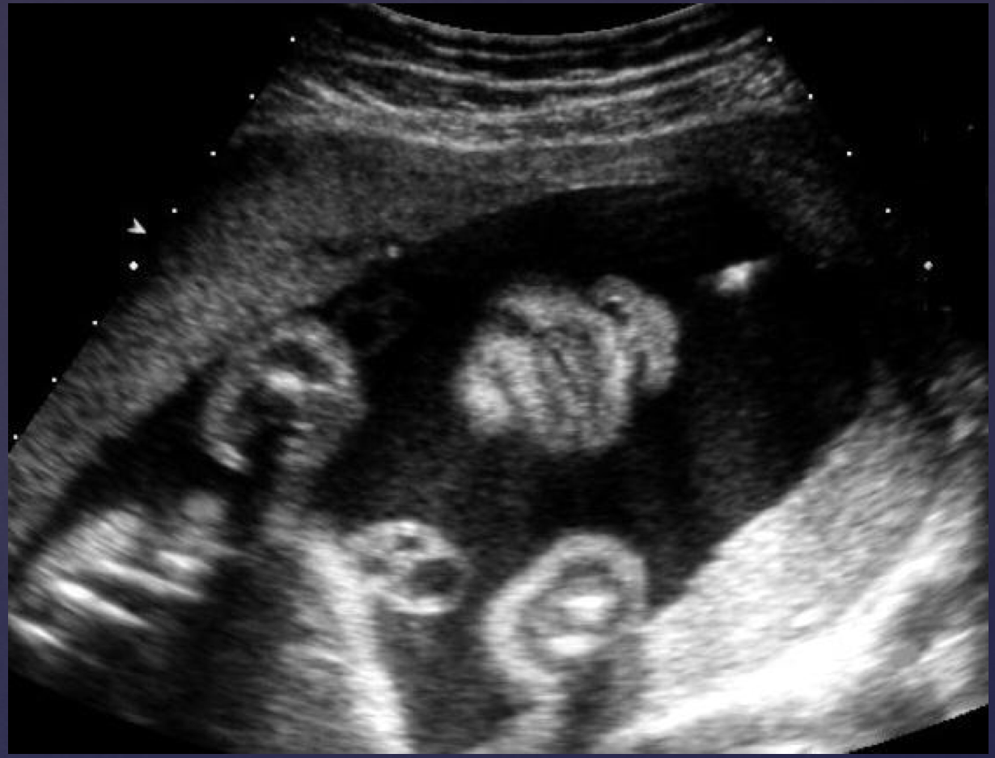
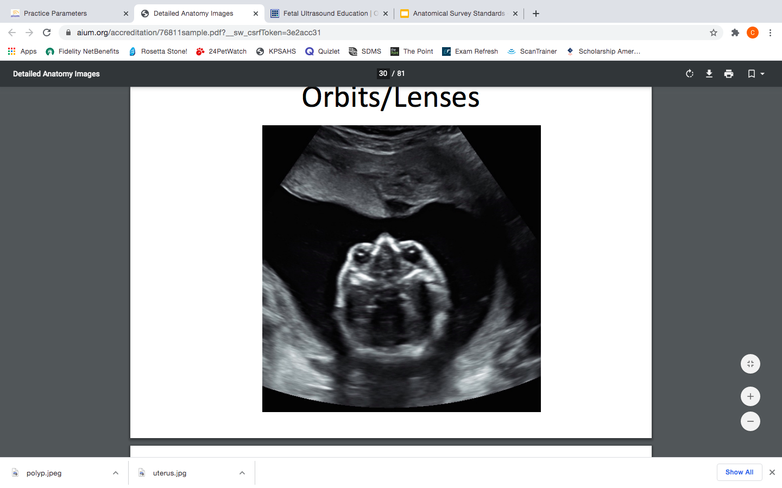
Fetal Face
Fetal face should include visualization of Orbits, Nose, Lips, Palate, Maxilla, Mandible, and Chin.

Slide 9
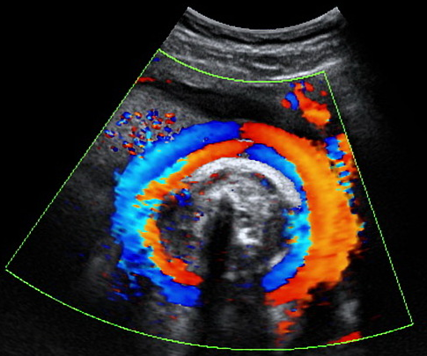
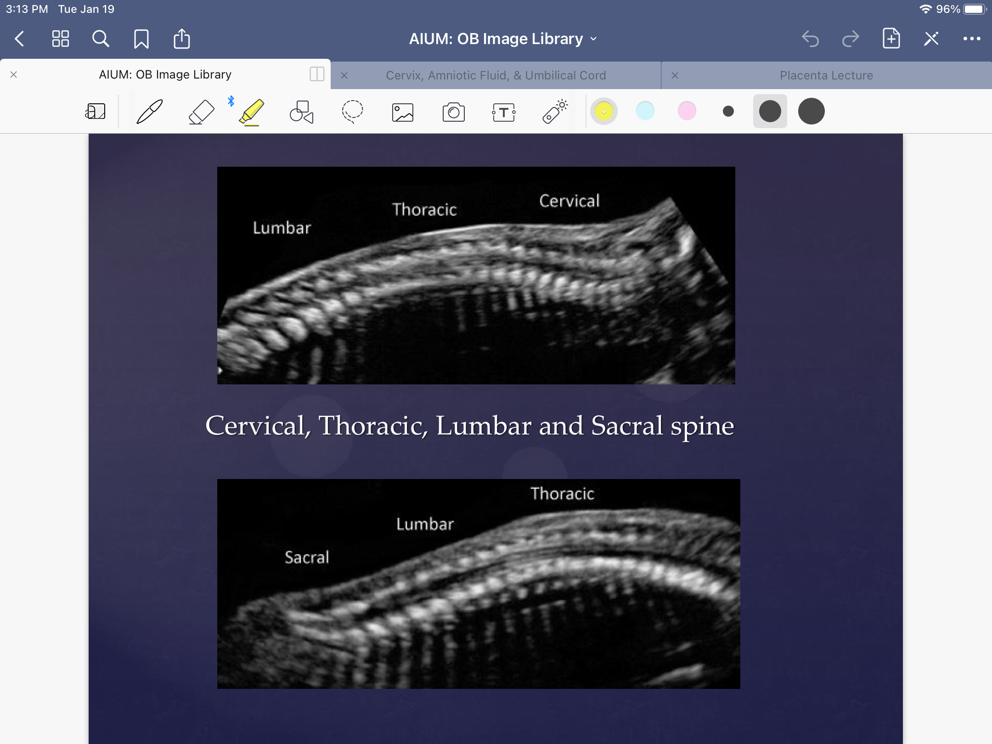
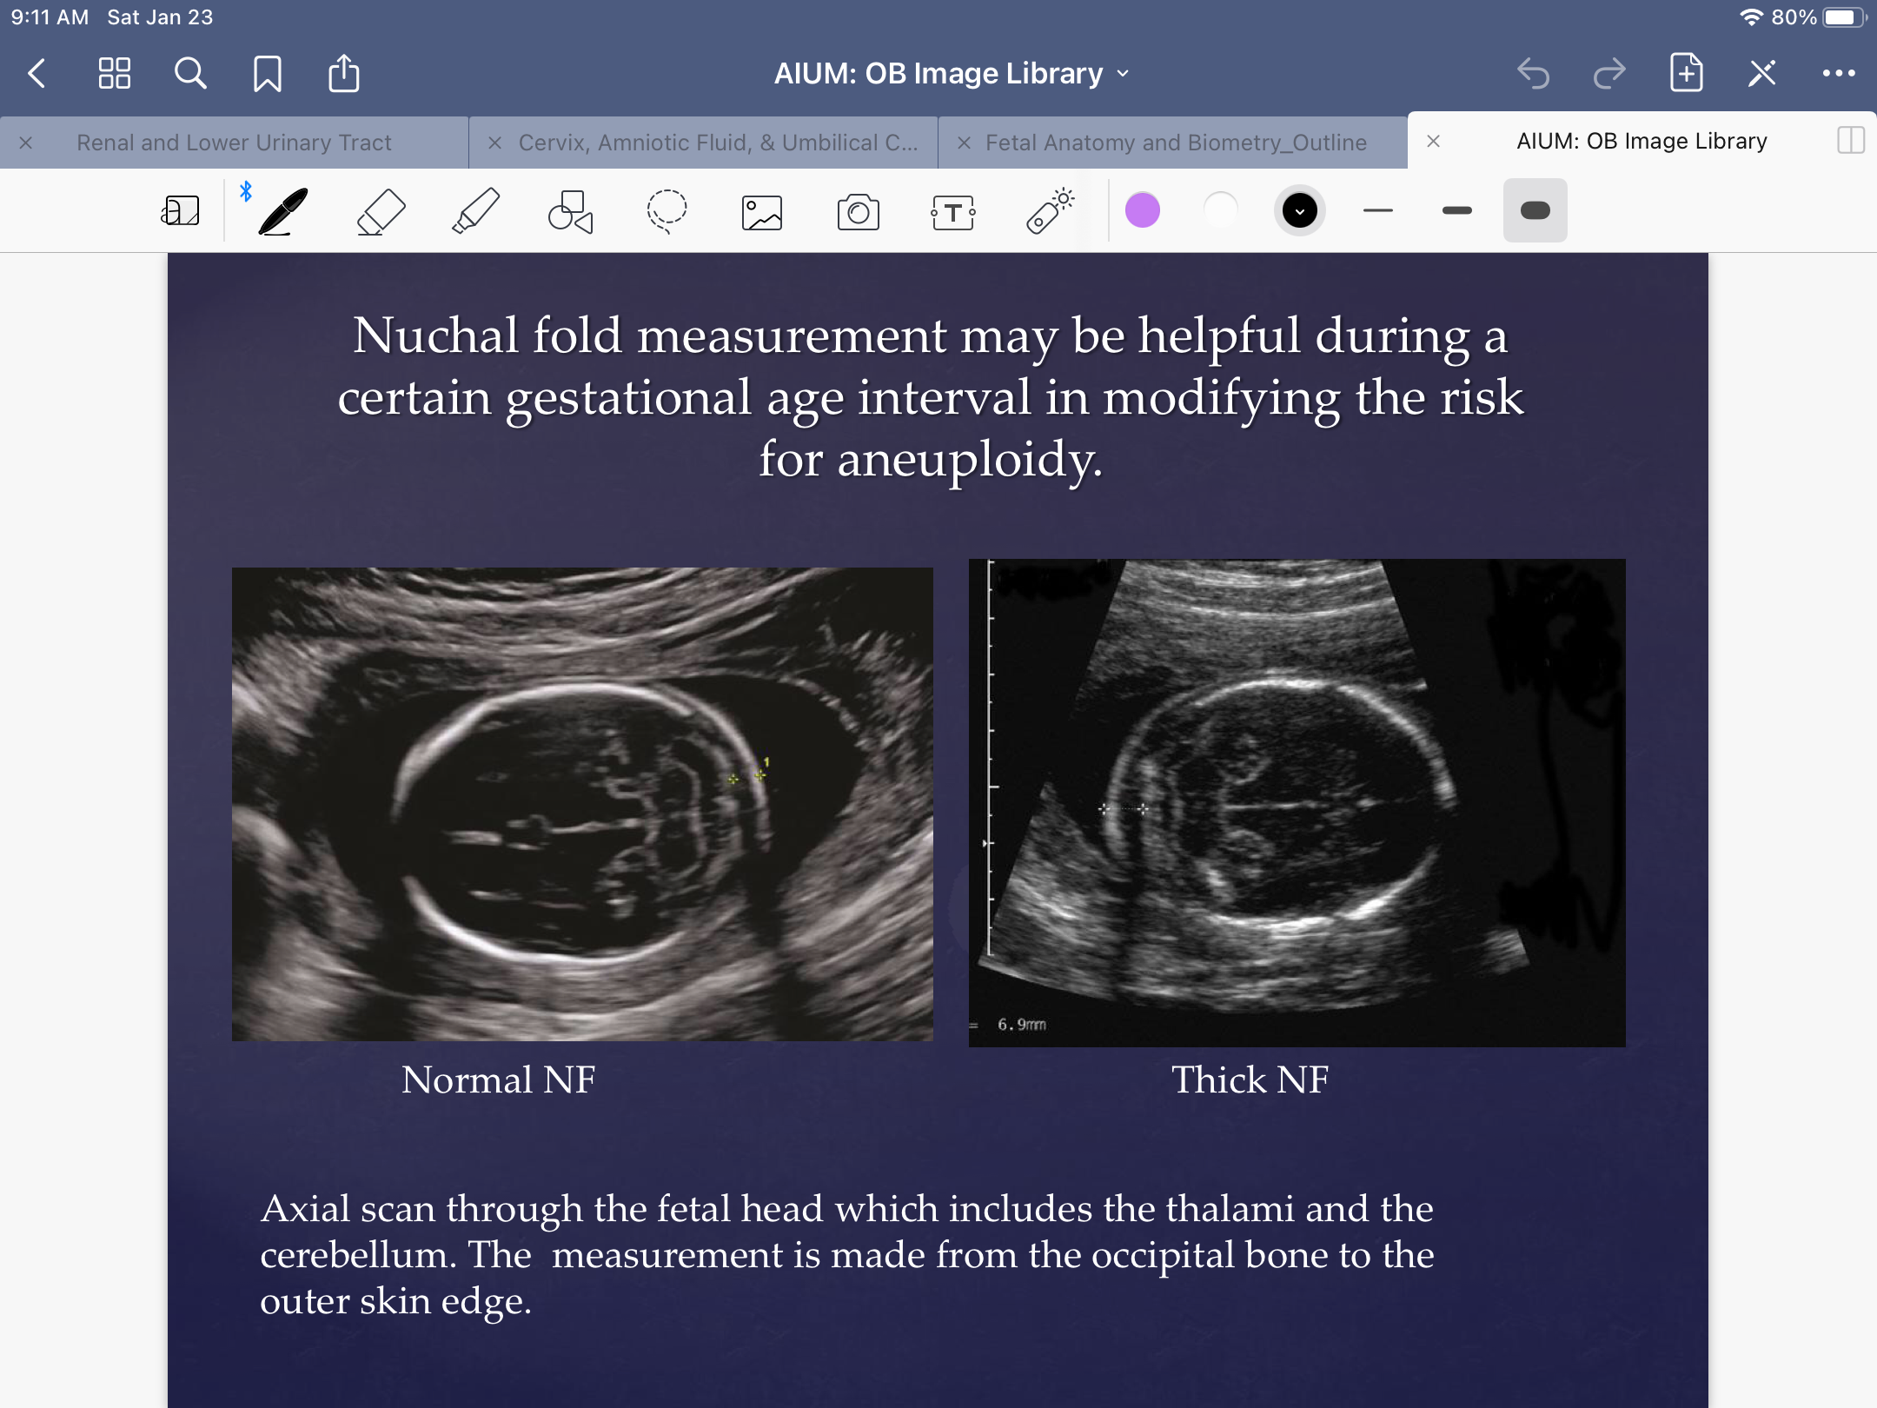
Fetal Neck & Spine
Nuchal Cord
Nuchal fold <6mm is normal!

Slide 10
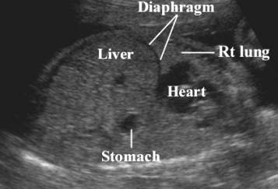
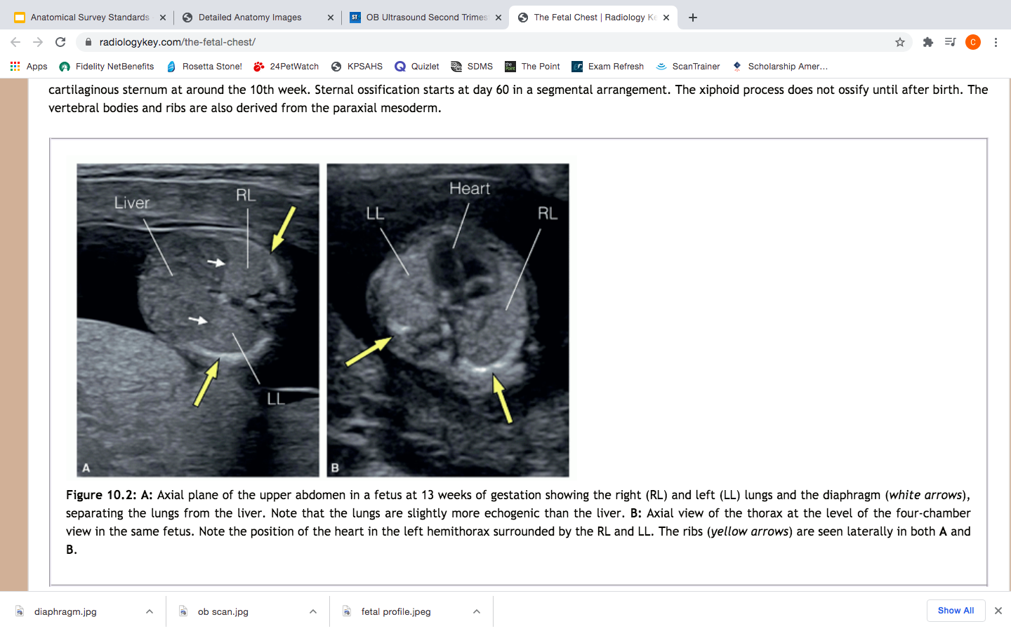
Fetal Chest
As we continue to move downward along the fetus we will next evaluate several areas of the chest including:
Lungs
Diaphragm
Heart

Slide 11
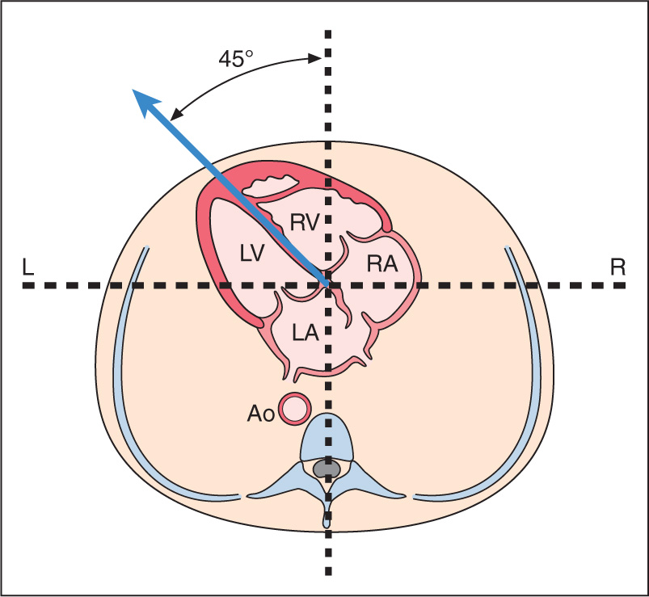
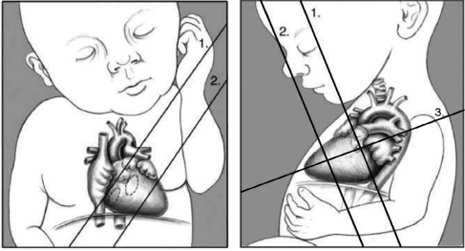
Normal Heart Fetal Heart:
45° to the left of midline
Occupies 1/3 of chest cavity
Includes 2 Atria, 2 ventricles, Valves, and Septums.

Slide 12
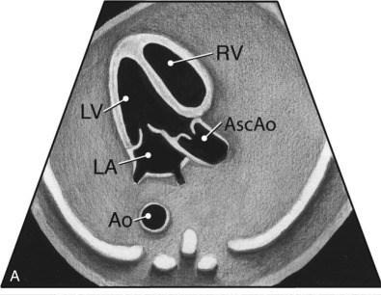
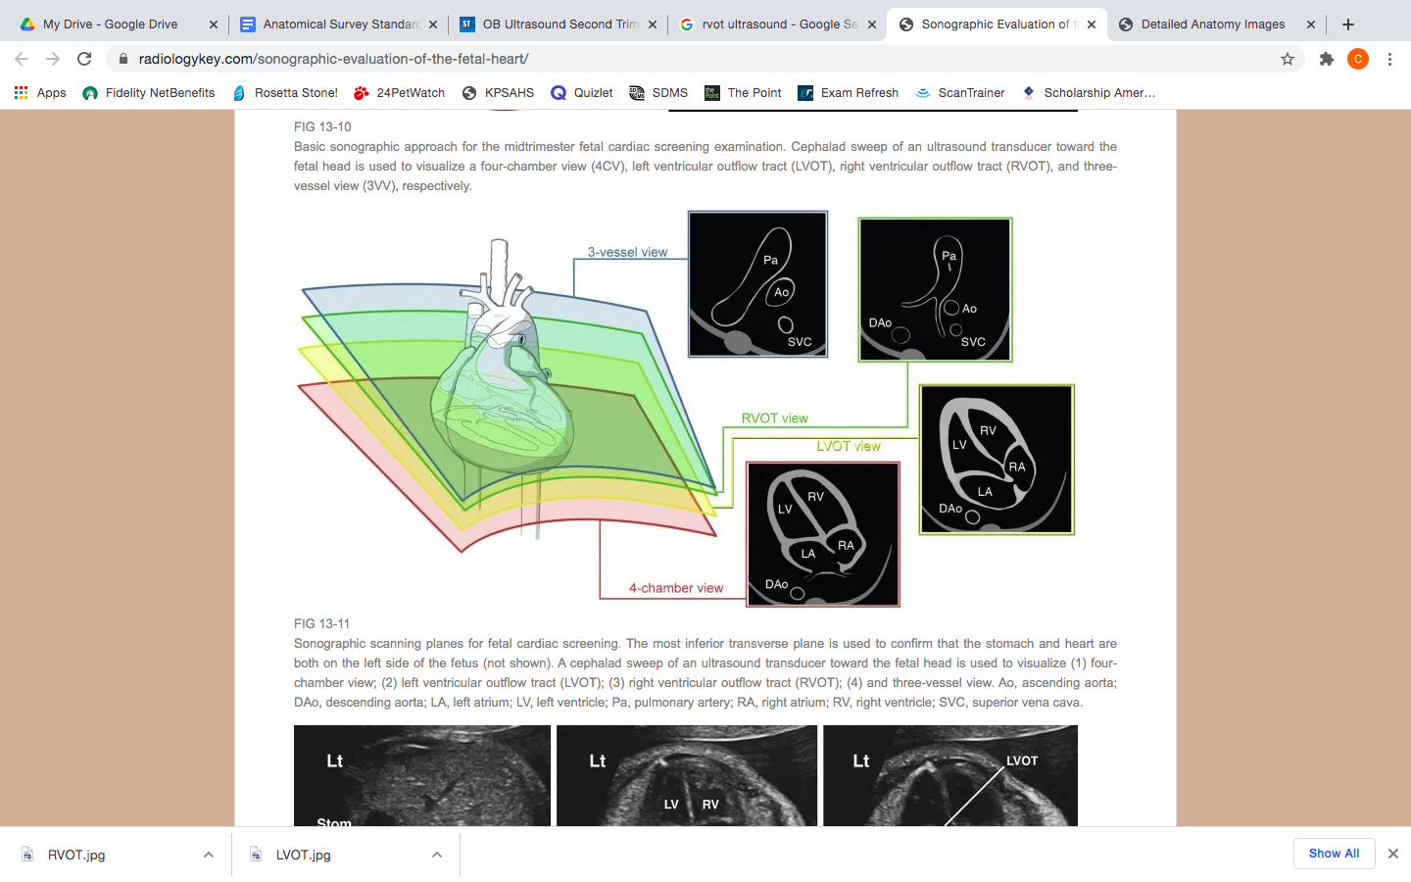
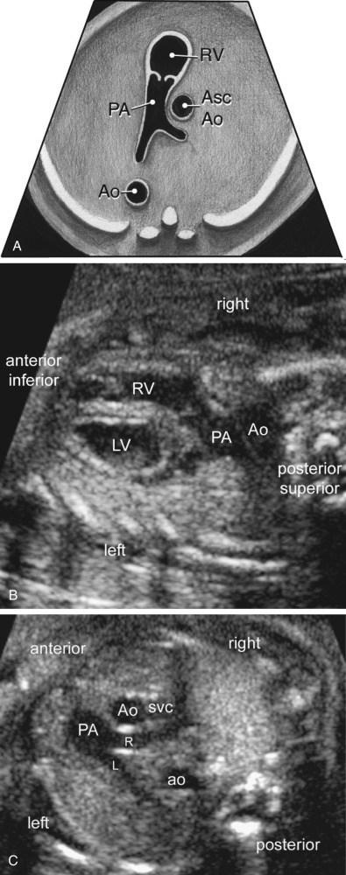
Left Ventricular Outflow Tract (LVOT)
Right Ventricular Outflow Tract (RVOT)

Slide 13
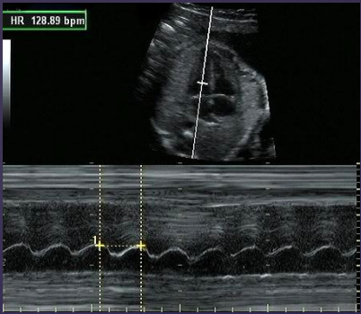
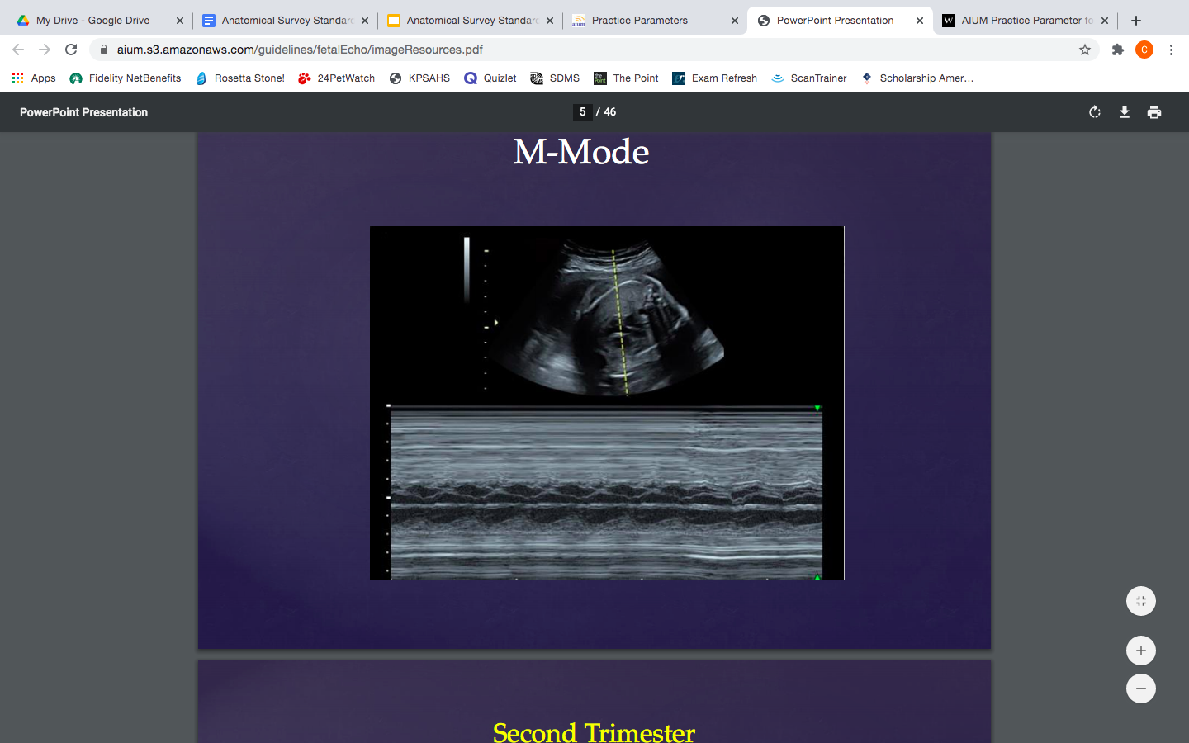
Normal HR after 12 weeks is 120-160 BPM!

Slide 14
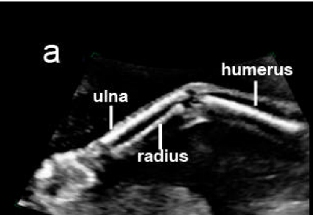
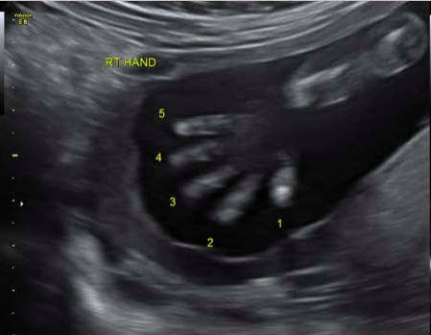
Fetal Upper Extremities

Slide 15
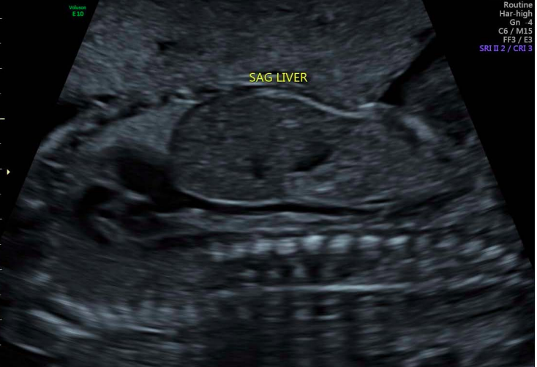
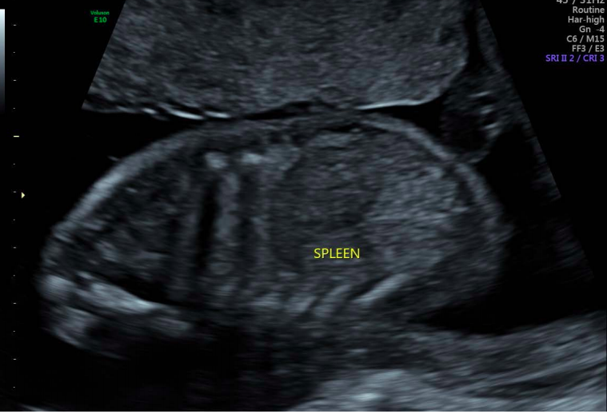
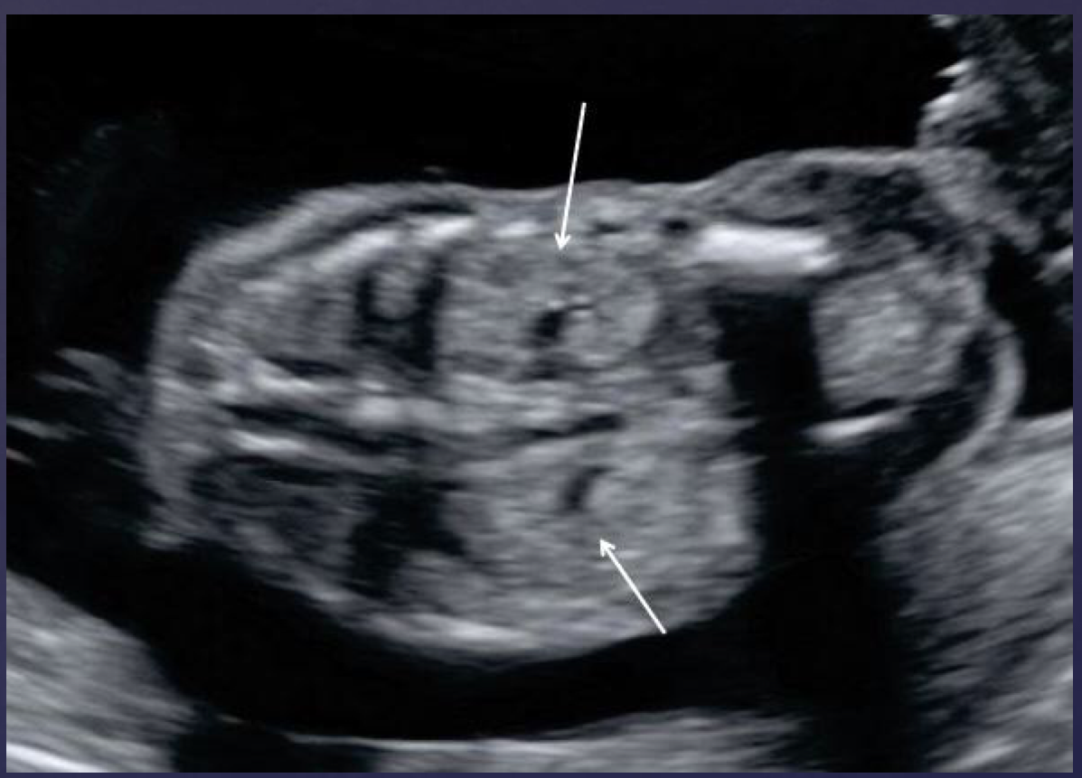
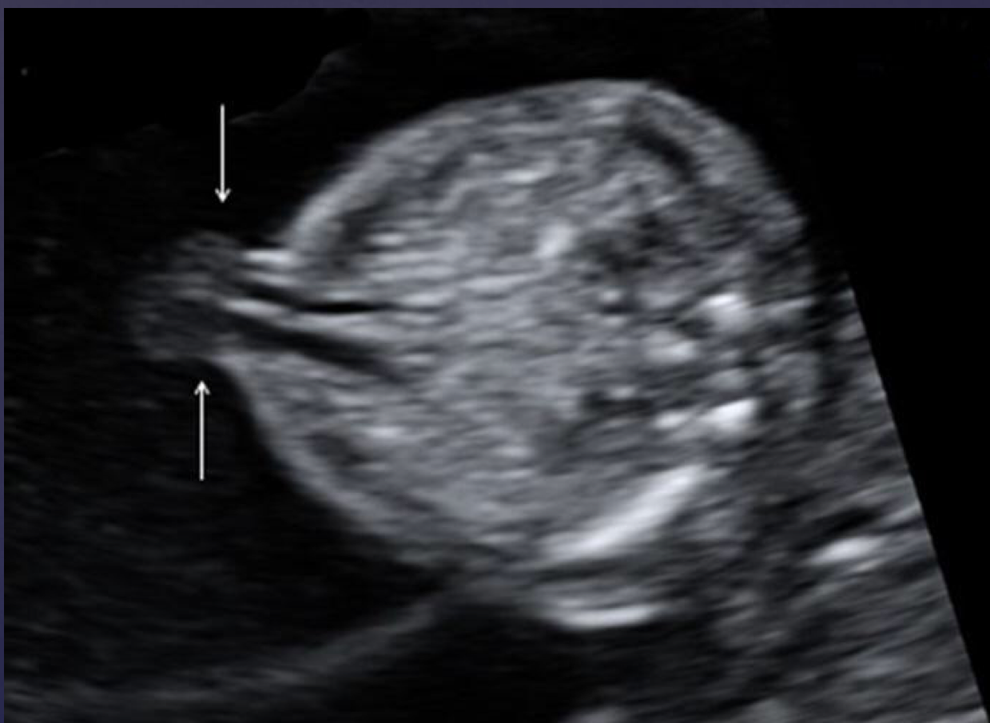
Fetal Abdomen
Cord insertion into fetal abdomen
Bilateral Kidneys

Slide 16
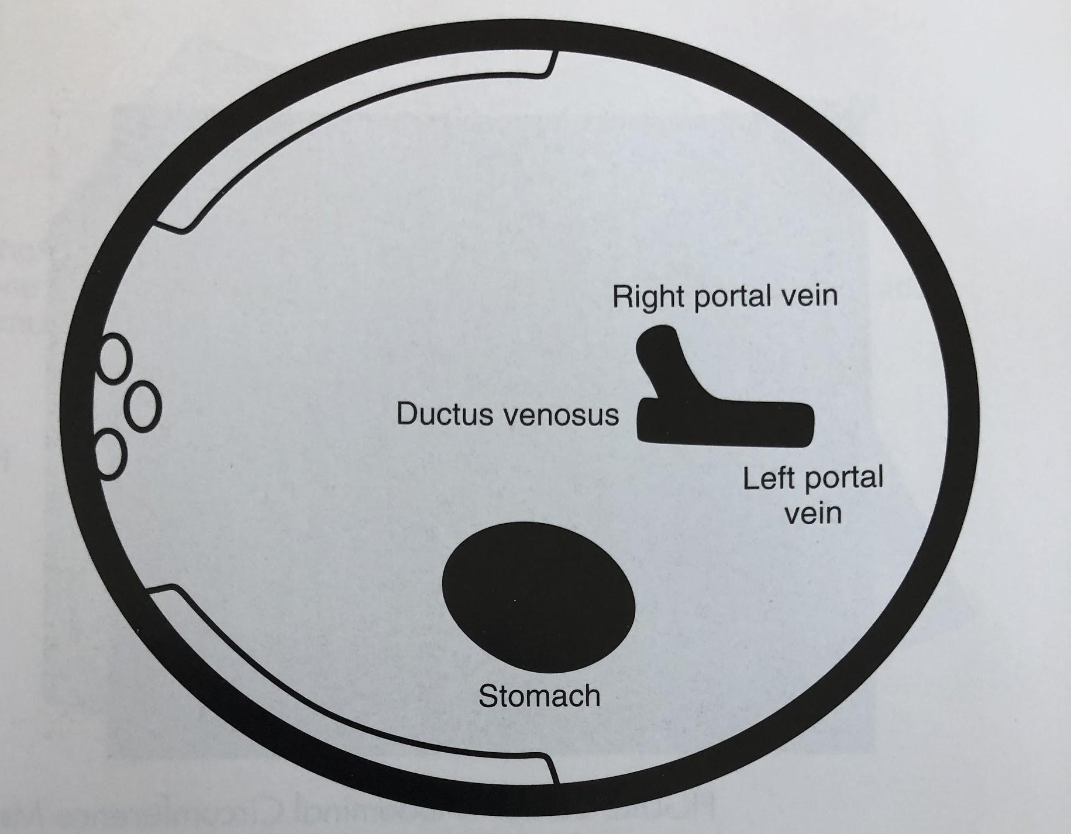
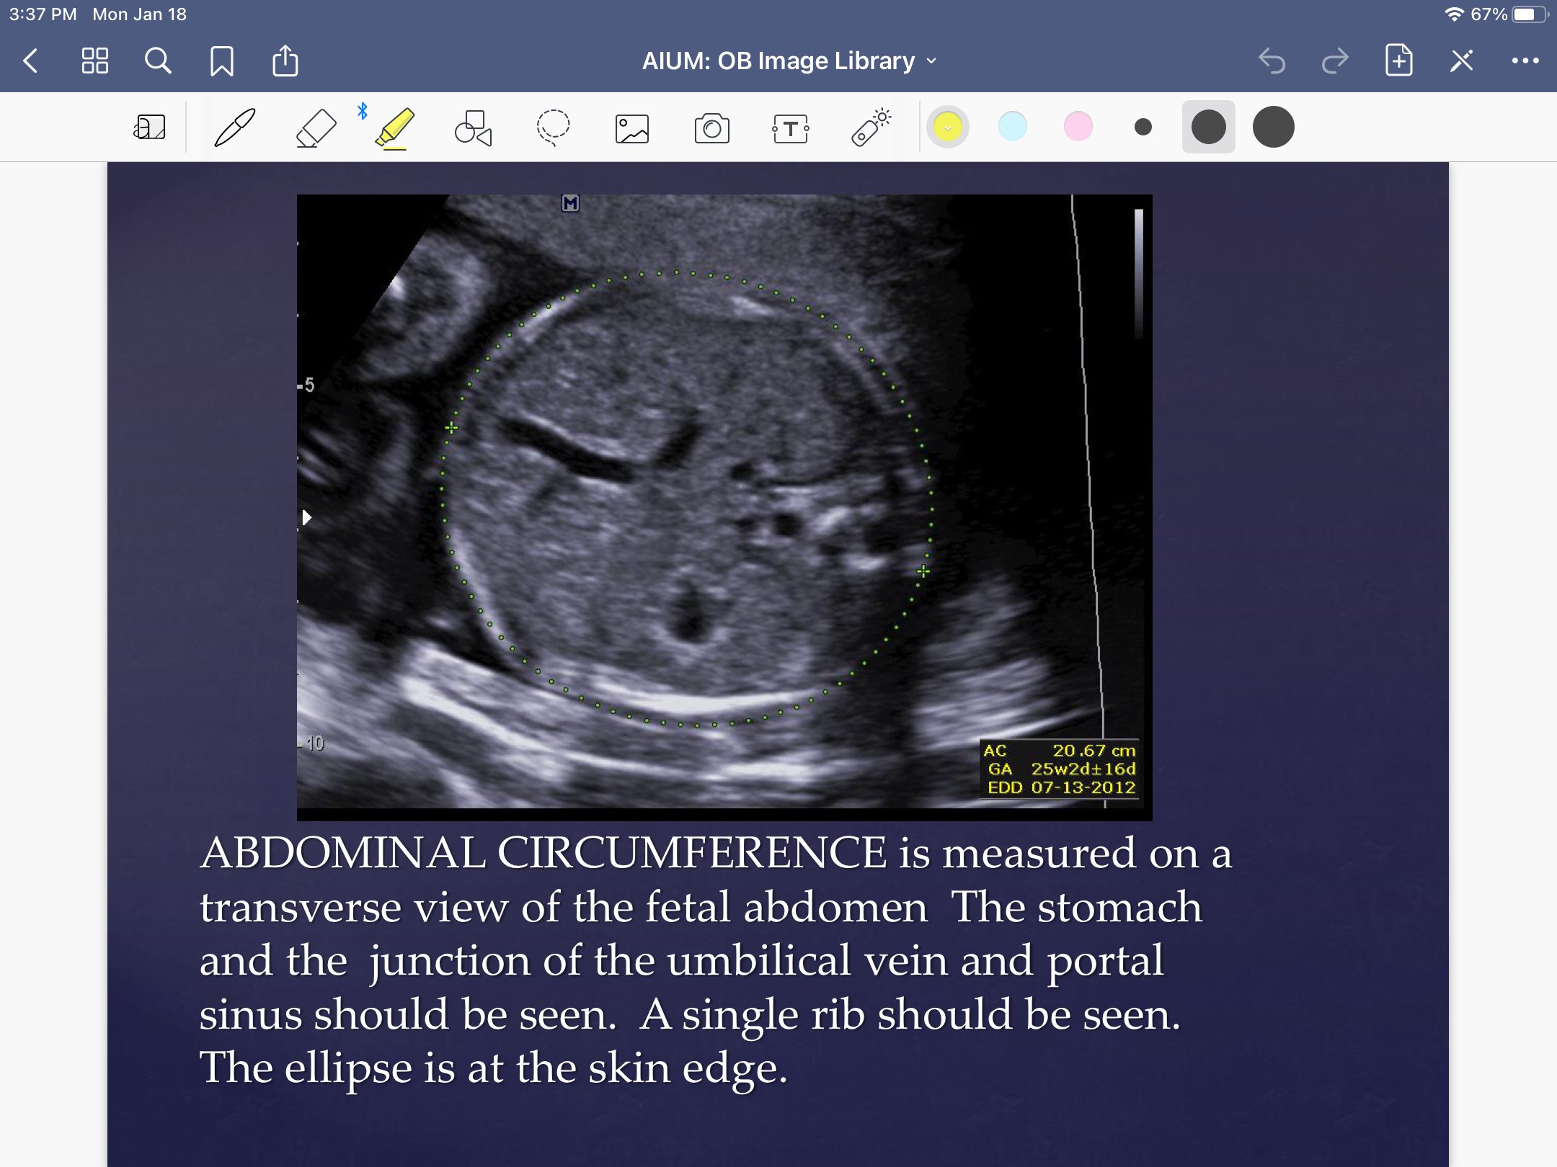
Abdominal Circumference (AC)
Accuracy of this measurement is extremely important. It is used more as indication of fetal weight than fetal age.
Used a way to estimate the size of both the liver and spleen. Incorrect calculations could reflect poor fetal health.
Often the most mismeasured fetal parameter, should be documented at a precise location
Always remember to look for the “Hockey stick” or “J” signs created by the joining of the umbilical and portal veins!
“J” sign

Slide 17
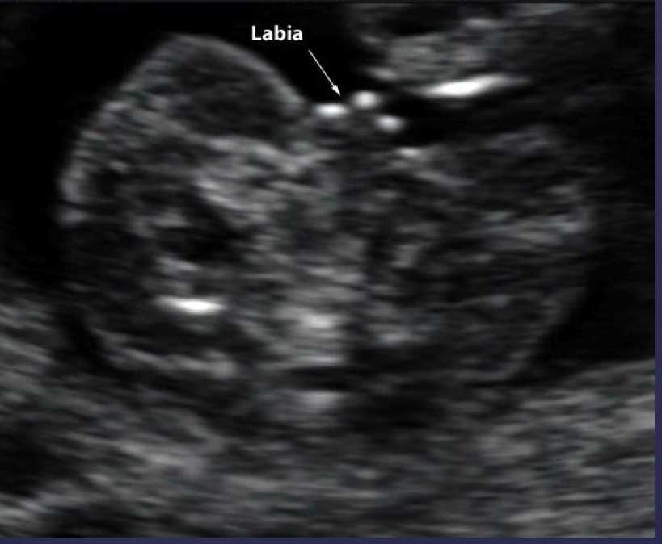
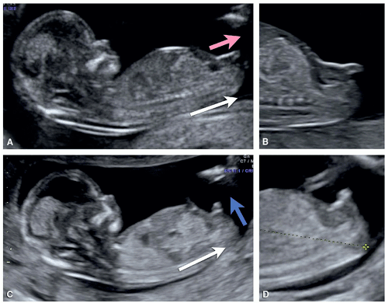
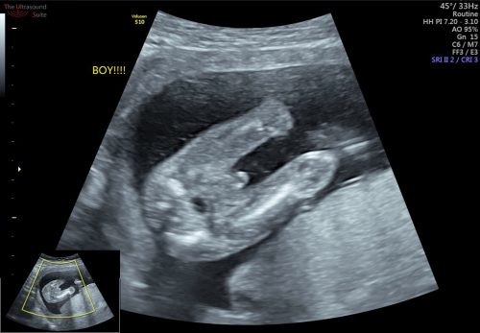
Fetal Genitalia
Girl!
Boy!

Slide 18
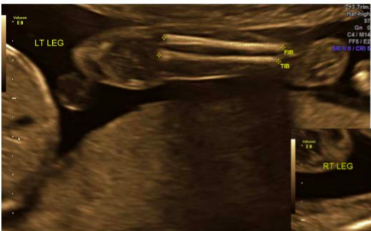
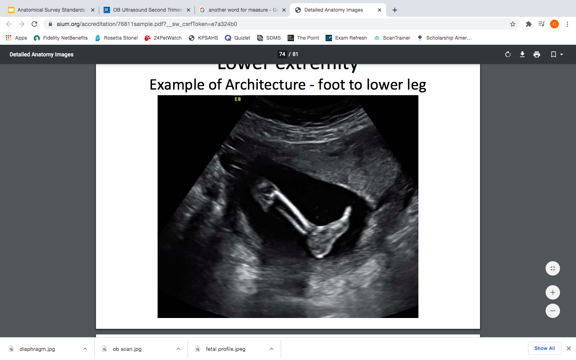
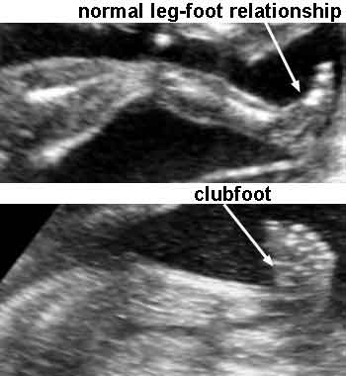
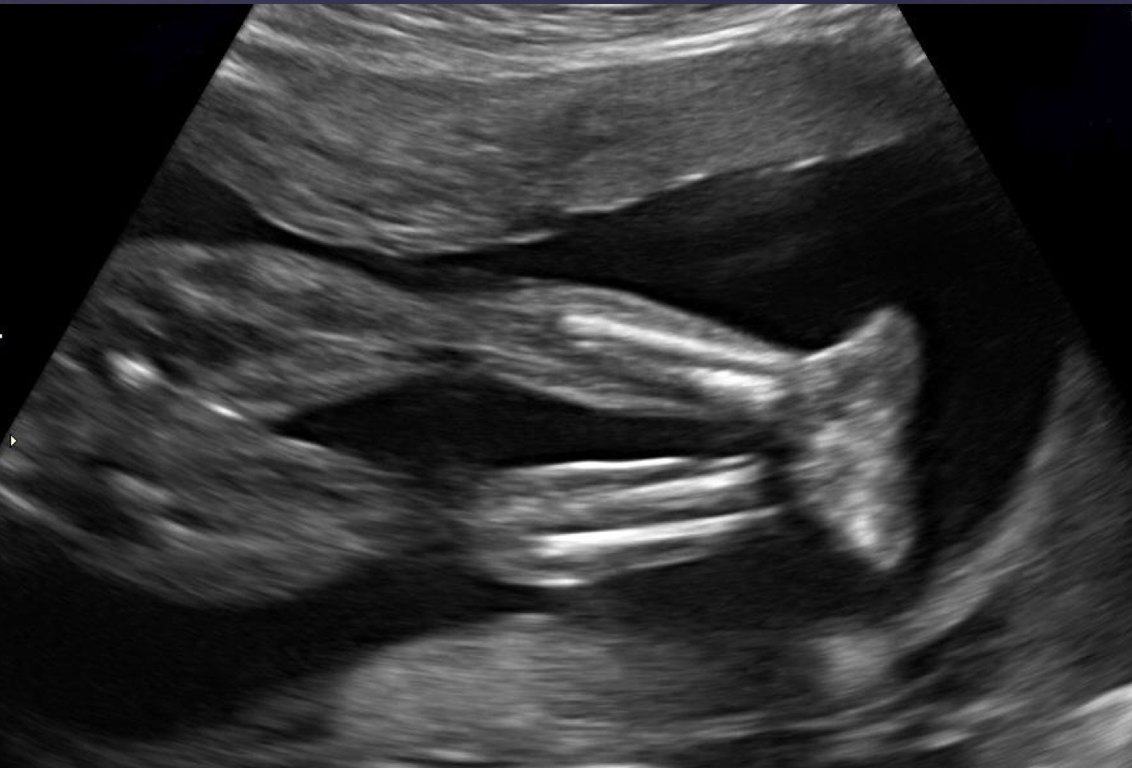
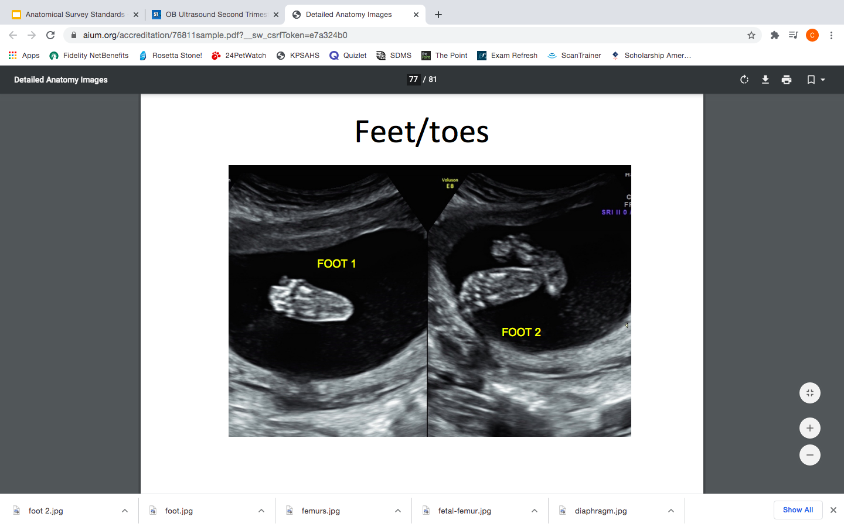
Fetal Lower Extremities
Be sure to count all the little piggies!

Slide 19
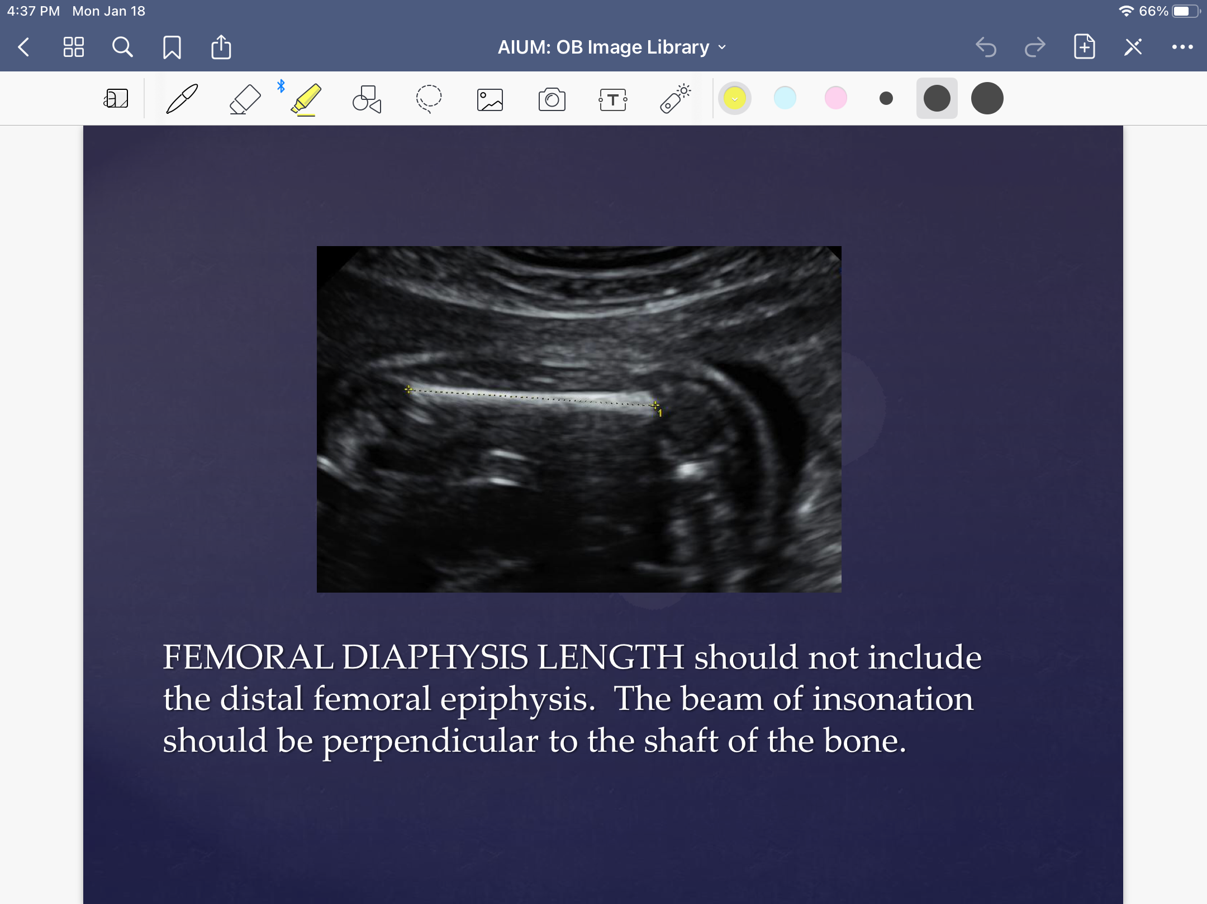
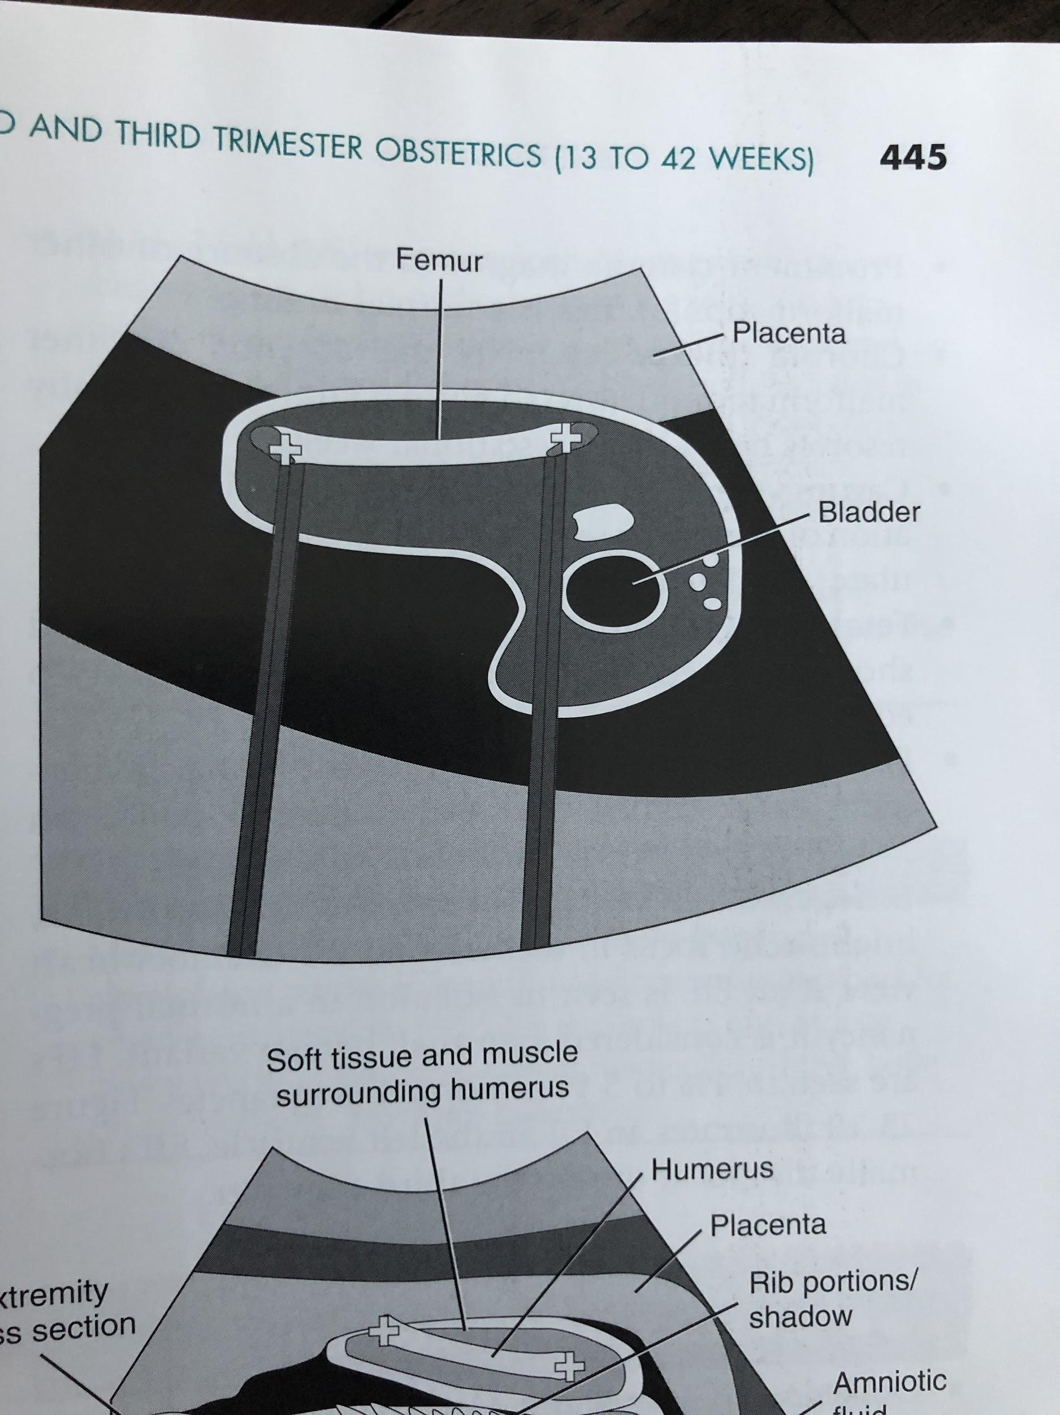
Femur Length
Most common parameter used for assessing fetal age.
Some sources believe it to be more accurate than the BPD.
Usually measured beginning at 14 weeks gestation to the end of pregnancy
Only the femoral diaphysis (shaft) is measured-do not use the femoral head or distal condyles.

Slide 20
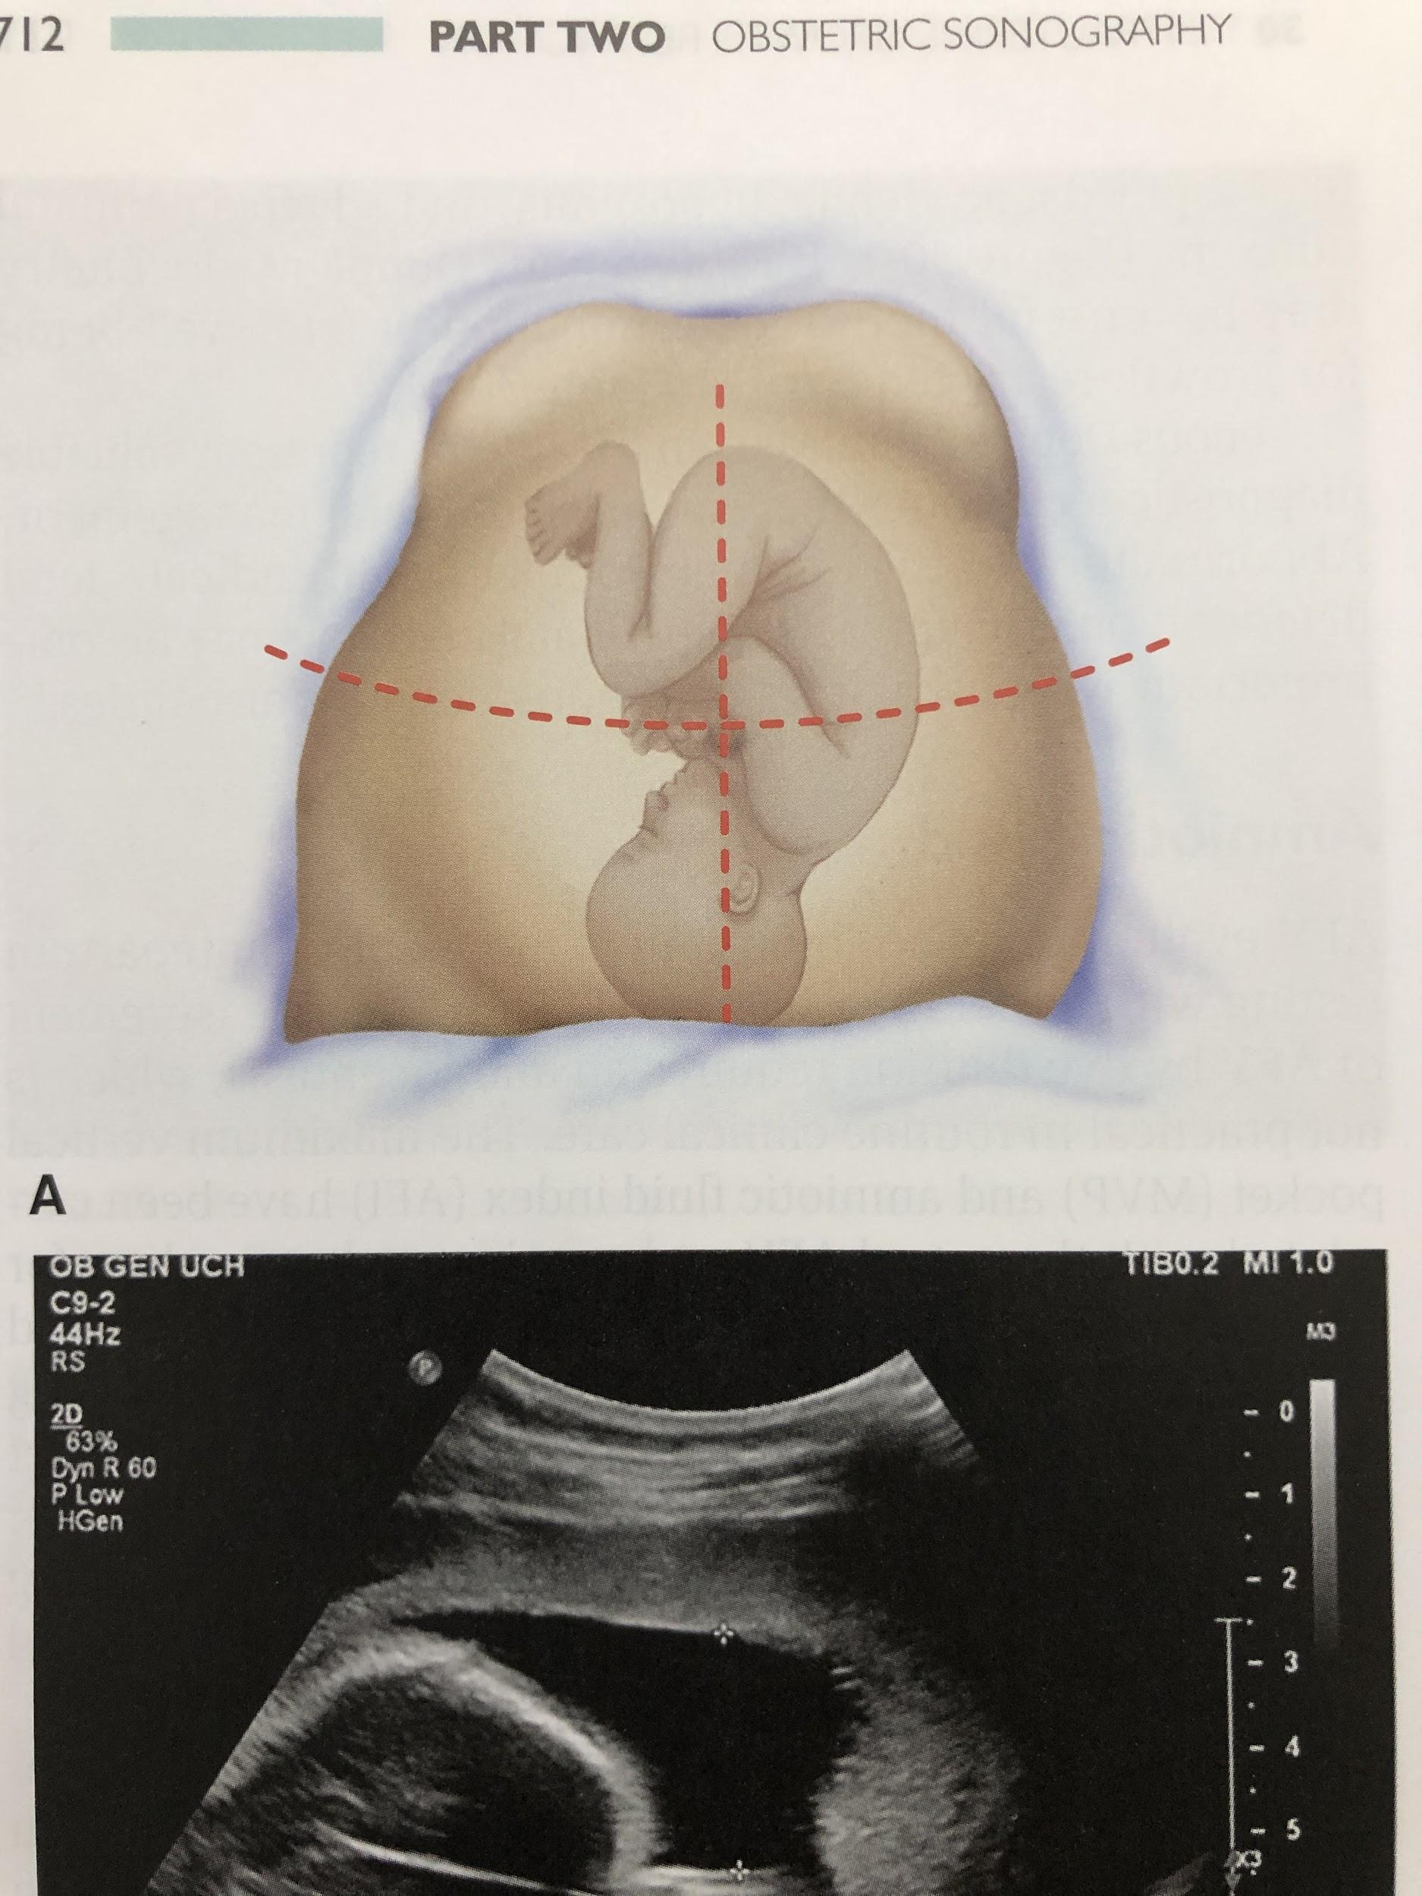
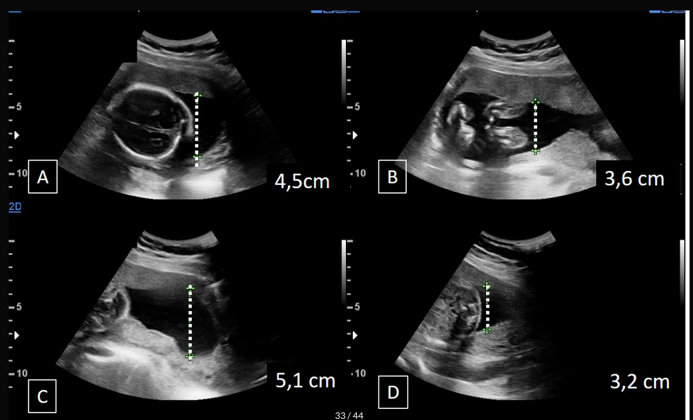
Amniotic Fluid Index (AFI)
Normal Range of AFI: 8cm-24cm
1.
2.
3.
4.

Slide 21
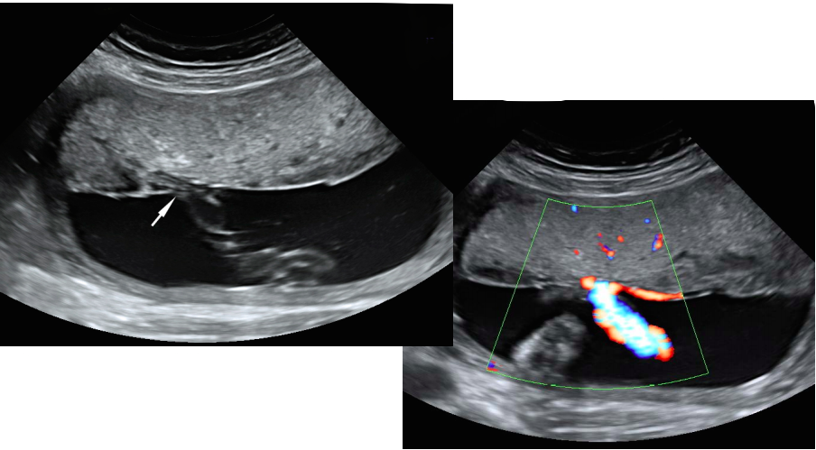


Placenta
Umbilical Cord Insertion should always be examined!

Slide 22
References
Feldstein, Vicki, and Roy A Filly. “ULTRASOUND EVALUATION OF NORMAL FETAL ANATOMY.” Radiology Key, 10 Mar. 2016, radiologykey.com/ultrasound-evaluation-of-normal-fetal-anatomy/.
Hughley, Michael. “2nd And 3rd Trimester Ultrasound.” Brooksidepress.org, 2008, brooksidepress.org/Products/OBGYN_101/MyDocuments4/Ultrasound/2nd_and_3rd_Trimester_Ultrasound_Scanning.htm.
King, Robbi R. “Chapter 23.” Sonography: Introduction to Normal Structure and Function, by Reva A. Curry and Betty Bates. Tempkin, 4th ed., Elsevier Saunders, 2011, pp. 411–447.
Lee, Wesley. “Practice Guidelines for Performance of the Routine Mid-Trimester Fetal Ultrasound Scan.” Pedrad.org, 2010, www.pedrad.org/Portals/5/Subspecialties/practice%20guidelines%20mid%20trimester%20us.pdf.
None, Provided. “Home.” ICOI, 18 Mar. 2019, www.icoi.org/glossary/calvaria/#:~:text=The%20calvaria%20definition%20is%20a,cavity%20that%20houses%20the%20brain.&text=The%20skull%20roof%20then%20becomes,much%20more%20difficult%20to%20penetrate.
Patel, Neel, et al. “Fetal Cardiac US: Techniques and Normal Anatomy Correlated with Adult CT and MR Imaging.” RadioGraphics, vol. 37, no. 4, 2 June 2017, pp. 1290–1303., doi:10.1148/rg.2017160126.
Stephenson, Susan R. “Chapter 18.” Diagnostic Medical Sonography: Obstetrics and Gynecology, by Julia Dmitrieva, 4th ed., Wolters Kluwer Health, 2018, pp. 391–419.
Suarez, Henry. “OB Ultrasound Second Trimester (The Basics).” Sonographic Tendencies, 6 Mar. 2020, sonographictendencies.com/2019/12/20/ob-ultrasound-second-trimester/.
Tutschek, Boris. Fetal Biometry, Apr. 2018, www.isuog.org/clinical-resources/fetal-biometry.html.
Weerakkody, Yuranga. “Second Trimester Ultrasound Scan: Radiology Reference Article.” Radiopaedia Blog RSS, radiopaedia.org/articles/second-trimester-ultrasound-scan?lang=us.
Zezo, Dr. “Sonographic Evaluation of the Fetal Heart.” Radiology Key, 16 Feb. 2019, radiologykey.com/sonographic-evaluation-of-the-fetal-heart/.
Zezo, Dr. “The Fetal Chest.” Radiology Key, 14 Oct. 2019, radiologykey.com/the-fetal-chest/.

Slide 23

Thanks for watching! Any Questions?

