Slide 1
Antenatal Fetal Screening Tests
&
Biochemical Analysis

Slide 2
Outline
Why do we screen?
Screen vs Diagnostic Tests
First Trimester
Second Trimester
Third Trimester

Slide 3
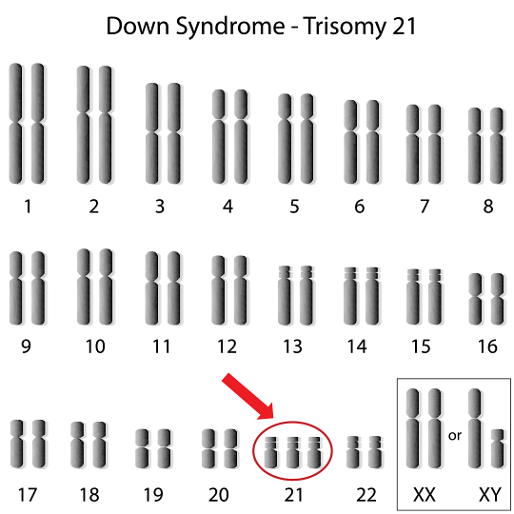
Fetal Aneuploidy: Chromosomal Abnormalities
Trisomy 21
Trisomy 18
Trisomy 13

Slide 4
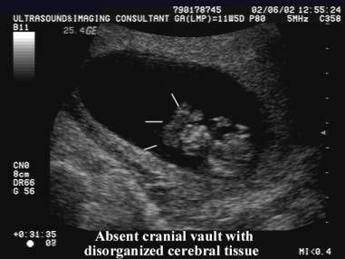
Neural Tube Defects
Spina Bifida - neural tube does not close around the spinal cord
Anencephaly- neural tube does not close at the top (brain/skull)
Iniencephaly- distorted spine, head bent backwards (RARE)
Encephalocele- neural tube does not close near the brain, protrudes out into a sac (RARE)

Slide 5
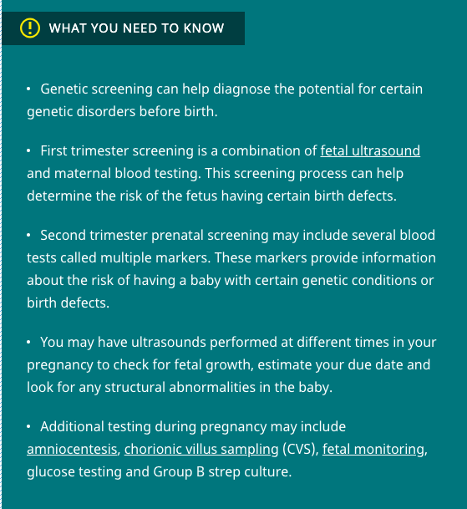
Screening tests do NOT provide specific diagnosis
Diagnostic: amniocentesis, CVS, and ultrasound

Slide 6
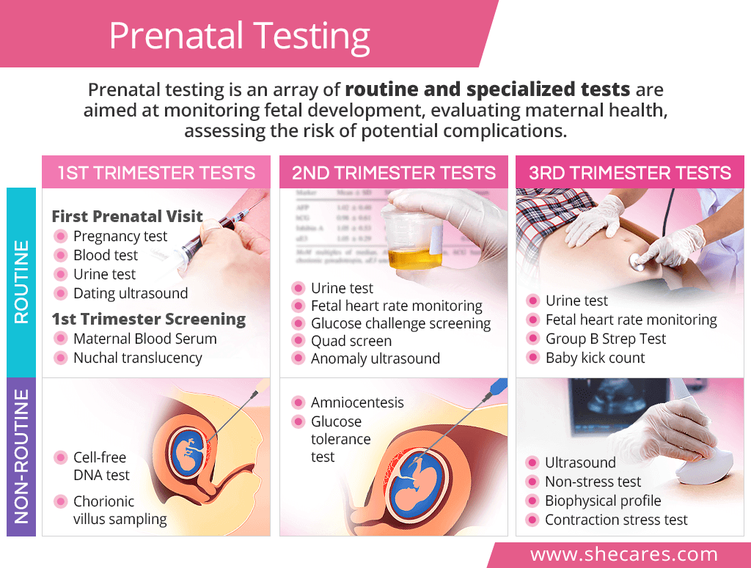

Slide 7

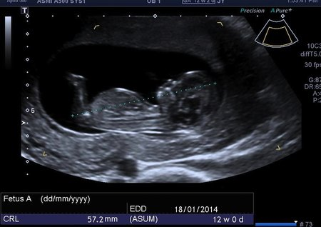
First Trimester
Maternal Serum Screening
Nuchal Translucency
Nasal Bone
Cell-free Fetal DNA Screening
Chorionic Villus Sampling (CVS)

Slide 8
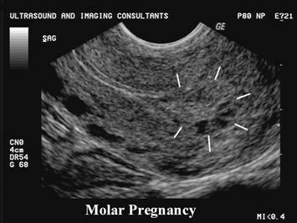
Maternal Serum Tests
Pregnancy-associated Plasma Protein A (PAPP-A) & hCG : made by placenta in early pregnancy
Abnormal levels associated with chromosomal abnormalities
Excessive hCG can also indicate molar pregnancy

Slide 9
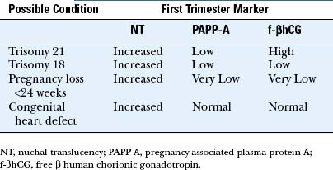

Slide 10
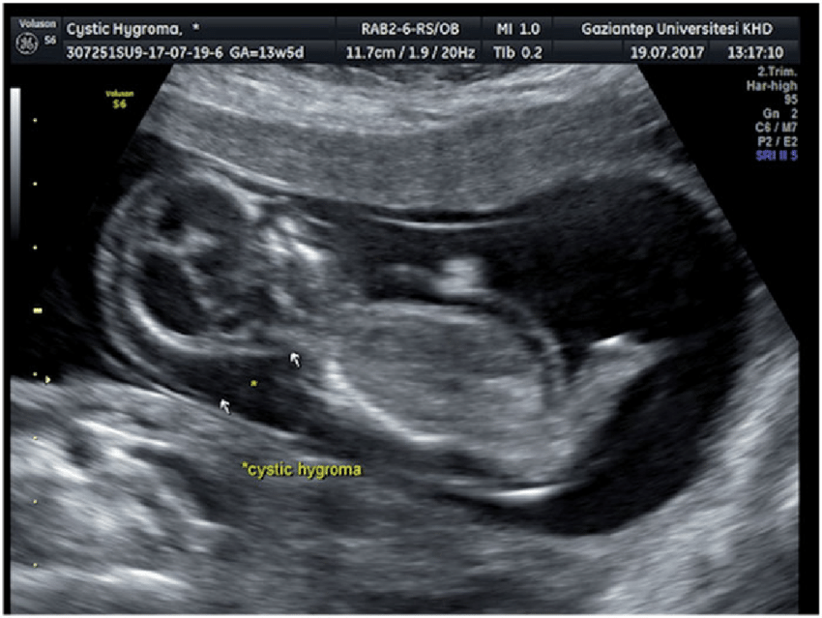
Nuchal Translucency
Fluid-filled space in the back of the neck
Space is significantly increased in fetuses with Down’s Syndrome
Cystic Hygroma
Congenital heart disease, Noonan Syndrome, skeletal dysplasias, and more
10-14 weeks (CRL 45-84mm)

Slide 11
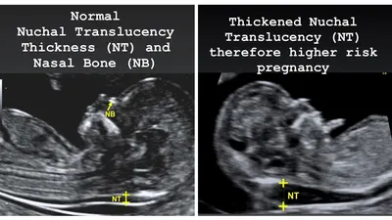
Should be imaged in midsagittal position (nasal bone, hard palate, diencephalon)
Fetal head should not be extended or flexed
Calipers inside hyperechoic edges at widest part

Slide 12
Nasal Bone
Absence of a nasal bone in the first trimester can be indicator for Down’s Syndrome
Inclusion of the nasal bone in the current first-trimester screening protocol along with nuchal translucency, free beta-hCG and PAPP-A can achieve high detection at a very low false-positive rate.
-ISUOG article

Slide 13
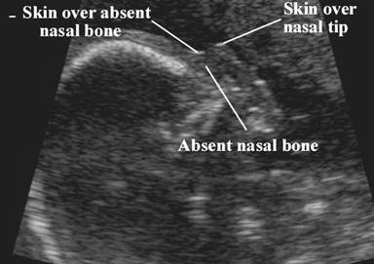
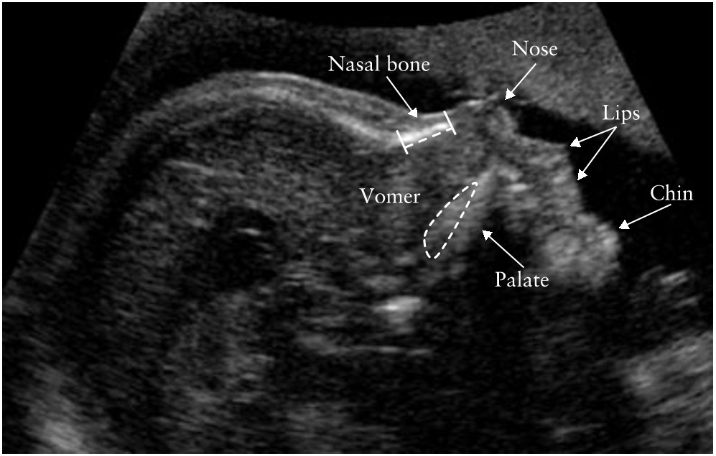

Slide 14
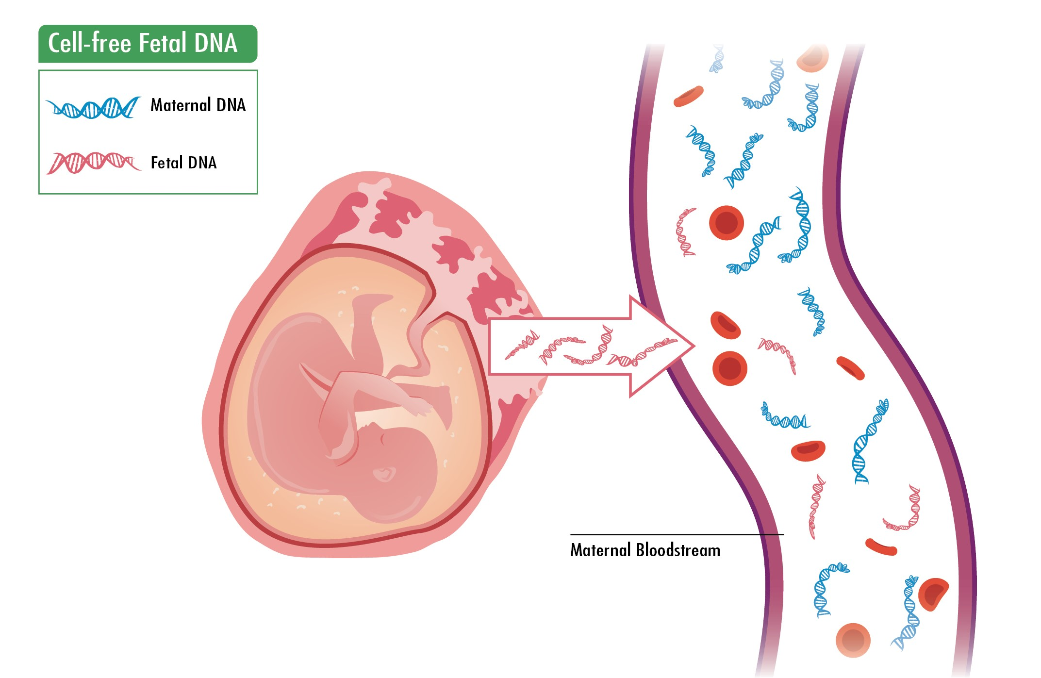

Cell-Free Fetal DNA Screening (NIPT)
After 10 weeks, from maternal blood sample
Screens for chromosomal anomalies/aneuploidy
Also screens for fetal sex
Can help avoid need for more invasive testing like amniocentesis and CVS in higher risk pregnancies

Slide 15
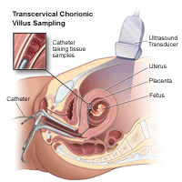
Chorionic Villus Sampling (CVS)
Diagnostic
10-13 weeks
Takes sample of placenta tissue
Genetic screening
Does not include information on NTDs

Slide 16
Second Trimester
Maternal Tests
Quad Screening
Glucose testing (2nd/3rd tri)
Amniocentesis
Cordocentesis

Slide 17

Maternal Tests
“Quad Screening” - can indicate potential for birth defects, but would need to be confirmed with amniocentesis
Maternal serum AFP (Alpha-Fetoprotein)
Inhibin A
Estriol
hCG
~ week 15-18

Slide 18
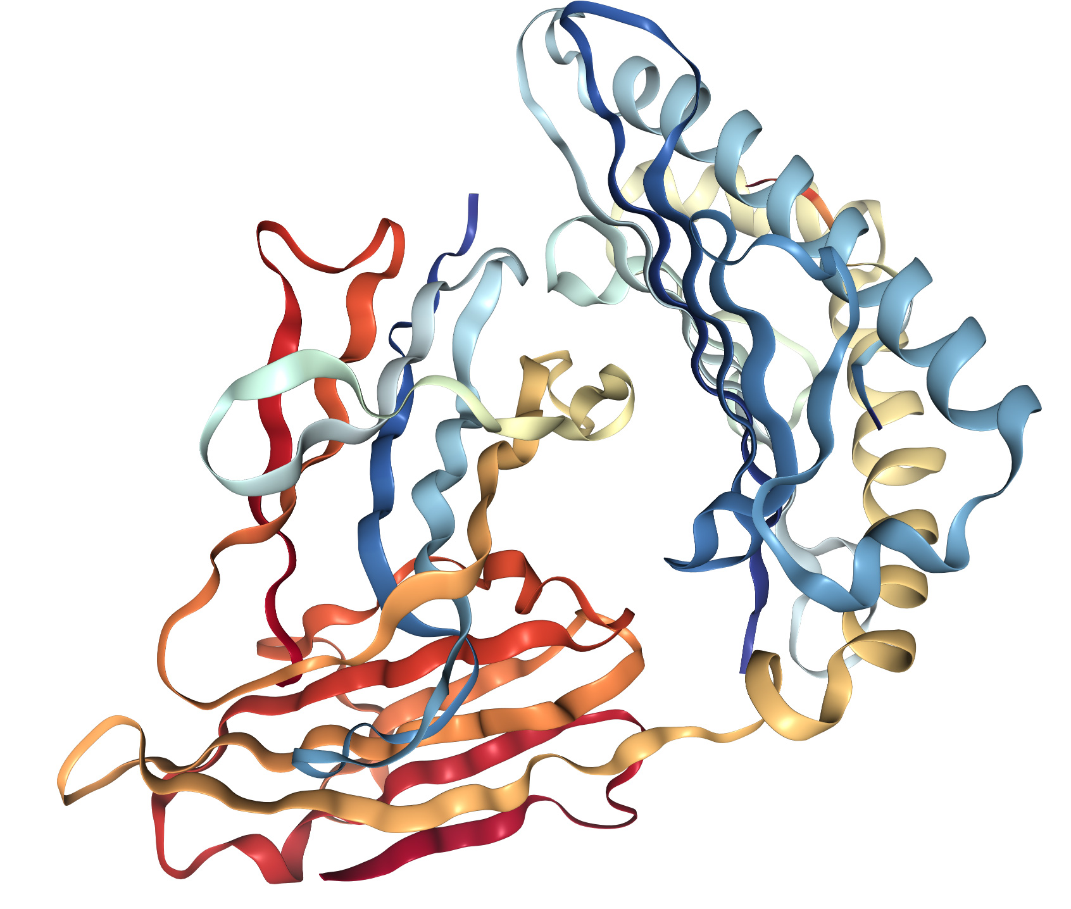
Alpha-Fetoprotein
Produced by fetal liver, it moves through amniotic fluid and placenta into maternal blood
Abnormal levels can indicate: fetal abdominal wall defects, neural tube defects (NTDs) such as spina bifida, twins, or some chromosomal abnormalities
Serum AFP was reduced in pregnancy with Trisomy 21
Serum AFP was increased in neural tube defects
  90% of fetuses with anencephaly present with elevated AFP

Slide 19
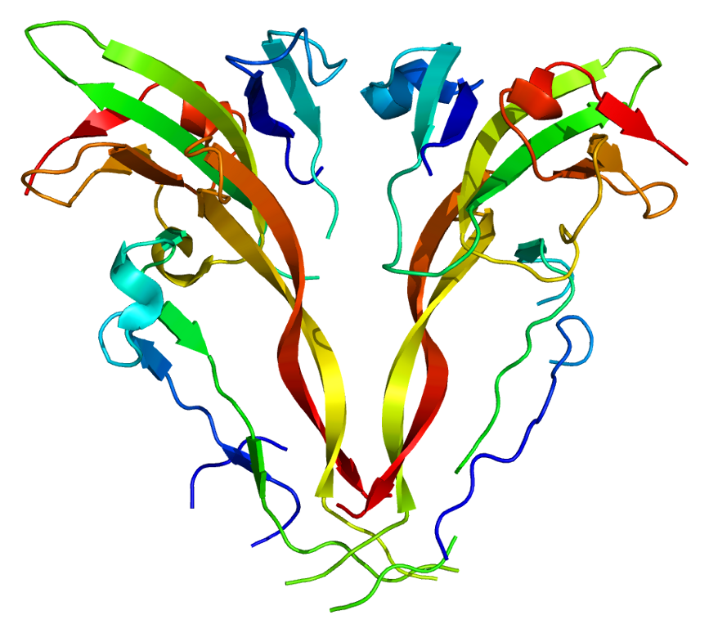
Hormone Inhibin A
Made by placenta, used to screen for Down’s Syndrome
Not included in “Triple Screen”

Slide 20
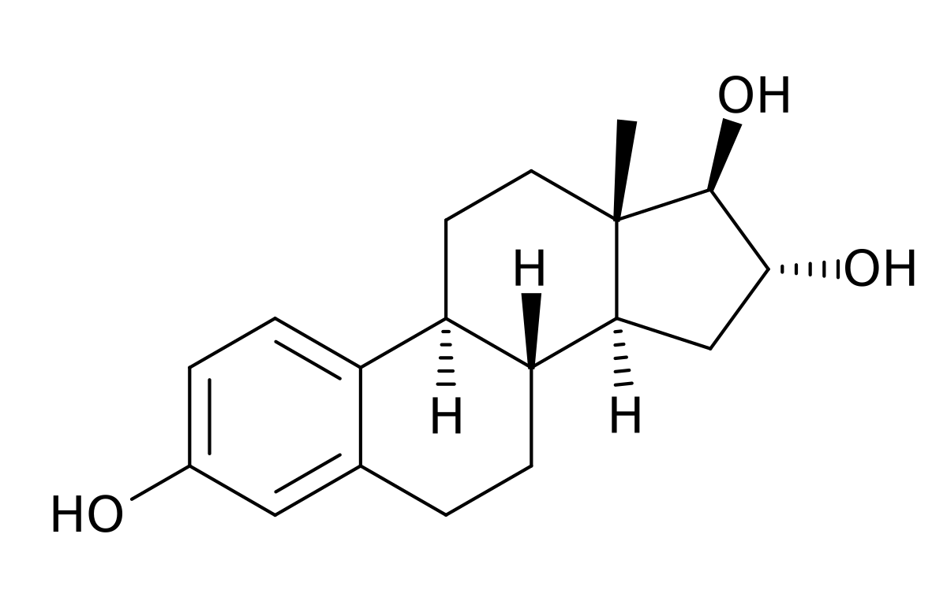
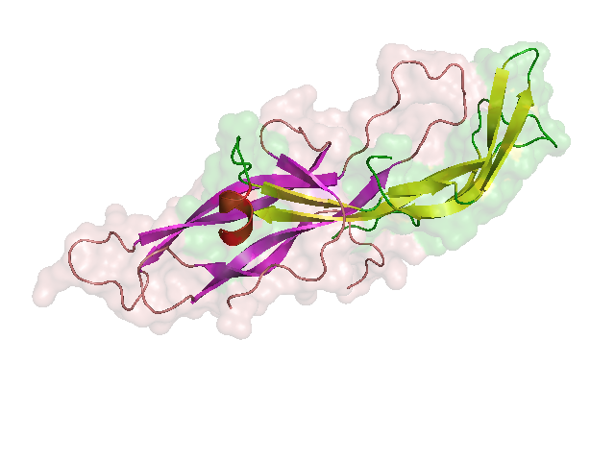
Estriol
hCG
Form of (unconjugated) estrogen that appears in increased levels during pregnancy
Produced by placenta
Can also be measured in urine
Screens for birth defects, molar pregnancy, and some cancers
Produced by placenta (also produced by germ cell tumors)
Can also be detected in urine

Slide 21
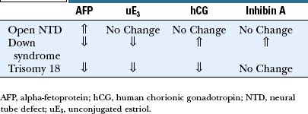

Slide 22
Types of diabetes
Type I - “juvenile diabetes”
Autoimmune disorder, attacks insulin-producing cells and body cannot effectively remove glucose from blood
Type II - “adult onset” (90-95%)
Body produces insulin but cannot use it effectively
Gestational Diabetes - high blood sugar during pregnancy; higher risk of later developing Type II

Slide 23

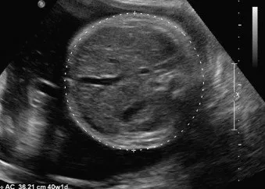
Glucose Testing (24-28 weeks)
Blood test for gestational diabetes in the mother
With gestational diabetes, excess sugar can be passed along to fetus
Complications: macrosomia (9+ pounds), stillbirth, preeclampsia, hypoglycemia
36 week AC measurement

Slide 24
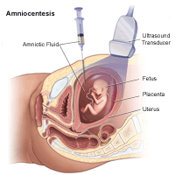
Amniocentesis
15-20 weeks if increased risk of chromosomal abnormalities
Tests for AFP and AChE
High AFP can indicate NTD or body wall defect
AChE (acetylocholinesterase) is produced by fetus, found in amniotic fluid if NTD

Slide 25
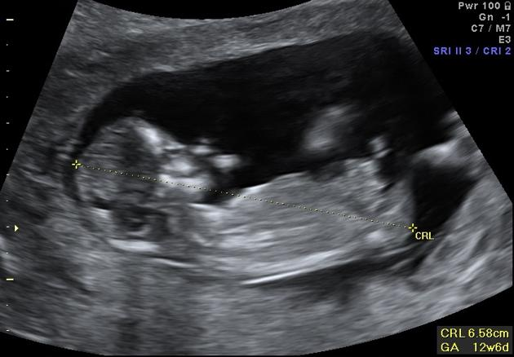
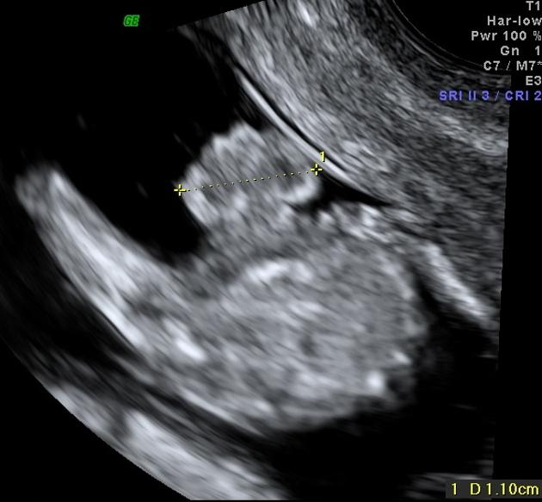

Slide 26
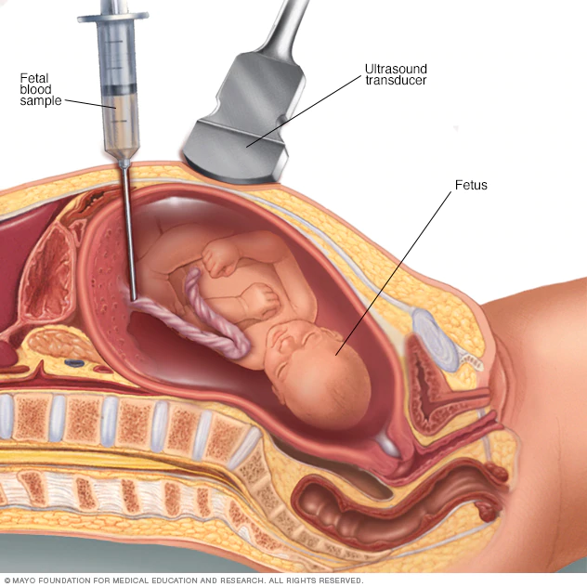
Percutaneous Umbilical Cord Sampling
Aka Cordocentesis
Samples fetal blood from umbilical cord
After week 18
Tests for genetic disorders, infections, blood conditions such as anemia
Can also deliver medication directly to fetus
Less common due to higher risk (vs amniocentesis, CVS)

Slide 27
Third Trimester
Amniocentesis
Urine Test - protein preeclampsia
BPP
Strep B

Slide 28
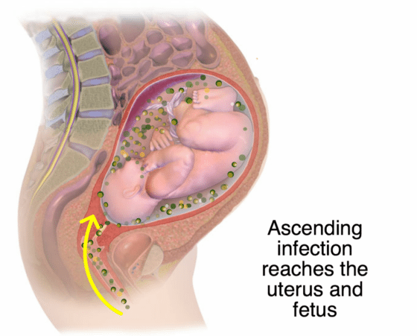
3rd Trimester Amniocentesis
If suspicion of chorioamnionitis or risk of premature delivery
Chorioamnionitis: ascending bacterial infection of chorion and amnion (and fluid)
→ considered a medical emergency due to serious complications
Amniocentesis will show low glucose, high WBCs, and bacteria

Slide 29
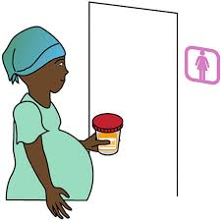
Preeclampsia
Preeclampsia is persistent high blood pressure after week 20 with at least one of the following: proteinuria, low platelet count, impaired liver and/or kidney function, pulmonary edema, headaches and visual disturbances
→ urine test!
Urine tests may be done throughout the pregnancy to check for sugar, ketones, bacteria, protein, and blood cells

Slide 30
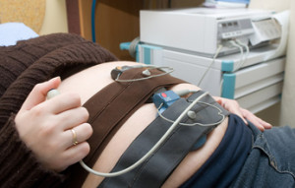
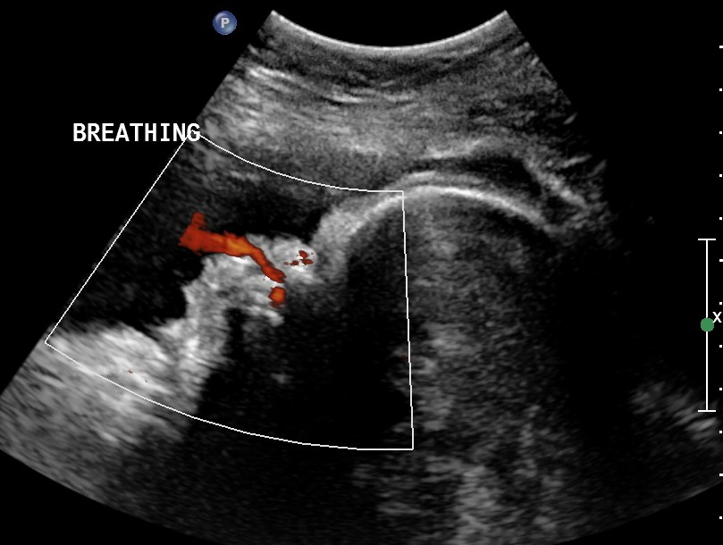
Biophysical Profile
Nonstress test - heart rate
Ultrasound - muscle tone, movement, breathing, amniotic fluid
10 Points

Slide 31
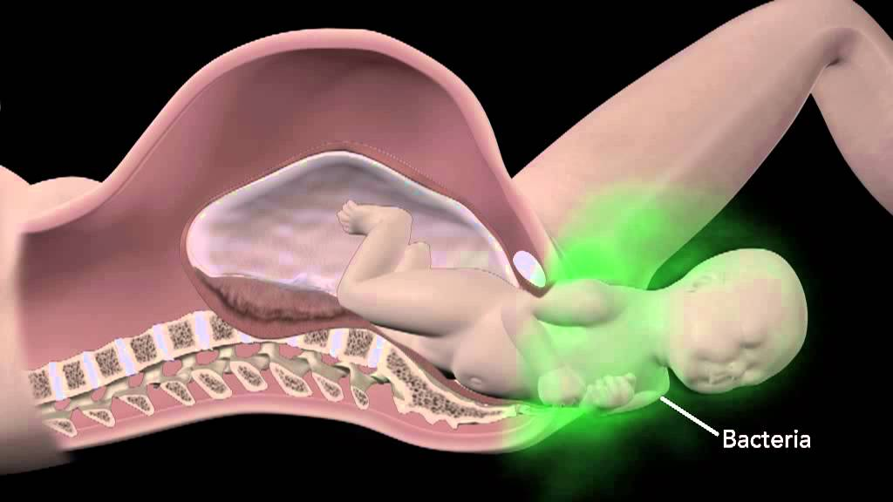
Group B Strep Screen
Bacteria that can be passed from mother to fetus during birth
Routine screening at 36-38 weeks
If positive, IV penicillin once mother goes into labor

Slide 32
References
Articles
https://www.ncbi.nlm.nih.gov/pmc/articles/PMC3110997/
https://pubmed.ncbi.nlm.nih.gov/12858300/
https://www.researchgate.net/profile/Liona_Poon/publication/221873390_First-Trimester_Screening_for_Neural_Tube_Defects_Using_Alpha-Fetoprotein/links/0c96052c33738a8c68000000/First-Trimester-Screening-for-Neural-Tube-Defects-Using-Alpha-Fetoprotein.pdf
Textbook
Stephenson, S. and Dmitrieva, J., 2018. Diagnostic Medical Sonography: Obstetrics & Gynecology. 4th ed. Philadelphia: Wolters Kluwer, pp.265-339

Slide 33
References: Websites
https://www.hopkinsmedicine.org/health/wellness-and-prevention/common-tests-during-pregnancy
https://www.mayoclinic.org/tests-procedures/percutaneous-umbilical-blood-sampling/about/pac-20393638
https://www.mayoclinic.org/tests-procedures/noninvasive-prenatal-testing/about/pac-20384574
https://www.uofmhealth.org/health-library/hw1663 (plus associated links)
https://www.acog.org/womens-health/faqs/gestational-diabetes
https://www.medicinenet.com/third_trimester_tests_during_pregnancy/article.htm#7_common_third_trimester_tests_introduction
https://www.stanfordchildrens.org/en/topic/default?id=common-tests-during-pregnancy-85-P01241
https://www.cdc.gov/ncbddd/birthdefects/diagnosis.html
https://www.fetalhealthfoundation.org/fetal-syndromes/anencephaly/
https://radiologykey.com/first-trimester-screening-for-aneuploidy/
https://www.nichd.nih.gov/health/topics/ntds/conditioninfo
https://radiopaedia.org/articles/nuchal-translucency-1?lang=us
https://www.healthcentral.com/condition/diabetes-types
https://www.mayoclinic.org/diseases-conditions/gestational-diabetes/symptoms-causes/syc-20355339
https://radiologykey.com/fetal-macrosomia/
https://www.healthline.com/health/pregnancy/infections-chorioamnionitis#diagnosis
https://www.preeclampsia.org/preeclampsia-tests
https://www.mayoclinic.org/diseases-conditions/preeclampsia/diagnosis-treatment/drc-20355751
https://www.babycenter.com/pregnancy/health-and-safety/urine-tests-during-pregnancy_1699
https://www.uofmhealth.org/health-library/tw9854
https://www.mayoclinic.org/tests-procedures/biophysical-profile/about/pac-20393061
https://www.acog.org/womens-health/faqs/group-b-strep-and-pregnancy

