Slide 1


Care Redesign for Post-Partum Blood Pressure Evaluation
Meeting patients where they are by eliminating office visits
Lauren D. Demosthenes, MD
PRISMA Health | University of South Carolina School of Medicine Greenville
Notes:
Notes:
In Powerpoint, click View > Guides
Keep text within gutter guides.
Author list: Don’t split names onto two lines (e.g., “Jimmy [break] Smith”). If that happens, use a new line, unless you need the space. Bold the first names of anybody who’s presenting in person.
Intro/methods/result: Do not drop below font size 28, but if you have extra space, jack up the font size until the space is full.
Do not use color in the sidebars except in graphs/figures. It’ll pull attention from the center and slow interpretation for passersby.

Slide 2
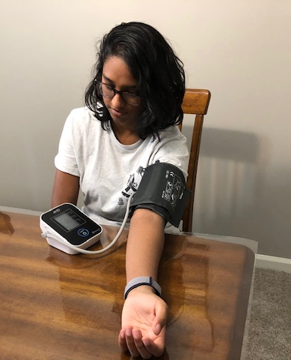
Rationale
Hypertension is a leading cause of maternal morbidity, mortality and readmissions.
New ACOG guidelines recommend that women with hypertensive disorders of pregnancy have BP monitored for 72 hours post partum and again at 7-10 days after delivery.
PRISMA hypertensive safety bundle began January 2019 with this new guideline.
In person visits have high “no-show” rates.
Goal: Replace in-person office visits with telehealth enabled blood pressure checks as suggested by new guidelines.

Slide 3
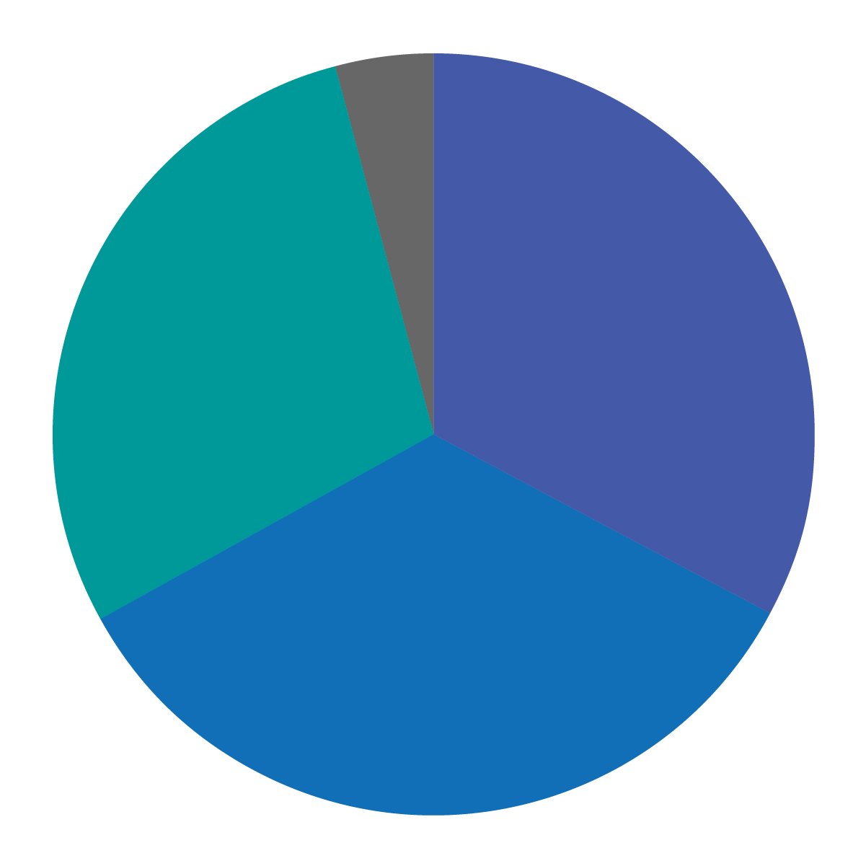
Setting & Population
PRISMA Greenville Memorial Hospital Obstetrical Center patients
African- American
2,664
deliveries in 2019
75%
Medicaid
Hispanic
29%
33%
34%
White

Slide 4
Critical Early Steps
Departmental buy-in by applying for and receiving a SC telehealth grant in collaboration with another health system
Creation of project as a randomized controlled trial with IRB approval from two sites
Inclusion of resident and attending team as mandatory resident research ensuring ongoing departmental awareness and support

Slide 5
Strategies
Qualitative interviews with patients to assess their access to technology and address anticipated resistance from providers. (patients had smart phones and liked the idea of remote monitoring)
Continuous communication with other academic medical centers who are using and finding success with technology
Communication to department re: adherence to guidelines and post partum BP visits since implementation of hypertensive safety bundle – demonstrating opportunity for a better way

Slide 6
Challenges
Delays in launching project due to long process of multi-site IRB
Delays with technology company that is providing the service: resulted in a third site.
Applying for and dividing grant funds between two institutions.
Delays allowed more robust baseline data from launch of safety bundle and inclusion of third site which will increase size of study population and provide data on readmissions.
Acceptance of telehealth suboptimal due to fee-for-service Medicaid.

Slide 7
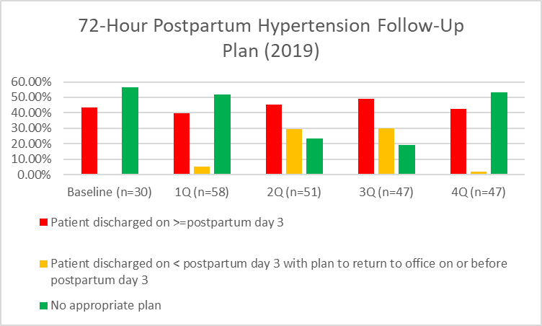
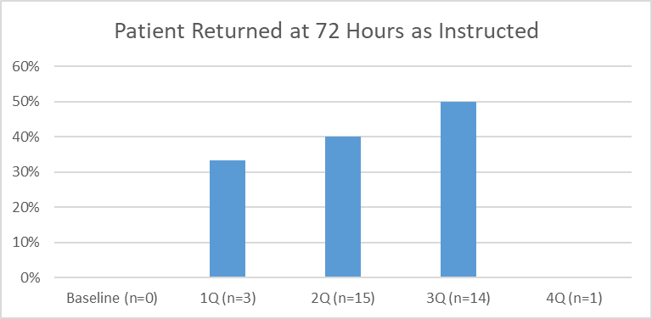
Findings
Pre-implementation findings since the release of the safety bundle (January 2019) demonstrate the need for a different care model addressing patient adherence
*Notably, MFM eliminated 3-day blood pressure check by Q4 due to patient adherence difficulties

Slide 8
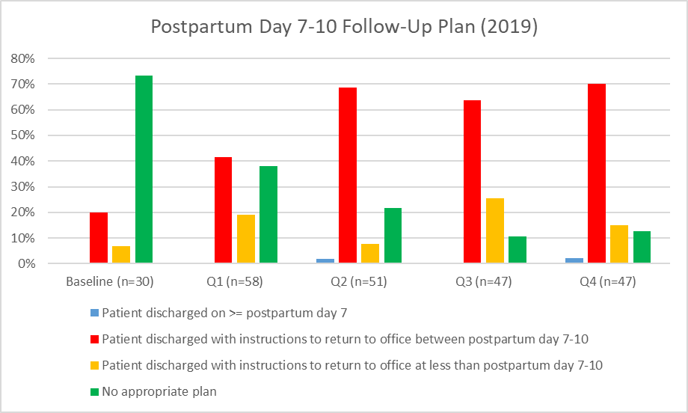
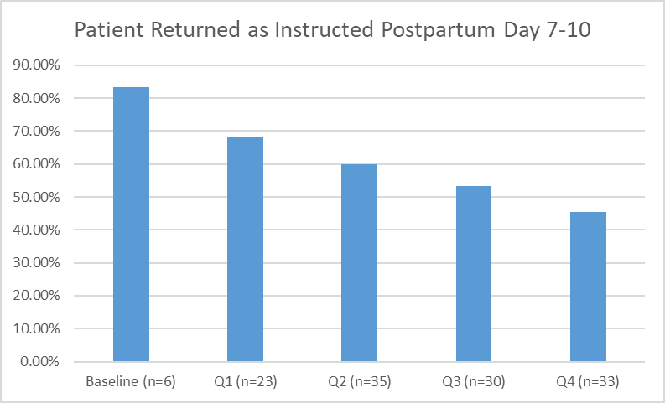
Findings
Pre-implementation findings since the release of the safety bundle (January 2019) demonstrate the need for a different care model addressing patient adherence
*As more patients were told to return in 7-10 days, % of adherence decreased.

Slide 9
Next Steps & Lessons Learned
Expect formal launch of study in April: unlikely now due to Covid-19
Currently in conversation with state Medicaid and our health system about reimbursement for these services.
Expanding research with the third site
Article in OBGManagement “Break that Practice Habit”
Present findings at High Value Practice Academic Alliance
Launching new IRB approved survey to bring in the patient voice

