Slide 1
Overuse of Opioids for Chronic Pain in Primary Care
Roberto Diaz del Carpio MD
Department of Medicine, Jacobs School of Medicine | Buffalo, NY
Notes:
Notes:
In Powerpoint, click View > Guides
Keep text within gutter guides.
Author list: Don’t split names onto two lines (e.g., “Jimmy [break] Smith”). If that happens, use a new line, unless you need the space. Bold the first names of anybody who’s presenting in person.
Intro/methods/result: Do not drop below font size 28, but if you have extra space, jack up the font size until the space is full.
Do not use color in the sidebars except in graphs/figures. It’ll pull attention from the center and slow interpretation for passersby.

Slide 2
Overused Service & Rationale
When prescribing long-term opioid therapy for chronic pain, the potential for harm often outweighs the potential for benefit.
Erie County has a high rate of opioid overdose and death, and many of our clinics do not have a consistent and safe approach to managing long-term opioid therapy in our patient population.

Slide 3
Setting
Hertel Elmwood Primary Care Internal Medicine Center.
5 general internists 1 family physician
1 nurse practitioner 32 internal medicine residents
110 on Long-term opioid therapy
Patients are predominantly uninsured or on Medicaid.

Slide 4
Early Critical Steps
Leadership engagement/set up an improvement team/ to gather and review baseline encounter characteristics, engage clinical/clerical staff and redesign the long-term opioid therapy encounter.
Baseline Data Assessment (next slide) helped to prioritize key aspects of the long-term encounter.
Re-design a standardized chronic pain encounter with workflows for front desk staff, nurses, medical assistants and clinicians, and with screening tools incorporated into each workflow.

Slide 5
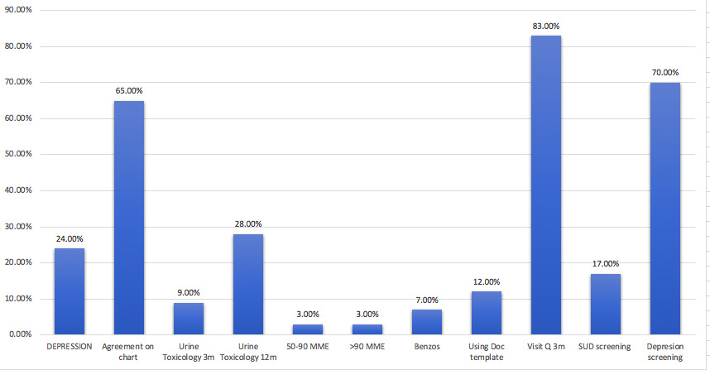
Long-Term Opioid Therapy patient encounter characteristics in a Primary Care Center. Buffalo, NY. October 2019.
N: 110

Slide 6




Timeline of Interventions
Weekly feedback
Workflow, education, templates
Engagement/Data dissemination/ Story telling
RX
New CPM encounter
Encounter re-design
Baseline data assessment/chart review
Timeline
October 2019
Nov-Dec 2019
Jan 20th
Feb- March

Slide 7

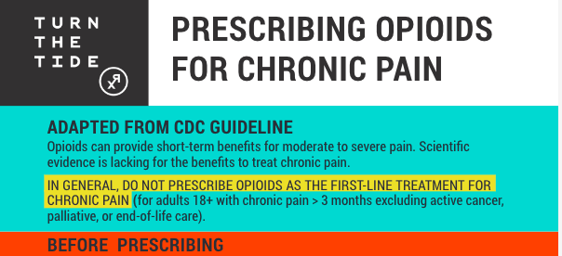

Slide 8


Slide 9
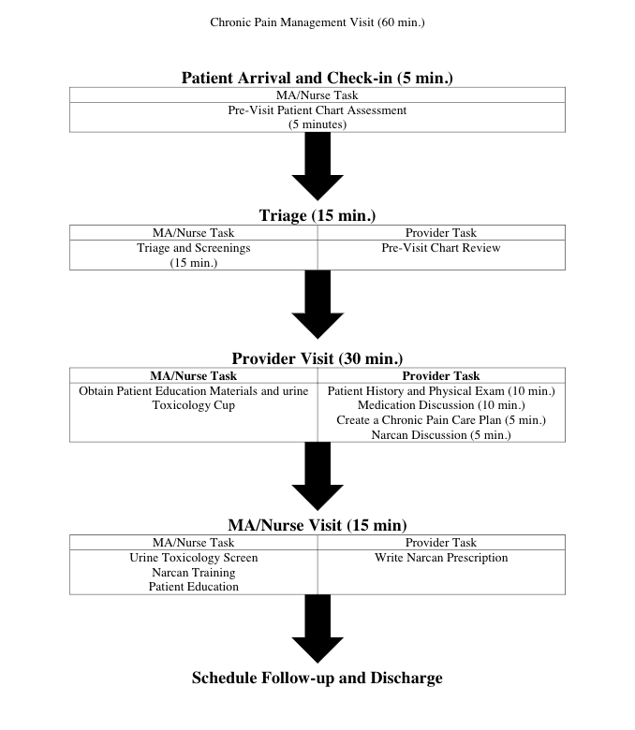

Slide 10
Long-Term Opioid Therapy 8 weeks post intervention in a Primary Care Center. Buffalo, NY. March 2020.
n: 110
n: 6
n: 8

Slide 11
Key Lessons Learned
Listen to patient and clinician stories about chronic pain experiences.
Chart review to learn the untold story from administrative data
Engage your team/practice early.
Use evidence to guide your intervention strategy.

Slide 12
Next Steps
Sustainability plan, write study protocol, statistical analysis, register study
Analyze data from control practices, Implement in other practices

