Slide 1



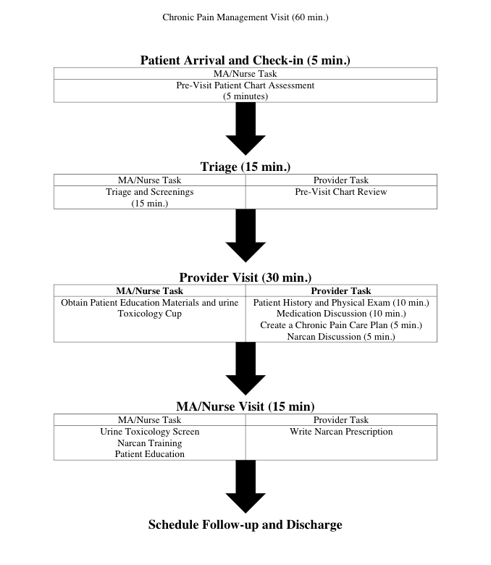
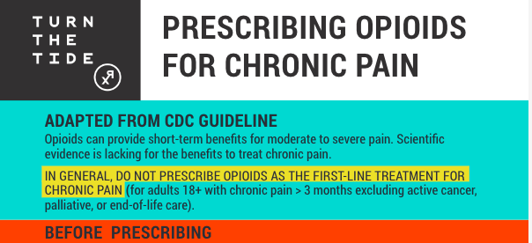
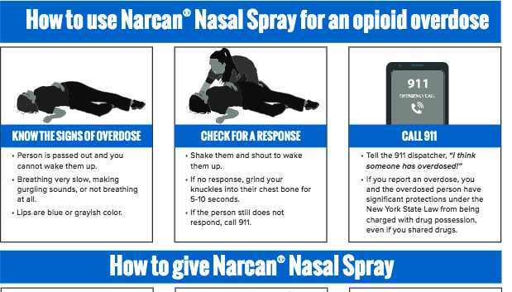
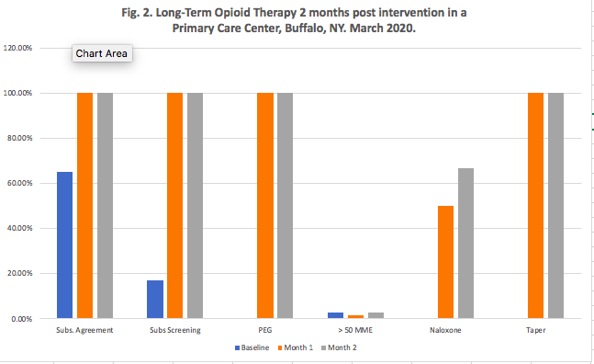
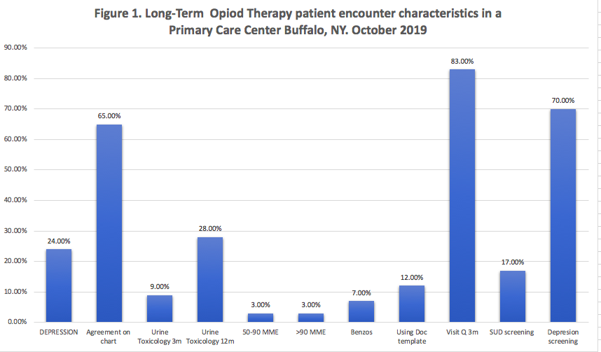
Overuse of Opioids for
Chronic Pain in Primary Care
Roberto Diaz del Carpio MD
| Department of Medicine, Jacobs School of Medicine | Buffalo, NY
Overused Service & Rationale
When prescribing long-term opioid therapy (LtOT) for chronic pain, the potential for harm often outweighs the potential for benefit.
Erie County has a high rate of opioid overdose and death, and many of our clinics do not have a consistent and safe approach to managing LtOT in our patient population.
Key Lessons Learned
Listen to patient and clinician stories about chronic pain experiences.
Chart review to learn the untold story from administrative data
Engage your team/practice early.
Use evidence to guide your intervention strategy.
Intervention Strategies
Setting
Hertel Elmwood Primary Care Internal Medicine Center
5 general internists 1 family physician
1 nurse practitioner 32 internal medicine residents
Patients are predominantly uninsured or on Medicaid.
Early Critical Steps
Set up an improvement team to gather and review baseline LtOT encounter characteristics, engage clinical/clerical staff and redesign the LtOT encounter.
Baseline Data Assessment (Fig. 1) helped to prioritize key aspects of the LtOT encounter.
Re-design a standardized chronic pain encounter with workflows for front desk staff, nurses, medical assistants and clinicians, and with screening tools incorporated into each workflow.
Next Steps
Sustainability plan, write study protocol, statistical analysis, register study
Implement in other practices
Notes:
Notes:
In Powerpoint, click View > Guides
Keep text within gutter guides.
Author list: Don’t split names onto two lines (e.g., “Jimmy [break] Smith”). If that happens, use a new line, unless you need the space. Bold the first names of anybody who’s presenting in person.
Intro/methods/result: Do not drop below font size 28, but if you have extra space, jack up the font size until the space is full.
Do not use color in the sidebars except in graphs/figures. It’ll pull attention from the center and slow interpretation for passersby.

