Slide 1

PICCing Wisely: Optimizing Vascular Access
George Hoke
University of Virginia Medical Center | Charlottesville, VA
Notes:
Notes:
In Powerpoint, click View > Guides
Keep text within gutter guides.
Author list: Don’t split names onto two lines (e.g., “Jimmy [break] Smith”). If that happens, use a new line, unless you need the space. Bold the first names of anybody who’s presenting in person.
Intro/methods/result: Do not drop below font size 28, but if you have extra space, jack up the font size until the space is full.
Do not use color in the sidebars except in graphs/figures. It’ll pull attention from the center and slow interpretation for passersby.

Slide 2
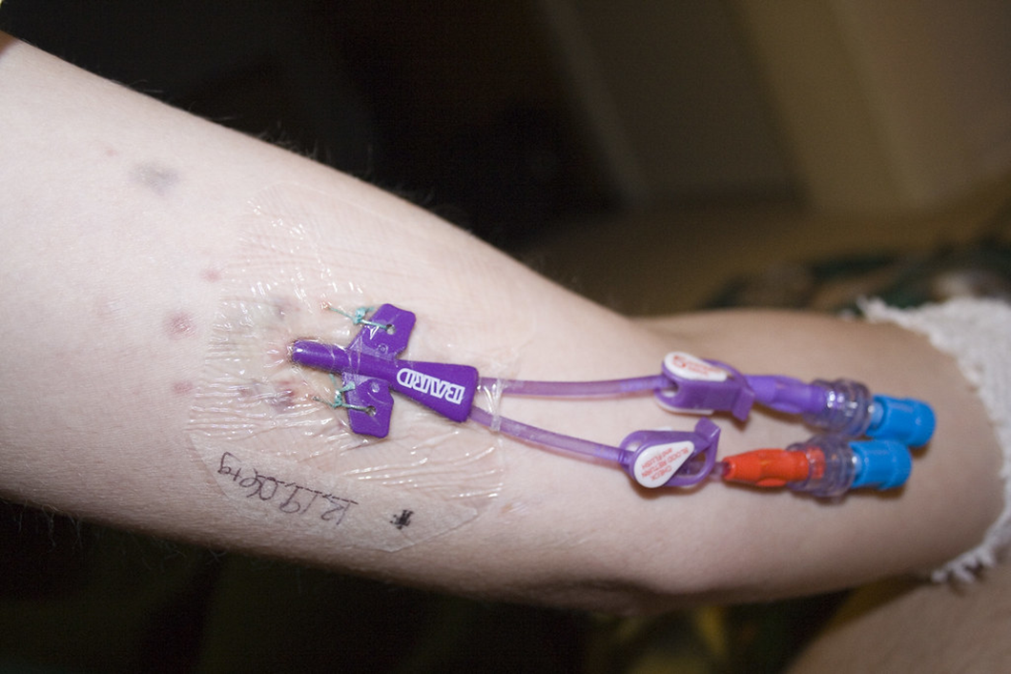
Overused Service & Rationale
Peripherally inserted central catheters (PICCs) are commonly used for long-term administration of antibiotics, chemotherapy and parenteral nutrition.
PICC use can result in harm by increasing the risk of deep venous thrombosis (DVT) and blood stream infections.
We aimed to reduce the overall use of PICCs and to insert the smallest catheter with the fewest lumens needed by the patient.

Slide 3

Setting
University of Virginia Health (UVA Health) consists of a 600-bed acute care hospital, a 40-bed LTACH, and outpatient clinics across central Virginia.
Geographic service area is very large and predominantly rural.
26% of visits involve uninsured or Medicaid-covered patients

Slide 4
Early Critical Steps
Obtain Institutional Support by aligning project closely with health system’s established improvement priorities.
Conduct a detailed stakeholder analysis. Qualitative interviews with individuals across the continuum of care revealed:
    Lack of training and expertise in selection of venous access devices.
    The important role of nurses, who often requested PICC for ease and patient comfort, to avoid frequent blood collection for labs.
Survey of intended target audience to assess knowledge and attitudes about venous access selection.

Slide 5
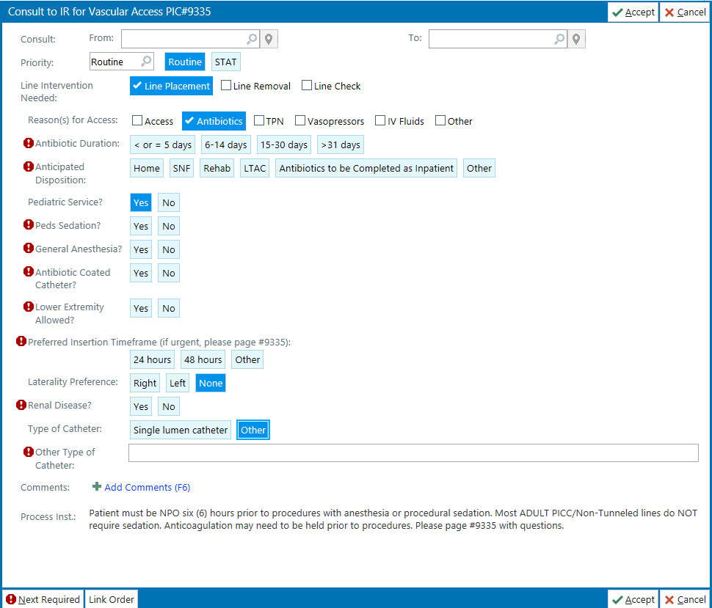
Intervention Strategies
Brief, in-person educational sessions with all house staff and hospitalists.
Replaced EMR pathway for requesting a venous access device with an order for a consultation.
Made ‘single lumen catheter’ the default line type when PICC requested in the order set as it has lower rate of DVT than multi-lumen catheters.

Slide 6
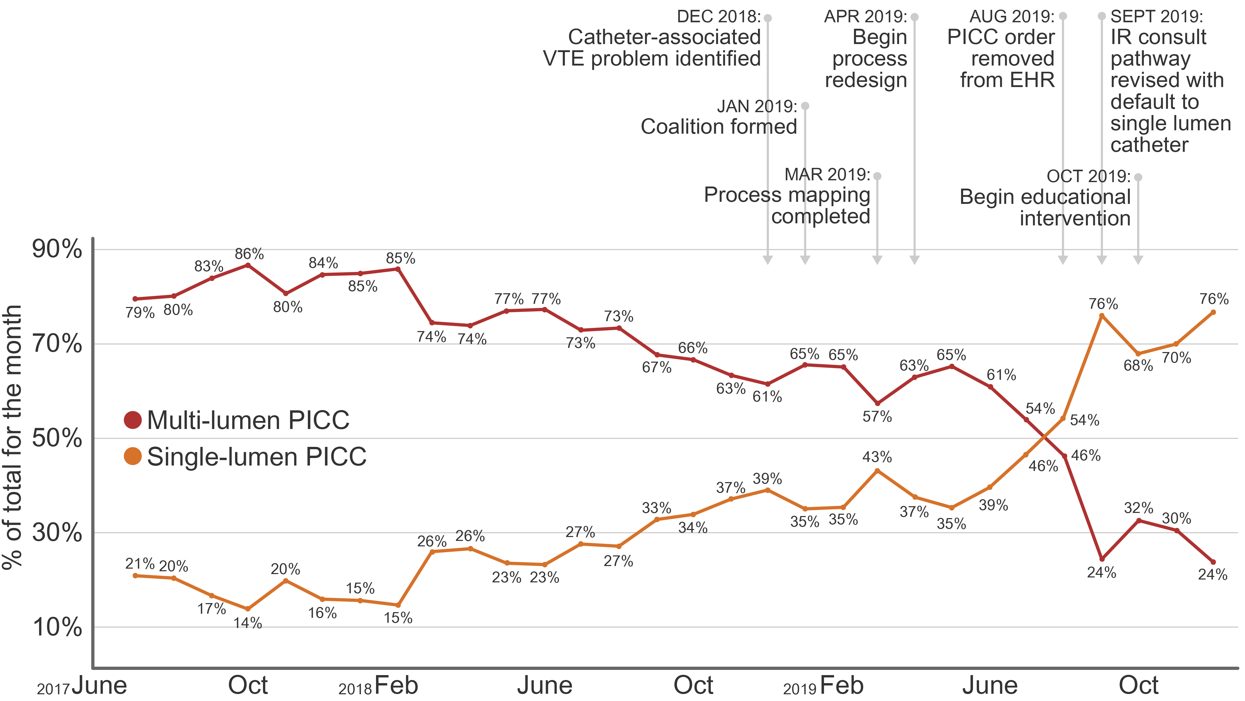
Single- vs.
Multi-lumen
PICC Use Trend

Slide 7
Findings
Increase in use of single lumen catheters
39% 73%
Average monthly number of PICC lines inserted went from 126 to 93, a 26% reduction.
Nonsignificant decrease in number of venous thrombo-embolic events thus far.

Slide 8
Key Lessons Learned
Stakeholder analysis and a project charter pay dividends during implementation phase.
Avoid rework and mistakes by keeping a journal and documenting process mapping exercises.
Ensure stakeholder buy-in before implementing any changes to their workflow.
Don’t let perfect be the enemy of better as simple interventions may achieve much of the desired change with less work and disruption.

Slide 9
Next Steps
Share provider-specific
ordering data with peer comparison.
Offer placement of mid-line catheters as a replacement strategy.
Revise patient education
materials regarding risks
associated with PICC line.
Ensure a plan for PICC
removal after hospital discharge.
Engage with specialty groups
such as oncology and cystic
fibrosis teams.
Collaborate with antibiotic stewardship team on shortening duration of IV antibiotic treatment
to decrease the demand/need
for PICC lines.

