Slide 1

Reducing Unnecessary X-rays for Low Back Pain in the Emergency Department
Joshua Moskovitz
Jacobi Medical Center | Bronx, New York
Notes:
Notes:
In Powerpoint, click View > Guides
Keep text within gutter guides.
Author list: Don’t split names onto two lines (e.g., “Jimmy [break] Smith”). If that happens, use a new line, unless you need the space. Bold the first names of anybody who’s presenting in person.
Intro/methods/result: Do not drop below font size 28, but if you have extra space, jack up the font size until the space is full.
Do not use color in the sidebars except in graphs/figures. It’ll pull attention from the center and slow interpretation for passersby.

Slide 2
Overuse Issue & Rationale
Overuse of conventional radiography for patients presenting with low back pain.
Imaging exposes patients to unnecessary radiation, and may lead to unnecessary procedures that lead to unintended harm.

Slide 3
Setting
Jacobi Medical Center is a Level 1 Trauma Center Emergency Department in the Bronx, New York.
65,000 ED visits per year.
Patients are predominantly uninsured or publicly insured.
Team: Emergency Medicine Residents

Slide 4
Early Critical Steps
URI Symptom Kit
Conduct a medical literature review to identify a consensus about indicators of appropriate or inappropriate imaging.
Determine levels of overuse and possible harm early through:
Identify possible sources of data.
Conducting chart reviews.
Assess both internal and external stakeholder buy-in, as well as sources of resistance.

Slide 5
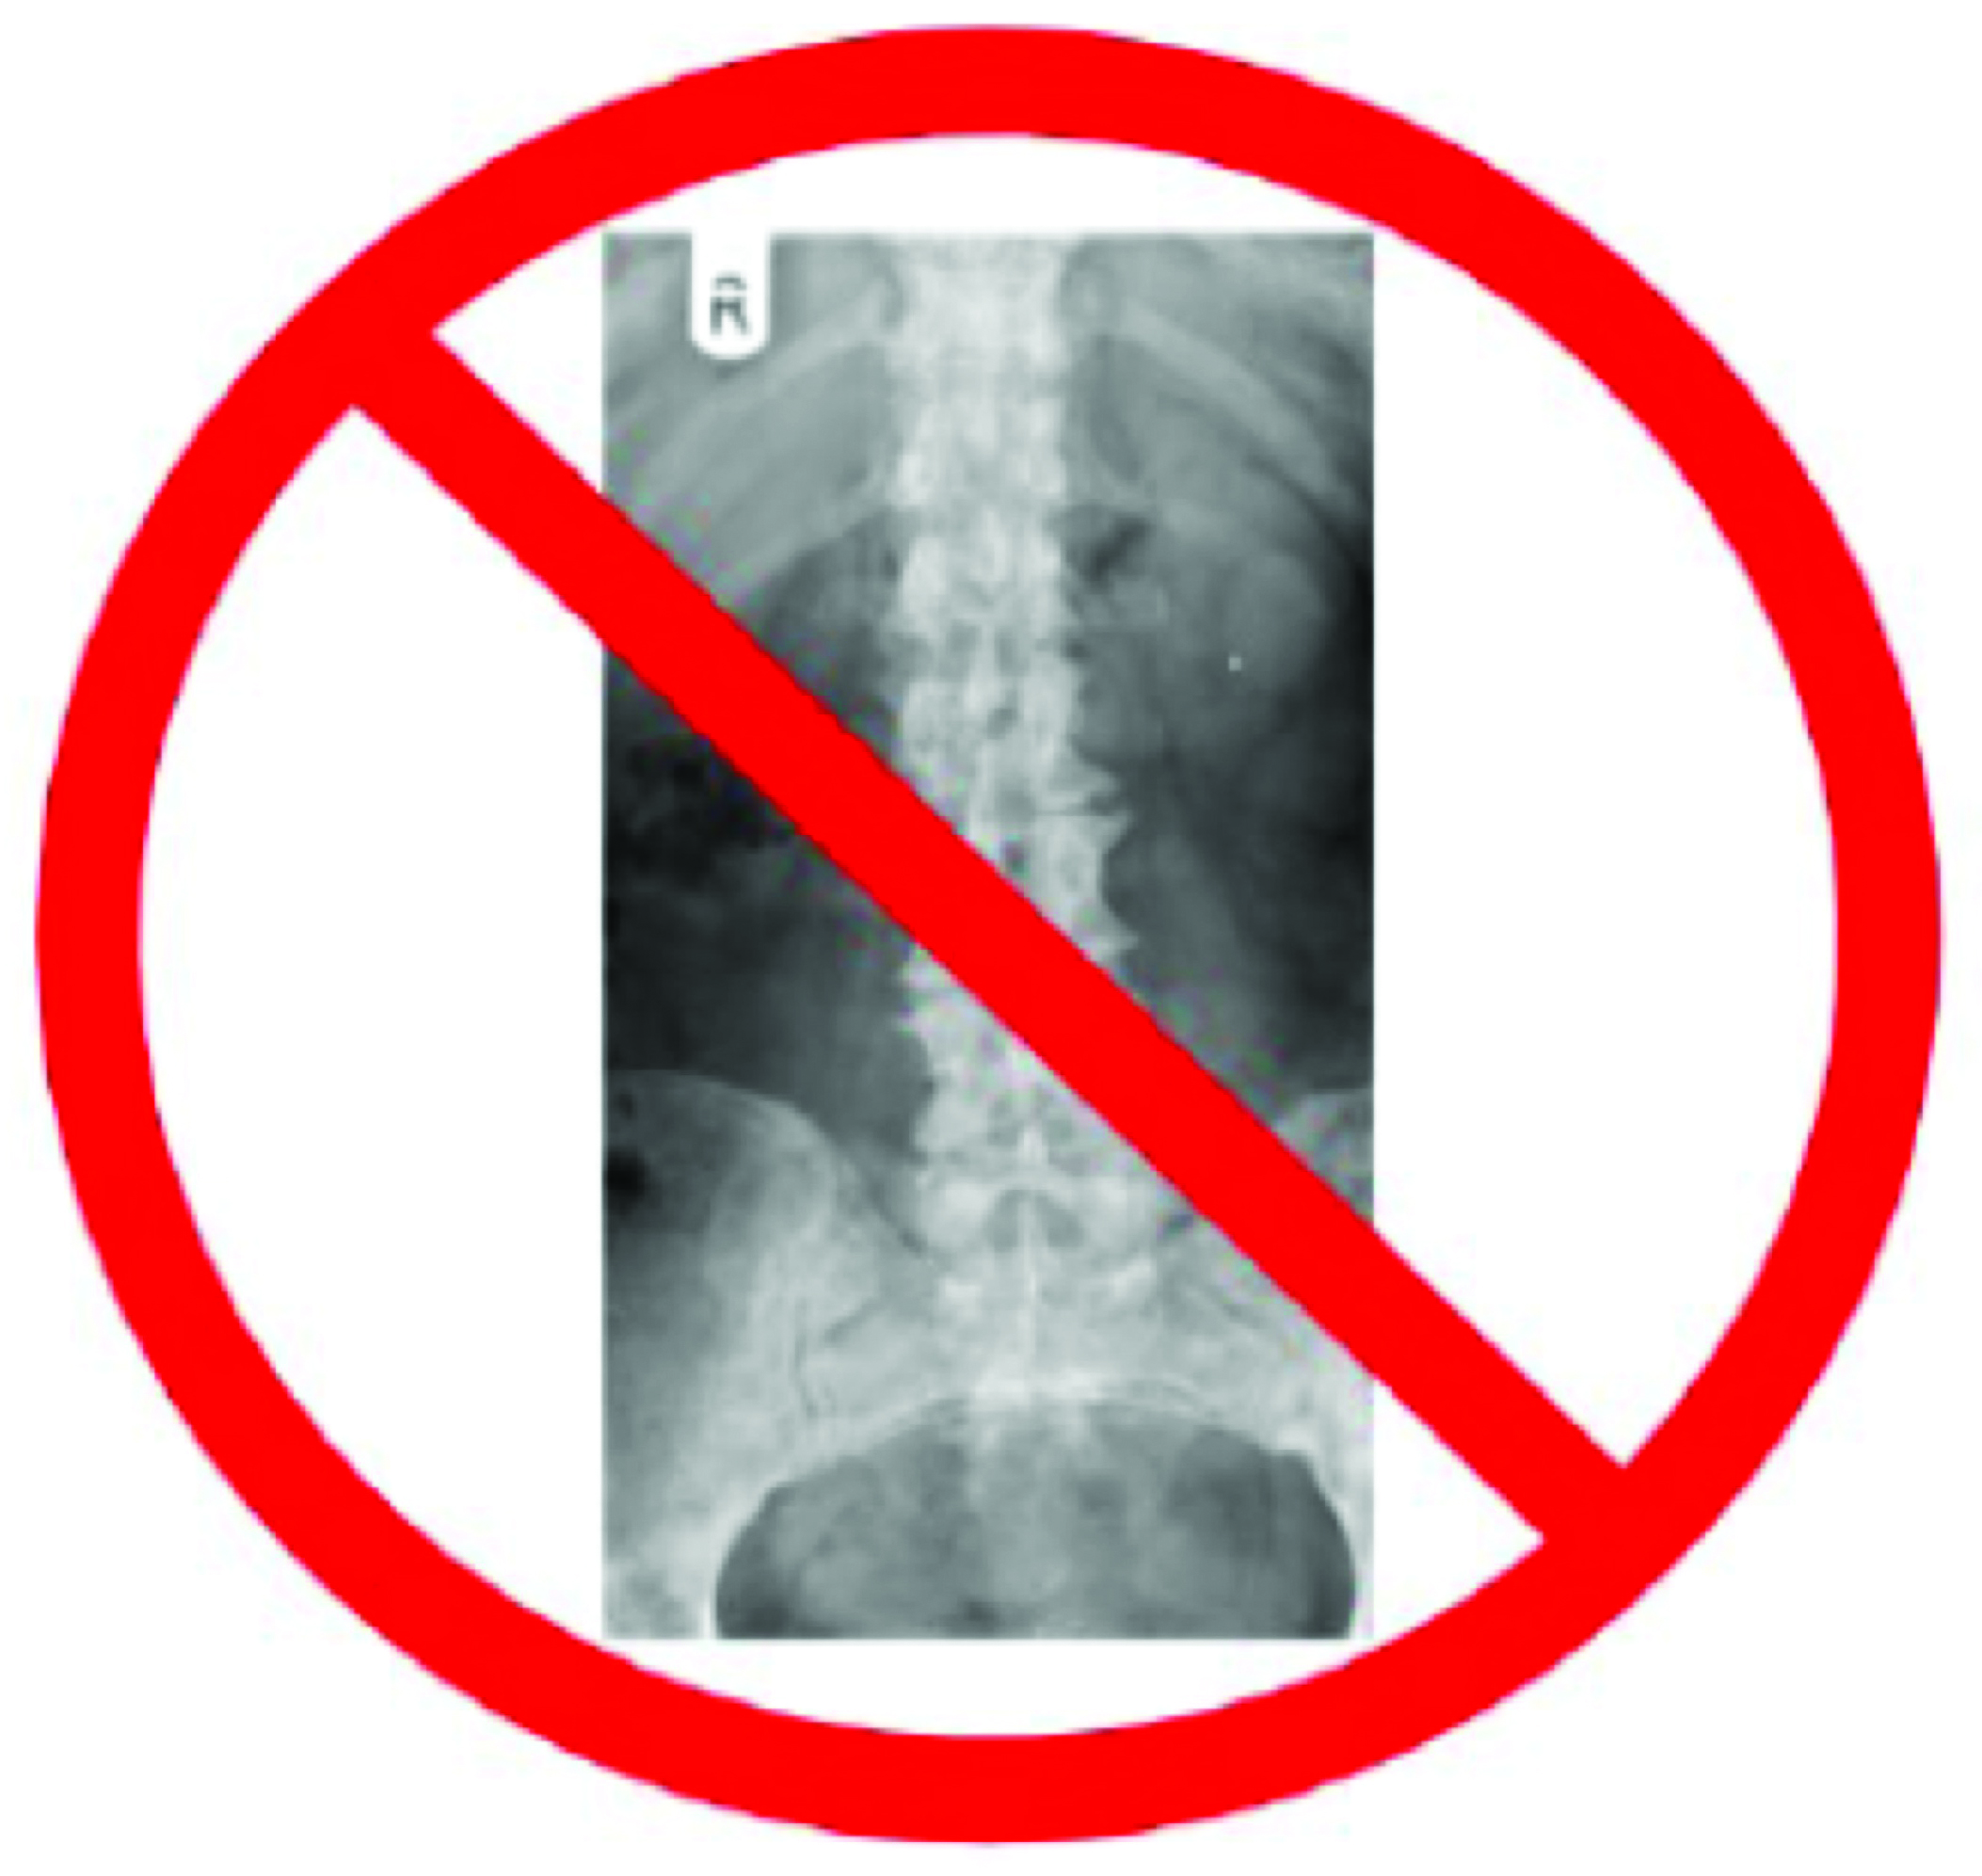
Strategies
No Red Flags, No RADS!
In the absence of red flags (trauma, or worsening neurological signs and symptoms) imaging is rarely helpful for back pain.
Clinician education and awareness: through lectures during usual ED faculty/resident meetings about potential harm from overuse and address concerns.
Patient education: about potential for harm through materials placed in exam rooms.
Peer-to-peer feedback: top 3 over utilizers identified for hallway conversation with the clinical champion.
Decision-making workflow support: “Best Practice Advisory” cards placed on computer workstations. (See above)
Conventional x-ray removed from quicklist order set in HER.

Slide 6
Findings
Trend Chart: Total Radiographs and Percent Appropriate

Slide 7
Key Lessons Learned
Engage stakeholders early in conversations about overuse.
Be patient-centric when engaging clinicians: focus on change for patients’ benefit.
Start small and simple, even simple tasks (e.g. identifying high utilizers) have many obstacles.

Slide 8
Next Steps
Follow up with stakeholders at all levels and celebrate success.
Use the momentum from this project to address overuse of other radiographic studies in the ED.
Incorporate learnings from this project into a hospital-wide PI program.
Present findings at conference and publish in an academic journal.

