Slide 1

Unnecessary Use of Over-the-Counter Medicine for Coughs & Colds in Children
Elizabeth Vossenkemper
Tri-Cities Community Health | Pasco, WA
Notes:
Notes:
In Powerpoint, click View > Guides
Keep text within gutter guides.
Author list: Don’t split names onto two lines (e.g., “Jimmy [break] Smith”). If that happens, use a new line, unless you need the space. Bold the first names of anybody who’s presenting in person.
Intro/methods/result: Do not drop below font size 28, but if you have extra space, jack up the font size until the space is full.
Do not use color in the sidebars except in graphs/figures. It’ll pull attention from the center and slow interpretation for passersby.

Slide 2
Overused Service & Rationale
Prescribing over-the-counter medications for upper respiratory infections in children 0 – 13 years of age has more potential for harm than benefit.
Goal: Be a positive catalyst to:
Ensure high-value, evidence-based care; and
Create an opportunity for providers, staff and patients to work as a cohesive team to prevent potential harm to our pediatric population.

Slide 3
Setting
Tri-Cities Community Health (TCCH) a Federally Qualified Health Center in Eastern Washington.
Patients are predominantly Hispanic. Most are migrant farmworkers with low health literacy and limited socioeconomic resources.

Slide 4
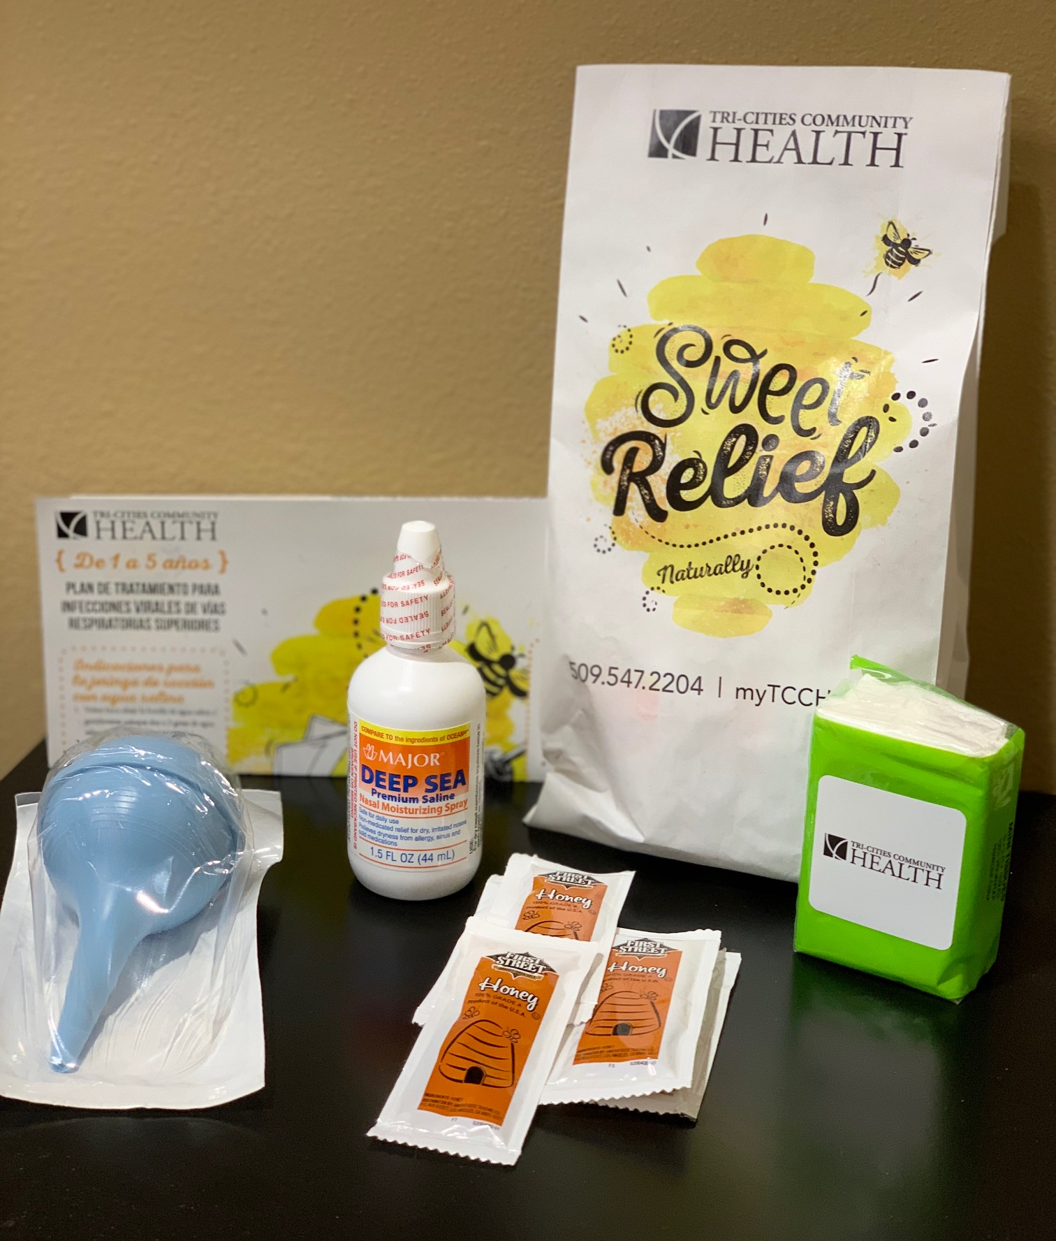
Early Critical Steps
URI Symptom Kit
Establish the extent of the problem by collecting data through EHR, identifying inappropriate prescribing for viral URI.
Identify and engage key stakeholders by sharing data on overuse, and developing an action plan with input from prescribers, pharmacy, nurses, frontline staff, parents and leadership.
Create resources. Gather input from multiple departments and create a "URI Symptom Kit” for use instead of OTC medications.

Slide 5
Strategies
Assessment of parent and guardian beliefs: Early focus groups were useful to understand the interests and motivations of parents and guardians. Their feedback was useful in clinician engagement to address parent and guardian concerns and resistance.
URI Symptom Kit: Offered at no cost to patients. The kit included patient education materials. Nursing staff and medical assistants were educated to provide parent teaching on how to use the kit, as well as how to support prescribers in implementation.
Provider education and support: Formal educational meetings to share data on current and past prescribing practices. Provided scripts for providers on how to talk to parents. Created a space for providers to discuss frustrations, concerns, and observations.

Slide 6
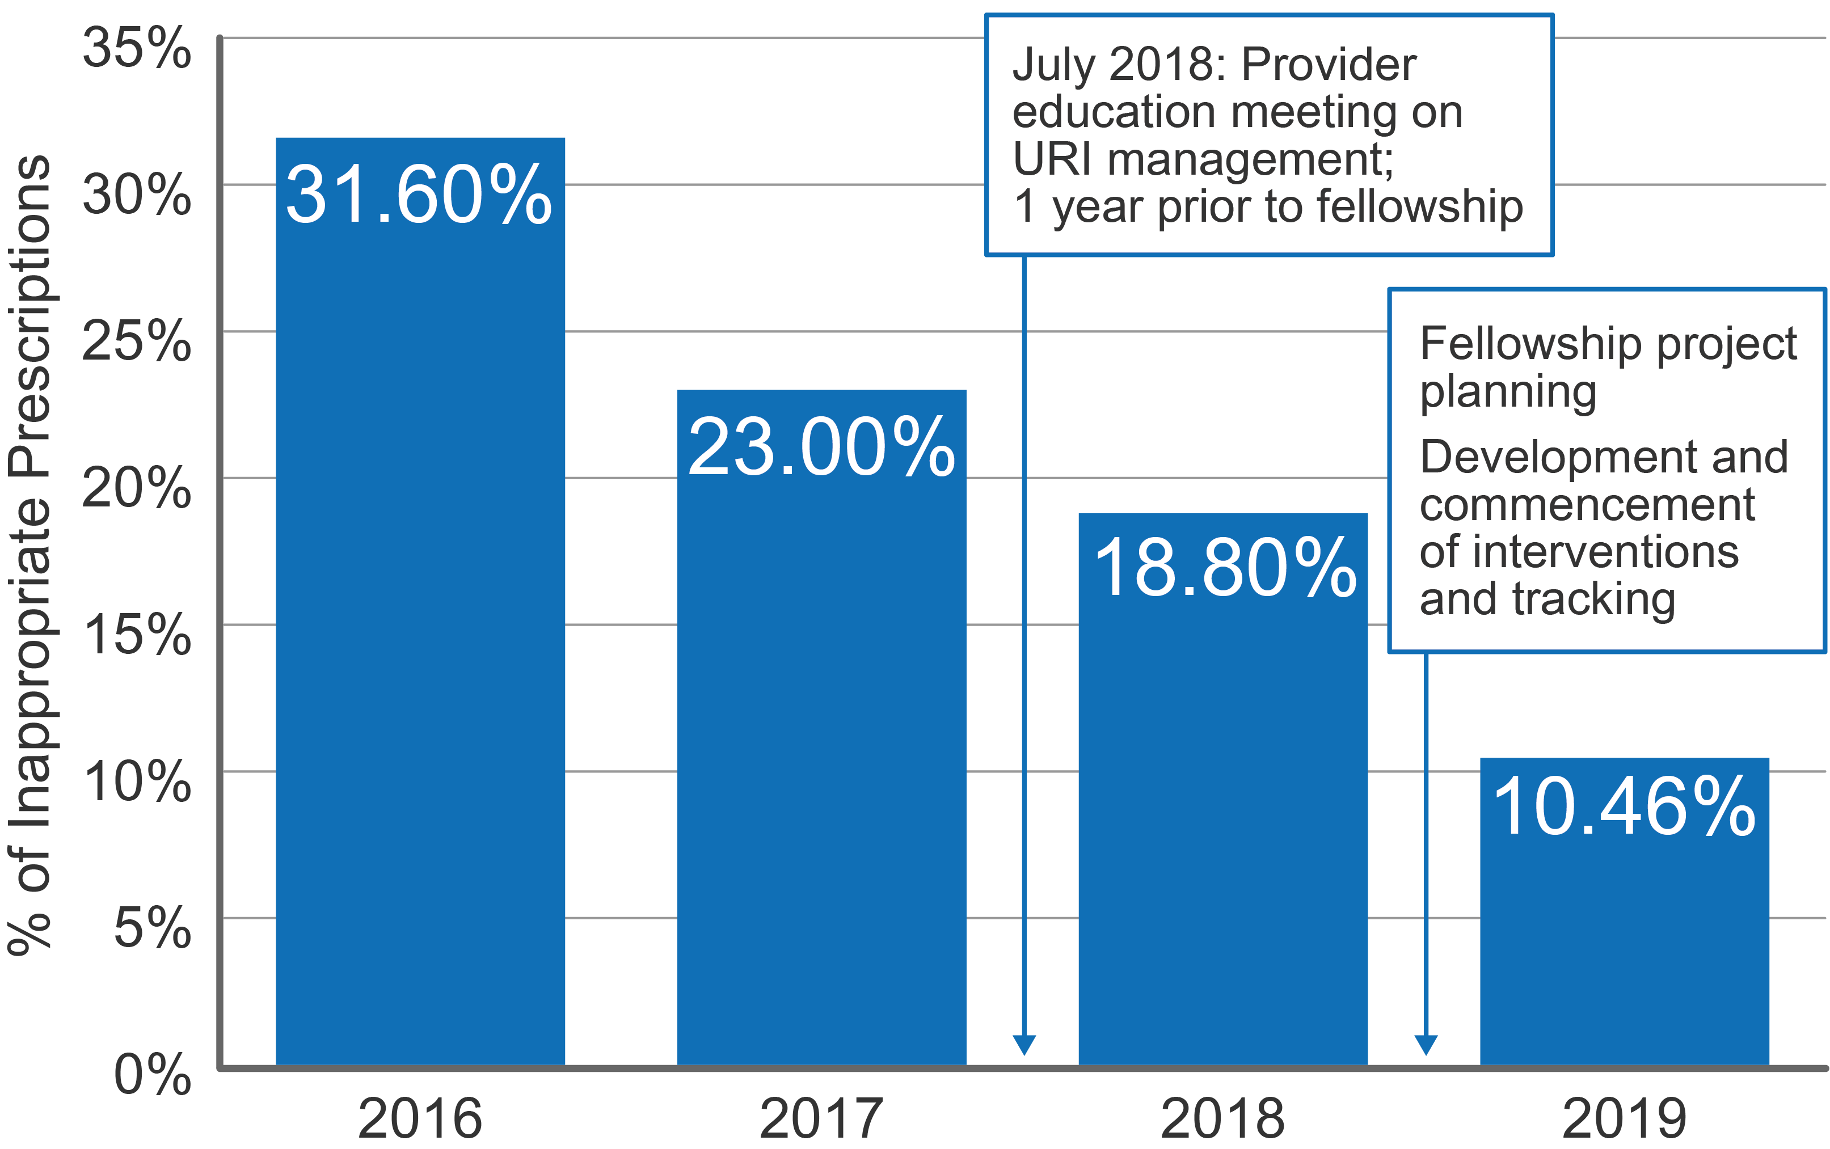
Findings
Inappropriate Prescriptions for URI Visits, Birth-13 years, All Specialties

Slide 7
Key Lessons Learned
Identify clinician motivators to de-implement. Being a clinical champion involves an immense amount of psychology.
Focus education and training on front-line staff who are often tasked with patient education.
Collecting qualitative data is as important as quantitative data because it speaks to the clinician and patient experience, as well as drivers of overuse.

Slide 8
Next Steps
Maintain the Gains:
URI Symptom Kit handed off to pharmacy/purchasing department.
QI team at TCCH will pull OTC prescribing data quarterly to identify if a resurgence of inappropriate prescribing occurs.
QI Publication of the project.
Plans are in place for discussions about future high-value care projects within different departments.
Empower other providers in these departments to take responsibility for ongoing implementation.

